Slide 1
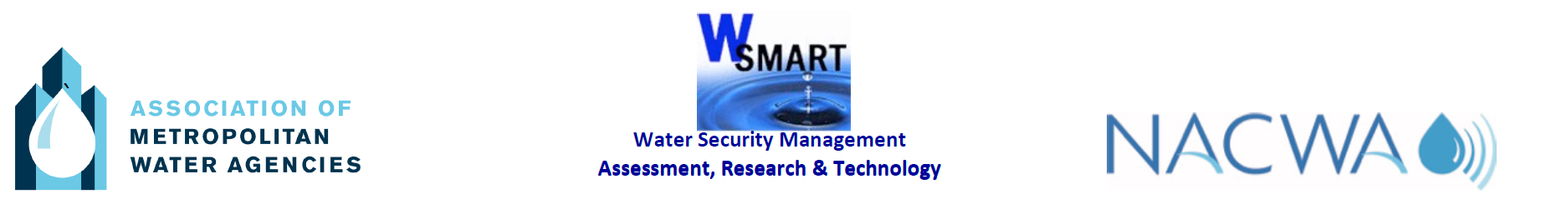

Crisis Management & Resilience Building Challenges
Eric Adamse
Corporate Security Manager
Vitens Water Utility, The Netherlands
AMWA 2018 Executive Management Conference & Workshop
San Francisco, US, October 14 to 17, 2018

Slide 2
Subjects:
Introduction
Risk Assessment
Business Continuity Management
Crisis Management
Cyber Security
Panellists today

Slide 3
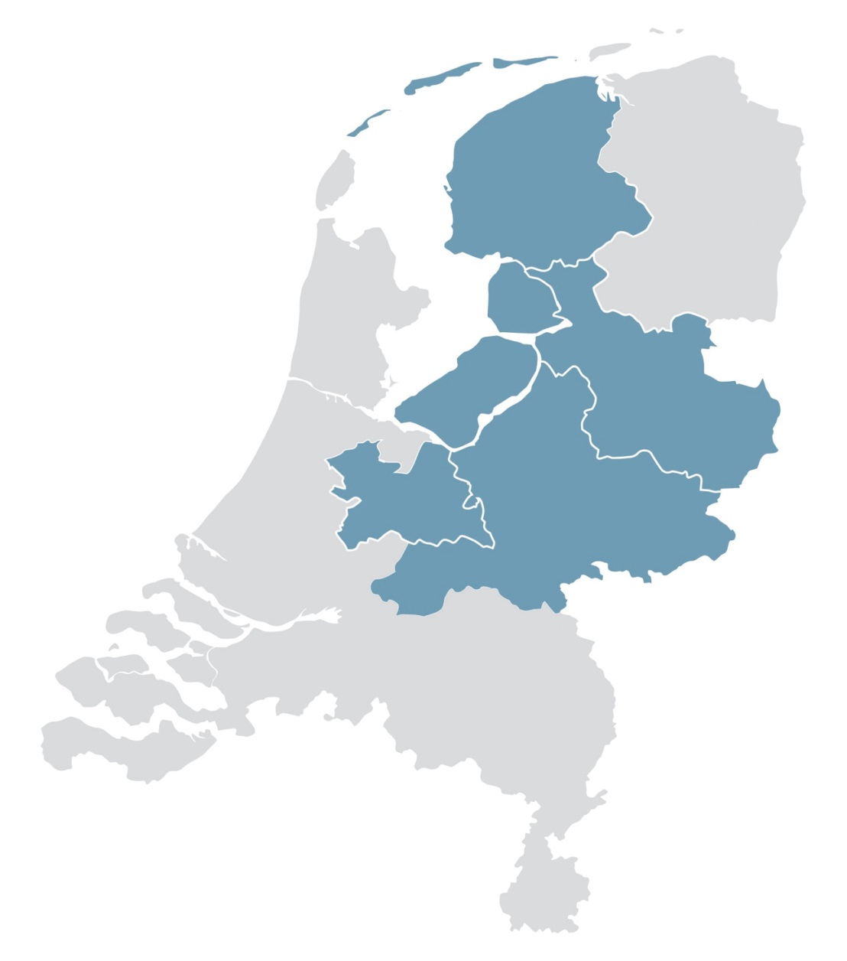
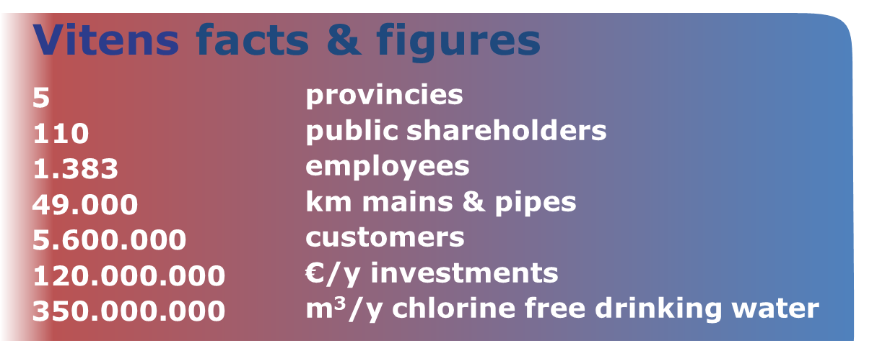
Cijfers 2015

Slide 4
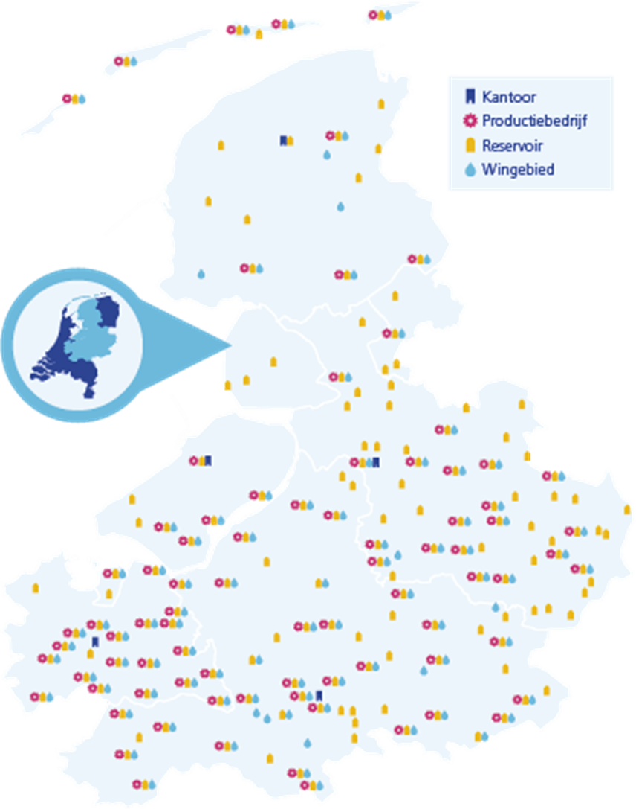

Slide 5
Risk Mitigation
All considerations for risk mitigation should be based on a decent risk assessment !
Risk = f
key-assets definitions
threat analysis
vulnerability assessments
( )

Slide 6
Risk Assessment Vitens (Step 1)
For Vitens :
Staff
Product Quality & Availability
Belongings (physical assets & €)
Information & IT-assets
Asset

Slide 7
Risk Assessment Vitens (Step 2)
For Vitens :
Staff
Product Quality & Availability
Belongings (physical assets & €)
Information & IT-assets
Asset
For Vitens :
Malfunction of assets
Pandemics
Flooding
Wild fire & drought
Hurricanes
Loss of Power & Telecommunication
Lack of Fuels and Chemicals
Chemical Fire and Nuclear Fallout
Terrorism (contamination of water)
Crime & Cybercrime (OA & PA)
Fraud & Bribery
Accidents
Threat

Slide 8
Risk Assessment Vitens (Step 3)
For Vitens :
Staff
Product Quality & Availability
Belongings (physical assets & €)
Information & IT-assets
Asset
For Vitens :
Inadequate:
Assets
Redundancy
Staff & Skills & Awareness
Organization (RACI)
Security & Safety
Crisis management
Procedures and guidelines
For Vitens :
Malfunction of assets
Pandemics
Flooding
Wild fire & drought
Hurricanes
Loss of Power & Telecommunication
Lack of Fuels and Chemicals
Chemical Fire and Nuclear Fallout
Terrorism (contamination of water)
Crime & Cybercrime (OA & PA)
Fraud & Bribery
Accidents
Threat
Vulnerability

Slide 9

Risk Assessment Vitens (Step 3)
For Vitens :
Staff
Product Quality & Availability
Belongings (physical assets & €)
Information & IT-assets
Asset
For Vitens :
Inadequate:
Assets
Redundancy
Staff & Skills & Awareness
Organization (RACI)
Security & Safety
Crisis management
Procedures and guidelines
For Vitens :
Malfunction of assets
Pandemics
Flooding
Wild fire & drought
Hurricanes
Loss of Power & Telecommunication
Lack of Fuels and Chemicals
Chemical Fire and Nuclear Fallout
Terrorism (contamination of water)
Crime & Cybercrime (OA & PA)
Fraud & Bribery
Accidents
Threat
Vulnerability

Slide 10
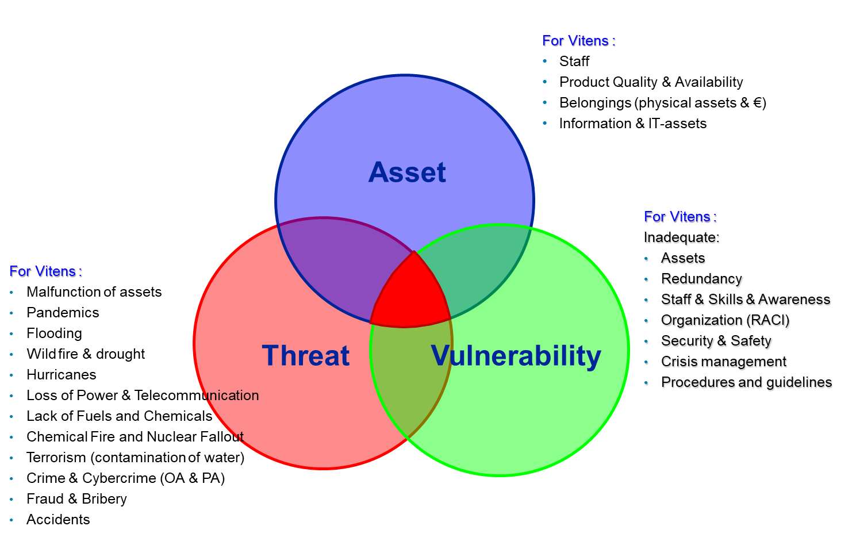
Risk Assessment Vitens (Step 4)
We now have:
Risk Assessment Vitens
  key assets are defined
  threat assessment
  vulnerability assessment
Now describe generic scenario’s
  what happens?
  time, place, staff involved
  choose a “ most likely” scenario per threat
Make a Heat Map
  take situation “as is”, not “if I should have done nothing”
  take in account all the measures you already have taken (nett risk)

Slide 11
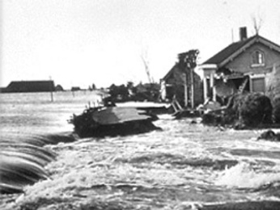
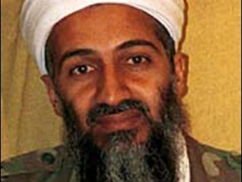
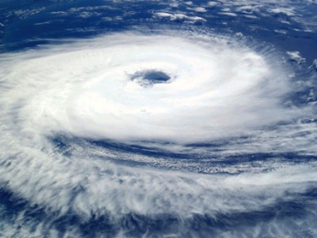
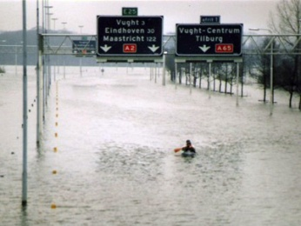
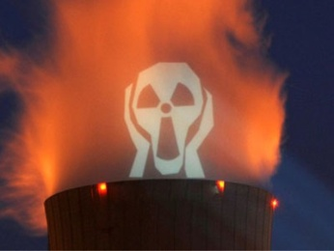
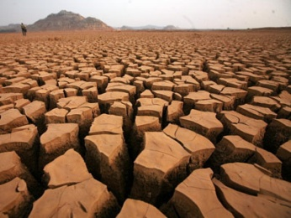

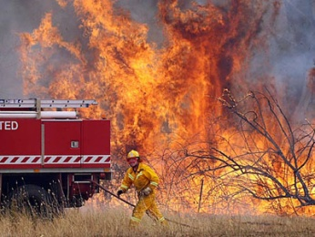
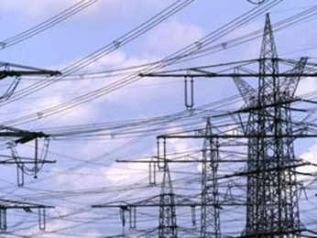
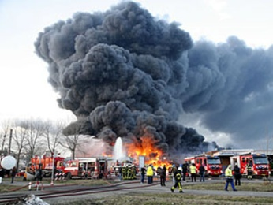
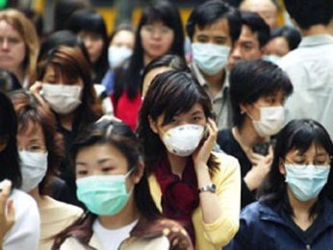
Vitens
Extreme
High
Medium
Low
Negligible
Extreme
High
Medium
Low
Negligible
Impact ➔
Remote Unlikely Possible Likely Probable
Likelihood ➔

Slide 12
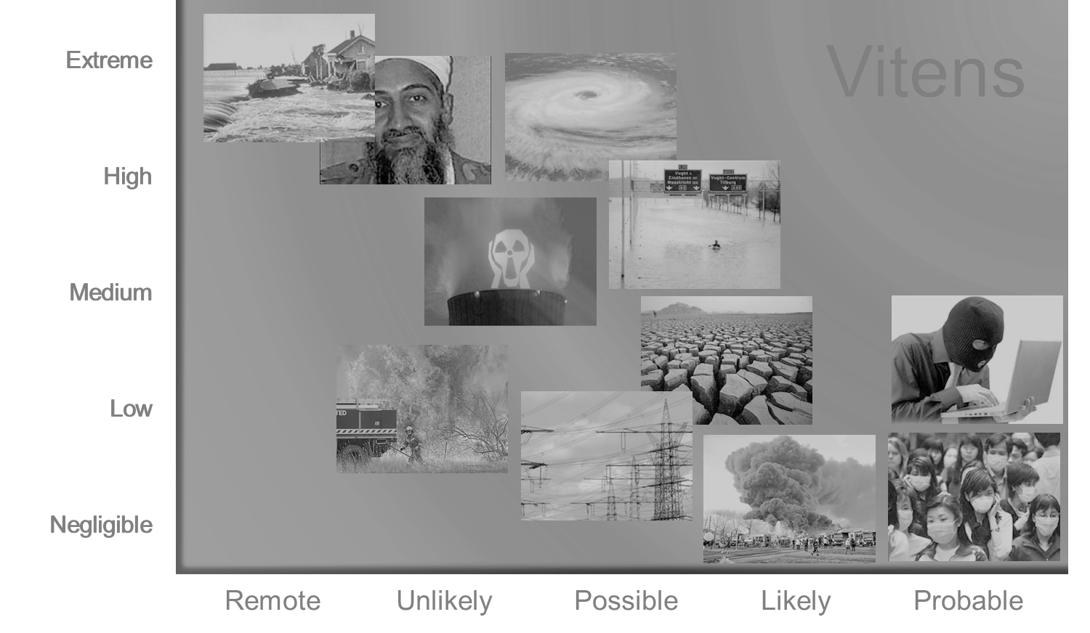
Safety & Security Management
Resilience Building
Incident & Crisis Management
Impact ➔
Likelihood ➔

Slide 13
⬅ unwanted top occasion
MITIGATE or AVOID
INSURE
ACCEPT MONITOR and CONTROL
Impact ➔
Likelihood ➔

Slide 14
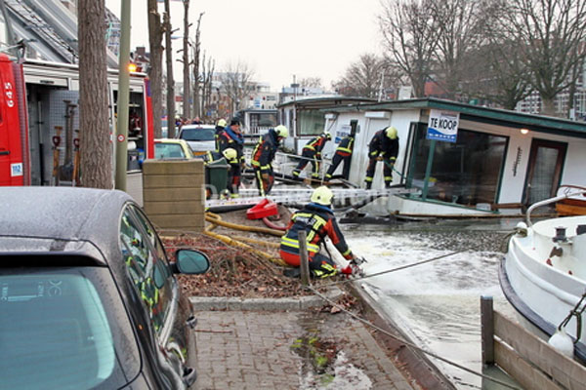
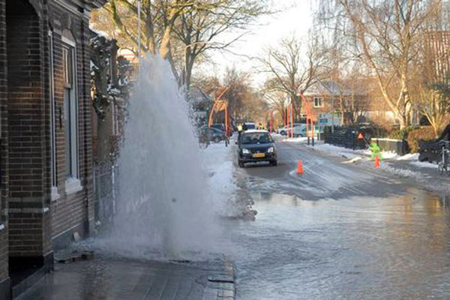
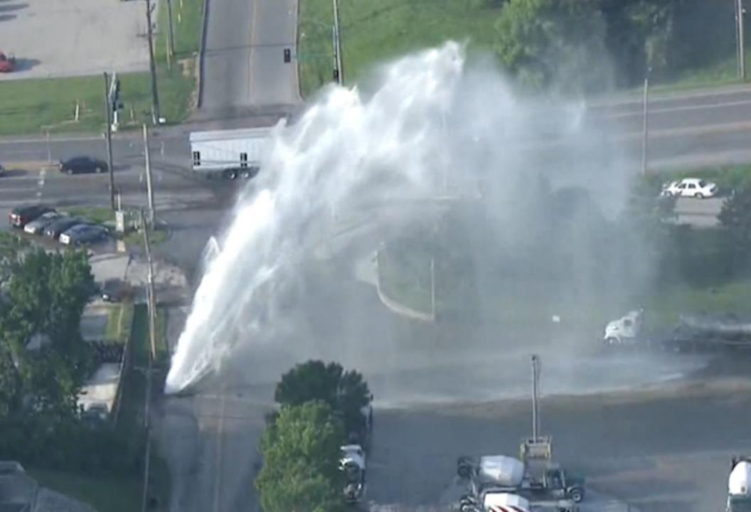
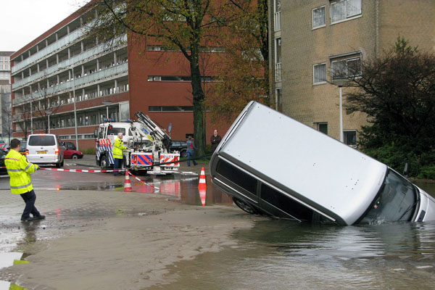
1 Malfunction & Failure of Assets

Slide 15
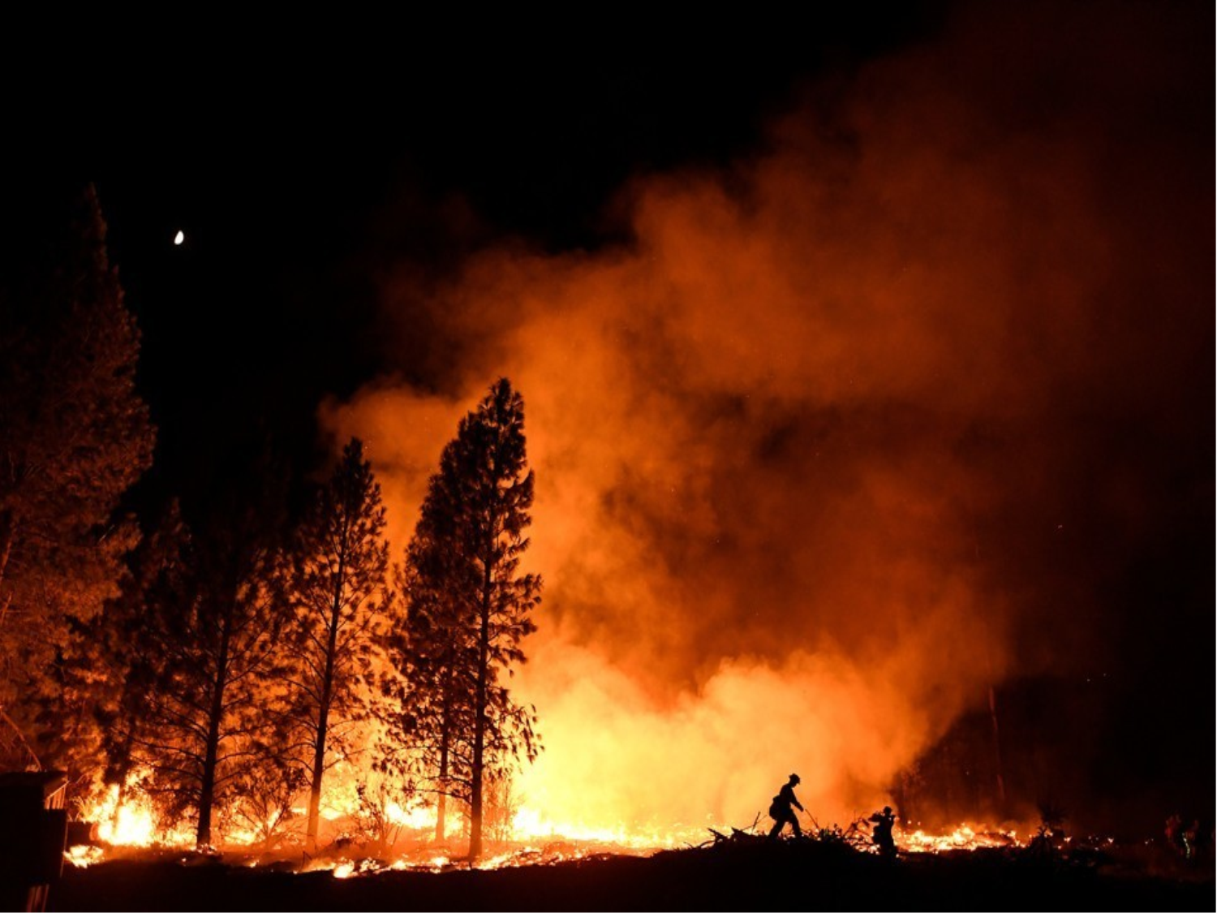
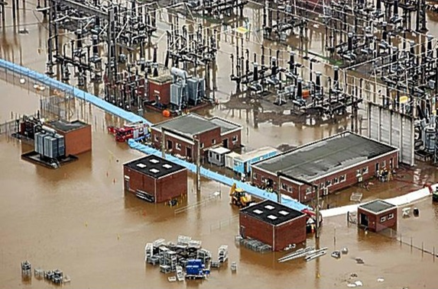
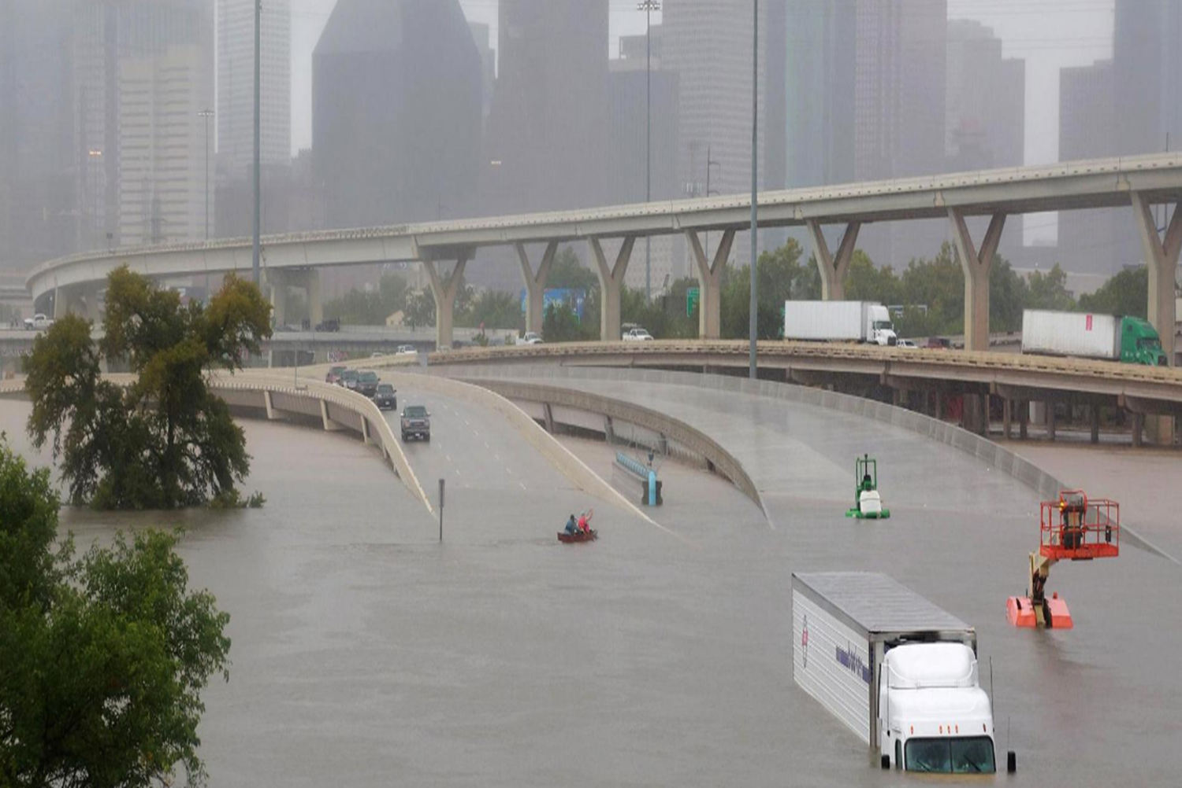
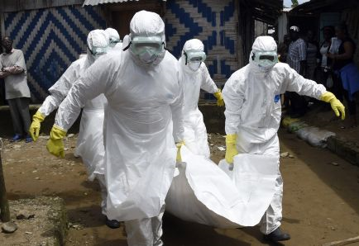
2 Natural Disasters, Diseases & Pandemics

Slide 16
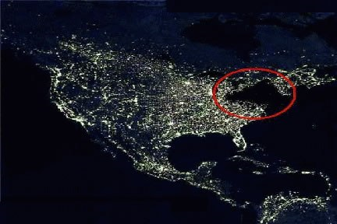
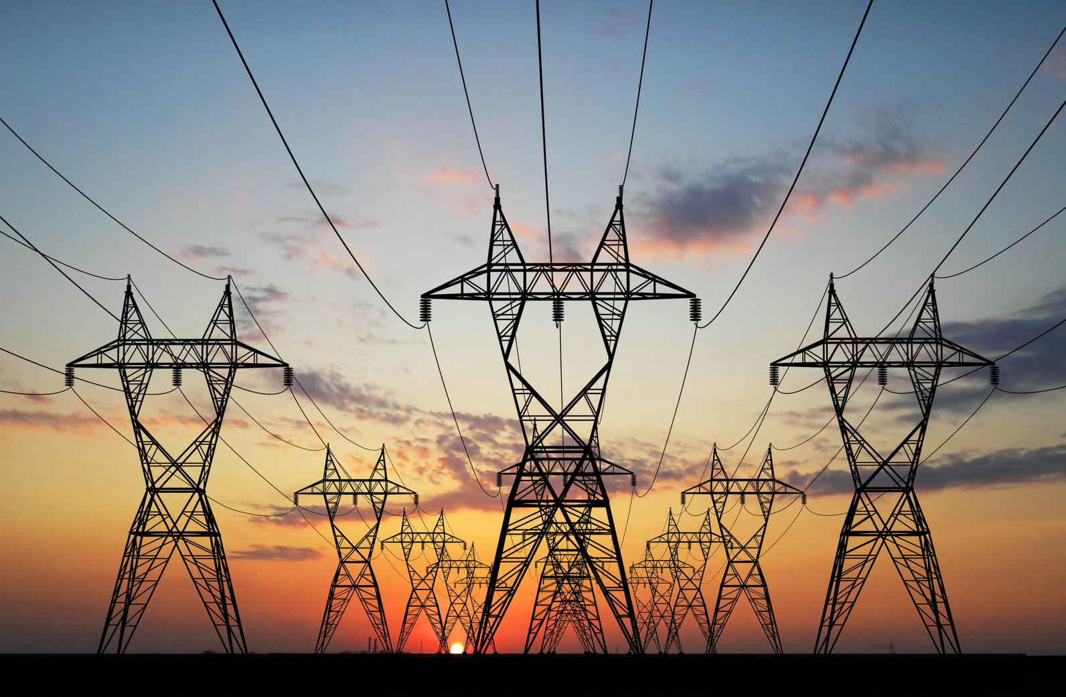
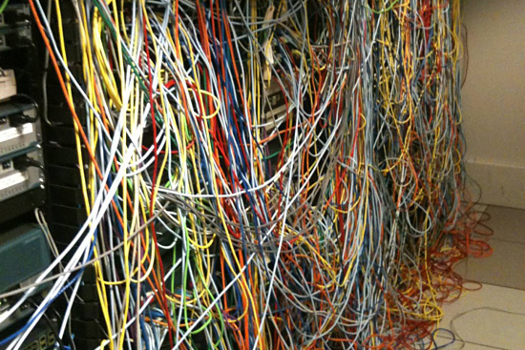
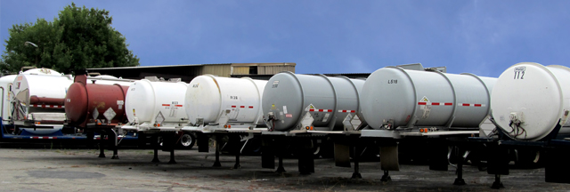
3 Interdependency Power, IT & Chemicals

Slide 17
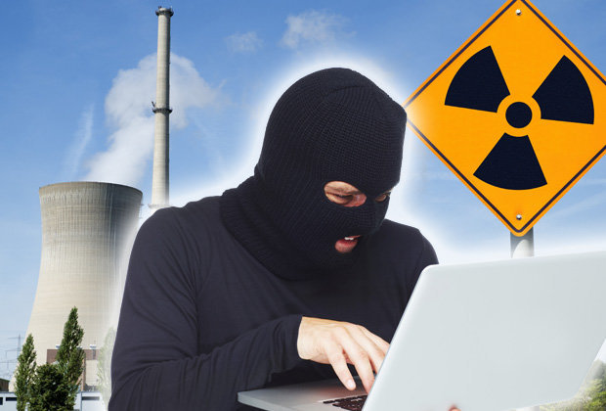
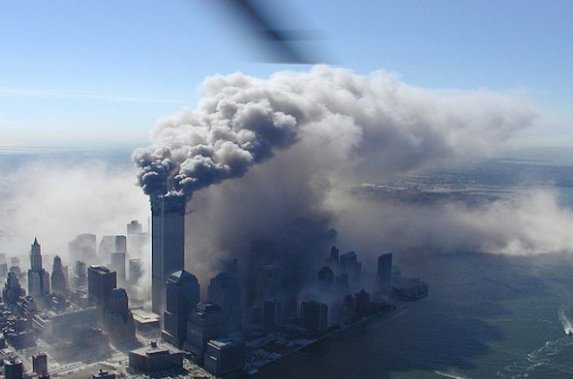

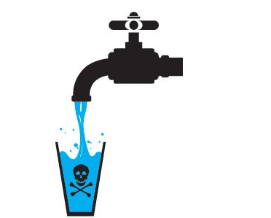
4 Intentional, (Cyber)crime, Terrorism, Sabotage

Slide 18
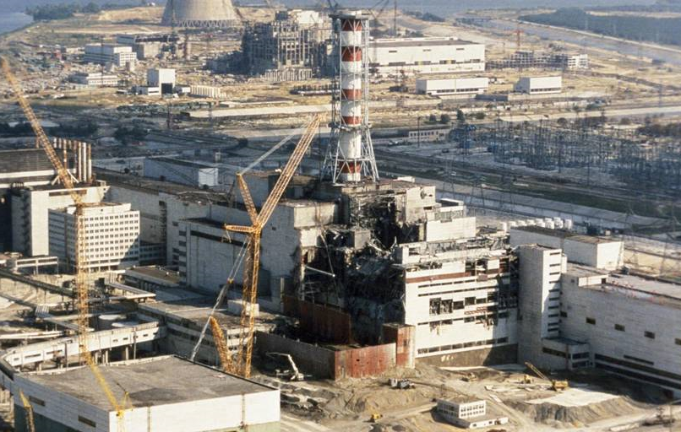
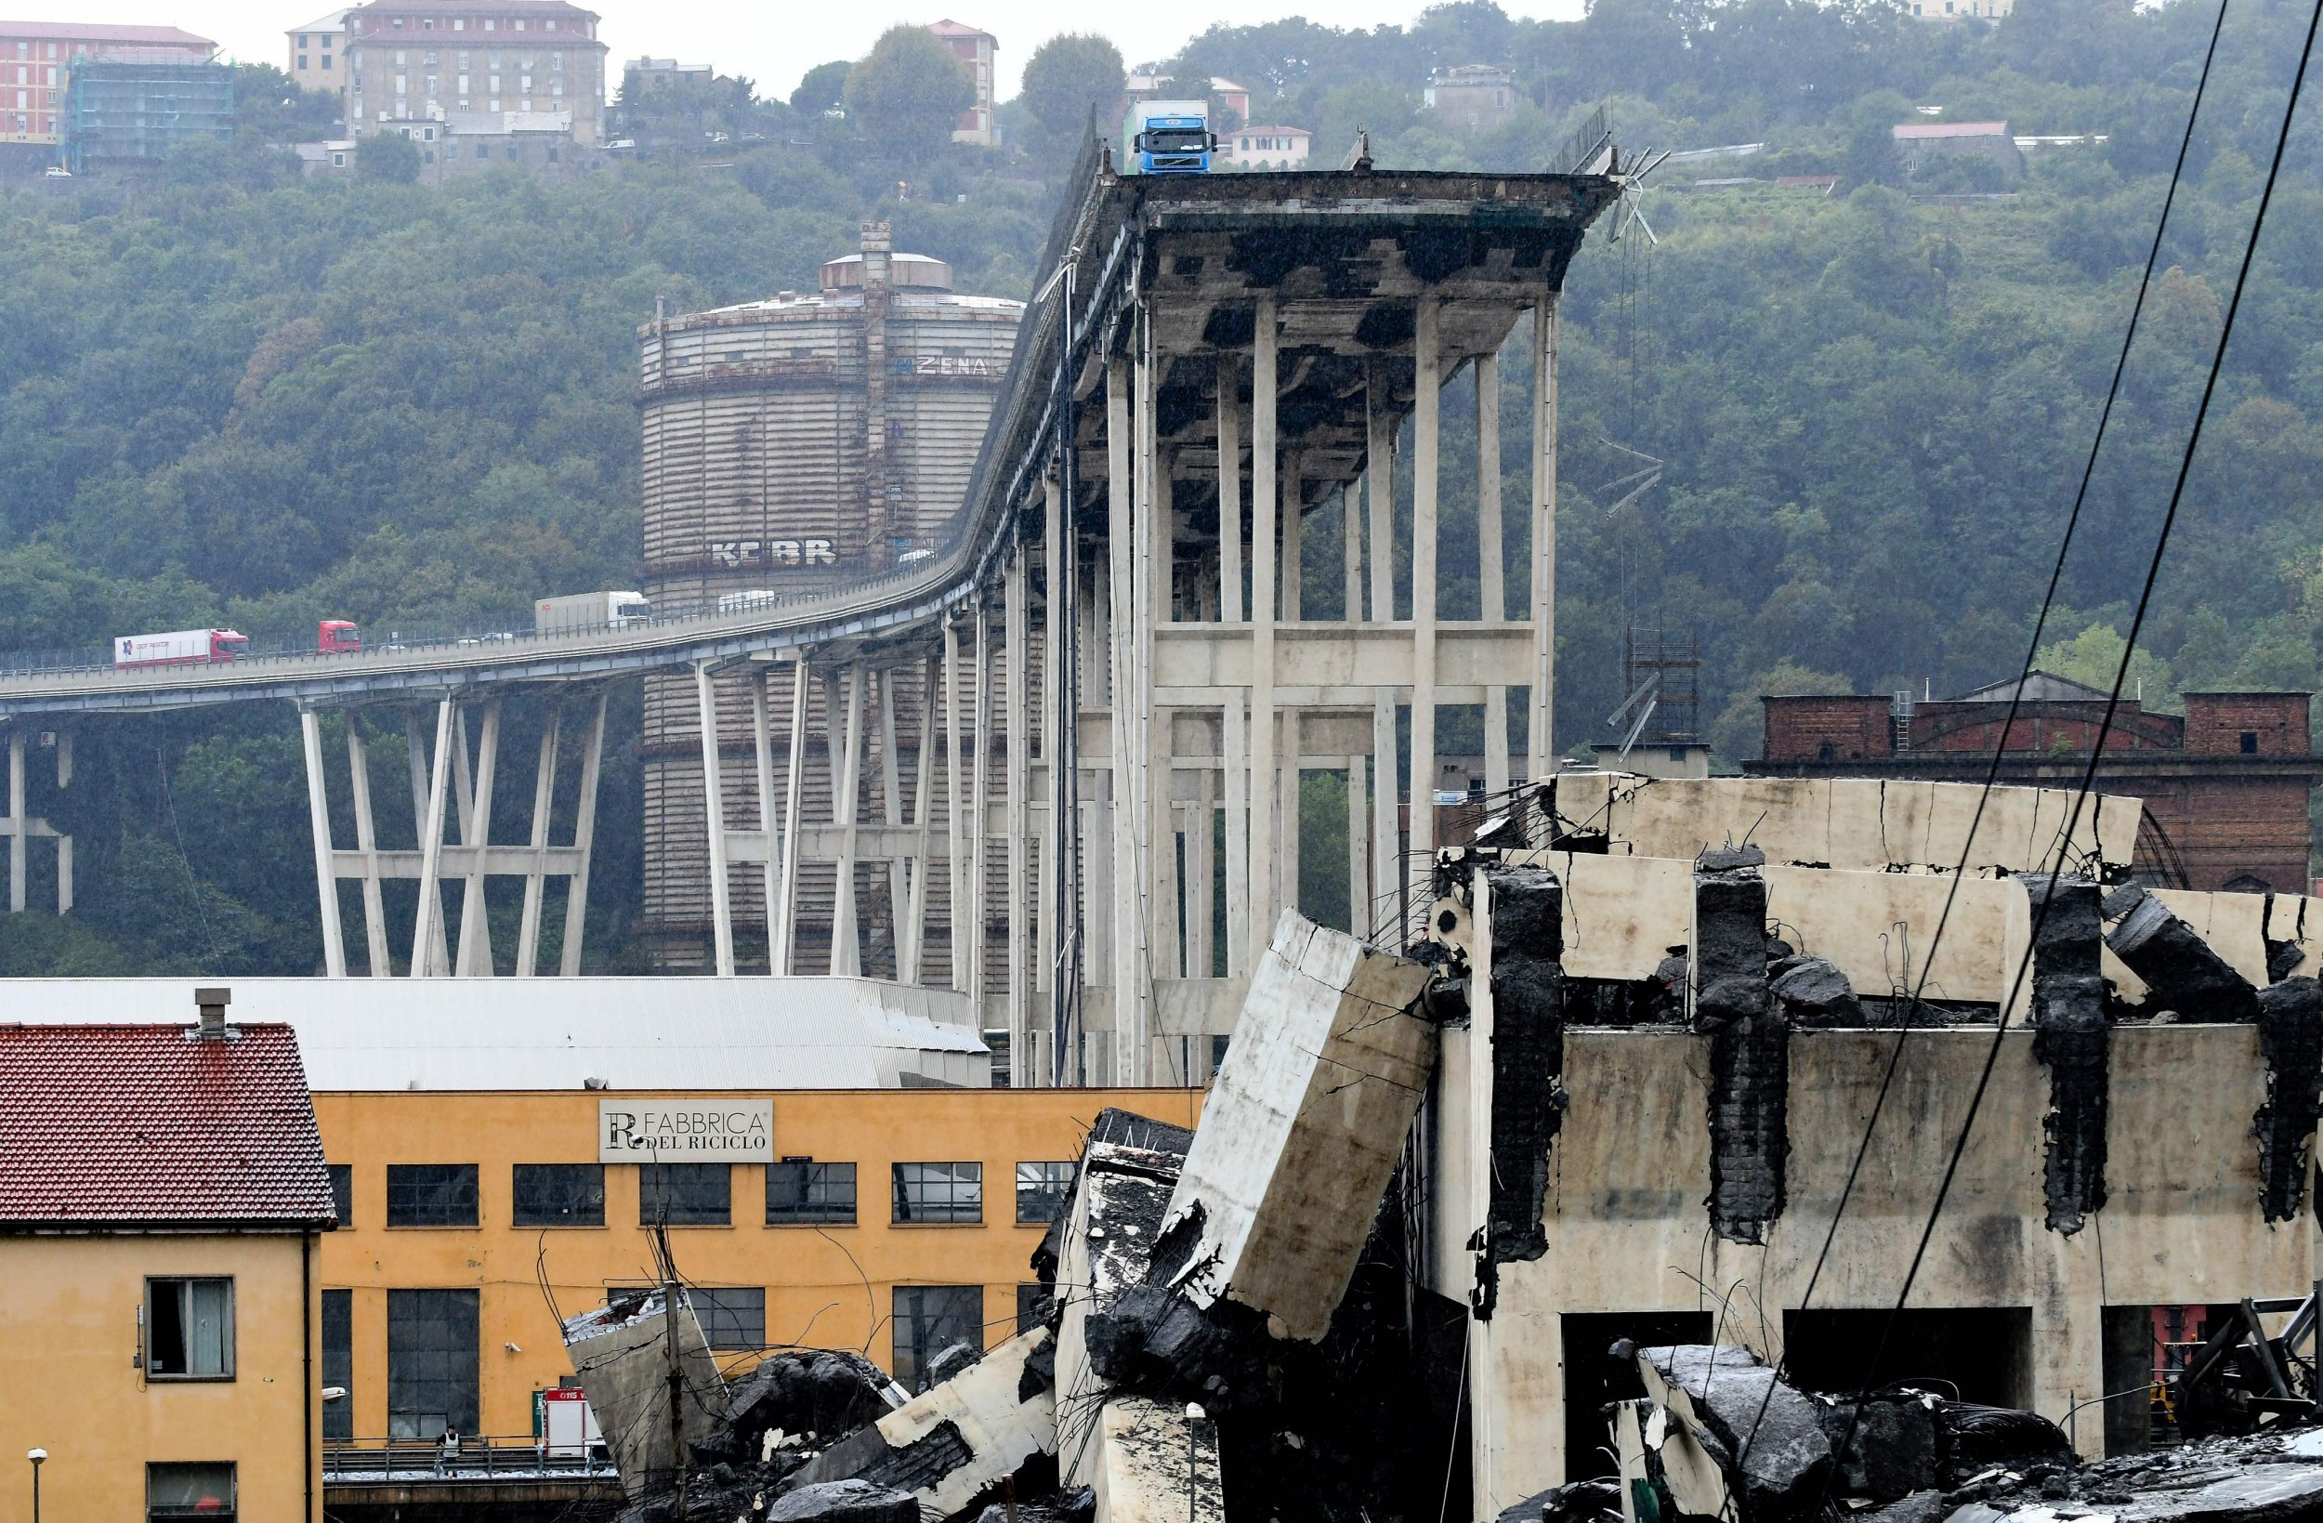
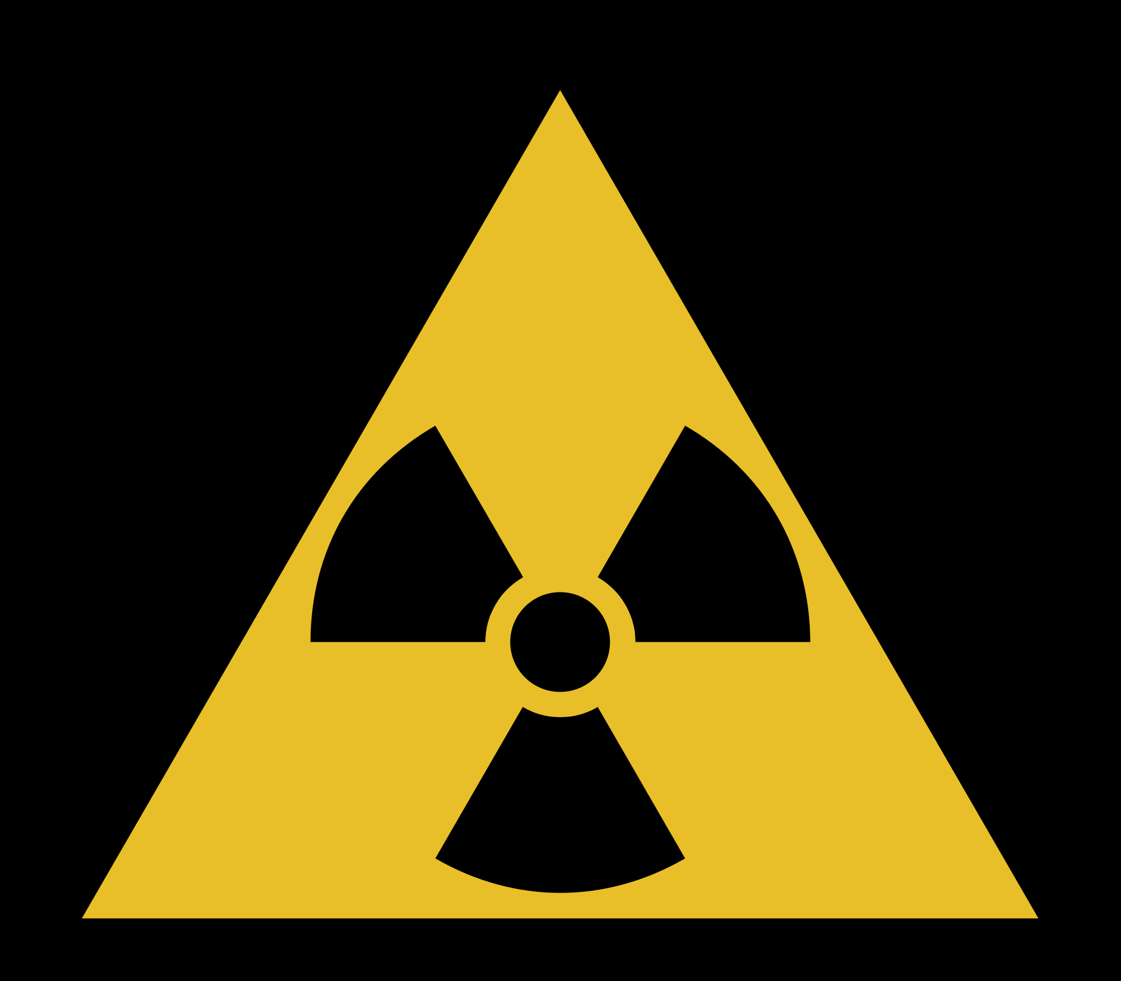
5 Accidents, Fire, Traffic etc.

Slide 19
Business Continuity Management Water Utility
Possible Impact of those 5 threats on your key-assets
Staff
Product Quality & Availability
Belongings (physical assets & €)
Information & IT-assets

Slide 20
Business Continuity Management Water Utility
“cold stage” pro action, prevention, preparation
malfunction & failure of assets
natural disasters, diseases & pandemics
interdependency power, IT, chemicals
intentional, (cyber) crime, terrorism, sabotage
accidents, fire, traffic etc.
“hot stage” incident, crisis & recovery management

Slide 21
Business Continuity Management Water Utility
asset management
maintenance
reinvestments
redundancy
reallocation of assets
resilience building
redundancy
power back up
IT infrastructure
Storage
redundancy
security management
cyber security
awareness
safety management
training
awareness
malfunction & failure of assets
natural disasters, diseases & pandemics
interdependency power, IT, chemicals
intentional, (cyber) crime, terrorism, sabotage
accidents, fire, traffic etc.
“hot stage” incident, crisis & recovery management

Slide 22
Business Continuity Management Water Utility
asset management
maintenance
reinvestments
redundancy
reallocation of assets
resilience building
redundancy
power back up
IT infrastructure
Storage
redundancy
security management
cyber security
awareness
safety management
training
awareness
malfunction & failure of assets
natural disasters, diseases & pandemics
interdependency power, IT, chemicals
intentional, (cyber) crime, terrorism, sabotage
accidents, fire, traffic etc.
“hot stage” incident, crisis & recovery management
All Hazards Approach

Slide 23
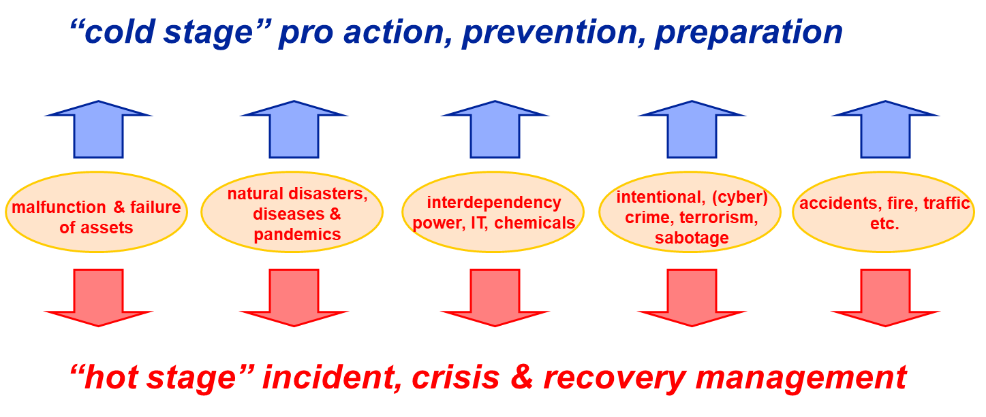
Utility
RECOVERY
Safety Boards (bleu light forces)
Ministry of Health (Regulator)
Ministry of Homeland Security
Regional Water Boards
Authorities

Slide 24
Severity & Escalation
Incident ➔ Often local orientated, caused by utility, asset-related, managable by technicians
Crisis ➔ Regional, many customers involved, manageable by IMT
in cooperation with authorities
Disaster ➔ Not caused by utility, authorities in the lead, utility-part
      managed by CMT

Slide 25
Disaster Many Customers Much Influence
CMT Customers Authorities
IMT
Breakdown Services
SEVERITY
Incident Few Customers Little Influence

Slide 26
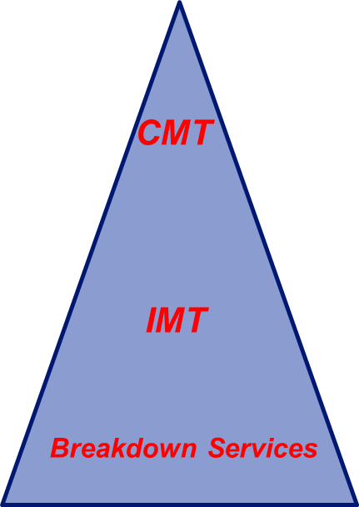
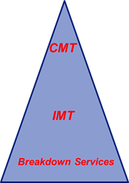
Business Continuity Management Water Utility
asset management
maintenance
reinvestments
redundancy
reallocation of assets
resilience building
redundancy
power back up
IT infrastructure
storage
redundancy
security management
cyber security
awareness
safety management
training
awareness
malfunction & failure of assets
natural disasters, diseases & pandemics
interdependency power, IT, chemicals
intentional, (cyber) crime, terrorism, sabotage
accidents, fire, traffic etc.

Slide 27
Level
Level
Strategic
Crisis Management Team
4
Strategic Guard
Crisis Manager
notification
3
Information Manager
Concern Spokesman
3
Tactical
escalation
2
Incident Management Team
notification
2
Operational Leader
Tactical Guard
1
Operational
escalation
Leveren deelnemers
0
Breakdown Service
1
Guard
Dist
Guard
Prod
Guard
Comm
Guard
Water
Quality
Guard
IT
Consigned
Not Consigned
0
25
Utility Authorities

Slide 28
Consigned teams in the “hot stage”
Breakdown Service
  Focussed to solve the malfunction
Incident Management Team
  Event driven
  Coordinates utility departments to solve the issue
  Coordinates the internal communication
Crisis Management Team
  Consequence driven
  Manages the interest & concerns of stakeholders
  Communicates with Authorities
  Concern Spokesman

Slide 29
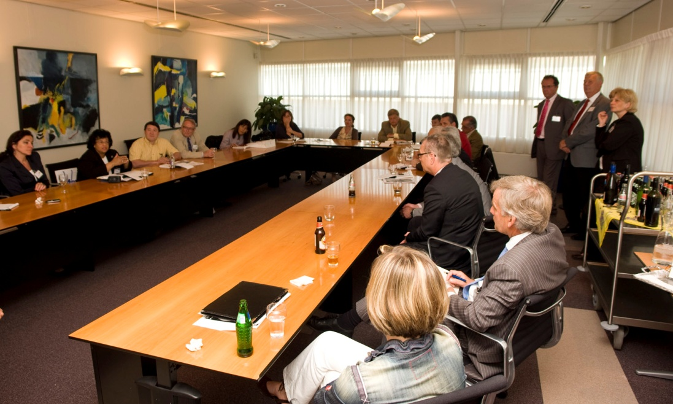
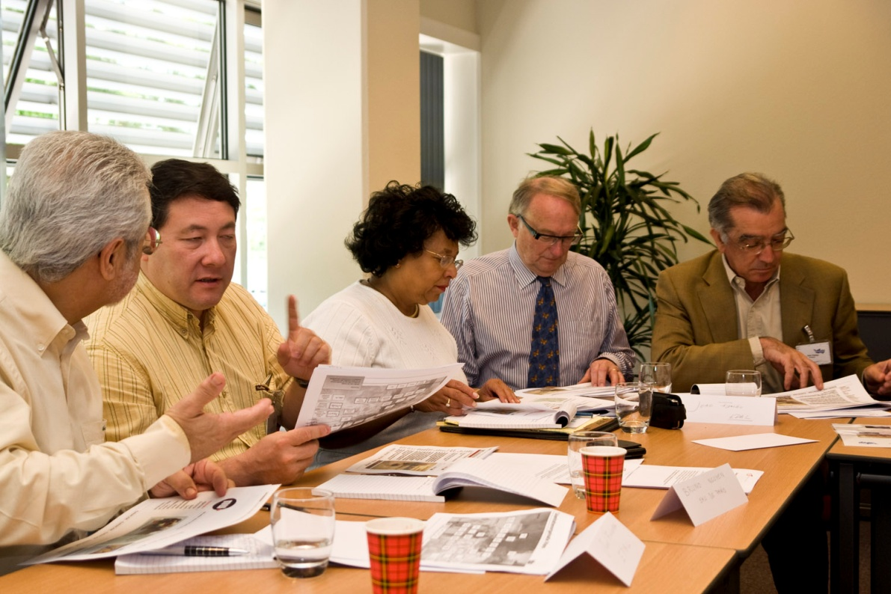

Training & Exercising

Slide 30
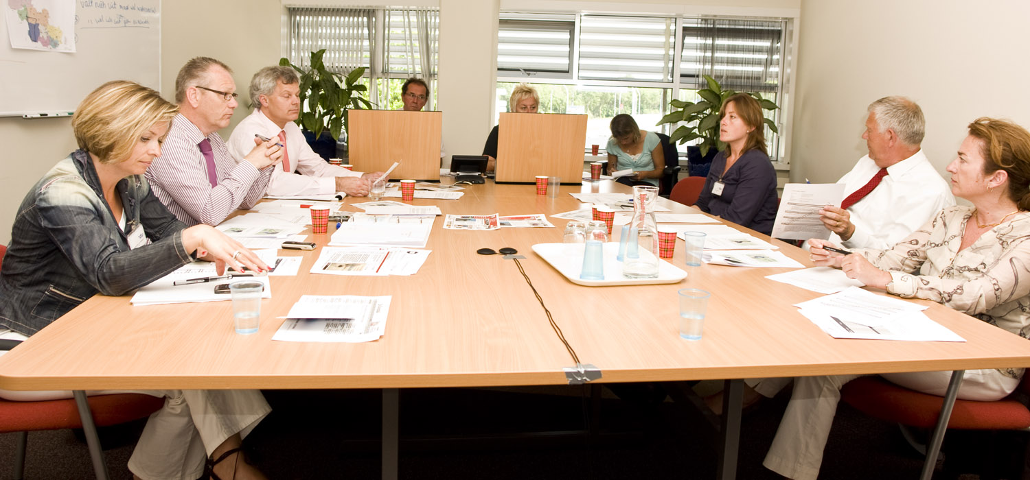
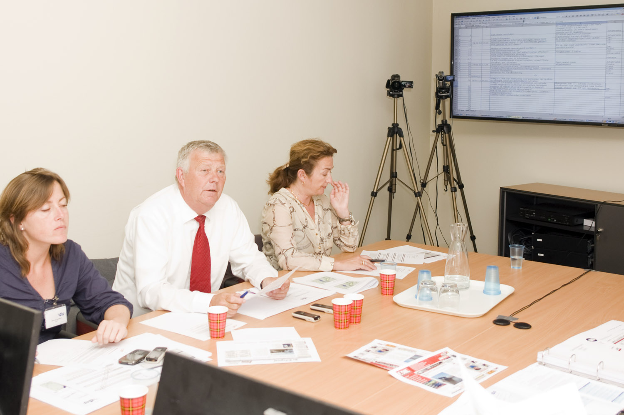
Training & Exercising

Slide 31
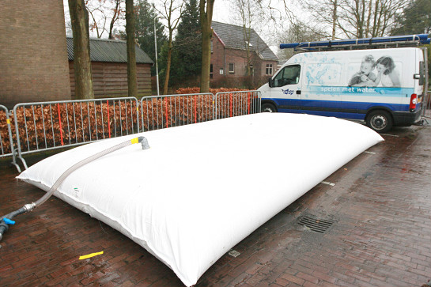
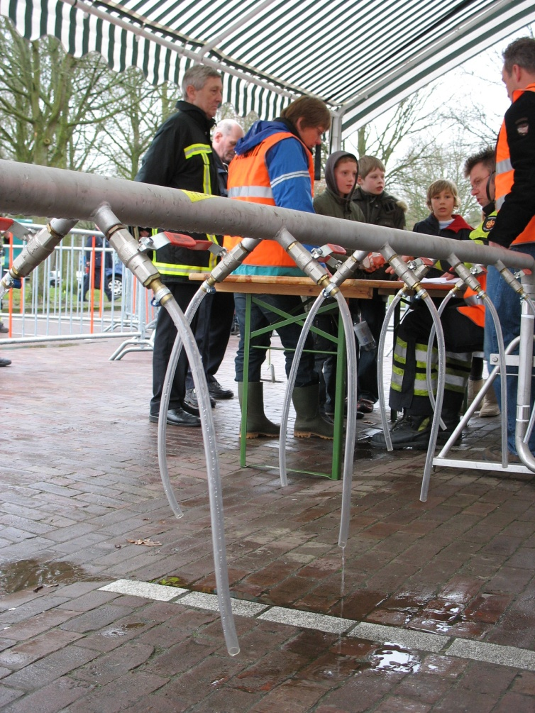
Last straw: Emergency Drinking Water Supply
3 liters per person per day
30.000 bottles (5 l) for quick first aid
Pooling Contract between all Water Utilities
Capacity = 2,7 million people (16% population)

Slide 32
Steps to be taken for a water utility
Define your own key-assets
Assess what’s threatening those key-assets
Assess your vulnerability and resilience
Define your most important risk scenario’s end rank them in a “heat map”
Scale the heat map with rational scales or expert judgement (Monte Carlo Methodology)
Discuss (per scenario):
  Can we accept the risk? (define your own risk appetite)
  Can we avoid the risk? (pro-action measures)
  Can we mitigate or insure the risk? (prevention measures)
  Can we monitor and repress the risk? (crisis management)
  Can we fast enough recover to normal operation?
You have to make your own considerations for prortionality!
Reducing risks costs money and resources, and needs awareness of your staff…

Slide 33
Cyber Security
Vitens
Extreme
High
Medium
Low
Negligible
Extreme
High
Medium
Low
Negligible
Impact ➔
Remote Unlikely Possible Likely Probable

Slide 34
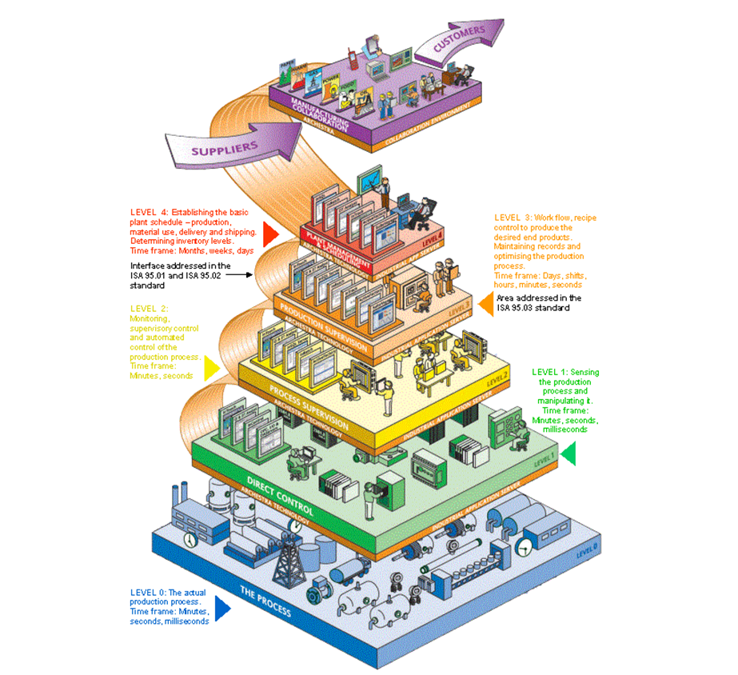
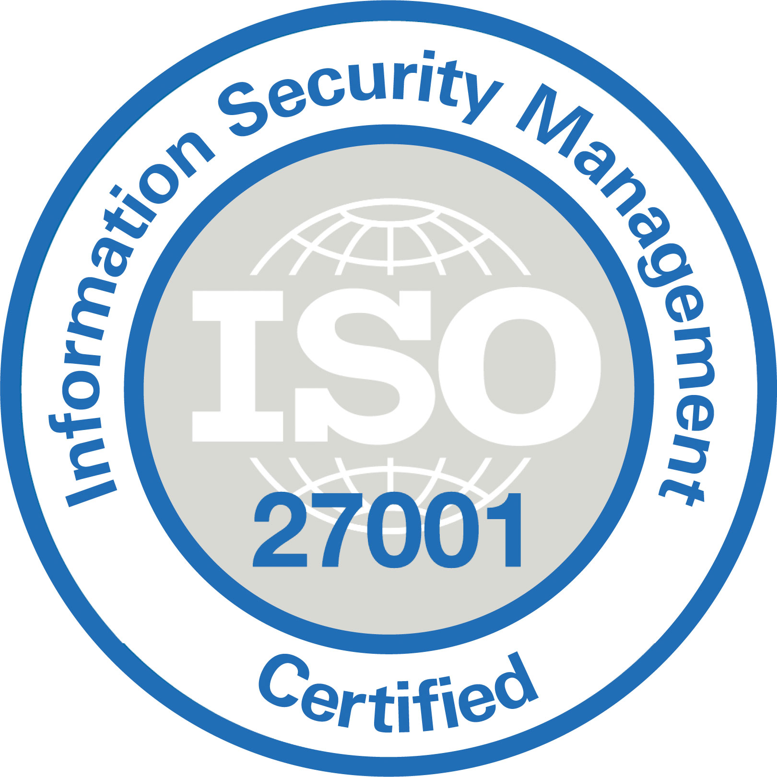

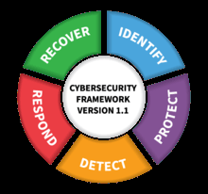
Cyber Security
ISO 27000
ISA 99
NIST Framework

Slide 35
Cyber Security Risks and Challenges
Lots of (inter) connectivity. The ‘air-gap’ is a myth
Numerous systems out in the field on unmanned remote locations
Legacy systems
Unpatchable (Windows) systems
No anti-virus, no hardening
Weak authentication (e.g. no or weak passwords only)
Unsecure protocols (e.g. Modbus, OPC-DA, clear-text protocols)
Increasing COTS systems and networks (e.g. Windows, Linux, Ethernet)
Remote access management (e.g. RDP, VNC, SSH)
IoT devices, e.g. smart meters and data collection using cloud services
Lots of outsourced work and contractors

Slide 36
Cyber Security Approach
Integrated safety, physical and cyber security approach
Enforce a basic cyber secure environment and ‘hygiene’
Enforce strict network separations, zones and conduits
Clear distinctions between office automation and process control systems
2-factor authentication unless absolute not possible due to operational restrictions
Anti-malware
Hardening of all systems
Logging, monitoring and intrusions detection (e.g. 24x7 Security Operations Centre)
Asset, Patch, Change and Incident management
Penetration testing and red team exercises
Threat intelligence

Slide 37
Panelists
William De Angelis (ISO at CILE) New European NIS Directive
Cecil McMaster (CIO at NYCPD)
Thierry Witkowicz (Vice President Veolia) Resilience & Smart Cities
Alexandra Cristóvāo (Director at EPAL) Corporate Sustainability
Jim Lochhead (CEO at Denver Water)

Slide 38
Crisis Management & Resilience Building Challenges
Eric Adamse
Corporate Security Manager
Vitens Water Utility, The Netherlands
AMWA 2018 Executive Management Conference & Workshop
San Francisco, US, October 14 to 17, 2018

