Slide 1


RESILIENCE BOND
Thierry Witkowicz
Senior Vice President
Smart and Resilient Solutions at Veolia
Notes:
Hi everyone,
Welcome to the session, I will first remind the context by explaining what we have done in New Orleans and then explain what we are trying to do in terms of financing especially in Houston

Slide 2
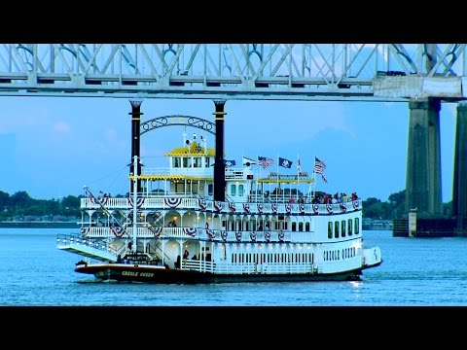

Notes:
New Orleans case has been pioneer in resilience. I take this opportunity to thanks the rockefeller foundation and especially Jeff Herbert which is the New Orleans Chief Resilience officer. This is our first Resilience Public Private Partnership.
Let's start by a video https://youtu.be/gXYawVivEJ0
· Our scope in Nola was to deliver this risk assessment study on the Water, sewage, drainage and energy supply assets. We analysed risks and impacts related to wind and storm events. We cover more than 203 assets with an estimate value of 3,4B$. Our recommendation was organized in three main categories : “Must have” “Quick wins” and “Good to have” to build a prioritized and strategic Mitigation Plan. In comparison with traditional approaches we did not deliver à risk assessment based only on the equipement but we had an holistic approach considering the equipment, its impact on other equipements and the general process, its maintenance and its operation, qualifying the organization beyond each equipement.
At the end, we have identified interesting cases representing a total necessary investment of 300M€. But how where can we find the money knowing that after Katrina New Orleans built a dam of 4B$

Slide 3
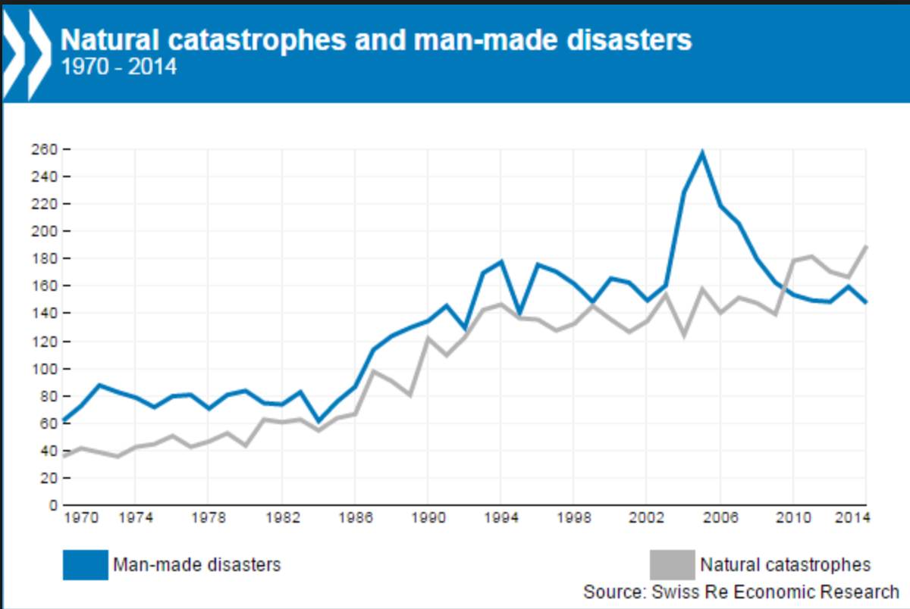
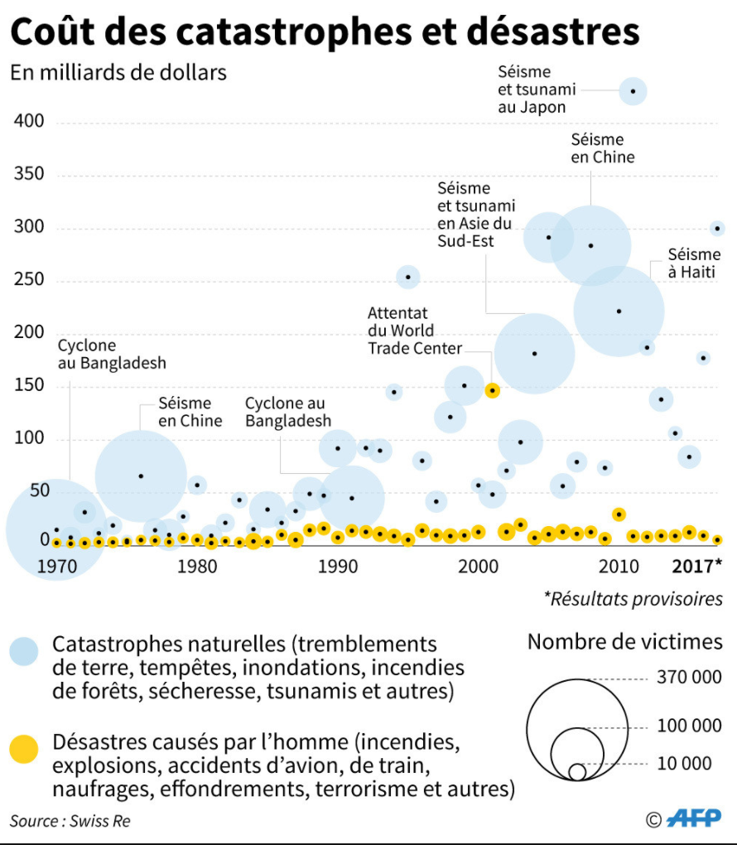
More violent, frequent and intense shocks: a growing economic exposure of cities
Increased number of natural disasters and man-made disasters (1970-2014)
Increased cost and frequency of natural and man-made disasters (1970-2017)
Natural disasters
In Billion Dollars
Number of victims
Man-made disasters
Natural disasters
Man-made disasters
Ouragan Katrina
Natural disasters intensify in billions:
More than 220 million people affected and about 100 billion US dollars of losses per year
Number of shocks increased by 60% in 4 years.
Evolution of the cost due to disasters:
2016 = 188 billion
2017 = 314 billion (x1,7)
Notes:
Few years ago, we were only talking about Nola which was sadly famous because of Katrina. Today, many cities have joined NOLA case because number of disasters and strength are increasing year after year. as you can see on this slide show clearly that disasters intensify and all specialists agree the trend will continue to increase. Even if big numbers are difficult to assess, I have selected few key figures:
More than 220 million people are affected per year
about 100 billion US dollars of losses are identified per year
Evolution of the cost due to disasters multiply by 1,7 these last 4 years to reach 314 billion$
These more violent, frequent and intense shocks drive cities to a growing economic exposure.

Slide 4
A major issue: how to capture the “de-risked” economic value to finance technical solutions
$
Amount mobilizable
Many investment funds dedicated to infrastructure
$
$
Investment needed
Exposure to economic losses
4,5 trillion dollars are needed every year for cities to become resilient in infrastructure
In 2017 the cost of natural disasters was estimated to $ 314 billion
How to make the link ?
What mechanisms of unionization?
Which actors to mobilize ?
Source: World Bank and the Global Facility for Disaster Reduction and Recovery (GFDRR)
Source: The State of City Climate Finance 2015 - Cities Climate Finance Leadership Alliance
Notes:
But the major issue is the financing.
In developing countries, mechanisms exist with the World Bank, IFC, bilateral loans and other countries mechanismes.
But in developed countries, needs are enormous and cities have difficulties in finding financing solutions. But according to our studies, many available investment funds dedicated to infrastructure are available but there are few projects. The question I ask to the audience is simple: how to make the link? what innovant funding mechanism can we put in place? are we able to capture the de-risk economic value to finance technical solutions ?
Maybe solutions to mitigate risks could lead to lower insurance costs and thus to be able to reinject this money to finance new solutions?
One solution could be the Resilience Bond allowing several cities or industries located on the same region and exposed on the same risk contract a common insurance linked with solutions of protection

Slide 5
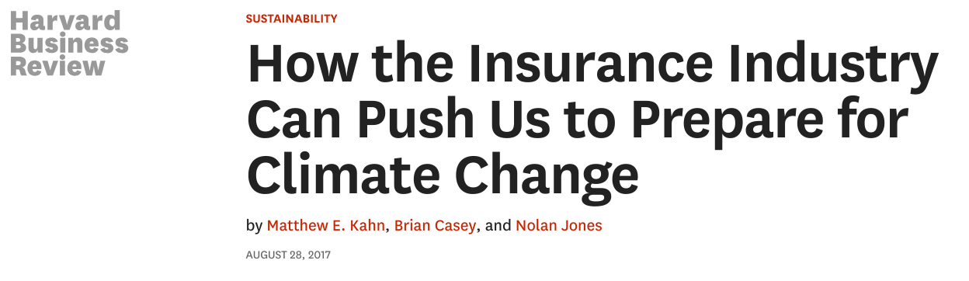
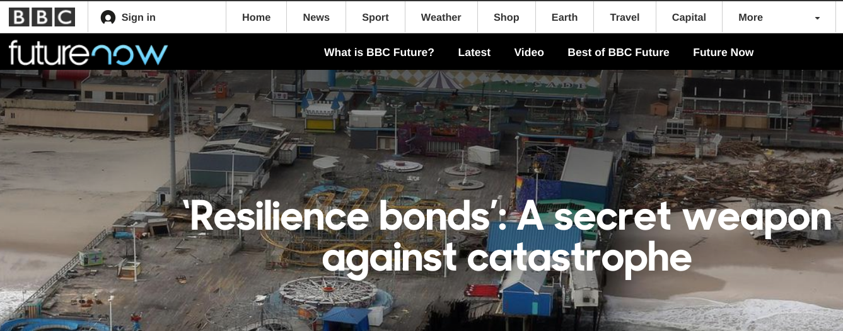
https://hbr.org/2017/08/how-the-insurance-industry-can-push-us-to-prepare-for-climate-change
http://www.bbc.com/future/story/20170515-resilience-bonds-a-secret-weapon-against-catastrophe
Notes:
All the world is looking on Resilience bond ? Resilience Bonds a secret weapon !

Slide 6

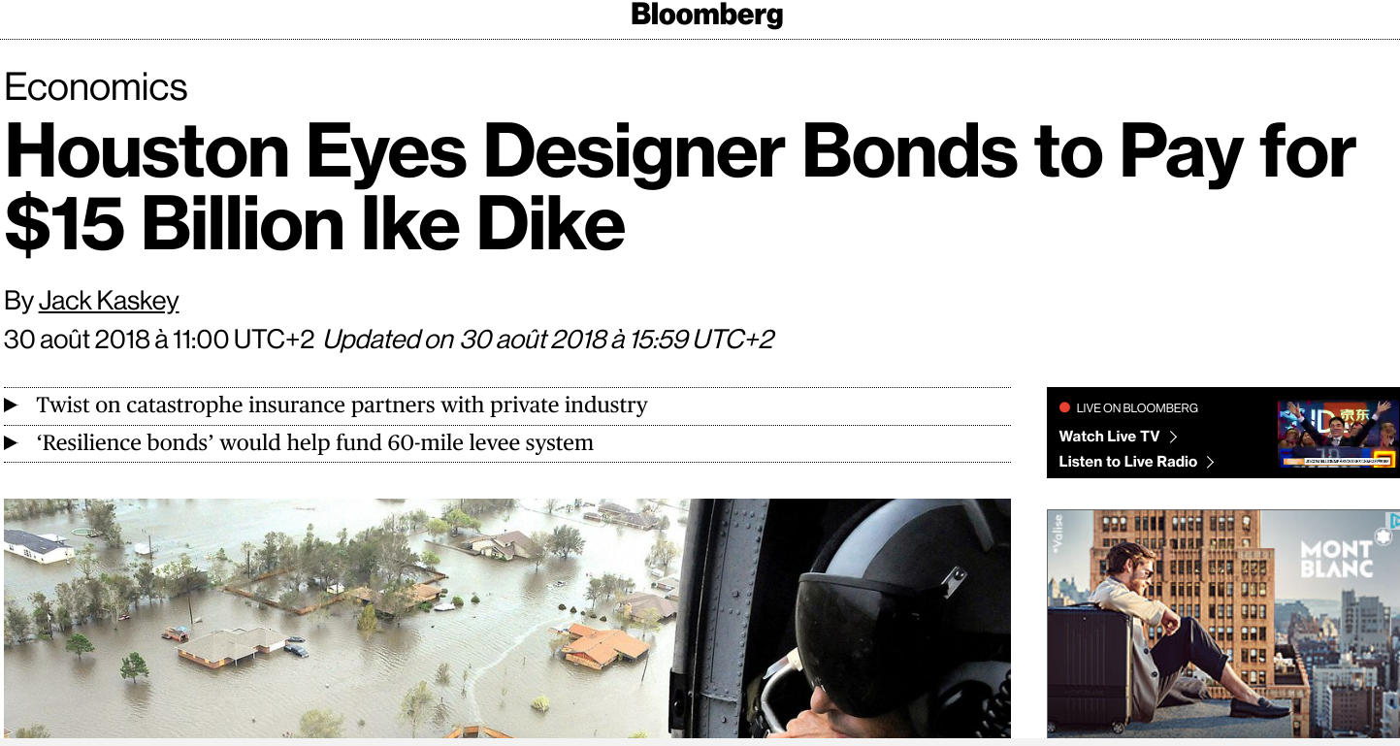
https://www.bloomberg.com/news/articles/2018-08-30/houston-eyes-designer-bonds-in-quest-for-15-billion-storm-wall
[...] Texas would put its own twist on the concept, pioneering a new instrument called “resilience bonds” that would both insure against flood damage and help fund construction of the Ike Dike, said Marvin Odum, Houston’s chief recovery officer [...]
Notes:
In Houston (Texas) the city is looking to issue a resilience bond not only to protect the public infrastructure but also to protect industries
In Veolia we believe on this innovative approach, we believe resilience bond can be the new fuel for growth

Slide 7
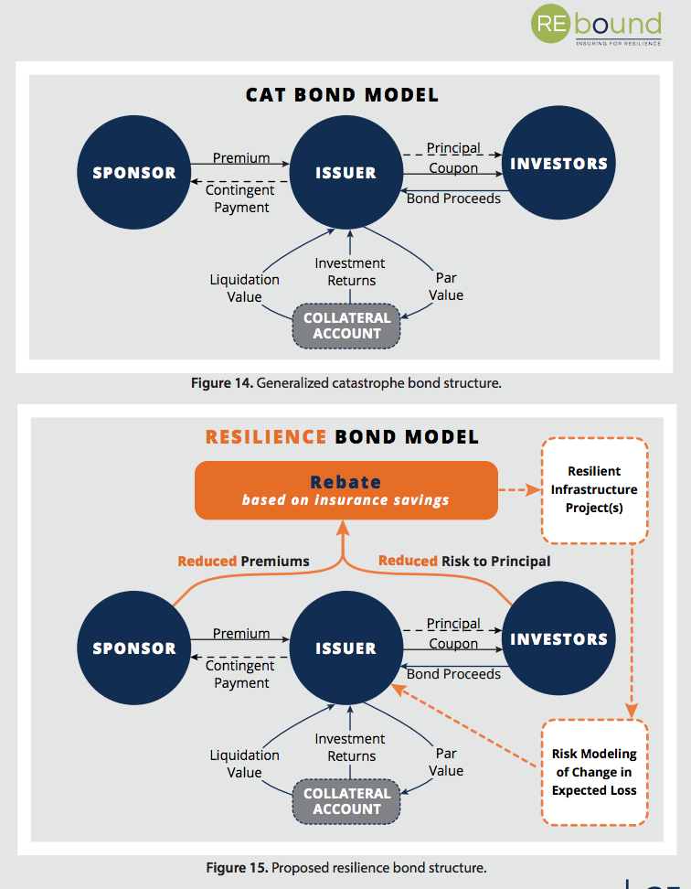
http://www.refocuspartners.com/wp-content/uploads/pdf/RE.bound-Program-Report-September-2017.pdf
Notes:
Cat Bond, was the first step to an innovative financing. They were created and first used in the mid-1990s after the Hurricane Andrew. Catastrophe bonds emerged from a need by insurance companies to alleviate some of the risks they would face if a major catastrophe occurred. This was a security to them to be sure that all damages will be covered by premiums, that they received.
The issuer (which is typically a Special Purpose Vehicle (a SPV) established by an insurance company associated with a major investment bank) issue a Cat Bond, which will be sold to investors (investors can be individuals, hedge funds or large pension funds). These investors are also looking for diversification in their portfolios and are willing to take more risk (including the risk of losing their principal invested) for higher returns on investment).
Catastrophe (Cat) is an insurance product and it is not a municipal bond, means sponsors (cities or industrial companies) are only responsible for paying premiums, not for repaying bond principal. This of course, give more security to public and private sponsors to limit their exposure on debt capacity and credit rating impacts.
These bonds are risky and usually have maturities less than 5 years. If no catastrophe occurred, the insurance company would pay a coupon (4 to 10 %) to the investors. But if a catastrophe did occur, then the principal would be forgiven and the insurance company would use this money to pay their claim-holders.
The boom of the “catastrophe bond market” reach a new record to $32.83 billion
This is now considered as a traditional approach

Slide 8
http://www.refocuspartners.com/wp-content/uploads/pdf/RE.bound-Program-Report-September-2017.pdf
Notes:
Ok now ! be concentrate because it’s complicate and I will ask question at the end to verify is you have followed ! What we try to do with various private partners, Houston city and industries :
We want to propose to sponsors (cities and industries) to pay the same premium as a cat bond knowing that a part of this premium will be used to implement and operate solutions against flood or other natural disruptive events were technical solutions can be implemented. Untill now, it’s not too complicated since industries and cities will be very happy to enjoy a better protection and not be obliged to pay more than the actual premium amount. At the end
We want to propose to the issuer to complete its SPV organization and competencies (insurance + bank) by a technical company which will be the resilience manager (a resilience manager should be a crisis management specialist, it can be any companies which have developed proven solutions. He will be in charge of designing, building and operating resilience solutions & infrastructure. Veolia could naturally take the lead while playing a broader role in the SPV as one key stakeholder in the bond issuance.)
Having that partner who share the same risk it will be possible for the issuer to use a part of the premium to implement technical solutions. By doing this, he will have less value creation through its collateral account but he will create a real competitive advantage markets opportunities. In short, he will differentiate himself from the competition by issuing these resilient bonds and will by this way increase its turnover!
For the investors, the efficiency will decrease since the coupon will be paid according to the premium less the part used for the resilience program but at the same time the risk on the principal will be reduced.

Slide 9
By Analogy
Cat bond = life insurance
you pay your insurance and everybody cross your fingers and pray
that your health is good
Resilience bond = Progressive health insurance
Pay back is less than life insurance but you enjoy free of charge
incentive, advice, health club to keep to keep you young, fresh and in very good health
Notes:
The resilience fund will be use to proactively invest in projects that strategically reduce risks.
Last comparison to better explain :
If catastrophe bonds are similar to life insurance policies that only pay out when the worst disasters strike, then Resilience Bonds are more like progressive health insurance programs that provide incentives to make healthy choices - quitting smoking or exercising regularly - that reduce long-term risks and the cost of care. In the case of infrastructure, this is like cities upgrading coastal protection systems or reinforcing whole neighborhoods of houses to reduce physical and financial damage from storms and floods, which in turn lowers potential losses passed up the chain to state and federal disaster budgets.

Slide 10
Thank you
LEVERAGING INNOVATIVE INSURANCE PRODUCT
to FINANCE INDUSTRIAL RESILIENCE & GROWTH

