Slide 1

EU Cybersecurity strategy
N.I.S. Directive
C.I.L.E. compliance guidance
William De Angelis

Slide 2







C.I.L.E.
Water Production & Distribution company located in Liège Belgium
TurnOver
150.000.000€
Water meter
252.000
FTE
380
Production network
265 Km
Customers
570.000
Distribution network
3.300 Km
Quality control
17.000/year
Operational Building
330

Slide 3
Directive vs Regulation
EU Directive: (Ex N.I.S.)
Applicable to all Member States
Sets certain aims, requirements and concrete results that must be achieved in every Member State
Sets a process for it to be implemented by Member States
National authorities must create or adapt their legislation to meet these aims by the date specified in each given Directive
EU Regulation: (Ex : G.D.P.R)
Immediately applicable and enforceable by law in all Member States
As good practice, Member States issue national legislation that defines the competent national authorities, inspection and sanctions on the subject matter.

Slide 4
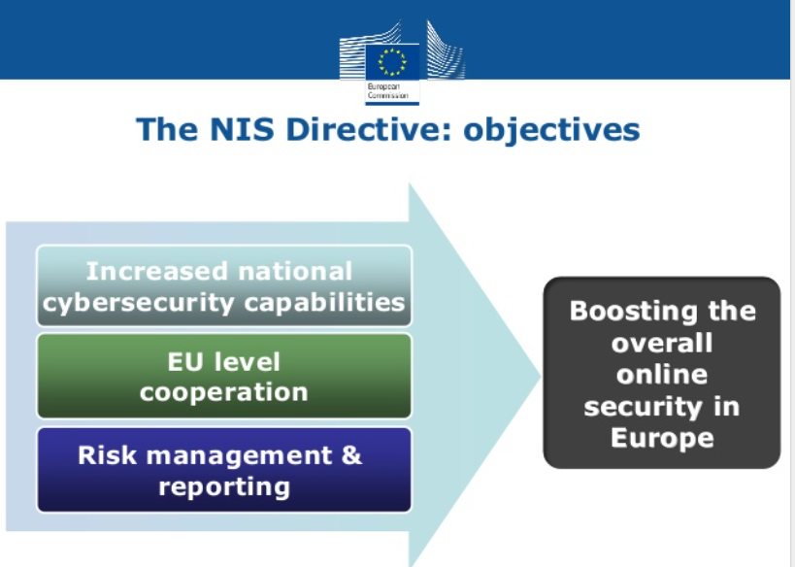
Common level of network and information systems security
Improving national cyber security capabilities
Increasing cooperation between EU member states
“Appropriate and proportionate” security measures (OSE and DSP)
OSE : operators of essential services
DSP : Digital service providers

Slide 5
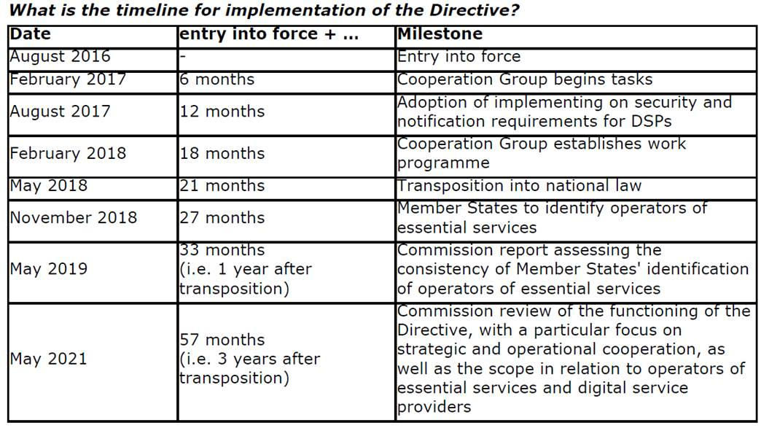
Quel Agenda ?

Slide 6
OSE : Operators of Essential Services
The Directive deems the following sectors essential:
Energy (electricity, oil and gas)
Transport (air, rail, water and road)
Banking (credit institutions)
Financial market infrastructures (trading venues and central counterparties)
Health (healthcare providers)
Water (drinking water suppliers and distributors)

Slide 7
The directive : 27 articles et 75 Recitals
Article 1 : Champ d’application « Adoption d’une stratégie nationale », coopération internationale et centres de réponses aux incidents…
Article 2 : Traitement des données à caractère personnel (95/46 --> GDPR)
Article 3 : Harmonisation minimale, chaque état membre est libre de faire plus que la « Baseline » définie par la directive
Article 4 : Définitions
Article 5 : Identification des opérateurs de services essentiels
Article 6 : Effet disruptif important
Article 7 : Stratégie nationale en matière de sécurité des réseaux et des SI
Article 8 : Autorités nationales compétentes et point de contact unique
Article 9 : Centres de réponse aux incidents (CSIRT)
Articles 10 ...13 : Coopération nationale, réseau CSIRT, coopération internationale
Article 14 : Exigences de sécurité et notification d'incidents
Article 15 : Mise en œuvre et exécution
Article 19 : ... règles sur les sanctions …
....
Article 21 …. encourager l'utilisation de normes ...
….
Considérant 54 : …service en nuage, adaptation des contrats dans le respect des exigences de la présente directive

Slide 8
Art 14 Security requirements and incident notification
Member States shall ensure that operators of essential services take appropriate and proportionate technical and organisational measures to manage the risks posed to the security of network and information systems which they use in their operations. Having regard to the state of the art, those measures shall ensure a level of security of network and information systems appropriate to the risk posed.
Notify, without undue delay, the competent authority (Notifications shall include information enabling the competent authority or the CSIRT to determine any cross-border impact of the incident. Notification shall not make the notifying party subject to increased liability).

Slide 9
Art 15 Implementation and enforcement
Implementation and enforcement
1. Member States shall ensure that the competent authorities have the necessary powers and means to assess the compliance of operators of essential services with their obligations under Article 14 and the effects thereof on the security of network and information systems.

Slide 10


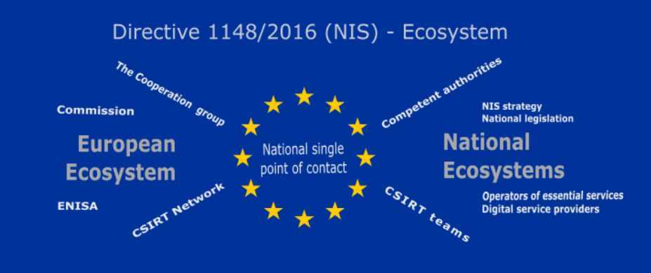







Belgium Ecosystem
NIS Cooperation Group
OSE
Autorité nationale
CSRIT
Incident
OSE
Audit
CRCW
Certification
Accréditation
Computer Emergency Response Team (CERT)
Computer Security Incident Response team (CSIRT)
Incident Notification to CSIRT national (CCB)
External audit every 3 year
OSE : operators of essential services identified by CCB

Slide 11
Article 19 Standardisation
Encourage the use of European or internationally accepted standards and specifications relevant to the security of network and information systems.
Article 21 Penalties applicable to infringements of national provisions adopted pursuant to this Directive and shall take all measures necessary to ensure that they are implemented. The penalties provided for shall be effective, proportionate and dissuasive.

Slide 12


4) Standard et norme : ISO27001
Source : NIS Cooperation Group members.
Building upon answers provided by the Member States ENISA’s questionnaire, the Group acknowledged that Member States may wish to use different sources or control frameworks for security measures from European or International standards (e.g. ISO 27.000)6 to existing or new sets of security measures (e.g. France’s cybersecurity measures for OES, Germany’s IT-Grundschutz, Spain’s National Security Framework, etc.).
6 Article 19 of the NIS Directive “Encourage the use of European and internationally accepted standards and specifications relevant to the security of Network and Information Systems”.

Slide 13
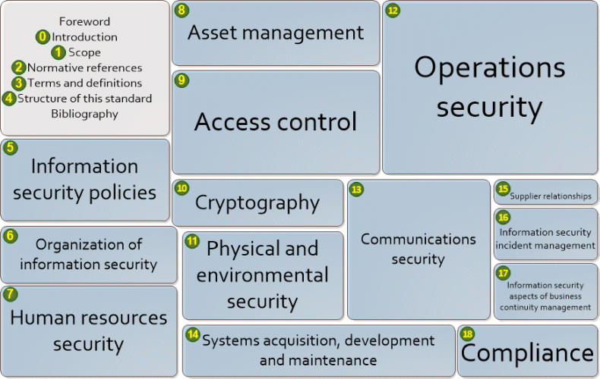
ISO 27002:2013 control blocks
114 Exigences de sécurité
Art14.2
Art14.2 : les OSE prennent les mesures appropriées en vue de prévenir les incidents qui compromettent la SRI utilisés pour la fourniture de ces services essentiels ou d'en limiter l'impact, en vue d'assurer la continuité de ces services.

Slide 14

NIS Implementation

Slide 15







Enterprise Arhitecture
Business Process
Enterprise Information
Security
Information
Services
Applications
IT Security
Infrastructure
© Copyright ICTC.EU 2017

Slide 16
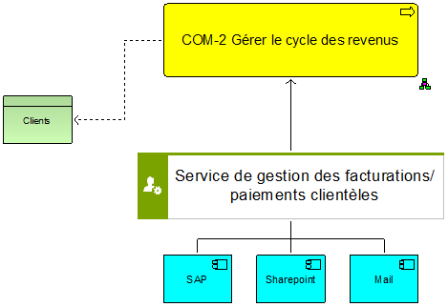
Protect the Crown Jewel !
BPMN Modelisation ARIS
Business process
Information
Services
Infrastructure
Applications

Slide 17
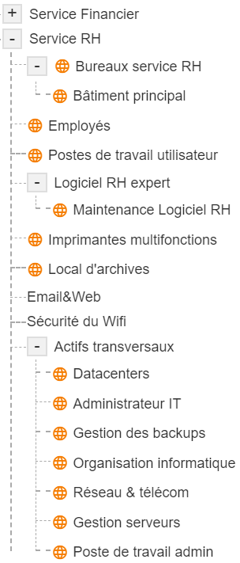











  Risk assessment tool MONARC.
Actif primaire
AP : Service RH
Coté utilisateur
Actifs secondaires
Actifs transversaux

Slide 18
Questions ?

Slide 19
Source :
https://eur-lex.europa.eu/legal-content/FR/TXT/PDF/?uri=CELEX:32016L1148&from=FR
https://circabc.europa.eu/sd/a/c5748d89-82a9-4a40-bd51-44292329ed99/reference_document_security_measures_OES(0).pdf
https://www.enisa.europa.eu/topics/critical-information-infrastructures-and-services/cii/nis-directive
https://www.ccb.belgium.be/fr/actualité/cadre-pour-la-sécurité-des-réseaux-et-des-systèmes-dinformation-pour-la-sécurité-0
https://www.europa.eu/rapid/press-release_MEMO-18-3651_en.pdf
https://www.cases.lu/monarc.html
https://securitymadein.lu/tools/monarc/

