Slide 1



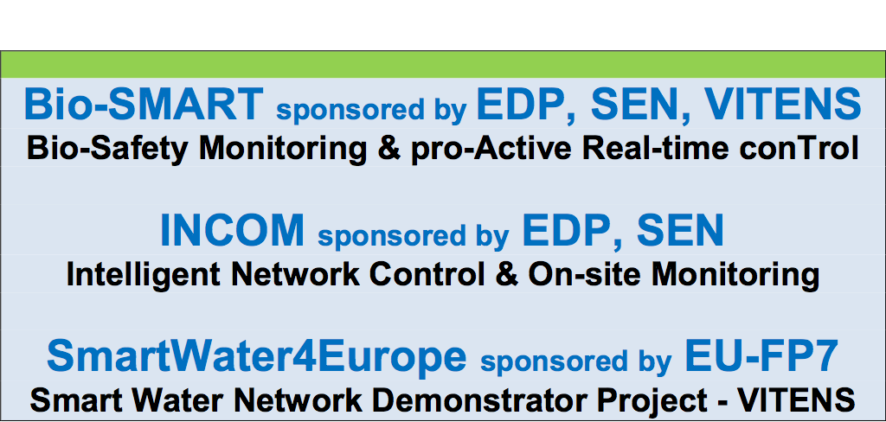

2018 Executive Resilience Building Forum
“W- SMART” R&D Center
University Industry Collaborative Research & Development
@University of Lille-1
W-SMART 2018 International Workshop, October 17, 2018, San Francisco

Slide 2
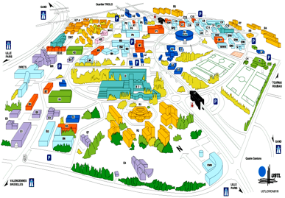
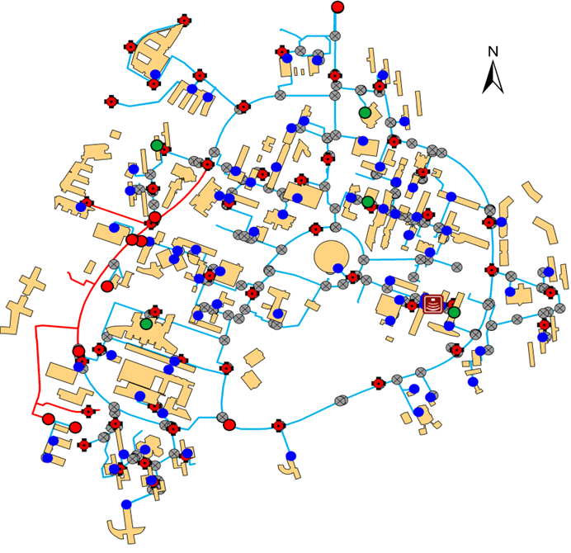
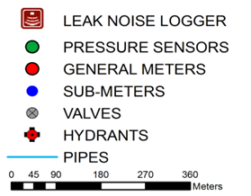
SUNRISE: Turning University Campus into Smart City Demonstration Site
University of Lille Small Town:
24,000 People; 140 Building
15 Kms networks; 50 Year
250 valves; 49 hydrants
140 Building; 95 AMR
EU-FP7 Sponsored
SW4EU

Slide 3
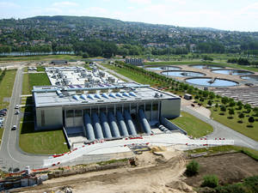
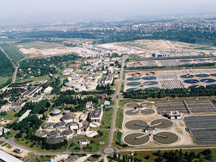
I-WWTP-COM
Intelligence based Waste Water Treatment Process - Control & Optimization Management
Feasibility Assessment of AI Algorithm Application to process control and optimization management of tertiary treatment to achieve:
Energy Opt & Cost Efficient TSS Removal for dry and rainy configurations with phosporus removal control (i. biological nitrogen removal);
Optimization of Dosage of chemical products during Physico-chemical settling on the Seine Aval clarifloculation process;
AI based Application Development for the Process Control & Optimization Management using off-line simulations of operational scenarios with field data (Seine-Aval WWTP).
Seine-Aval Wastewater Treatment Plant in Achères
https://www.water-technology.net/projects/seine-aval/

Slide 4
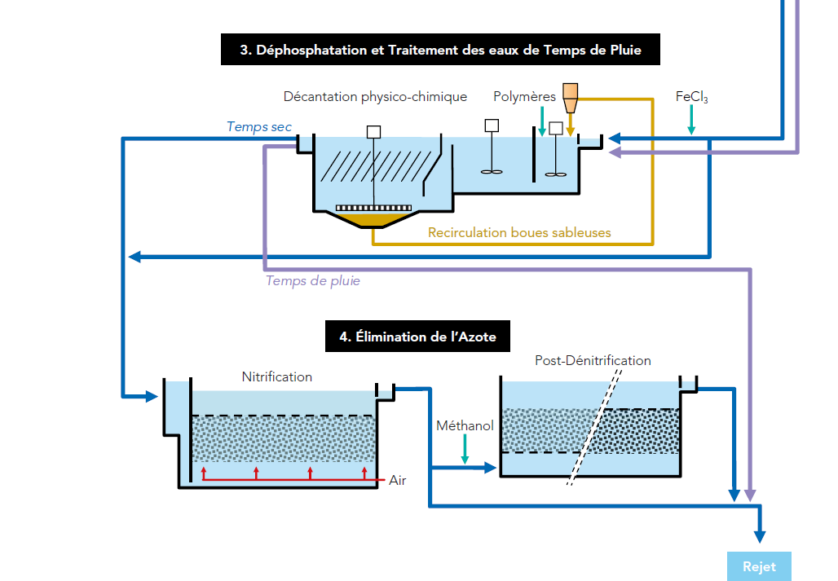
Seine-Aval Process
(Achères, Yvelines)
TSS; COD
Output
Input
QC
Process Efficiency = TSS Reduction Vs. Chemical Dosage

Slide 5
Phase 0 – Concept Demo-illustration
Statistical off-line Effluent Data Analysis of the tertiary process – Database of effluent input & output parameters
AI Application (SVM; ANN) for Anomaly Detection – Output Effluent Quality Control (Training & Testing)
Statistical Treatment Data Analysis of expected process efficiency (i.e. TSS; COD Reduction) Vs. concentration of treatment parameters – Process database
AI Application for Treatment Optimization – concept demonstration of the feasibility of an AI based application for an automated process
System Integration for “Beta” site testing planning & performance measures for feasibility assessment (ROI)

Slide 6
Statistical Data Analysis of the Tertiary Process – effluent input & output parameters
COD
TSS
PO₄

Slide 7
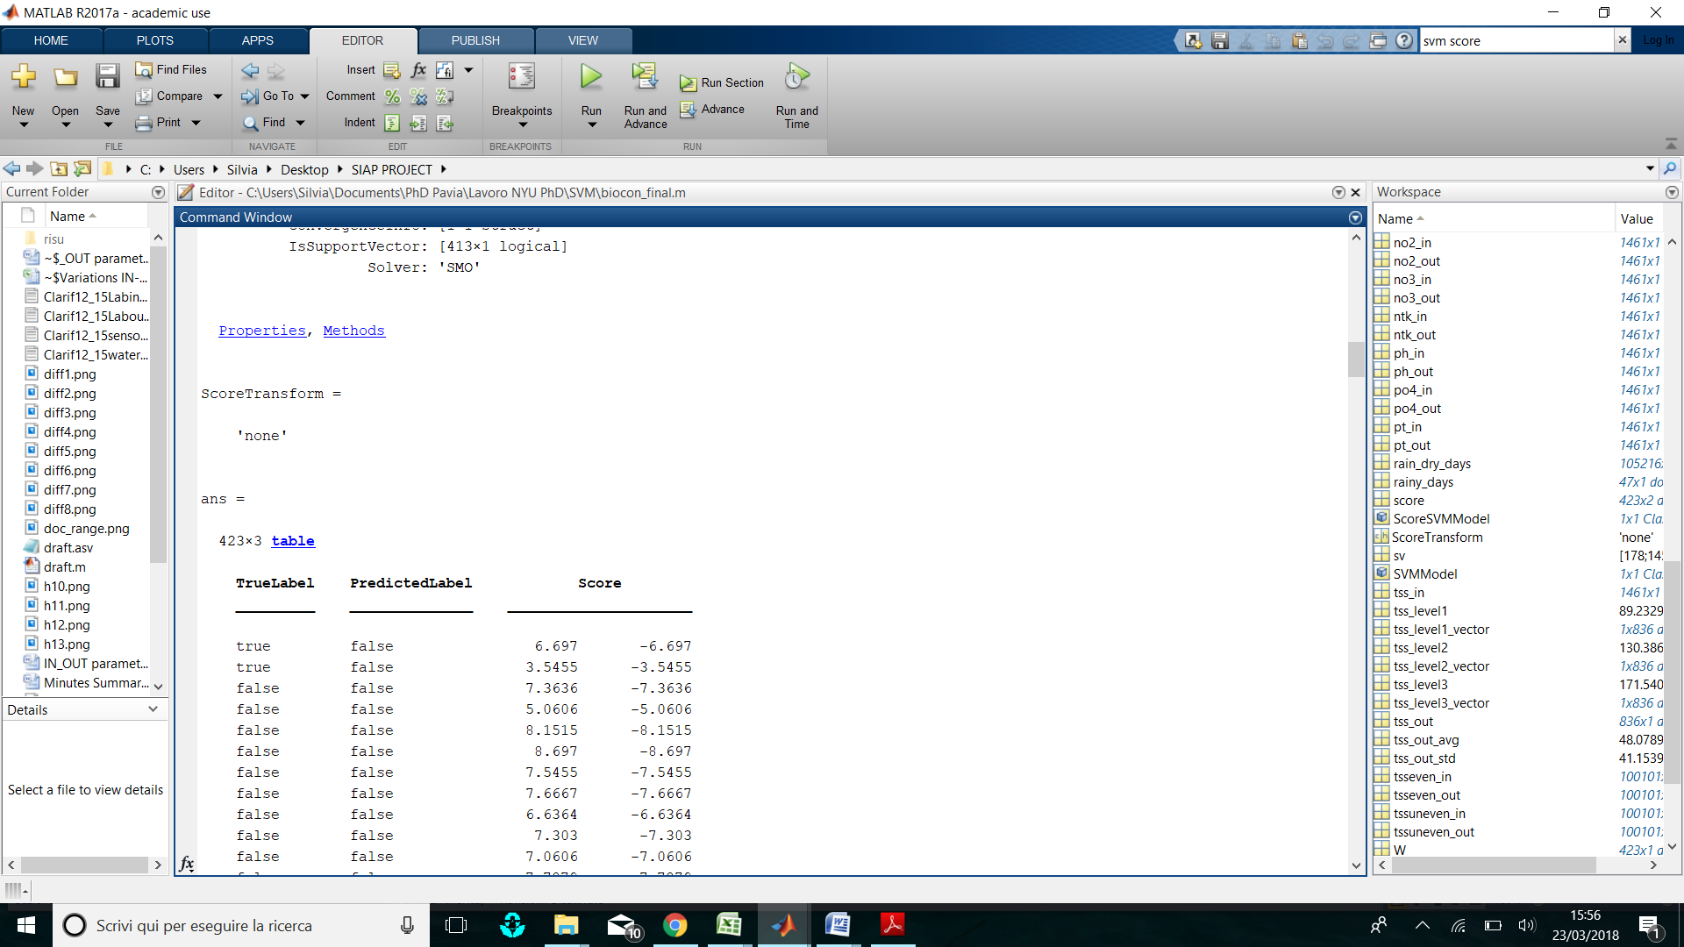
AI Application & Mono-parameter Analysis for Quality Control
Statistical tools used to establish Anomaly Severity Thresholds
Vector used for the definition of the anomaly ranges in mono-parameter analysis
Mono-parameter Analysis
 | COD | TSS
avg ± 1*STD | Non anomaly | Non anomaly
avg (±1*STD ± 2*STD) | Low | Low
avg (±2*STD ± 3*STD) | Moderate | Moderate
>avg ± 3STD | Severe | Severe
SVM Results for the TSS mono-parameter analysis
Next Phase – Process Optimization

Slide 8
I-WWTP-COM Network of Beta sites
The I-WWTP-COM Network Purpose:
Concept Demonstration & Feasibility Assessment of AI based algorithms for upgrading and automating the treatment process control to meet performance & QC requirements.
Leveraging Experience and Resources by creating several “Beta” sites for the adaptation, demonstration and pilot testing of AI based Process Control customized to utility needs.
Promoting a Network of Local University Centers to support AI driven Innovation for the development of the I-WWTP-COM
Current AI Applications for
  Drinking Water: Bio & Flow Anomaly Detection (SW4EU)
  Wastewater Treatment: Process Control, Energy Efficiency
  Reduced Energy for Sludge – AI & Monitoring (MEKOROT)
With our Thanks for SIAAP Leadership & R&D Team

