Slide 1
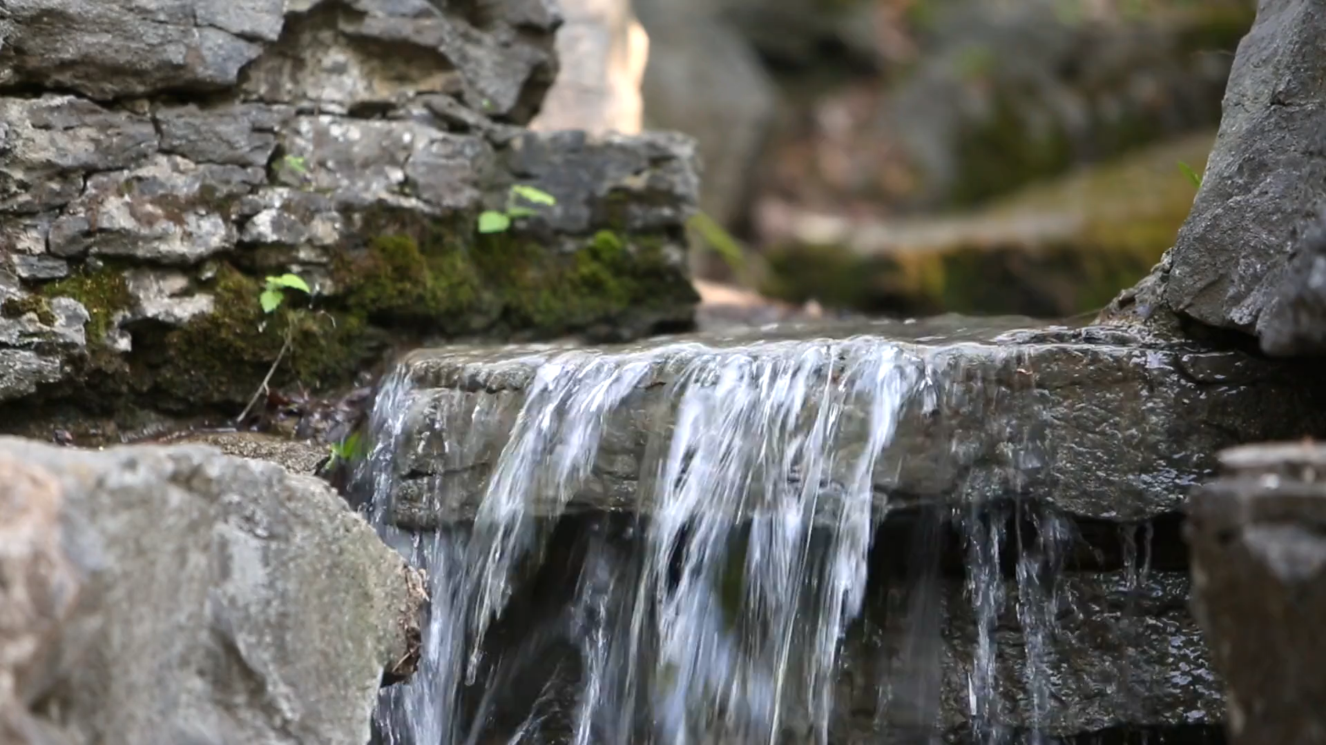

UNESCO Metropolitan “ECO – RISE” R2020 Colloquium
“Eco-development, Climate-impacts & service-Operators’ challenges for Resilient Infrastructure & Sustainable Ecosystems
7-8 Nov. 2019, UNESCO HQ, Paris
Global Challenges: Sustainable water management and the 2030 development agenda
Alexandros K. Makarigakis, Ph.D

Slide 2
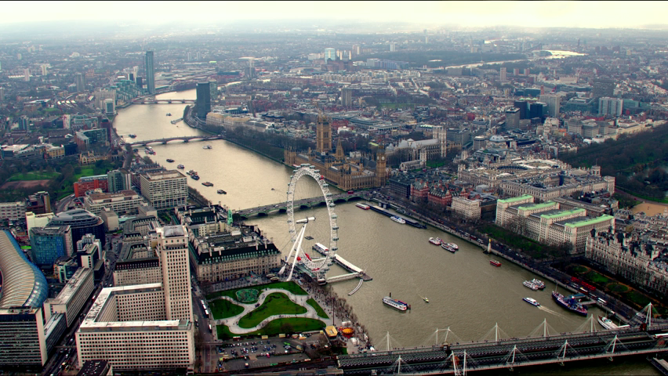
Water and human settlements of the future
Theme 4

Slide 3

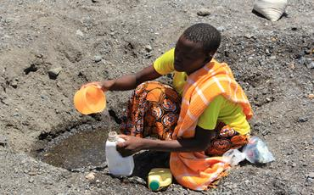
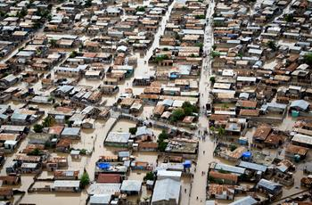
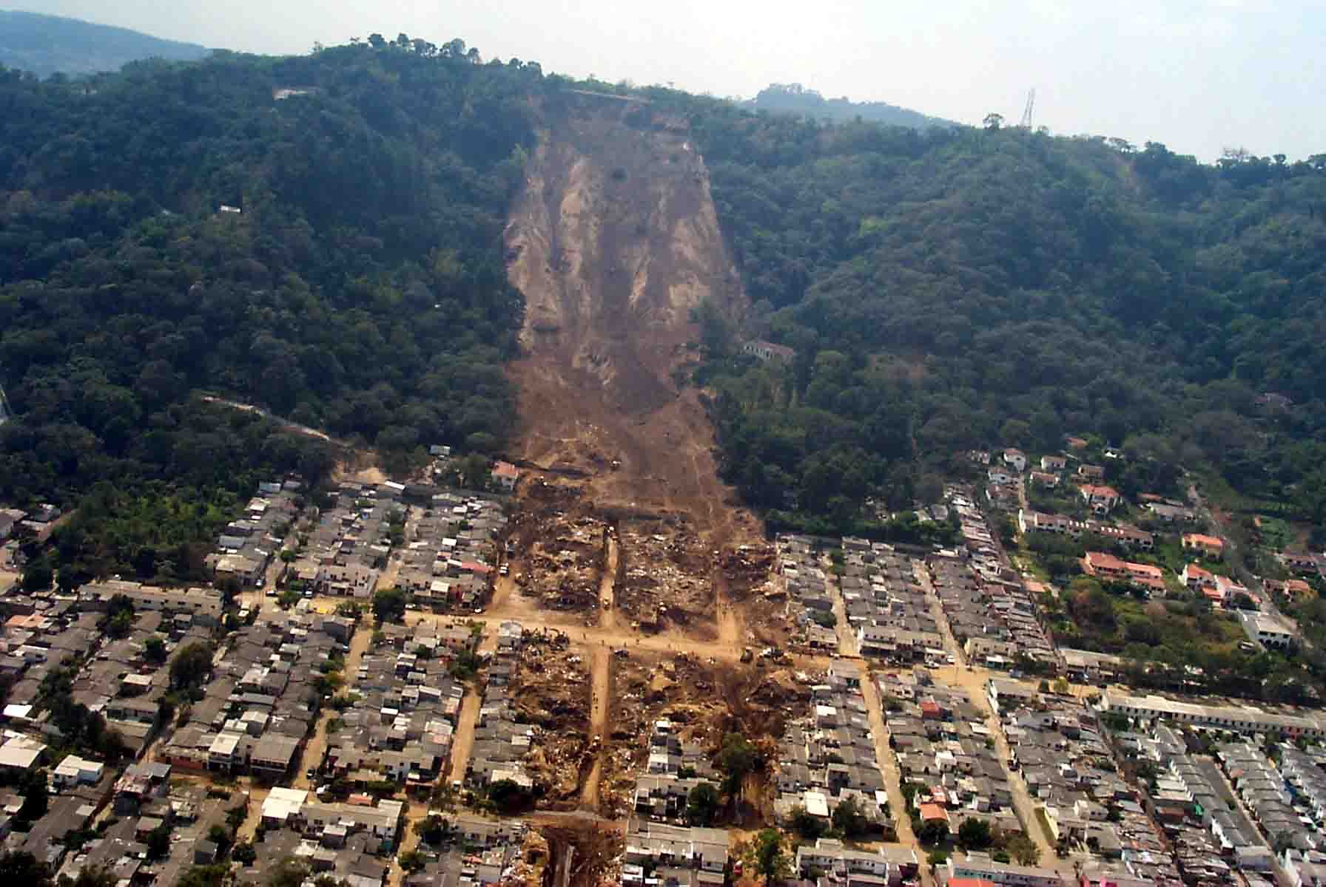
Water Security: 21st Century key challenges
85% of the human population live in arid and semi arid areas
6-8 million human beings are killed each year from water‐related disasters and diseases.
3000 deaths are attributed to landslides every year
Notes:
Economic losses from natural hazards are now reaching an average of 250 billion to 300 billion US dollars a year (from which 90% is associated to water related disasters), with a disproportionate impact on small and vulnerable countries..

Slide 4
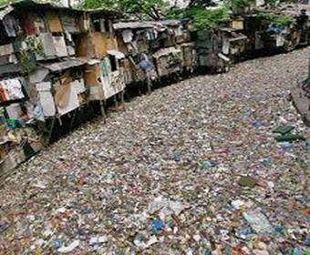
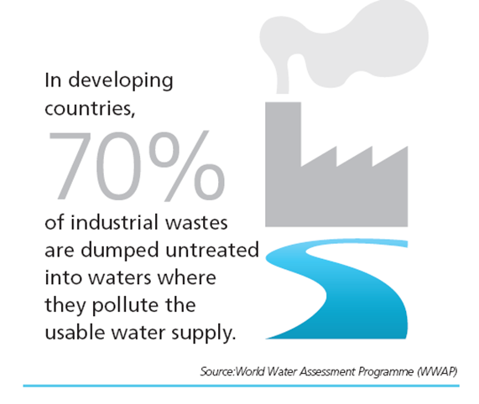
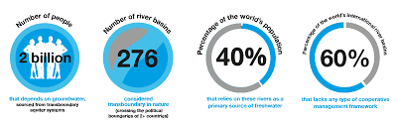
Water Security: 21st Century key challenges
Almost 85% of the world’s total wastewater is discharged without adequate or any treatment.
148 nations have transboundary river basins and there are 592 transboundary aquifers shared by 2-4 countries
Notes:
Groundwater is critical for the livelihoods of nearly 1.5 billion rural households in the poorer regions of Africa and Asia

Slide 5
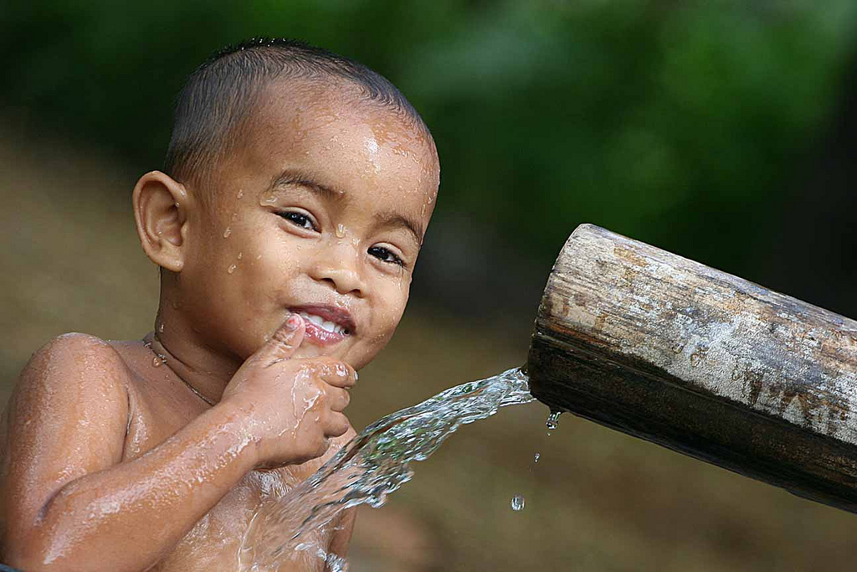

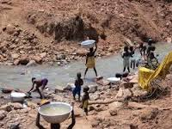
Water Security: 21st Century key challenges
750 million people lack access to safe water and 2.5 billion to adequate sanitation.
There are 4 billion without safely management of Sanitation (2015)
There are 2.5 billion of people without a safe water management
Notes:
In many parts of the world (including Europe and USA) the water infrastructure systems are over 100 years old and need rehabilitation. Just in Europe the cost for it is of about 5 billion Euros per year.
Lack of sanitation and solid wastes services is one of the main causes for ocean pollution

Slide 6

WATER & USES

Slide 7
WATER RESOURCES
1,380,000,000 km³
45,500,000 km³
178,000 km³

Slide 8

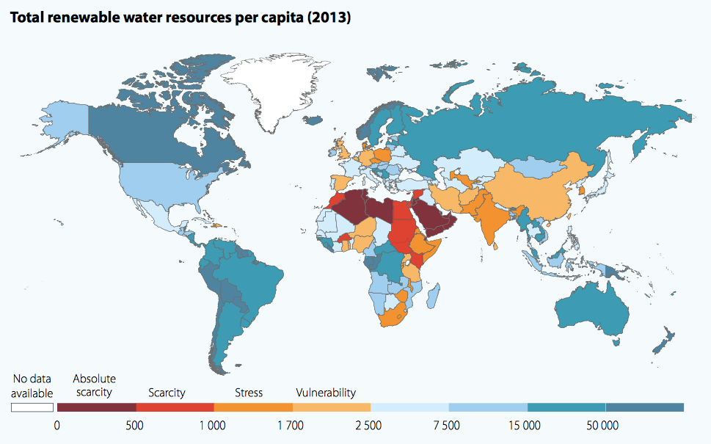
RENEWABLE FRESH WATER

Slide 9
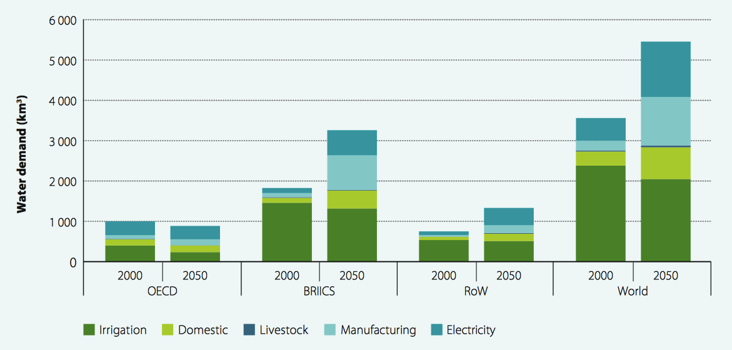
GLOBAL WATER DEMAND 2000-2050
Main Uses of Fresh Water | Percentage of Total Withdrawal - 2015
Agriculture (irrigation) | 70 %
Industry | 18%
Municipalities (Domestic) | 12%
Total Water Demand in 2015 is about 4,000 km³.
This represents 10 % of available renewable water.
BRIICS (Brazil, Russia, India, Indonesia, China, South Africa); RoW (rest of the world).

Slide 10

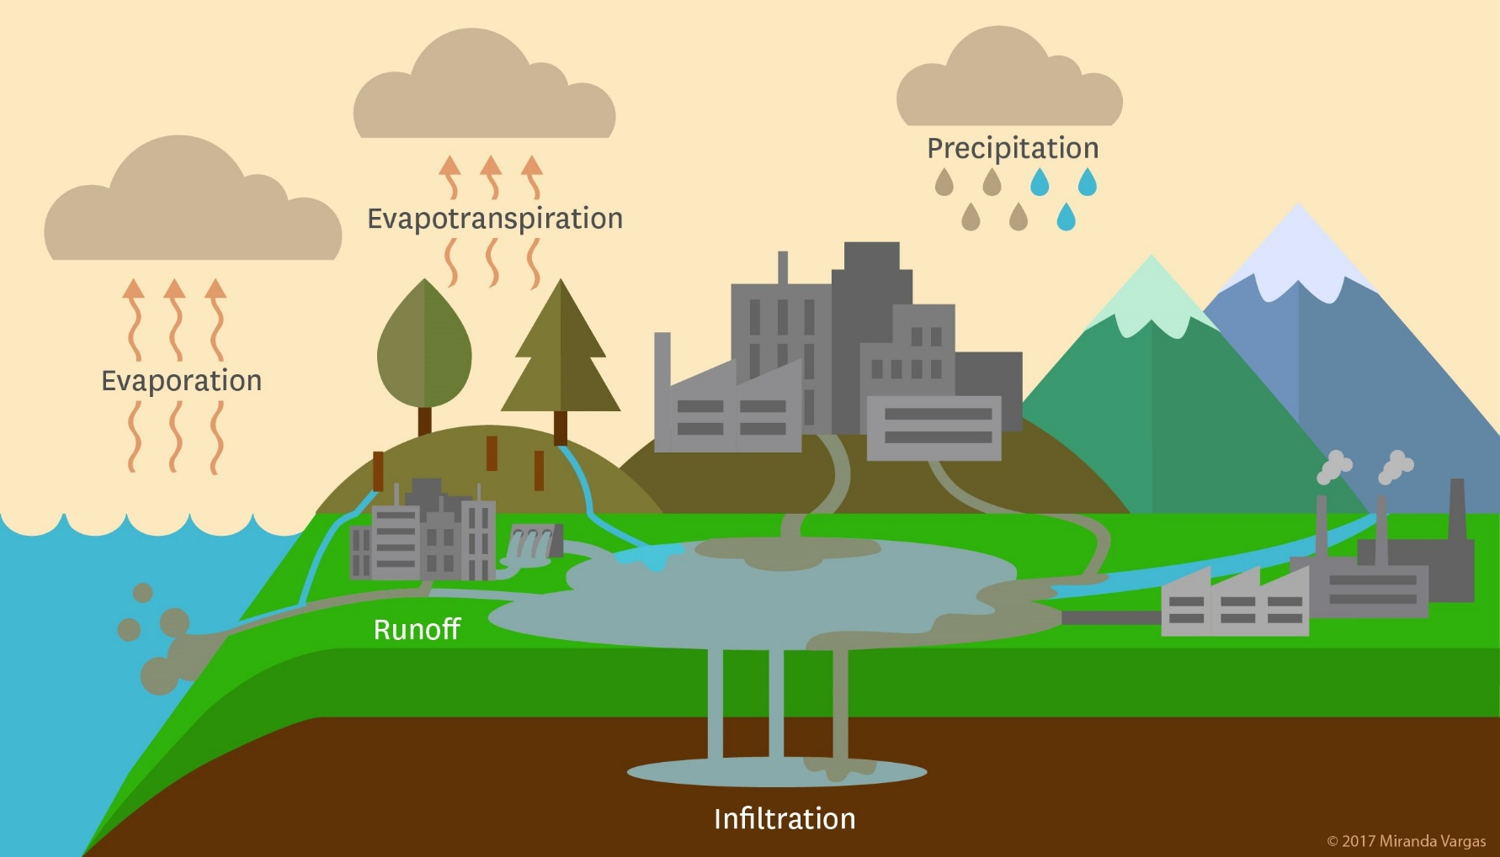
The (modified) urban water cycle
Notes:
Cities modify water availability in terms of the accessibility to the resource and creating an uneven and undesirable competition for it.

Slide 11
DEMOGRAPHY

Slide 12
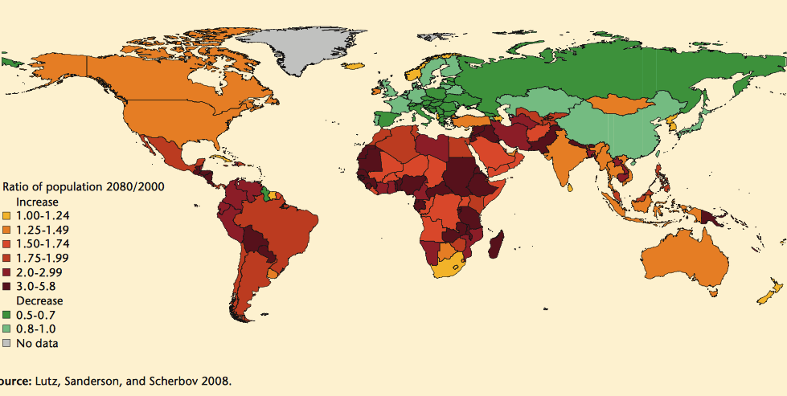
POPULATION GROWTH AND DECLINE
The largest population growth is awaited in urban centers in Africa

Slide 13
DEMOGRAPHY & WATER
  .
By 2050 the World population will increase from 7 to 9 billions.
90 % of increase located in developing countries
Almost 100 % of increase will be located in urban areas.
Forecasted 70-90 % of increase in demand for water.
By 2030, up to 70% of world population will be living in high water stress areas.

Slide 14
CLIMATE CHANGE &
VARIABILITY

Slide 15
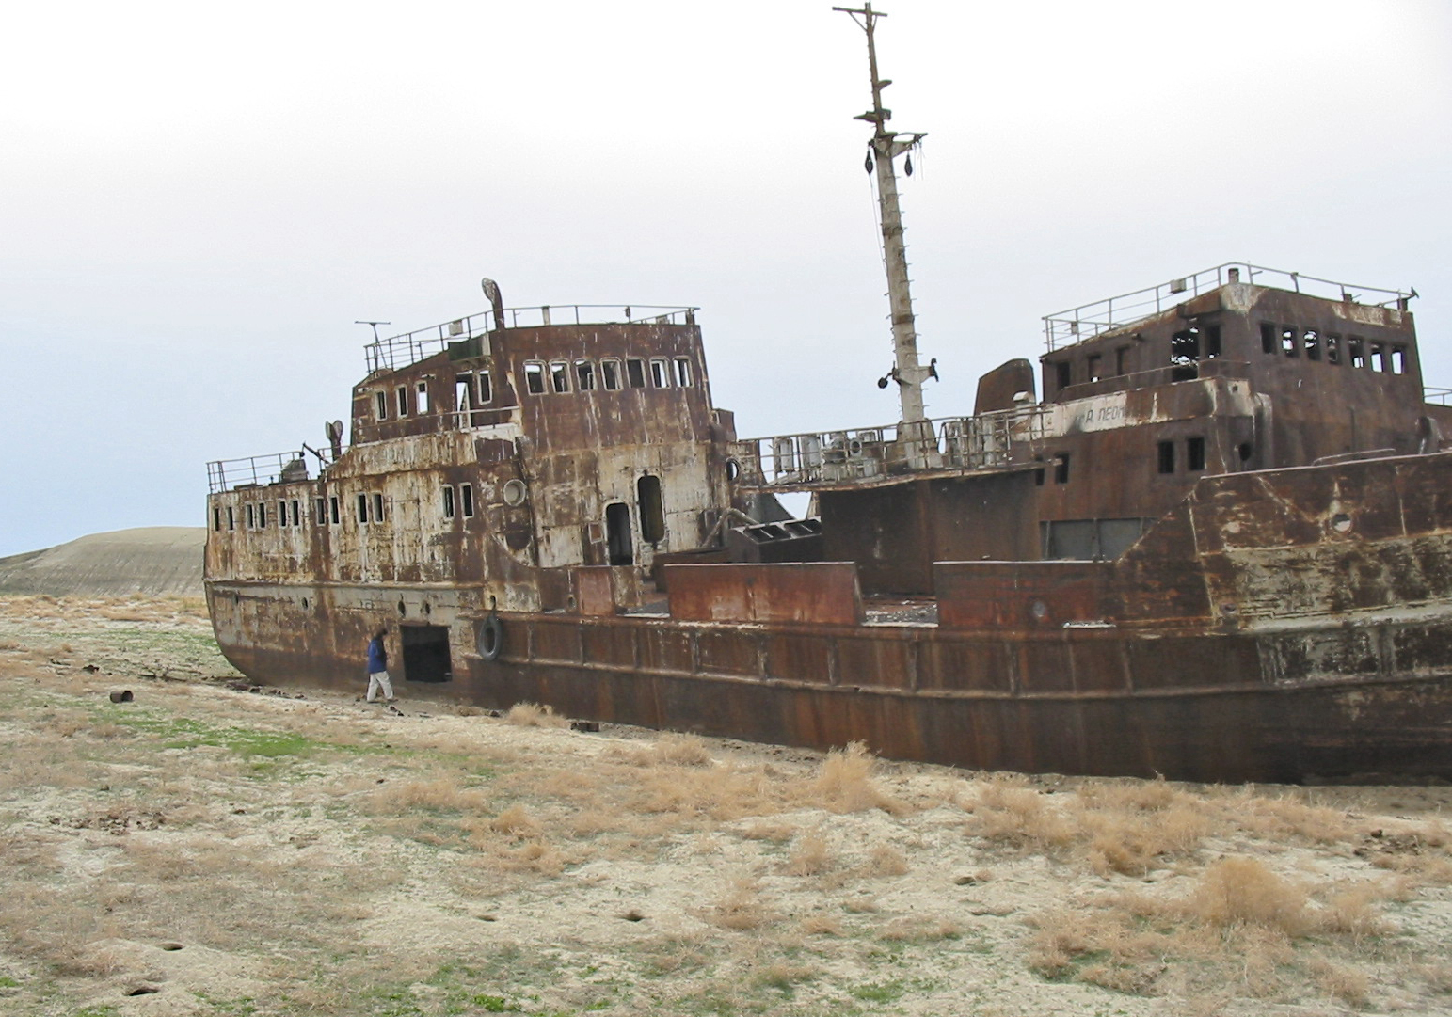
Climate Change: challenge already visible to-day !
Operation Cost $
9km
or Ironing 1 h
Brine
Abandoned ship in the former Aral Sea, near Aral, Kazakhstan
Notes:
EDUCATION - The debates on higher education are crossed in France today, with reflections on the reverse pedagogy and e-learning, for the many initiatives aimed at structuring the landscape to make it readable and visible to the International and, of course, for the real budget problems that constrain universities and colleges.
So many exciting topics, important even decisive, but that should not obscure the true meaning of higher education: providing the company executives able to solve the problems of tomorrow's world, which we will all face.
COP21 in full, it seemed useful since this place is mine now director of the National School of Bridges and Roads and Vice President of the CDEFI to recall that today more than ever, higher education should above all be at the rendezvous of climate change.
Climate change confronts our societies yards in the same magnitude as those of post-war reconstruction. To mitigate and reduce emissions of greenhouse gases, or to simply adapt to the impacts of climate upheaval in progress, it will change the way we live, produce, consume.
These unprecedented changes we impose new challenges to be met: it is to think, organize, finance, but also translate to the rulers of the civil society. It is therefore essential to strongly support our research around these issues and to invest in the training of a competent youth and able to meet these new challenges:
• The mitigation of greenhouse effect now affects all economic sectors.
• The construction will, for example, the development of low carbon materials (green concrete, mixed assemblages of wood).
• Energy, responsible for 40% of current emissions, require the design and optimization of low carbon technologies themselves.
• Transportation (20% of global CO2 emissions, nearly 30% in France) will also be profoundly rethought and their consequences - their environmental impact considered. The mass circulation of electric vehicles, for example, impose, unpublished infrastructure and urban forms adapted to their developments.
• Finally, it will redefine for all of these topics, a new social, political and economic management that mobilizes stakeholders at the local, national, but also international (because global warming knows no borders).
Whatever the measures adopted and implemented, the climate disruption is, in part, inevitable. It will have to adapt quickly.
This involves responding effectively to environmental disturbances. We saw during the recent floods south of France that the heaviest rainfall would thus need to be anticipated sufficiently accurate and powerful analysis tools to model what was happening in real time and in a very local level.

Slide 16

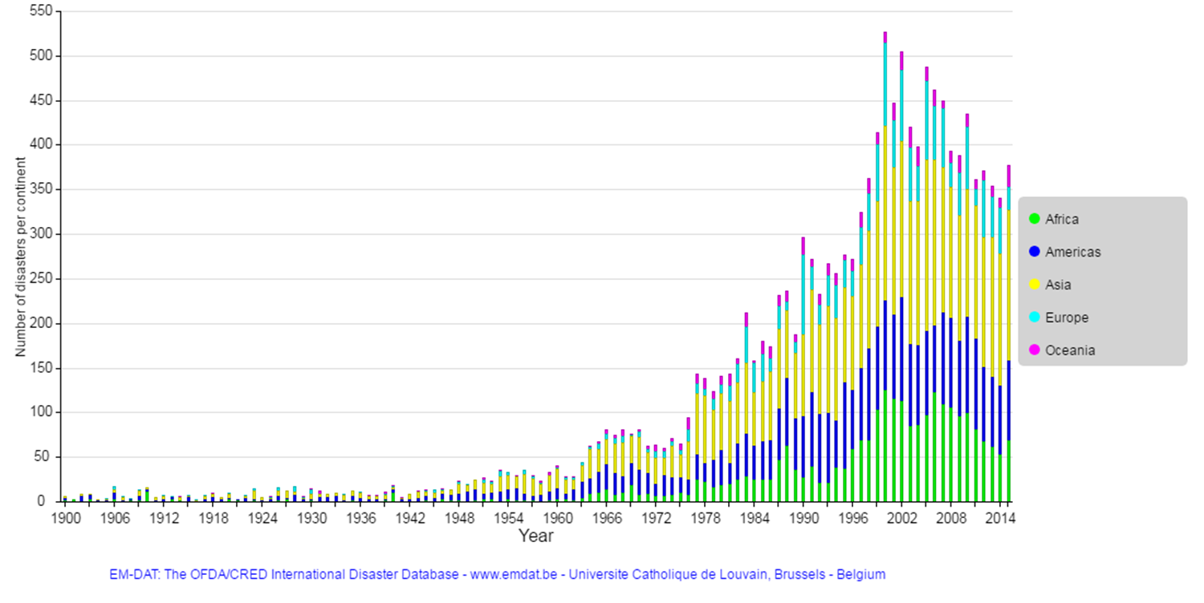
Number of disasters per continent

Slide 17
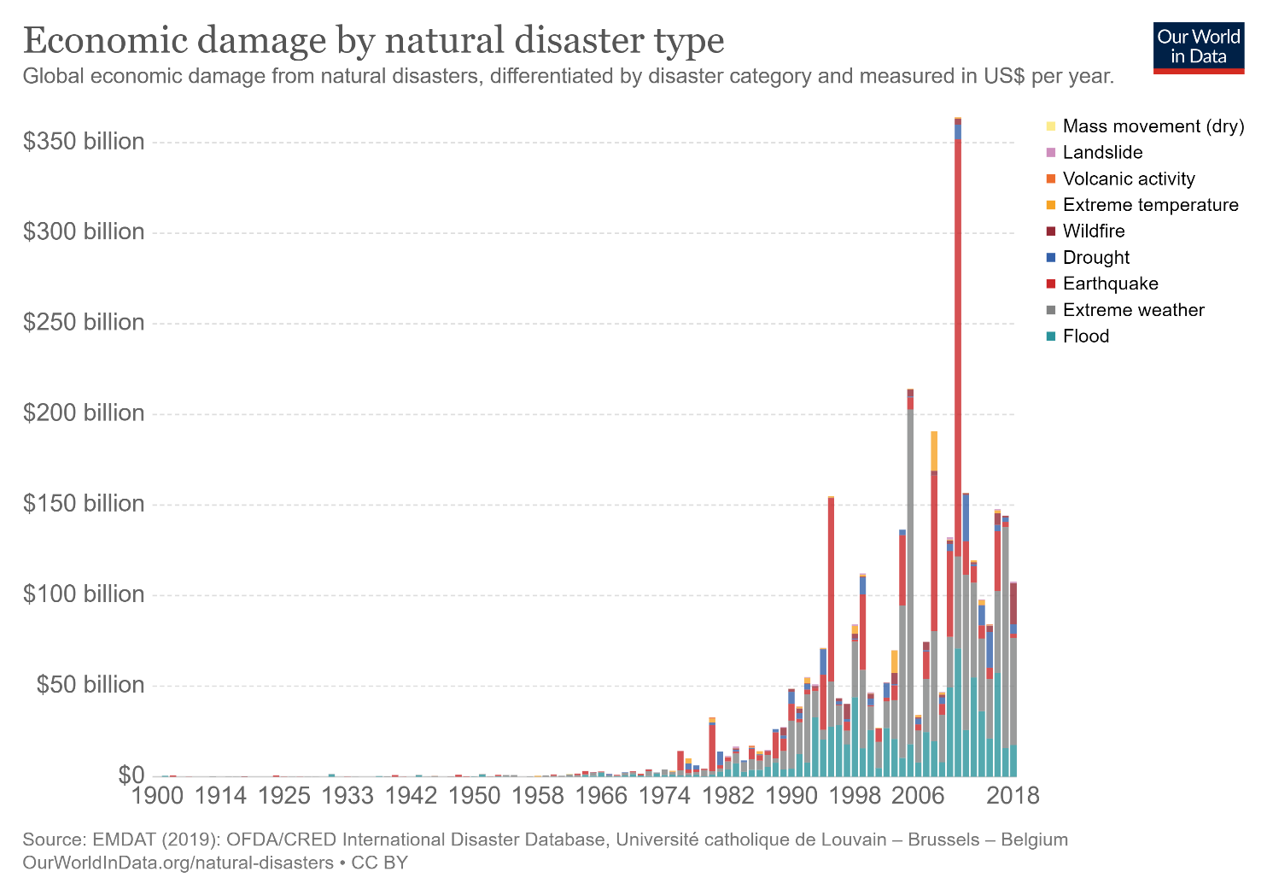

Slide 18
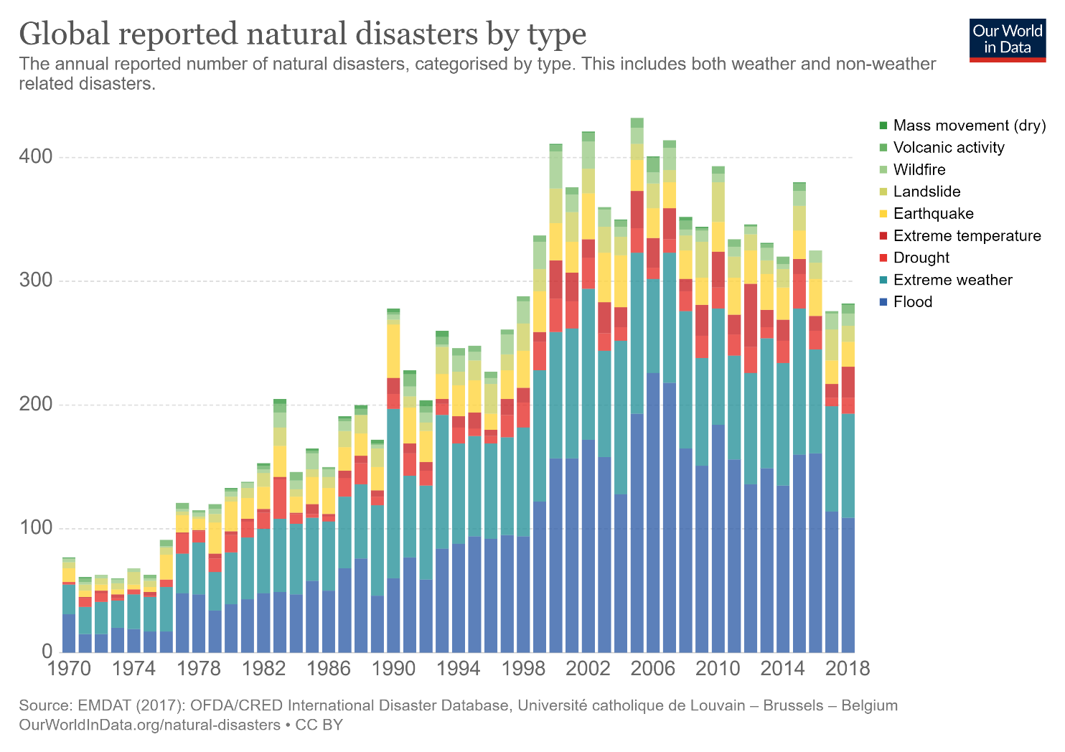
Notes:
Prediction is key for limiting the impat as we cannot change things

Slide 19
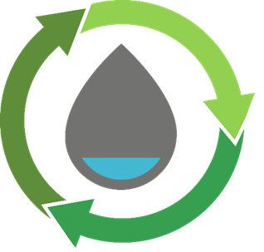

Call for Solutions
Facilitating policy environment
Prioritize Water in the government agenda
Institutional framework and set up
Policy and decision making tools (laws, codes, regulations
Water resources
Need to protect water resources
Avoid groundwater overexploitation and salinization
Account for effects of climate variability and change effects
Notes:
Urban water management policy
Water at top of Government agenda. Planning can be more effectively done if water is managed as a whole.
Stop splitting the Water Cycle into separate Mgt entities; acknowledge the “integrated” nature of water
Adopt the ‘10% solution’. Try ‘fixing’ the pipes, i.e. support operational performance improvements in utilities. The results may add up to only 40, 50, or 60%, but that is better than zero. For example, if high water losses are the problem, help the utilities reduce them and do not insist on governance reform as a precondition for support.
We can’t build cities of the Future without bringing planners, architects, developers into our fold.
Institutional framework wedded to Big Pipes. Big monopolies dreaming of big infrastructure solutions
Small scale close-loop utilities run by Private sector are the disruptors we need to engage & encourage
Invest in the present and the future. To remain future-ready, continue investing into R&D for areas such as development of a Smart Water Grid and reducing the energy consumption of our water treatment systems in reclaimed water and desalination. Investing in infrastructure in the present will alleviate the burden in the future.

Slide 20


Solutions
Capacity reinforcement
Institutional and Human resources
Raise Awareness
Water use and allocation
Minimize losses – Asset management
Optimize operations - SWM systems
Water supply
Prioritise water demand management
Link basin management plans with city ones
Guarantee the quality of water
Diversify water supply (wastewater use; desalination; rainwater harvesting

Slide 21
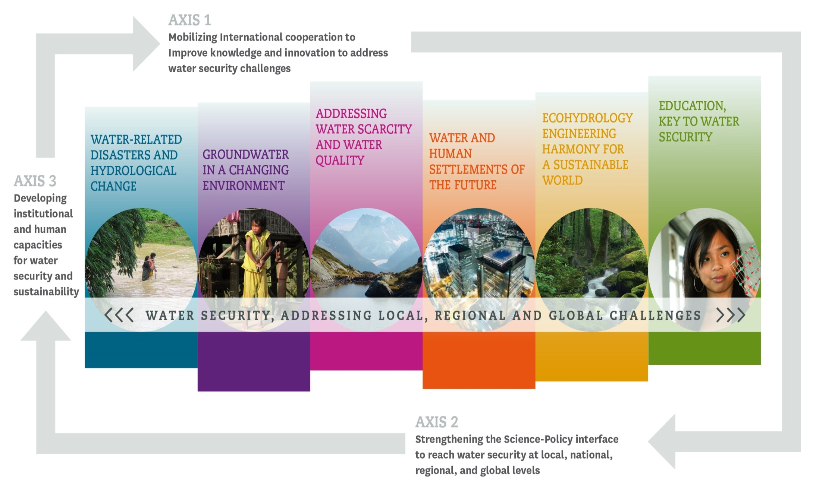
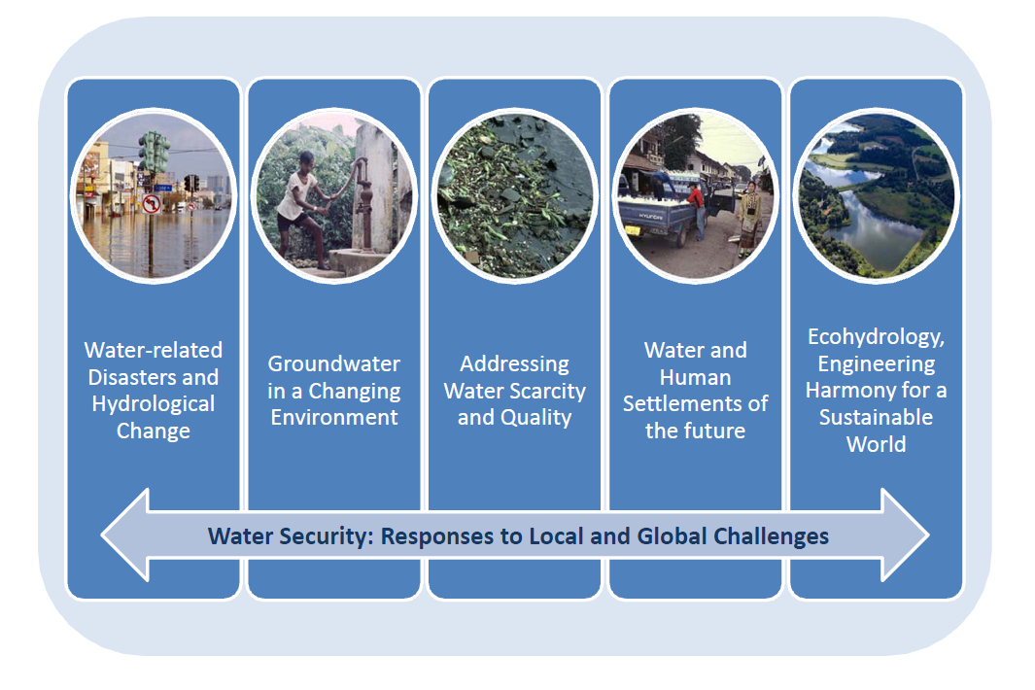

IHP-VIII: Addressing water security:
local , regional and international challenges (2014-2021)
Axis 1: Mobilizing international cooperation to improve knowledge and innovation to address water security challenges.
Axis 3: Enhancing policy advice to reach water security at local, national, regional and global levels.
Axis 2: Developing institutional and human capacities for water sustainability innovation
Notes:
UNESCO’s International Hydrological Programme, IHP, was founded in nineteen seventy-five. It is now living its eighth phase for the period two thousand fourteen – two thousand twenty one.
In response to the priorities and needs of Member States, IHP-VIII focuses on six knowledge areas, called “themes”, that you can see on the screen.
An entire Theme 6 is addressing Water Education.

Slide 22


Non-Engineered Solutions

Slide 23

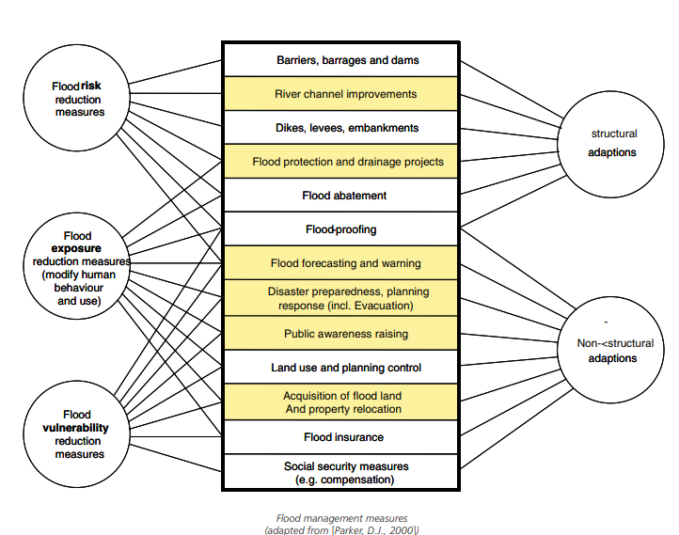
2
Flash Floods: Main Drivers
1- Governmental Policies on Natural Hazards
CASE STUDY #6: Guidance on Flash Flood Management – Recent Experiences from Central and Eastern Europe
Key Points to note:
The Figure presents a categorization of the measures that can be taken for flood management in general and the colored fields represent the measures that are particularly relevant in dealing with flash floods.
Source: https://www.gwp.org/globalassets/global/gwp-cee_files/regional/floods-guidance.pdf
Notes:
It is essential that the state creates a coherent legal framework and support for local activities, particularly in terms of division of competencies between particular administrative levels and sectors. The relevant legal solutions concerning spatial planning will also provide support, including the mapping of high-risk areas and restrictions in their use.
Such Methods would be more effective for limiting the damaged caused by flash floods.

Slide 24
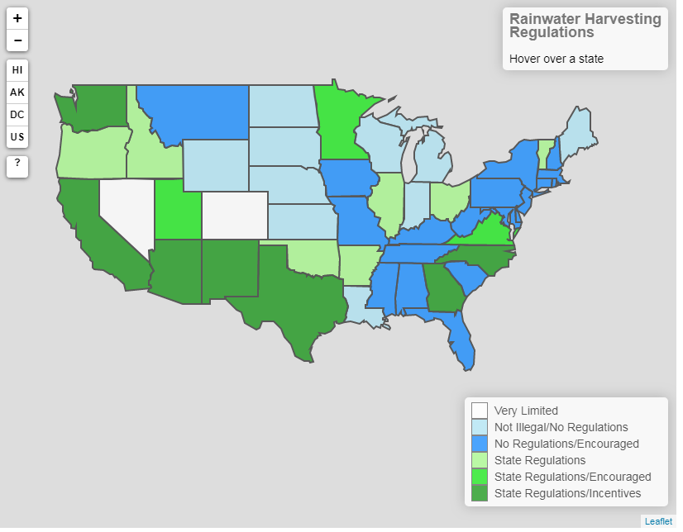
3
Now What we do
Do you know Rainwater Harvesting is illegal in some countries? While in other states, Rainwater Harvesting is incentivized!
Key Points to note:
Colorado law passed in 2016, homeowners are now allowed to catch and use two rain barrels (a total of 110 gallons) from their rooftops, but no more.
Texas and Ohio allow rainwater harvesting for potable purposes, a practice that is frequently excluded from other states’ laws and regulations.
Source: https://www.msn.com/en-us/lifestyle/did-you-know/this-is-why-it%E2%80%99s-illegal-to-collect-rainwater-in-some-states/ar-BBPMSSi?li=BBnb7Kz&parent-title=trump-arrives-in-saudi-arabia-to-warm-welcome&parent-ns=ar&parent-content-id=BBBkadg
http://www.ncsl.org/research/environment-and-natural-resources/rainwater-harvesting.aspx
Notes:
For example, under a Colorado law passed in 2016, homeowners are now allowed to catch and use two rain barrels (a total of 110 gallons) from their rooftops, but no more.
It comes down to a concept called “prior appropriation.” Also known as “first come, first served,” it’s an old policy that dates back to the Gold Rush when prospectors went across the country to pan for gold in California’s streams. Miners would use water to speed up the process, often employing a method called “hydraulic mining,” which over time could hurt the environment by creating huge demands on the dry region’s water resources.
Texas and Ohio allow rainwater harvesting for potable purposes, a practice that is frequently excluded from other states’ laws and regulations.
Rhode Island, Texas and Virginia offer tax credits or exemptions on the purchase of rainwater harvesting equipment. Oklahoma passed the Water for 2060 Act in 2012 to promote pilot projects for rainwater and greywater use among other water conservation approaches.

Slide 25
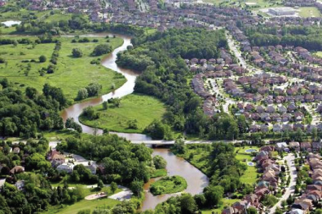
2
Flash Floods: Main Drivers
6- Land Use Control
CASE STUDY #14: Risk Reduction Policies in France
Key Points to note:
Existing regulations in France (R 111-3, Submersible Surface Plan (PSS)) were rarely applied until the setup of the Exposure to Predictable Natural Hazard Plans (PER in French) in 1984 and the Risk Prevention Plan (PPR in French) in 1995.
The Ministry of Ecology (CGDD, 2009) showed that in 424 French cities, nearly 100,000 dwellings were built in flood-prone areas between 1999 and 2006.
Source: https://books.openedition.org/irdeditions/23910?lang=en
http://mackieshea.com/wordpress/wp-content/uploads/2017/09/landuse.jpg
Notes:
Land use control is a fundamental point of risk reduction policies and practices.
Existing regulations in France (R 111-3, Submersible Surface Plan (PSS)) were rarely applied until the setup of the Exposure to Predictable Natural Hazard Plans (PER in French) in 1984 and the Risk Prevention Plan (PPR in French) in 1995.
When these plans are approved, they are generally respected but local authorities sometimes use stratagems to delay their application.
The Ministry of Ecology (CGDD, 2009) showed that in 424 French cities, nearly 100,000 dwellings were built in flood-prone areas between 1999 and 2006. Demand is also high from local authorities to urbanize areas “protected” by dikes.

Slide 26
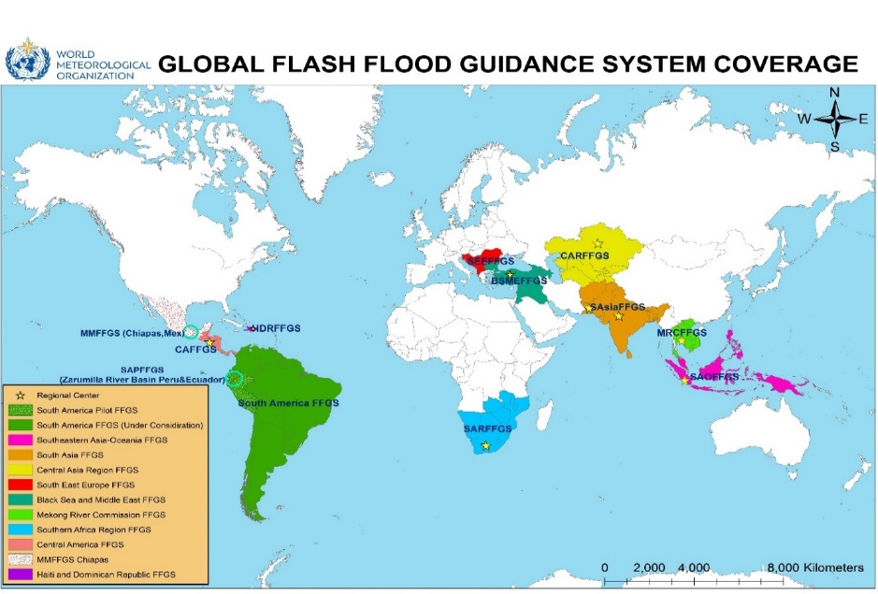
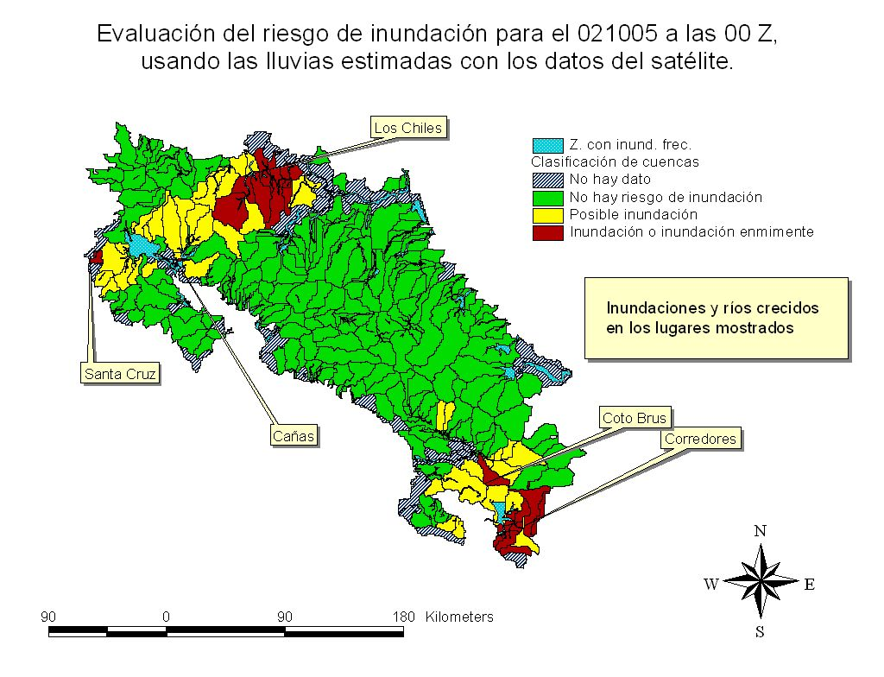
2
Flash Floods: Main Drivers
2- Flash Flood Guidance and Early Warning Systems
CASE STUDY #7: Regional Flash Flood Guidance system (Cosa-Rica)
Key Points to note:
SARFFG implemented operationally in Feb 2014 with NMSs.
2 Training workshops to forecasters (Feb and Oct 2014), Country training in San Diego.
Source: https://www.gwp.org/globalassets/global/gwp-cee_files/regional/floods-guidance.pdf
Notes:
2008: WMO initiated a global project to implement flash flood guidance systems (FFGS) in various regions of the world – Based on the system implemented in Central America (Costa Rica)
SARFFG implemented operationally in Feb 2014 with NMSs.
2 Training workshops to forecasters (Feb and Oct 2014), Country training in San Diego.
Aim is to improve flash flood warnings to disaster management and the public. Provide guidance to forecaster to aid to issue flash flood warnings.
Nowcasting application based on satellite information.

Slide 27
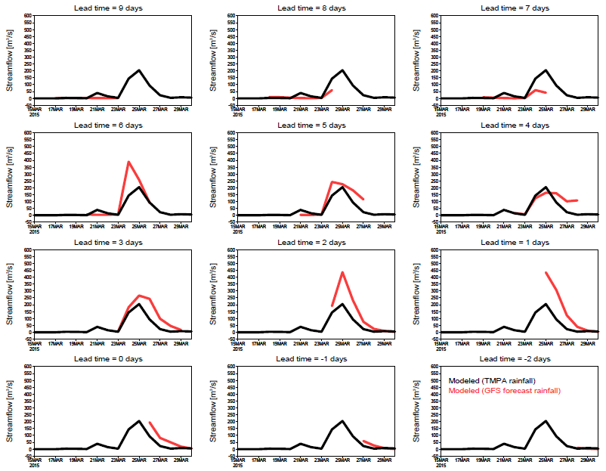
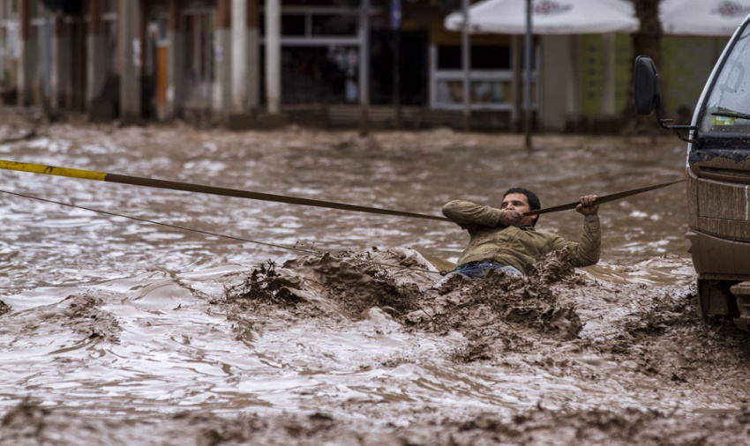
2
Flash Floods: Main Drivers
CASE STUDY #8: Forecasting the March 2015 Flood Event in Northern Chile
Black line = simulated flood using satellite precipitation.
Red line = simulated flood using forecasted precipitation.
Forecasting Flash floods in Northern Chile a Year before the flood
Source: Terrestrial Hydrology Research Group, Princeton University

Slide 28
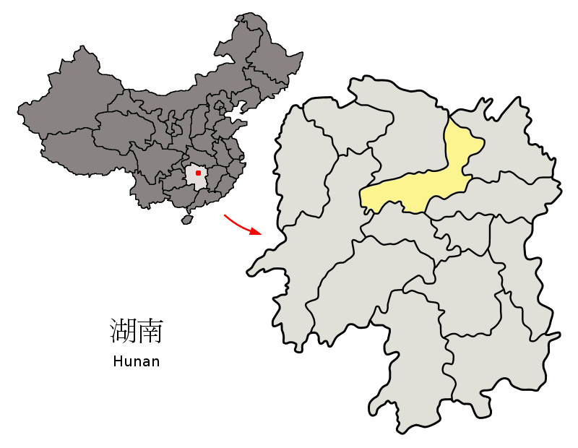
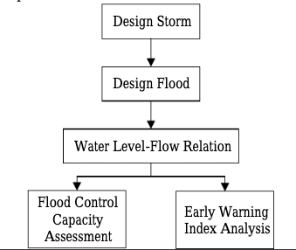
2
Flash Floods: Main Drivers
3- Publicity And Training And Emergency Drilling
CASE STUDY #9: Yiyang County Preparations in China
Key Points to note:
The flowchart of flash flood disasters analysis and evaluation
Followed in 2009, a series of pilot construction of non-engineering facilities including:
Monitoring and early warning facilities, monitoring and forecast platform, transfer plan, organization system, publicity and training and emergency drilling were established in 103 Counties.
Source: Li, Haichen & Zhang, Xiaolei & Li, Qing & Qin, Tao & Lei, Xiaohui. (2018). Flash flood disasters analysis and evaluation: a case study of Yiyang County in China. IOP Conference Series: Earth and Environmental Science. 128. 012035. 10.1088/1755-1315/128/1/012035.
Notes:
Followed in 2009, a series of pilot construction of non-engineering facilities including:
Monitoring and early warning facilities, monitoring and forecast platform, transfer plan, organization system, publicity and training and emergency drilling were established in 103 Counties.
The facts proved that those establishments of non-engineering facilities could bring favorable effect to prevent the huge disasters but only with little investment.

Slide 29
Engineered Solutions

Slide 30

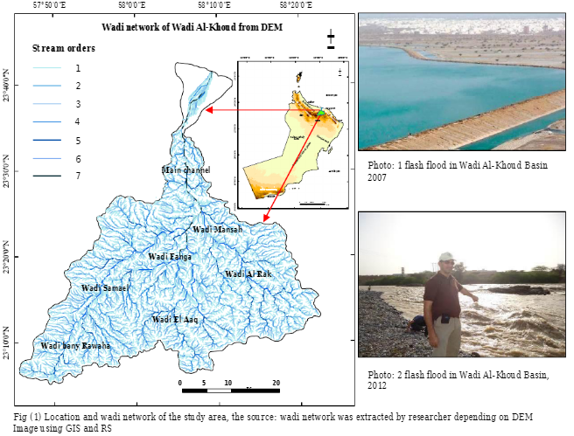
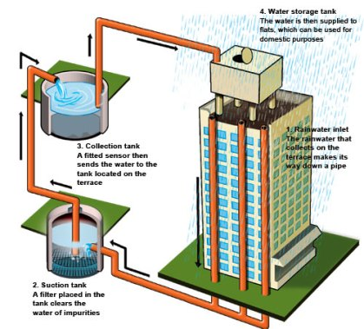
3
Now What we do
4- Rain Water Harvesting (RWH)
CASE STUDY #10: Wadi Al-Khoud, Oman
Key Points to note:
Oman is one of several countries located in an arid zone that is subjected to flash flooding Records show that major flash floods occurred in Oman in 2003, 2007, 2010, and 2012 Wadi Oday, Wadi Al-Kabir, and Wadi Al-Khoud.
Source: https://nssiitbblog.files.wordpress.com/2018/11/rainwater-harvesting-method-in-india-1.jpg?w=419&h=380
https://www.researchgate.net/publication/273247802_Flash_flood_mitigation_and_water_harvesting_in_Wadi_Al-Khoud_Sultanate_of_Oman
Notes:
Although the Flash flood causes hazards, but at the same time is considered fresh water resources which we can benefit from it.
Oman is one of several countries located in an arid zone that is subjected to flash flooding Records show that major flash floods occurred in Oman in 2003, 2007, 2010, and 2012 Wadi Oday, Wadi Al-Kabir, and Wadi Al-Khoud.
Floodwater harvesting could be a major solution in providing another conventional water resource and at the same time to mitigate flash flood hazard in future. Selection of the dams situation is based on several factors such as undertaking physical, socioeconomic, ecological data.

Slide 31
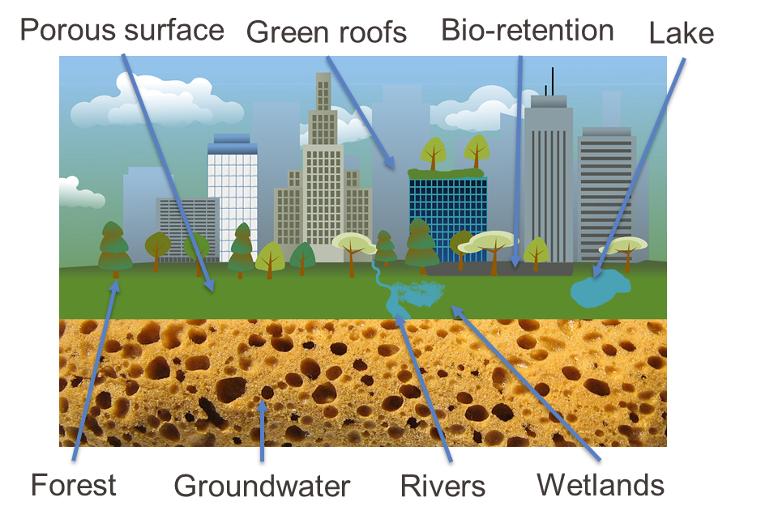
3
Now What to do
CASE STUDY #11: Sponge cities in China:
A novel solution for urban management paradigm
National Pilot Sponge City (China):
It has been a national policy and movement in late 2013
30 National pilot cities
1000 billion RMB Yuan market
Objectives:
No ponding in light rain;
No flooding in heavy rain;
No black and odorous urban water;
Mitigating Heat-island effect
China’s National Pilot Sponge Cities
Source: Prof. Dr. Haifeng JIA, D.WRE School of Environment, Tsinghua University jhf@tsinghua.edu.cn
Notes:
Sponge Cities: A Concept where Priority is given to rainwater detention and storage using on-site natural approaches when upgrading the urban drainage abilities, by which we could build the sponge cities capable of store, infiltrate detain and treat runoff naturally.

Slide 32
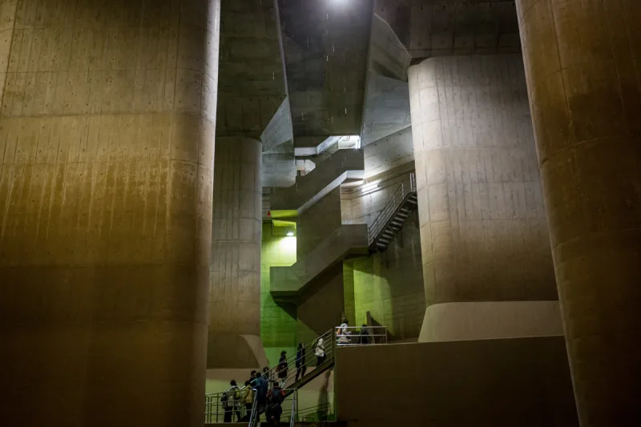
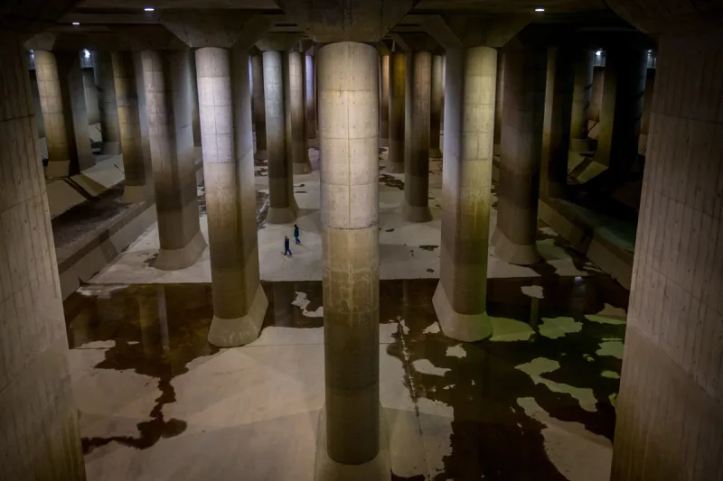
3
Now What we do
CASE STUDY #12: Tokyo Largest Underground Water Tank in the World in Kasukabe, Saitama, Tokyo
177 meters long, 78 meters wide, 25 meters high with a forest of 59 reinforced concrete pillars each weighing 500 tons supporting the ceiling.
Source: https://www.water-technology.net/projects/g-cans-project-tokyo-japan/
Photos inside the largest underground water harvesting tank in the world in Tokyo built in 2005
Notes:
The incredibly huge pressure-adjusting water tank. It was built 22 meters below ground level between 1993 and 2009: 177 meters long, 78 meters wide, 25 meters high with a forest of 59 reinforced concrete pillars each weighing 500 tons supporting the ceiling.
Water pumps altogether capable of delivering up to 200 tons of water per second.

Slide 33
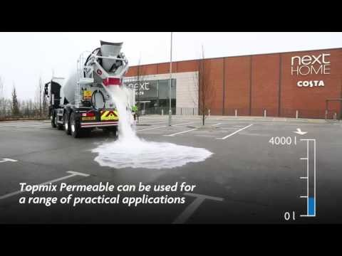
2
Flash Floods: Main Drivers
5- Flash Flood Mitigation using Flood Permeable Pavements
CASE STUDY #13: Chinese Sponge City Road Construction
Source: https://www.sciencedirect.com/science/article/pii/S0048969718340518
Notes:
Permeable pavement is one such technology in sponge city construction that is highly recommended by the Chinese Ministry of Housing and Urban Rural Development (MHURD) .
This technology has been studied and implemented in many areas in the world to manage urban storm water under different plans with terminologies such as sustainable urban drainage systems, low impact development, best management practices, and others

Slide 34
2
Flash Floods: Main Drivers
7- Natural Based Solutions
Natural Ecology Disrupted with Humans
Natural Road over highway
Forests Restoration
Source: https://www.omicsonline.org/open-access/flash-flood-and-its-mitigation-a-case-study-of-almora-uttarakhand-india-99599.html
Notes:
Afforestation: Forest is the mainstay of a mountainous ecosystem because forest protects the rocks from exposing and keep these rocks strong through their root system. Forest canopy intercept the 60% of rainfall which falls over the forest.
Ecological sensitive development: Environmental friendly development should be allowed to complete. The ecological processes and flora and fauna of that region should be allowed to complete.
Nature supportive roads and habitats: The connectivity is dependent on the presence of roads. Therefore, roads should be environmental friendly also, and it should not be on margins of hills. Roads should be constructed according to natural aspect of the region.

Slide 35
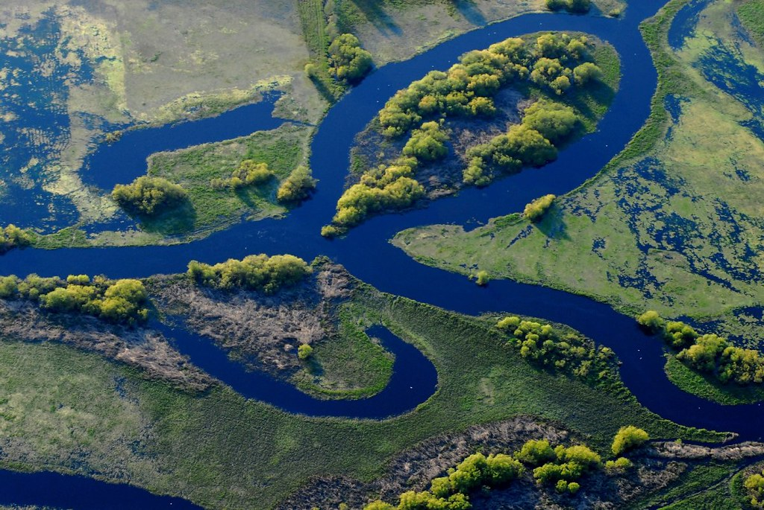
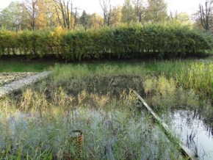
3
Now What to do
CASE STUDY #15: Eco-hydrology Engineering Solutions, Lodz, Sokolowka River, Poland
Constructed Wetlands in Poland
Objectives:
Rehabilitation of Sokolowka river and its valley
Elaboration and legalization of the Blue-Green Network Concept
Implementation of best management practices by developers in stormwater management
Source: Prof. Dr. Giuseppe Arduino, UNESCO – IHP
Notes:
POLAND- Ecohydrology based urban water management and city planning for human health and sustainable development
Ecohydrology engineering solutions applied:
Construction of reservoirs to mitigate the extreme stormwater flow
Stormwater purification in sedimentary-biofiltration system
Phytotechnology in reservoirs for the development of blue-green network in urban areas health and quality of life

Slide 36

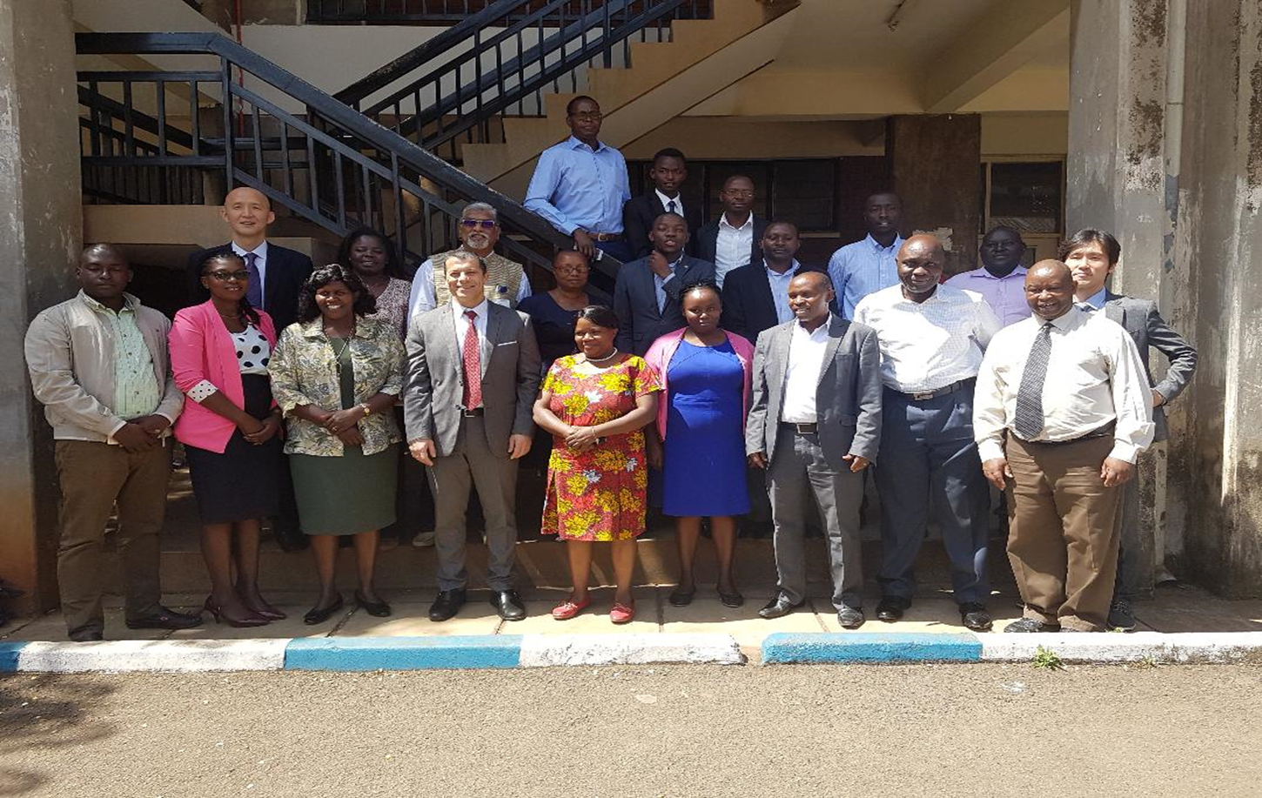





Water Security & Climate Change
Deliverables:
  Water security guidelines
  A roadmap to follow of
  engineering works
  Trained men and women from the Ministry
  Sensitized decision makers and funding agencies.
  established and operated within the project team to support participating MS even after the intervention in the country has ended and the local experts and Ministry are trying to implement the methodology, guidelines and roadmap developed

Slide 37
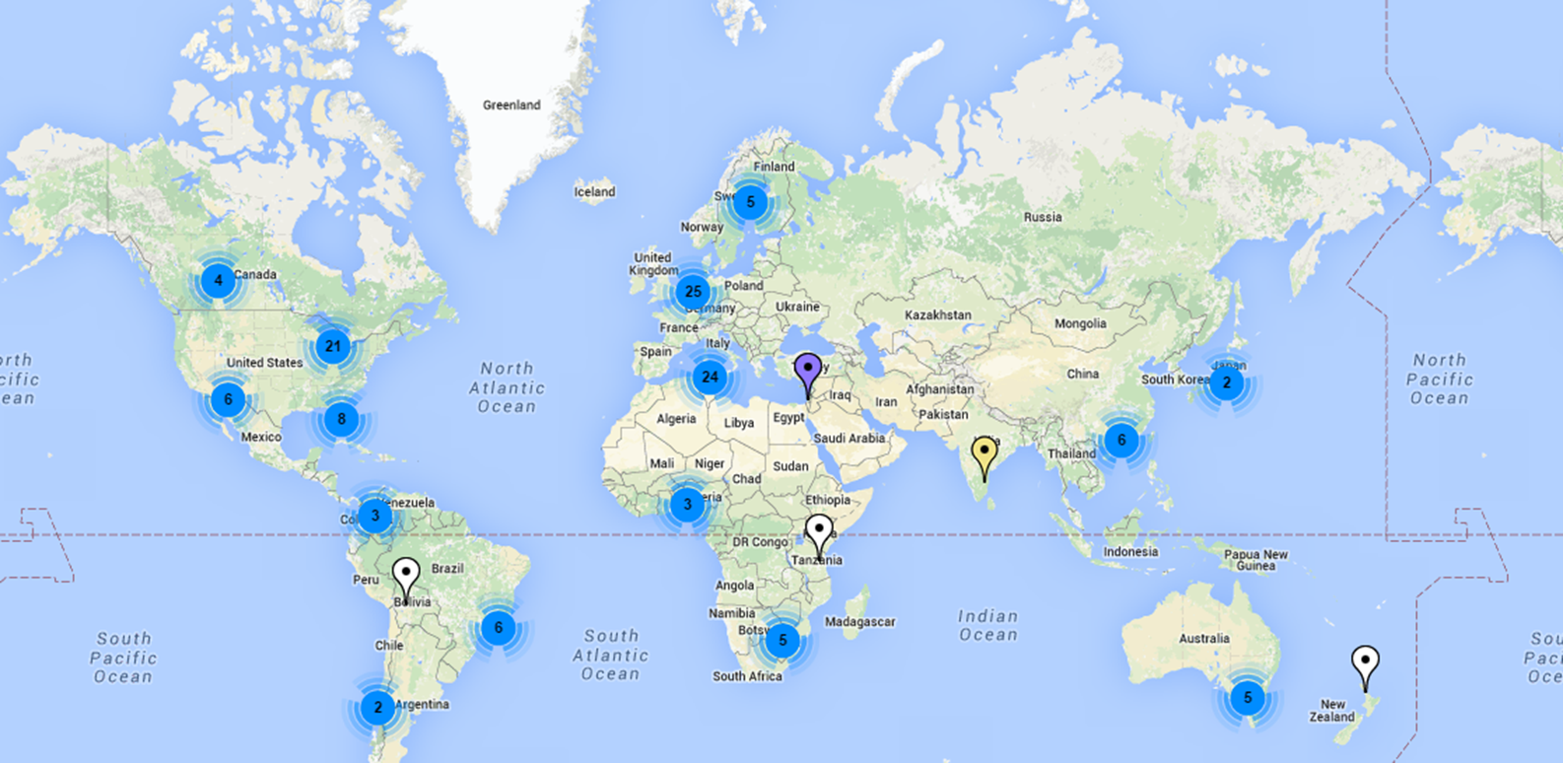
Global Water Pathogen Project
276 Authors
55 Countries
10 Teams
Notes:
A platform of ~160 researchers with research content, quantitative data, tools and material associated with excreta and wastewater.

Slide 38
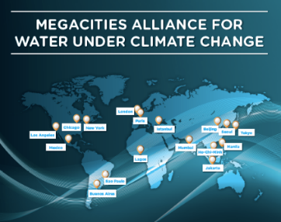


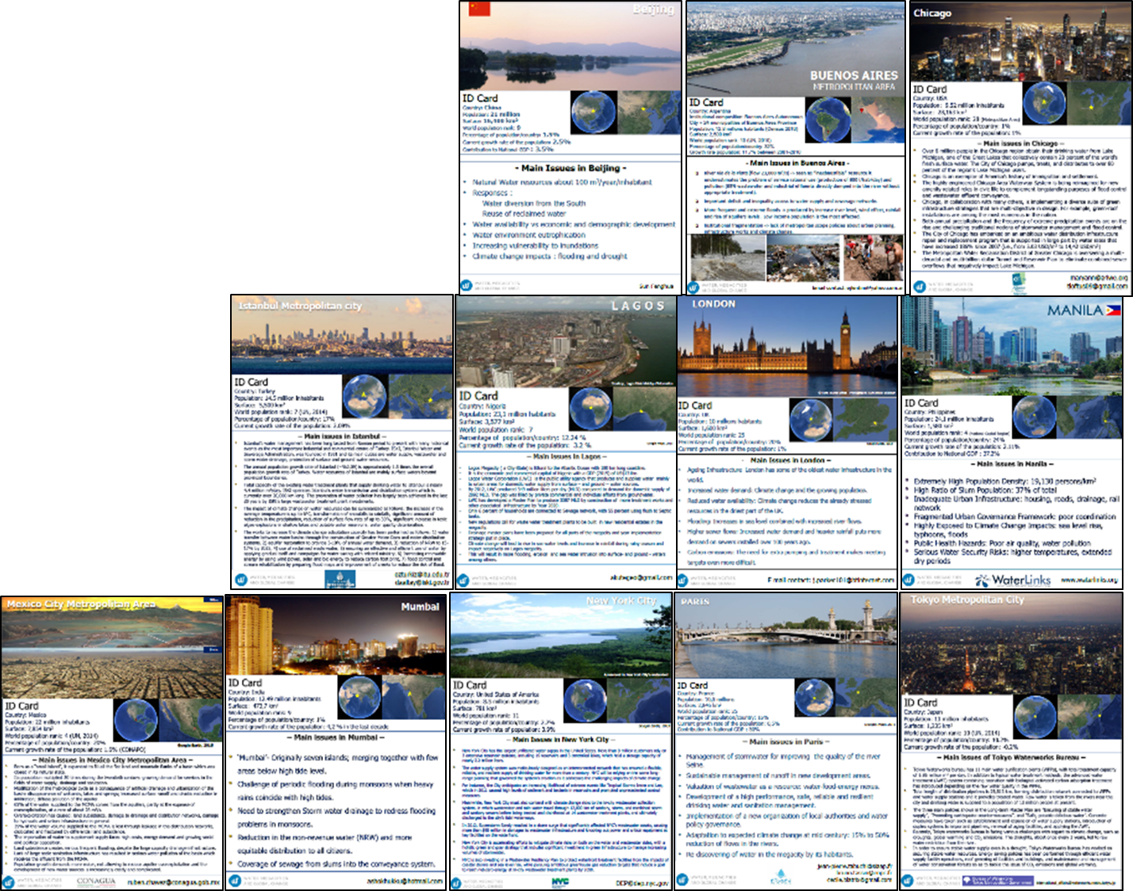
Notes:
Megacities Alliance for Water under Climate Change was launched in Paris during COP21 on December the 2nd at COP 21 by UNESCO during Resilience Day
At Water, Megacities and Global Change International Conference organised by ARCEAU IdF and UNESCO.
The Alliance gave birth to a publication on Water, Megacities and Global Change that discusses the challenges Megacities face in managing their water resources, especially under the climate change challenges and the solutions they have arrived at to cope with them.

Slide 39

Thank U
4 UR
@10Ti

