Slide 1
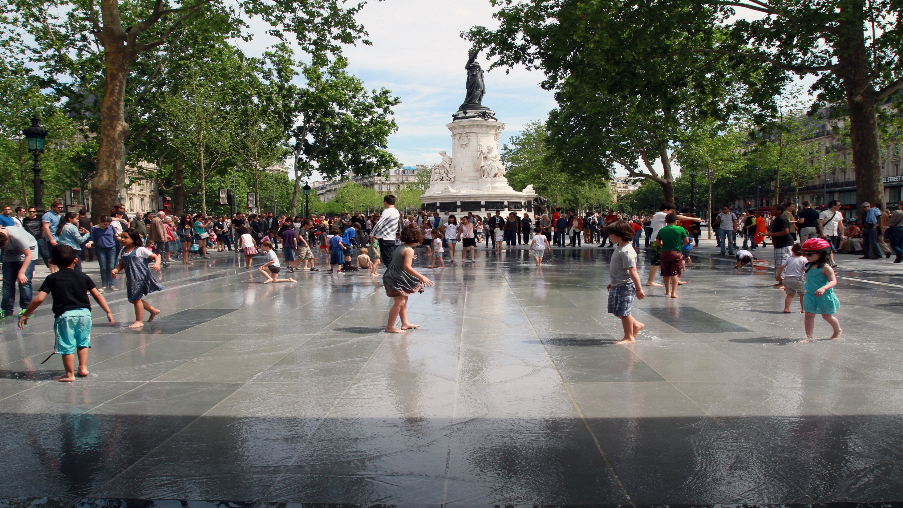

Paris Resilience Strategy and Capacity Building
UNESCO Metropolitan “ECO – RISE” R2020 Colloquium – Paris - 11/07/2019
#ResilientParis

Slide 2
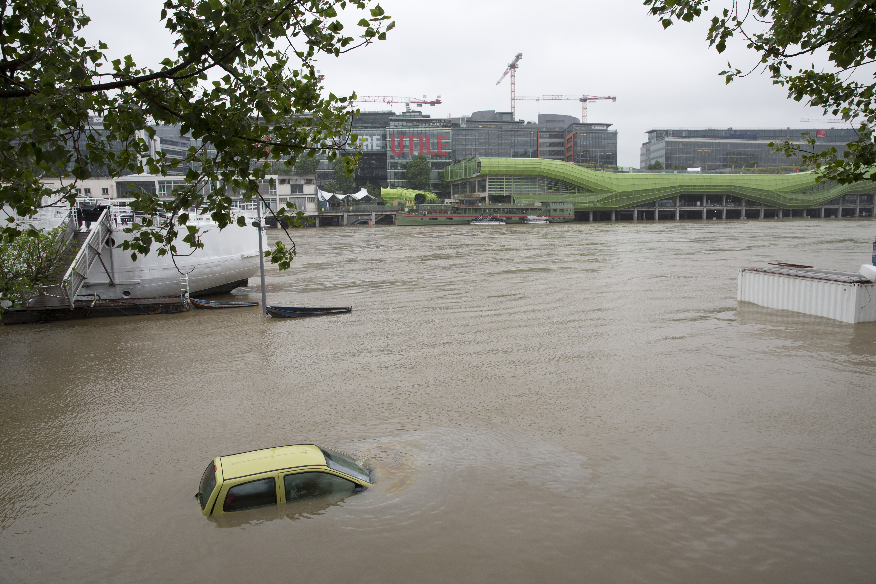

Paris resilience challenges
Inequalities and social cohesion
Terrorist Threat
Climate Change
Risks related to the river
Air pollution
Territorial Governance

Slide 3
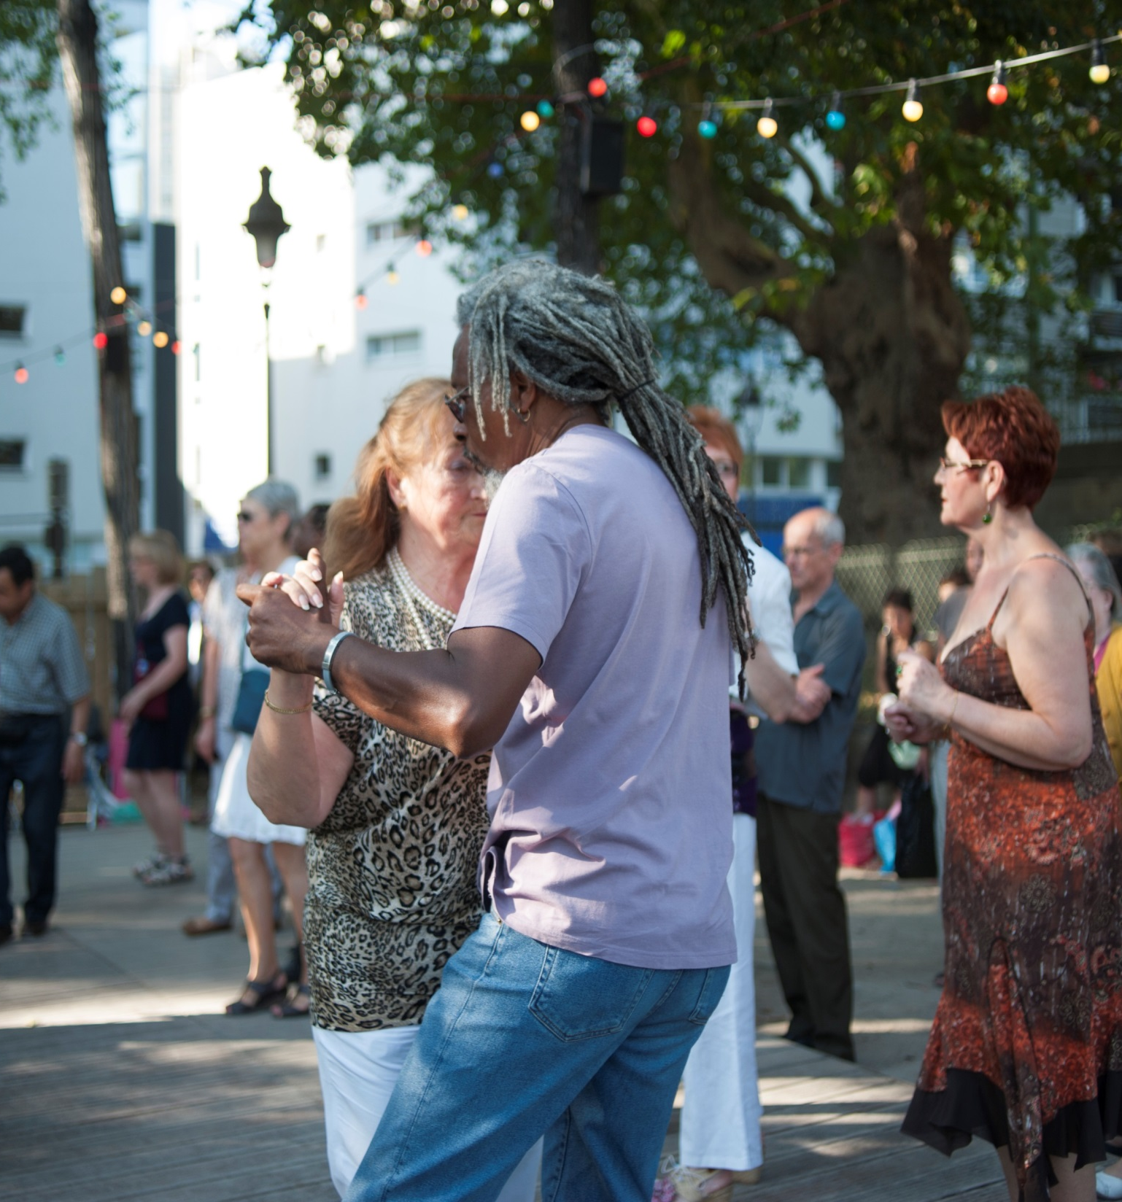
Pillar
1
Goals:
Prepare young and old to cope with acute shocks and daily stresses
Create conditions that encourage kindness among neighbours and inclusion at the neighbourhood level
Enable residents to co-create the city of tomorrow
An inclusive and cohesive city that builds on the strength of Parisian residents to become more resilient

Slide 4
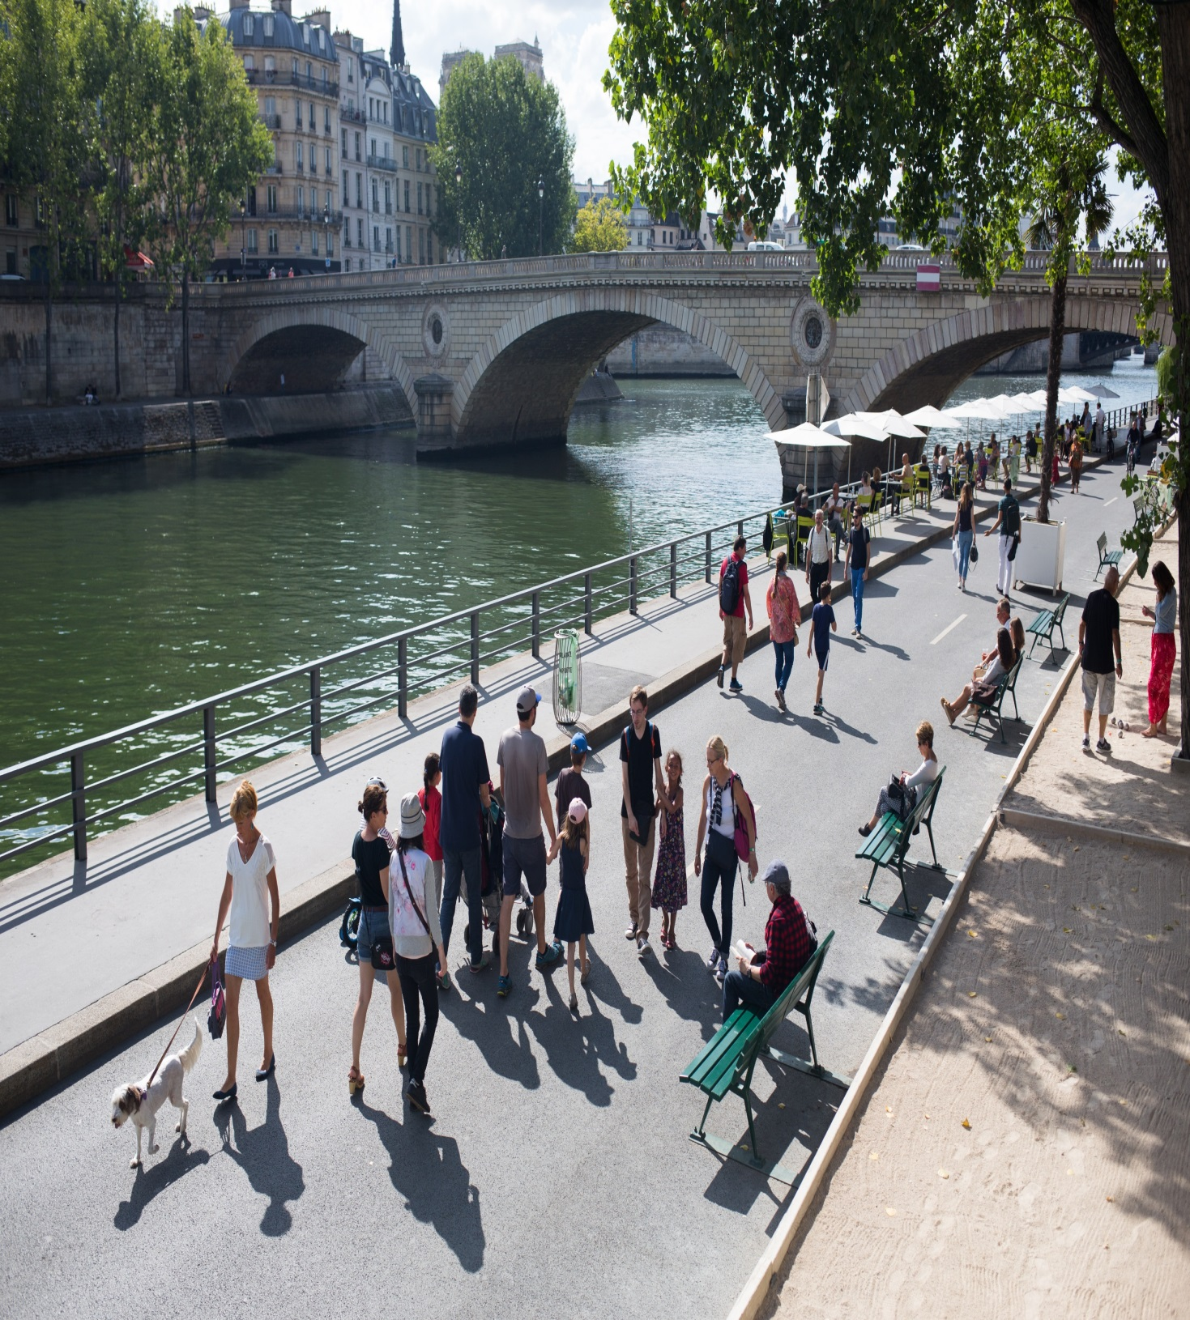
Pillar
2
Goals:
Anticipate risks and adapt infrastructure
Design infrastructure that creates multiple benefits
Promote resilient urbanism in a dense city
A city built and developed to meet the challenges
for the next century

Slide 5
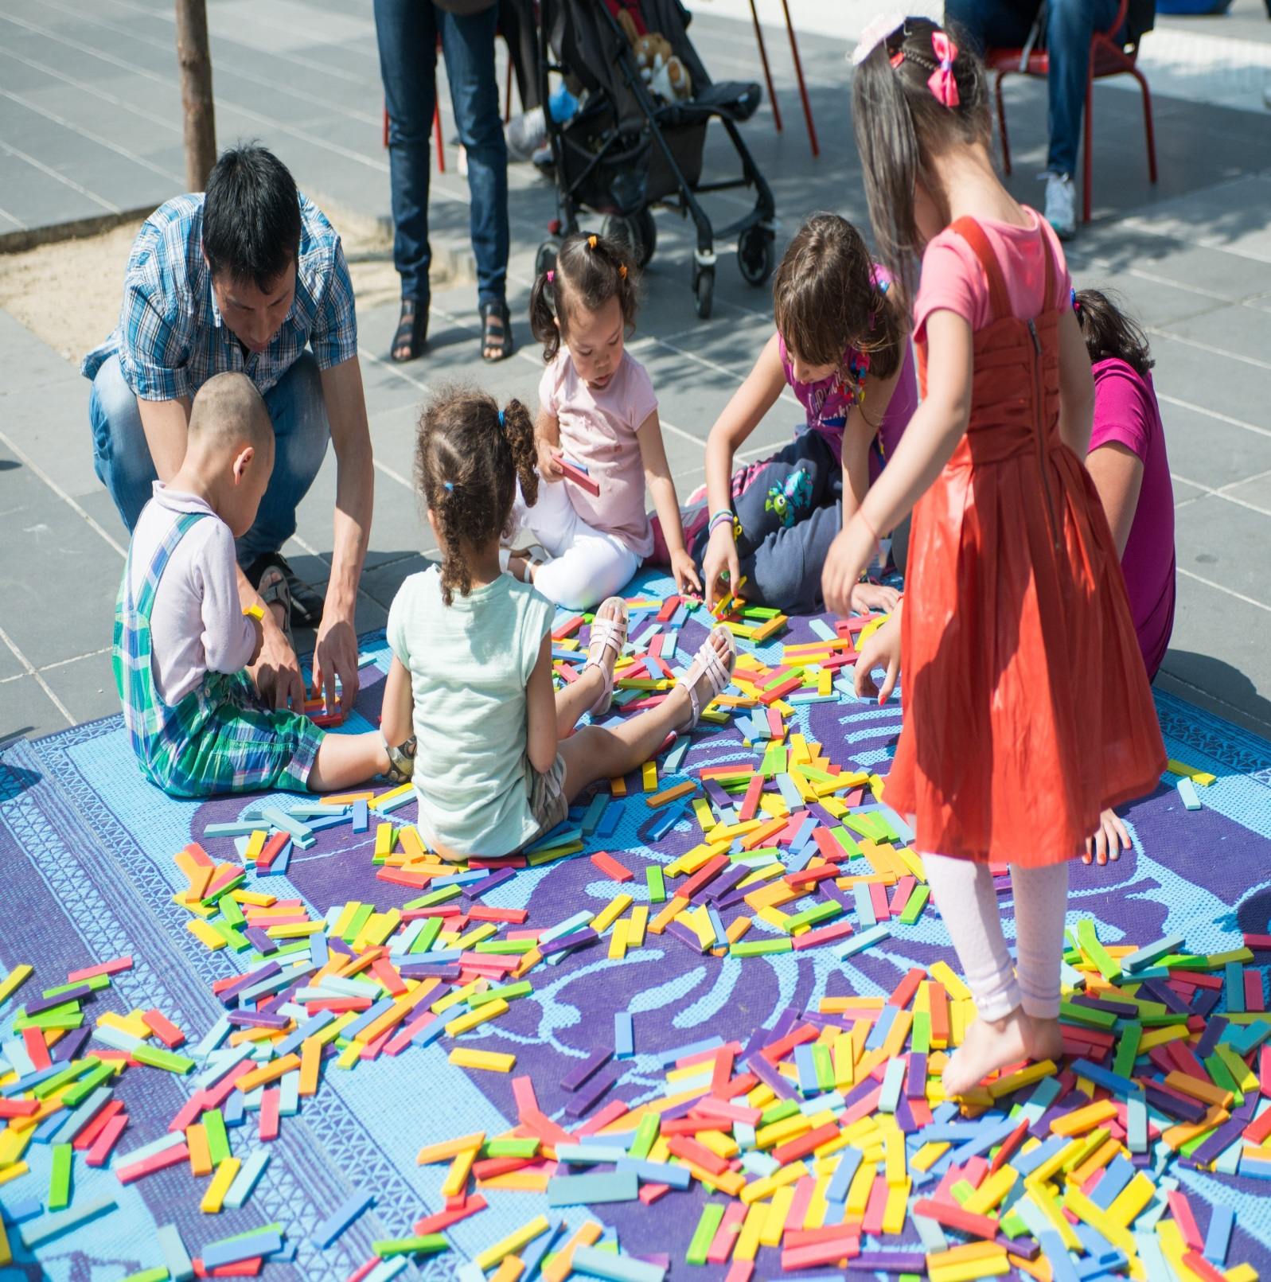
Pillar
3
A city in transition that mobilises its collective intelligence, adapts its operations, and cooperates with its surrounding territories
Goals:
Mobilize collective intelligence and resources
Ensure the continuity of the public service and the resilience of the administration
Cooperate with other territories to initiate transitions

Slide 6
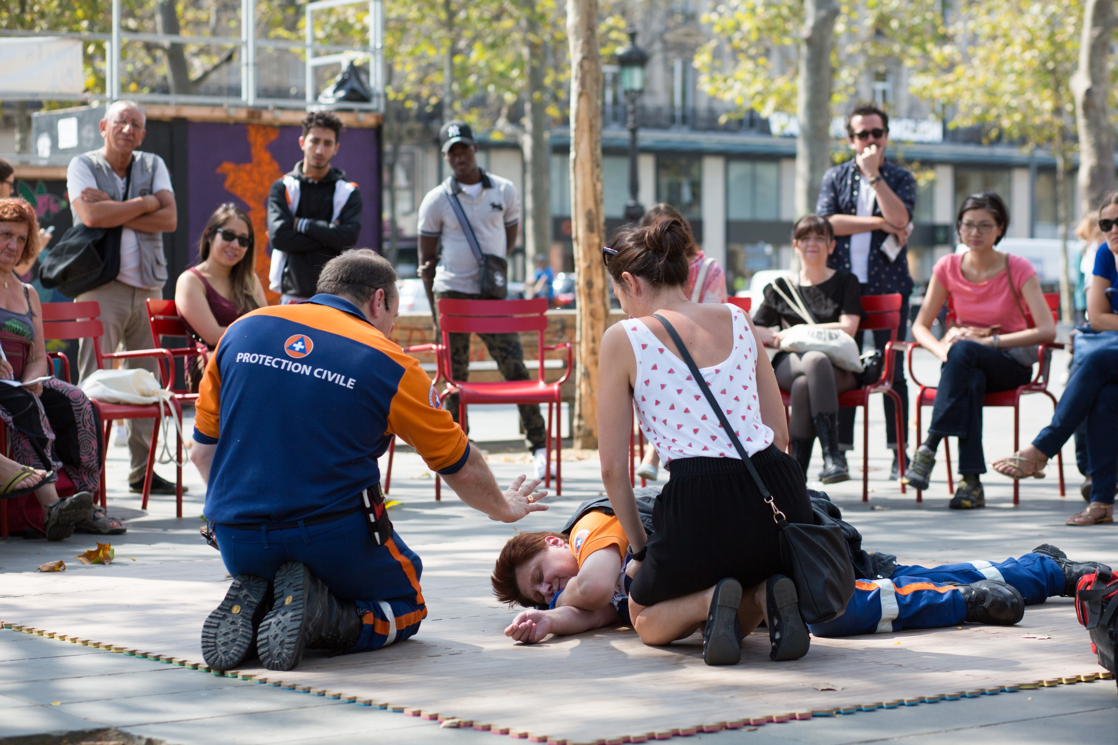
Action 1
Create residents volunteers networks, mobilized in case of major shock as well as on a daily basis

Slide 7
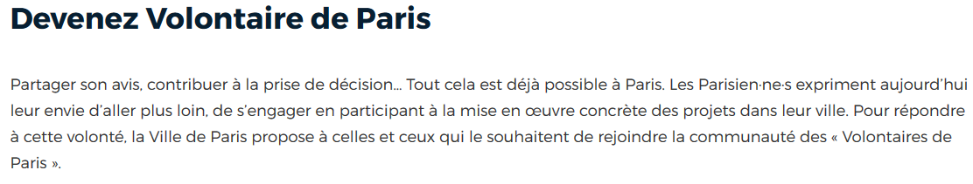
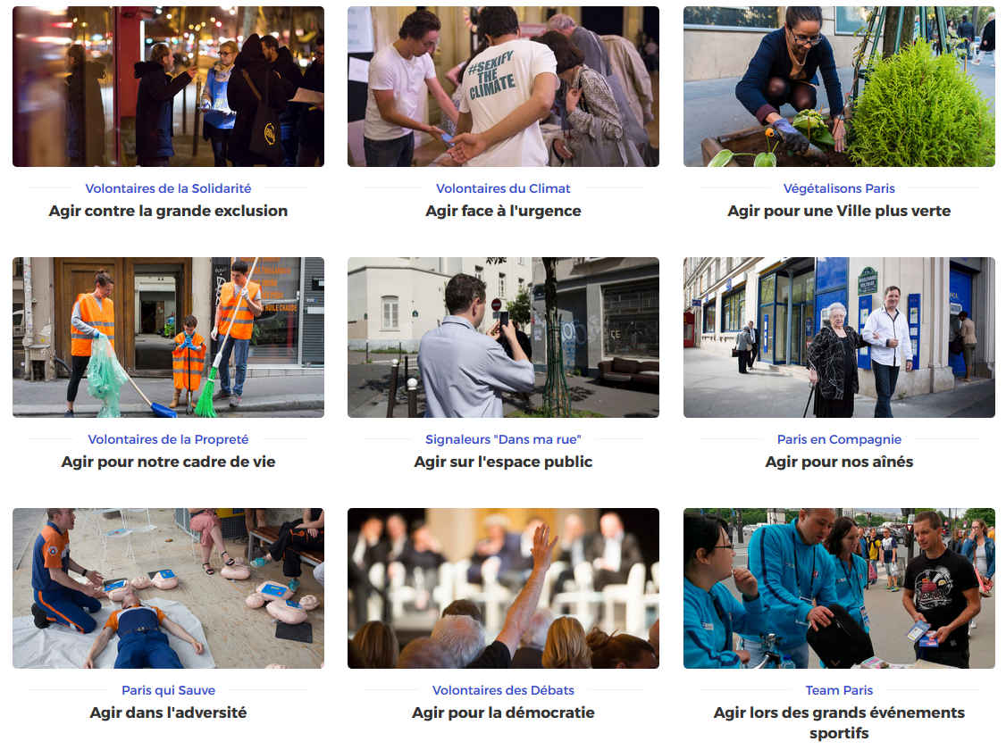
Notes:
Laurence saura très bien présenter le programme !

Slide 8
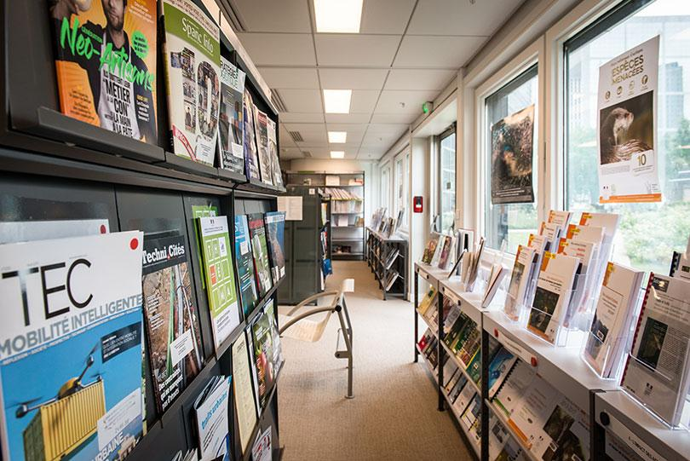
Action 28
Create an open-source and multi-target resource, research and training center for resilience

Slide 9
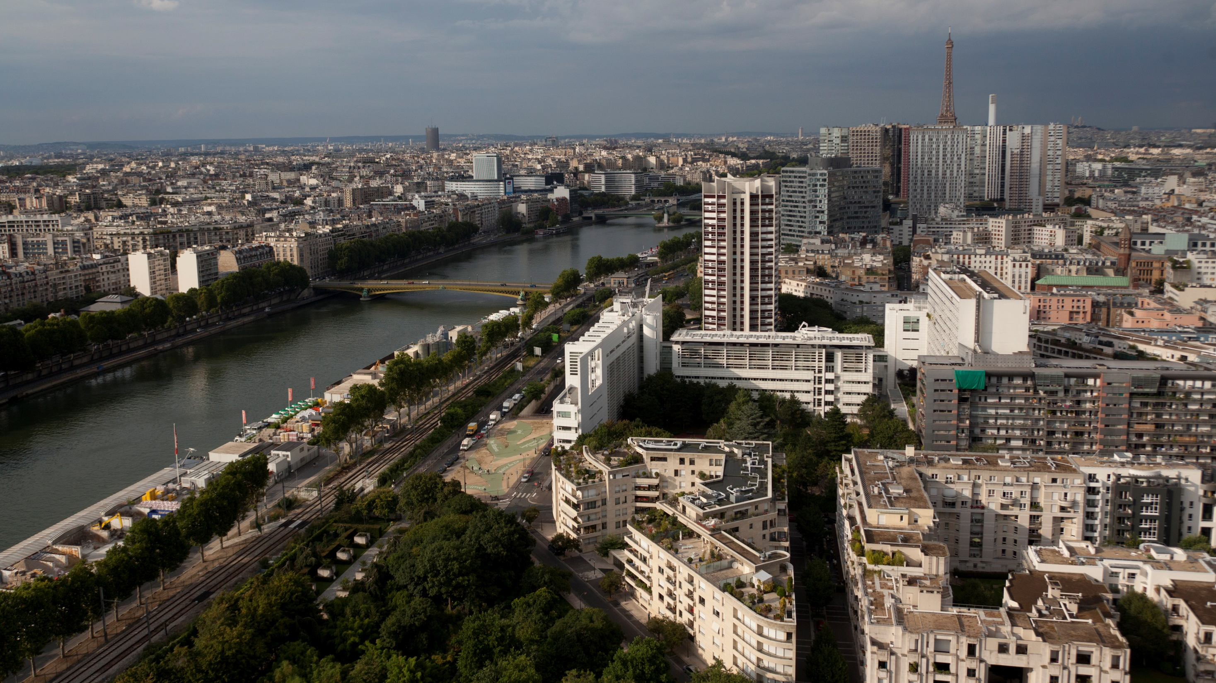
Action 28
Orienting municipal investments, public service contracts and public procurement to resilience through new indicators

Slide 10
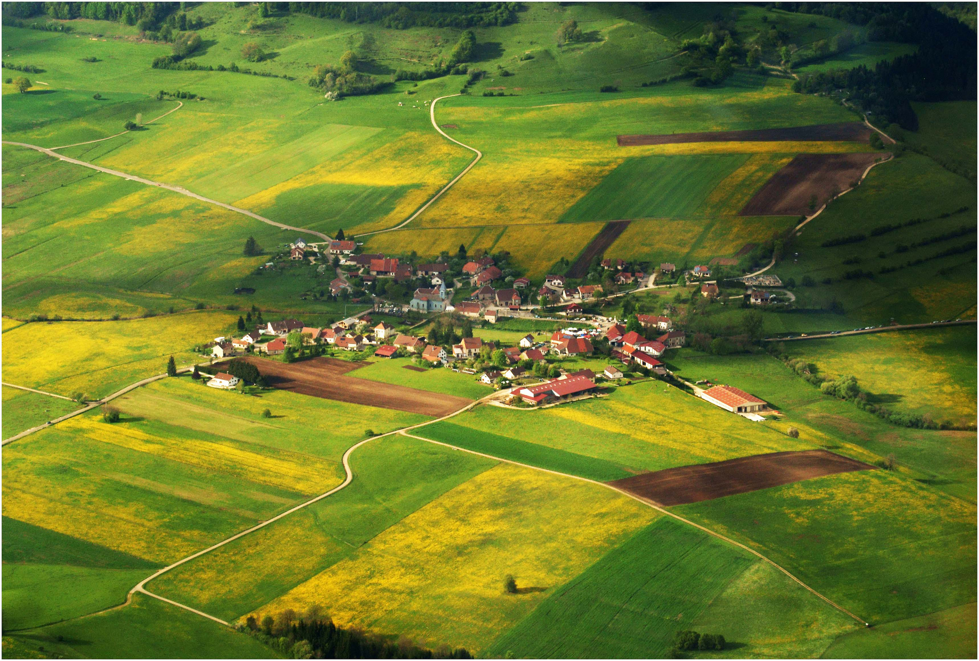
Action 31
Build new territorial cooperation with peri-urban and rural municipalities, around common interests and partnership actions

Slide 11
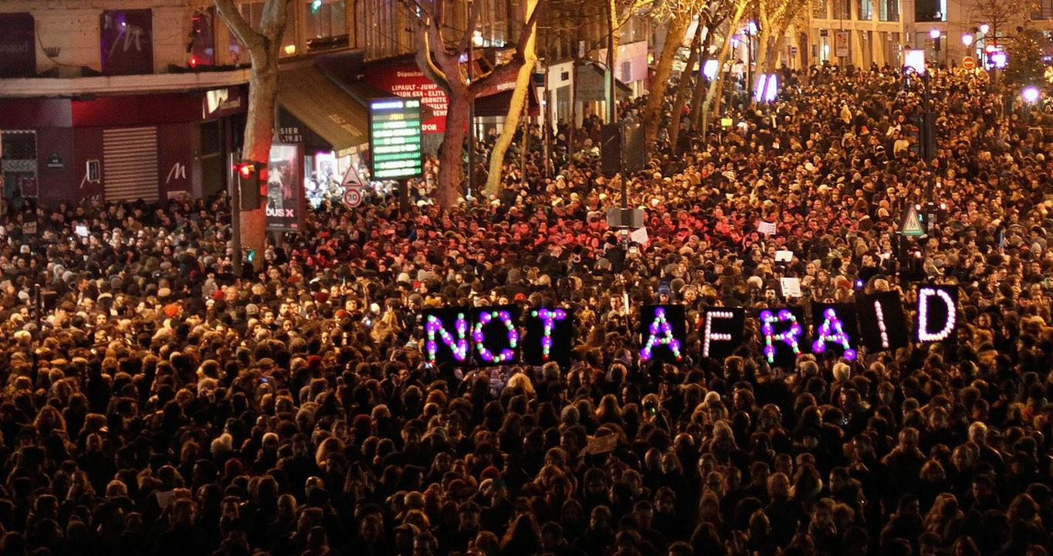


Thank you for
your attention
sebastien.maire@paris.fr
#ResilientCities
Notes:
Resilience is a positive and operationnal approach that says to residents and the whole world that whatever the challenges are tomorrow, the consequences of climate change, the huge changes that the world is going to face, that local authorities and cities, their mayors, their elected offcials, their civil servants and administrations are here to find concrete and positive solutions for and with the people to tackle this century’s challenges, and that we shouldn’t be afraid about the future.
On the contrary resilience is the best hope for the future, the most promising hope
Thank you for your attention

