Slide 1
CHANGES IN CLIMATE, CHANGES OF PARADIGM
Eau de Paris’s climate change and resilience strategies

Slide 2
SUMMARY
A TALE OF RESILIENCE IN 3 CHAPTERS
Chapter 1
The origins of resilience
Chapter 2
The advent of climate change
Chapter 3
A new beginning

Slide 3
CHAPTER 1: THE ORIGINS OF RESILIENCE
Paris water supply system: resilient by design

Slide 4
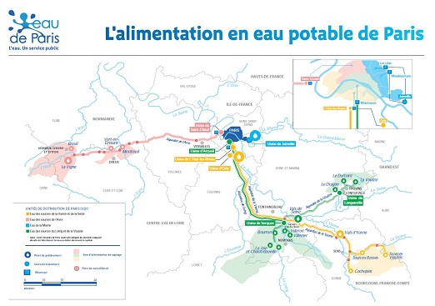

THE ORIGINS OF RESILIENCE
A PRECIOUS LEGACY
The design of a visionary
A vision at the basin level

Slide 5
THE ORIGINS OF RESILIENCE
THE NUMBERS OF RESILIENCE
Nominal production capacity 1 050 000 m3/day
Average daily consumption: 520-530 000 m3/day
Maximum daily consumption: 700 000 m3/day
Up to 2 days of stocks in massive reservoirs around Paris
14 interconnexions with the neighboring utilities
6 wells in the Albien deep aquifer in case of systemic crisis
50% underground water resources / 50% river water resources
900 staff members, 7/7 24/24 monitoring center, over 200 staff members « on duty »

Slide 6
THE ADVENT OF CLIMATE CHANGE
From adaptation to disruption

Slide 7

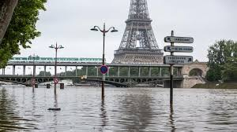
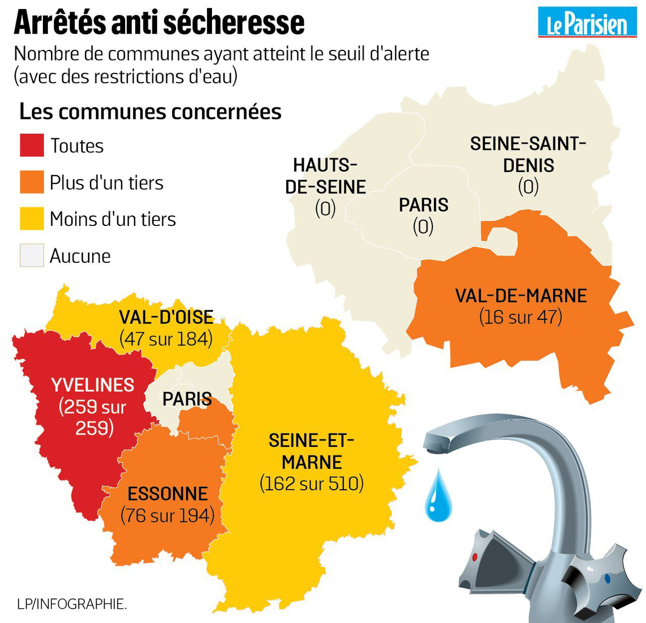
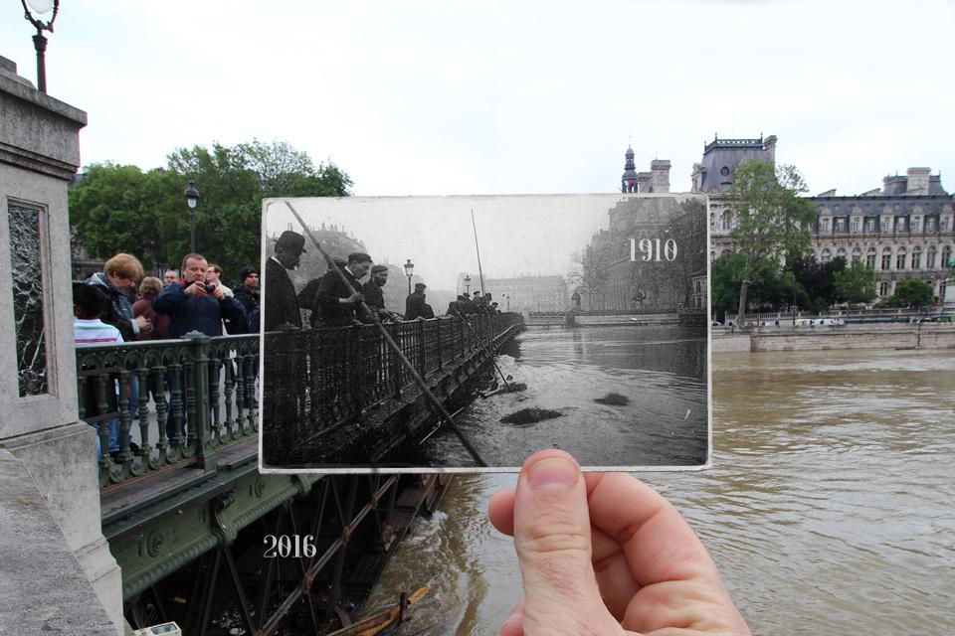
THE ADVENT OF CLIMATE CHANGE
(NOT SO) WEAK SIGNALS

Slide 8
THE ADVENT OF CLIMATE CHANGE
THE POTENTIAL FOR A BRUTAL DISRUPTION OF CURRENT PREPAREDNESS SCHEMES
Events of an unprecedented magnitude
  Duration
  Intensity
  Territorial impact
Prepare for the unexpected
  Unexpected time
  Unexpected locations
  Irrelevance of experience
The possibility of a systemic breakdown
  Failures in more than one vital sector

Slide 9
CHAPTER 3 – A NEW BEGINNING
Towards a new paradigm in water utilities resilience strategies

Slide 10
A NEW BEGINNING
GETING OUT OF THE FOG: KNOWLEDGE AS A KEY TO RESILIENCE
Understanding the local impact of climate change
Data-based approach to adapt more swiftly to new/unexepected conditions

Slide 11
A NEW BEGINNING
CHANGING SCALES: A NEW BALANCE BETWEEN OPERATIONAL AGILITY AND COLLECTIVE RESILIENCE
A shift towards agility and autonomy: operations, energy
Teaming up with partners at a wider scale:
  Study on the safety of water supply at the Greater Paris scale
  Solidarity with further territories

Slide 12
A NEW BEGINNING
A CALL FOR NEW ROLES
The public’s adaptation capacity: the X-factor of new resilience strategies
Urge to engage with the public and revive public participation in water services

Slide 13
conclusion

Slide 14

REVERSING THE WATER-CITY PARADIGM

