Slide 1

Lower Manhattan Sea-Level Rise Resilience Building Challenges
Climate Change Impacts presentation
²⁰¹⁹
Presented by:
Eric C. Macfarlane, P.E., M.ASCE, ENV-SP
Deputy Commissioner, Infrastructure Division
New York City Department of Design + Construction

Slide 2
NYC Panel on Climate Change (NPCC) projections:
By the 2050s:
4.1ºF (1,7 °C) to 5.7ºF (3,2 °C) increase in average temperature
Number of days in NYC above 90⁰F (32°C) could triple
4% to 11% increase in average annual precipitation
Sea levels likely to rise 1-2 feet (0,3m – 0,6m) or more
By 2100:
5.8ºF (3.2 °C) to 10.3ºF (5.7 °C) increase in average temperature
Sea level rise may exceed 6 feet (1,8m)
NYC Must Adapt to Climate Change Impacts

Slide 3
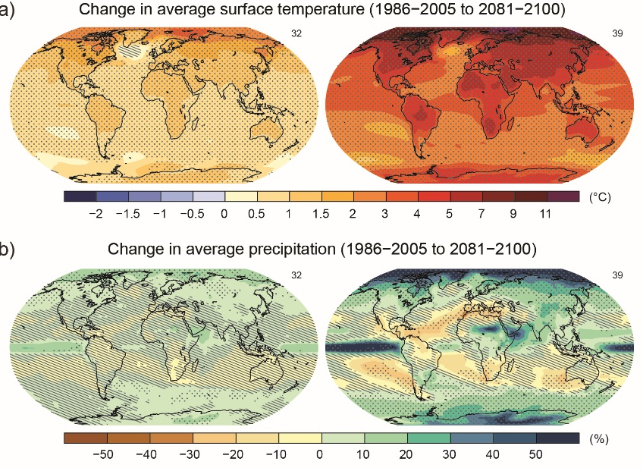
In 2007, the United Nations Framework Convention on Climate Change reported that developed nations must reduce greenhouse gas emissions 80 percent by 2050 (80x50), relative to 1990 levels, in order to limit global temperature rise to 2 degrees Celsius above the pre-industrial baseline and avoid the most catastrophic impacts of climate change.
NYC Must Also Work to Mitigate Climate Change
Notes:
NYC recognizes climate change as an existential threat
Sea level rise, stronger storms, more intense rainfalls, flooding
Higher average temperatures, worse air quality
Greater stresses on critical infrastructure
Increased economic and health risks for vulnerable and low-income populations

Slide 4
INTRODUCTION & PROJECT GOALS

Slide 5
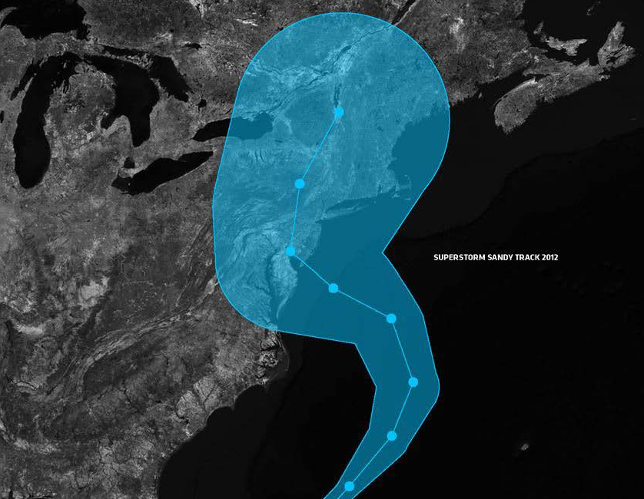
Hurricane Sandy (October 2012)
43 deaths
$19 billion in damage
11 million travelers affected daily
Close to 2 million people without power
Nearly 90,000 buildings in inundation zone

Slide 6
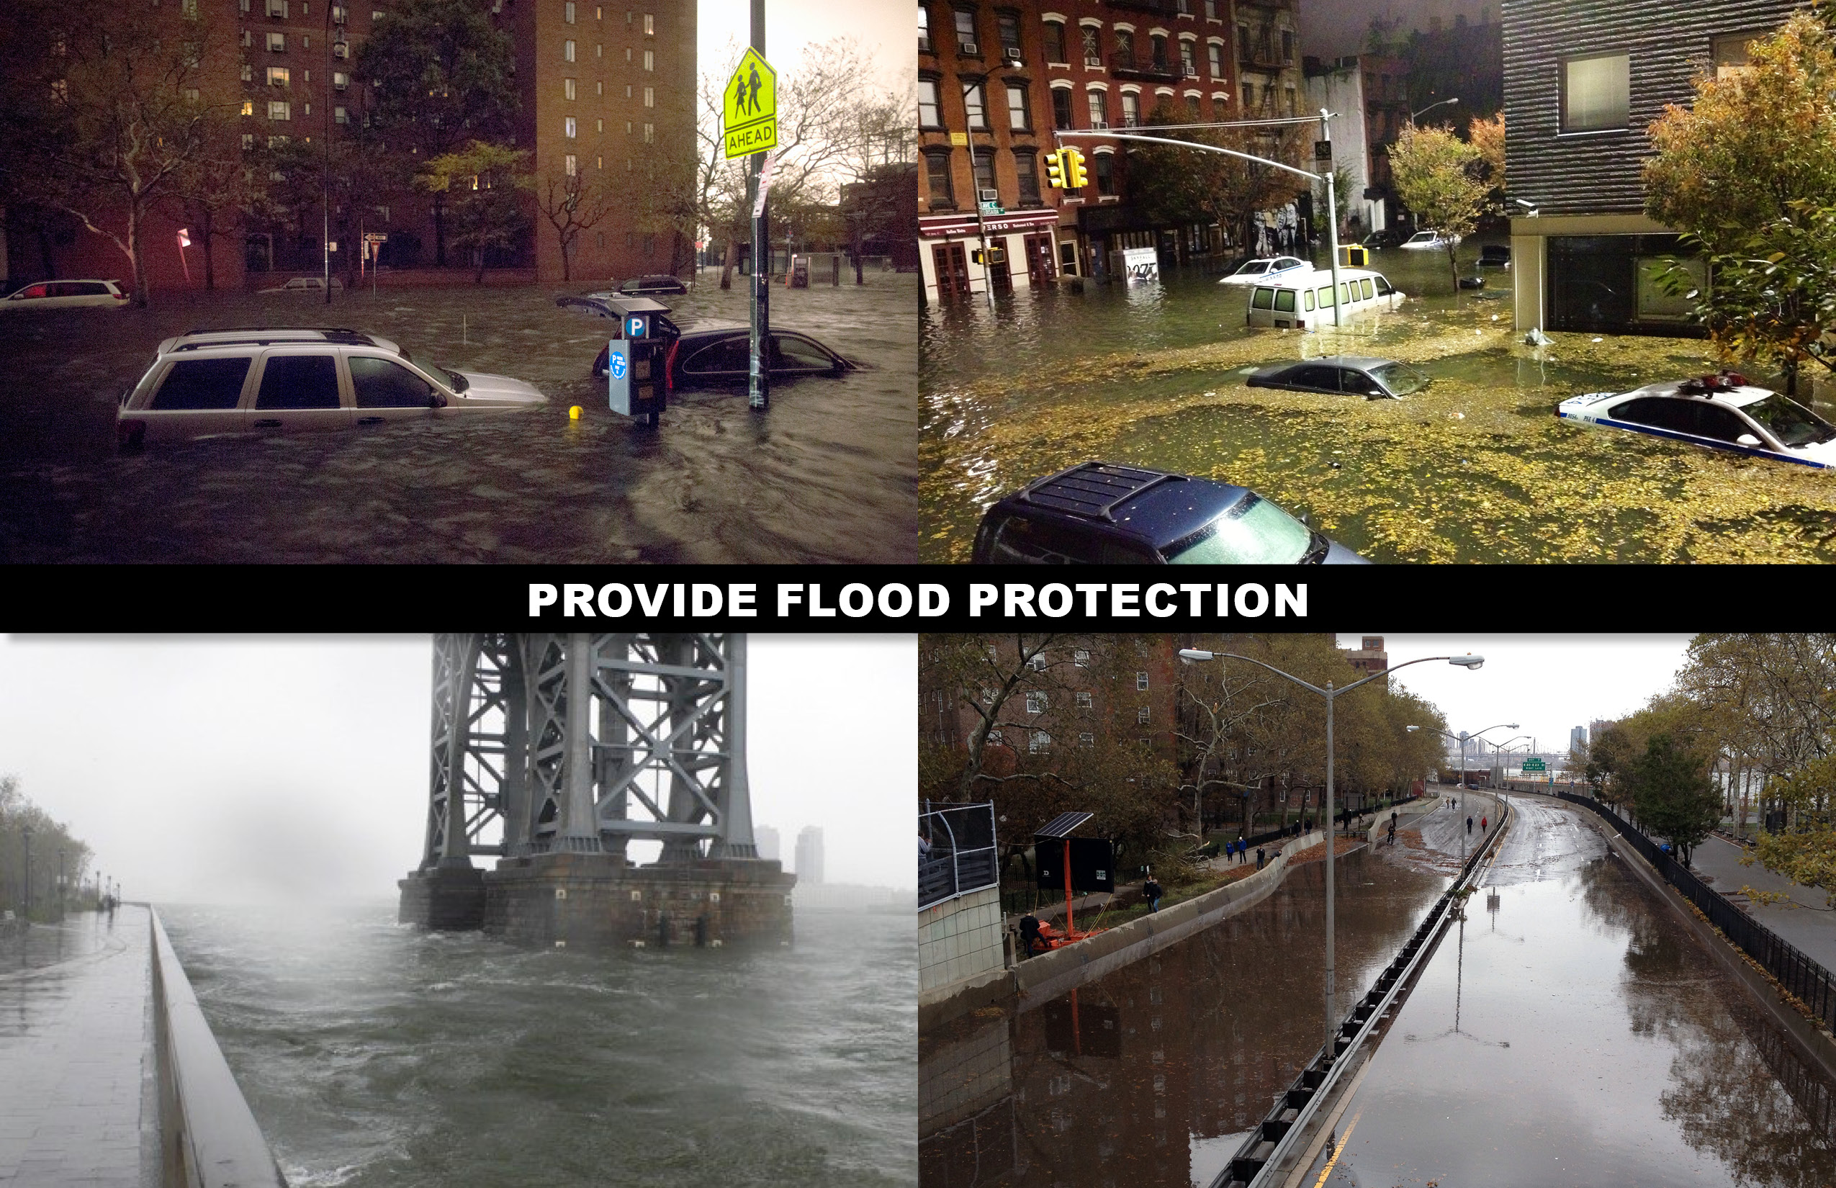

Slide 7
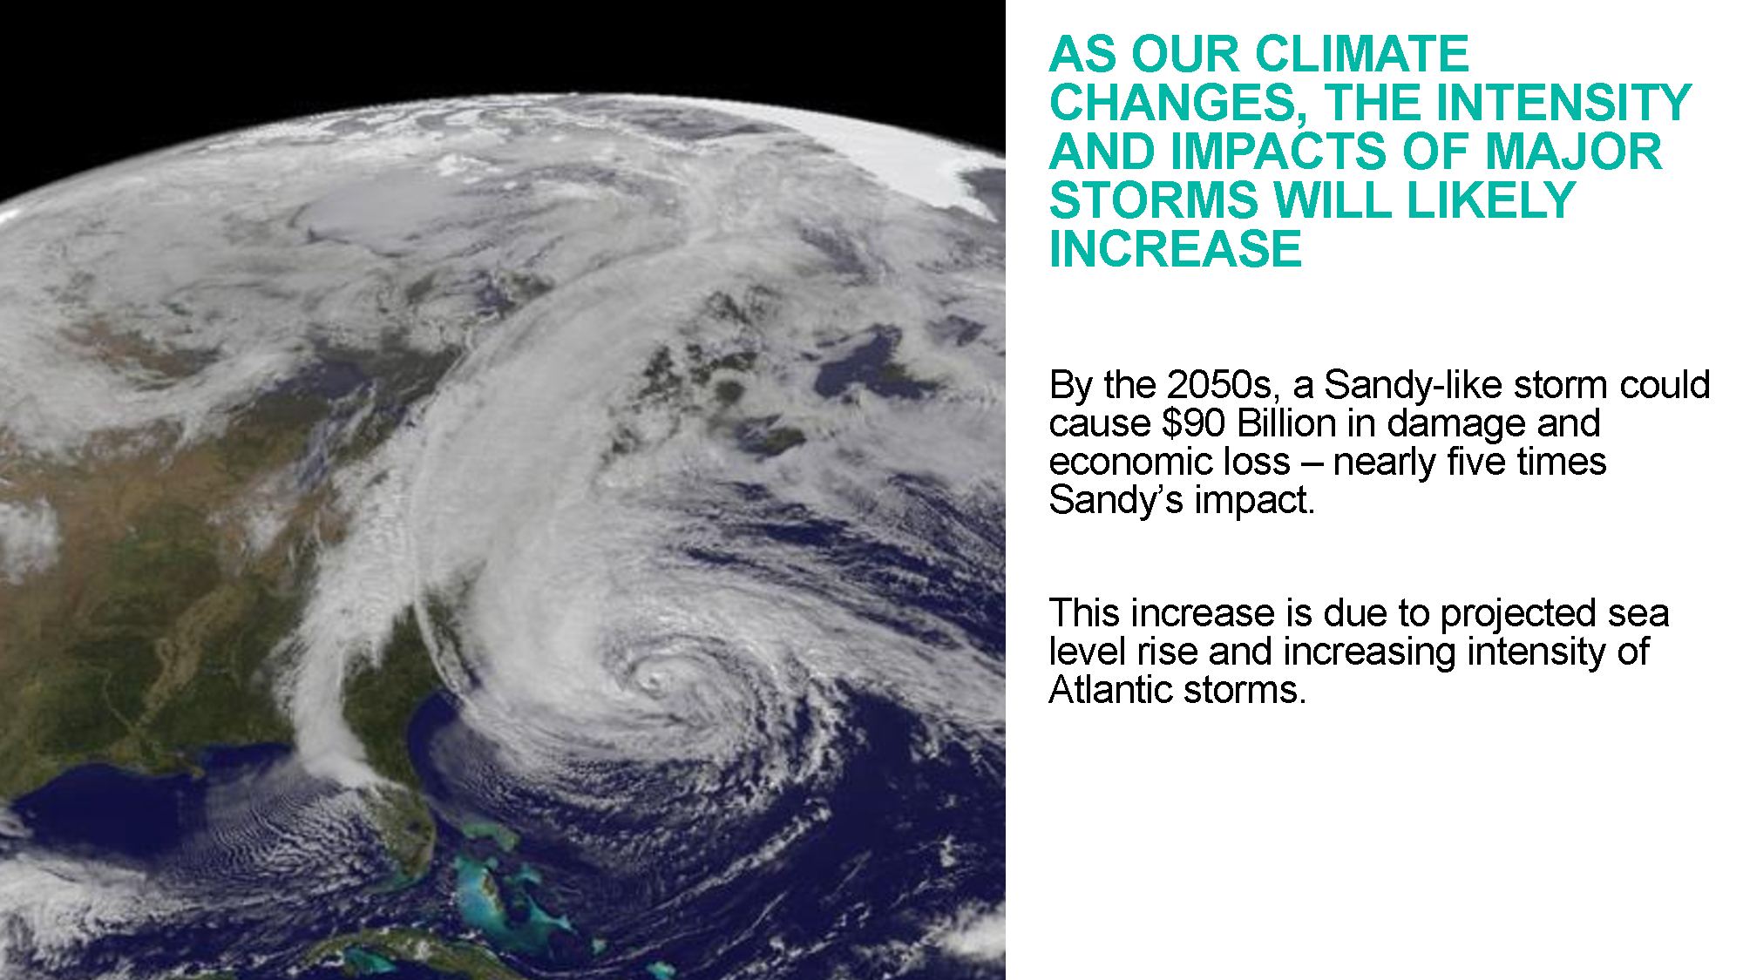

Slide 8
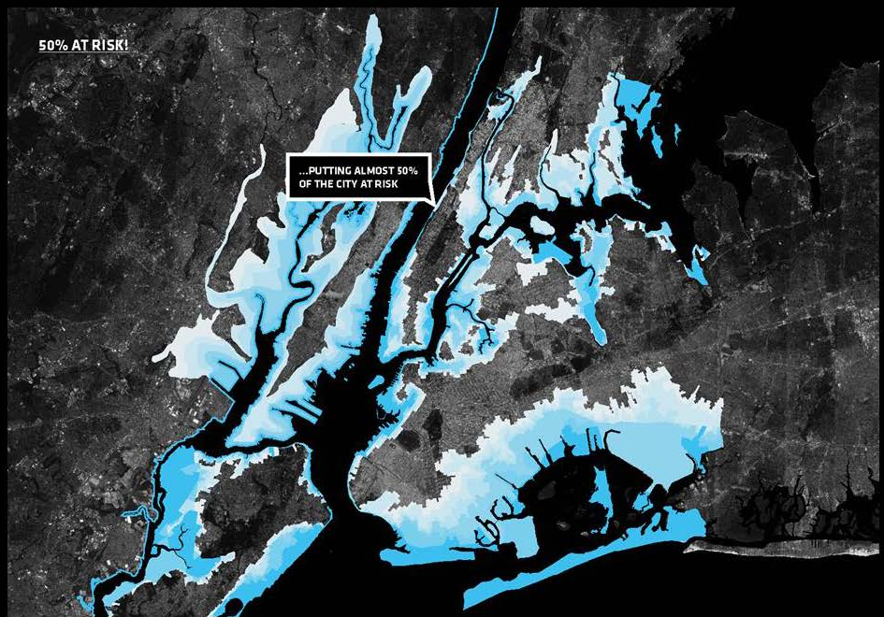
Notes:
Storm surge from hurricane Sandy

Slide 9
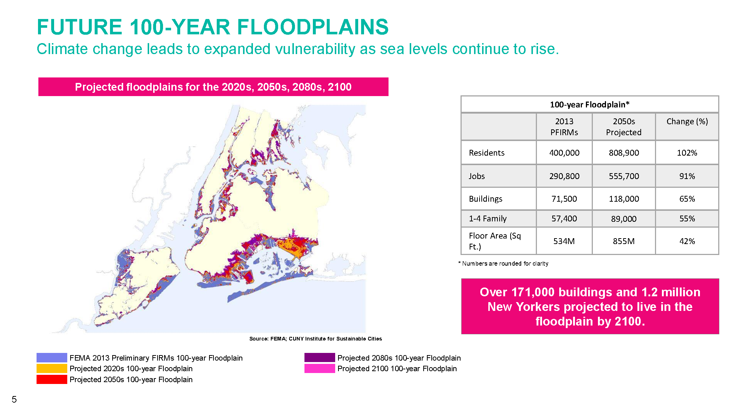

Slide 10
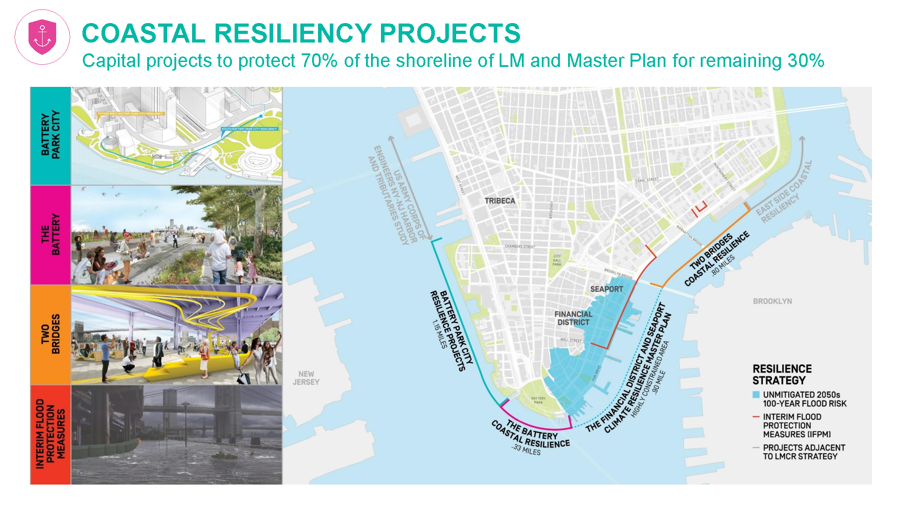

Slide 11
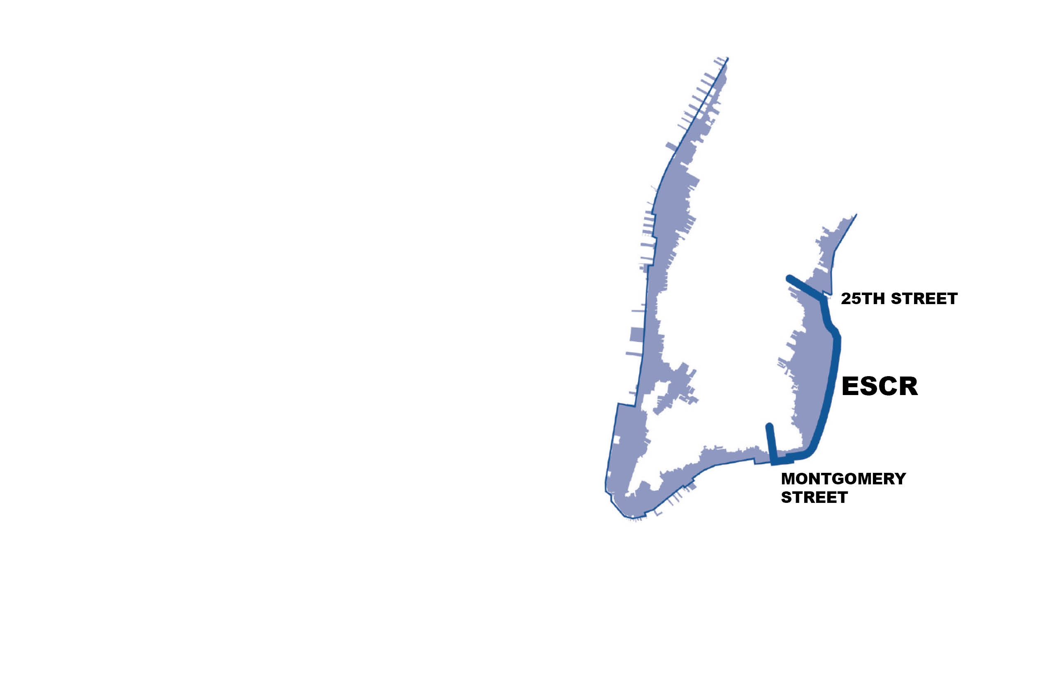
Project Goals and Origin
Provide a reliable, integrated flood protection system; minimize use of closure structures
Improve waterfront open spaces and access
Achieve implementation milestones and project funding allocations as established by HUD
Respond quickly to the urgent need for increased flood protection and resiliency

Slide 12
NYC Panel on Climate Change
Sea-Level Rise (SLR) Projections
Year | 10th Percentile (90% chance of exceedance over time) | 50th Percentile (Mean or most likely to occur as an average) | 90th Percentile (10% chance of exceedance over time)
2050s | 8 in (20cm) | 16 in (41cm) | 30 in (76cm) ^{(*)}
2100s | 15 in (38cm) | 36 in (91cm) | 75 in (191cm)
(*) Projection adopted for the ESCR Project Design Criteria

Slide 13
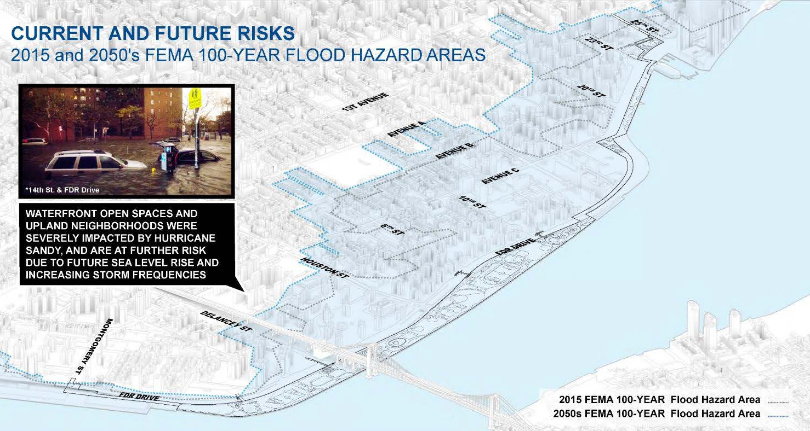
Notes:
Design criteria

Slide 14
PROJECT DESCRIPTION

Slide 15
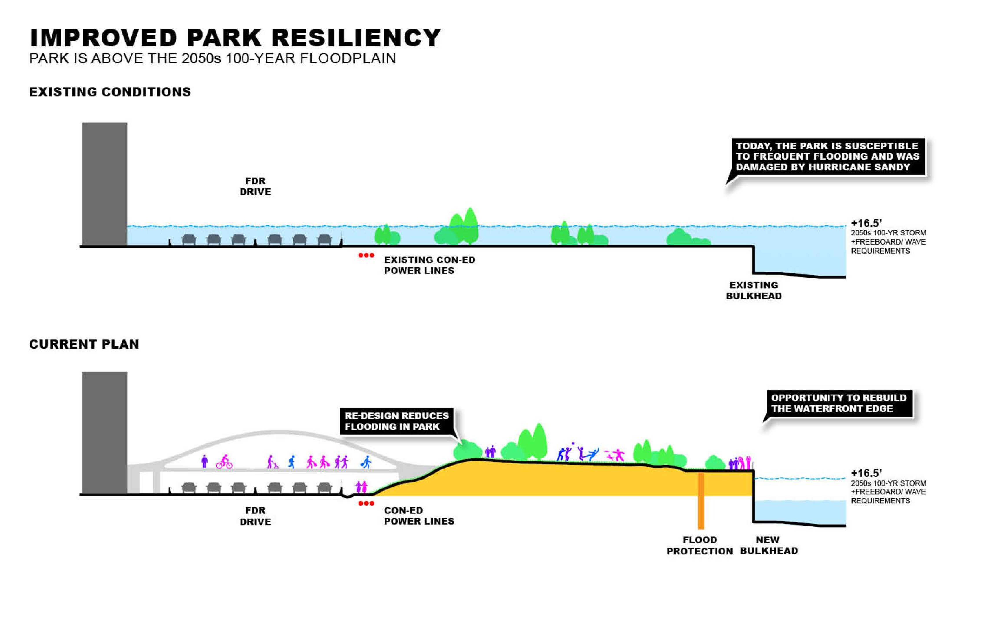

Slide 16
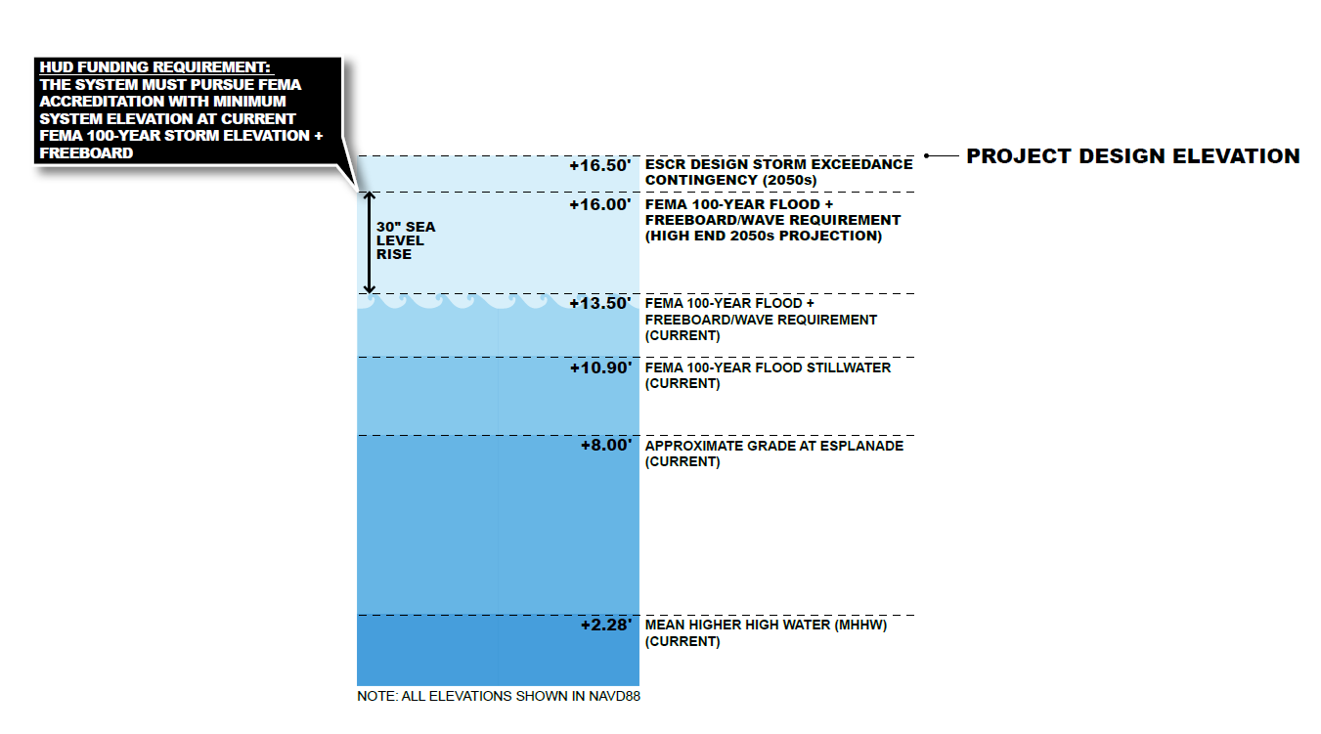
Current Grade at esplanade = +8 feet (2,2m)
Design Grade at esplanade = +16.5 feet (5m)

Slide 17
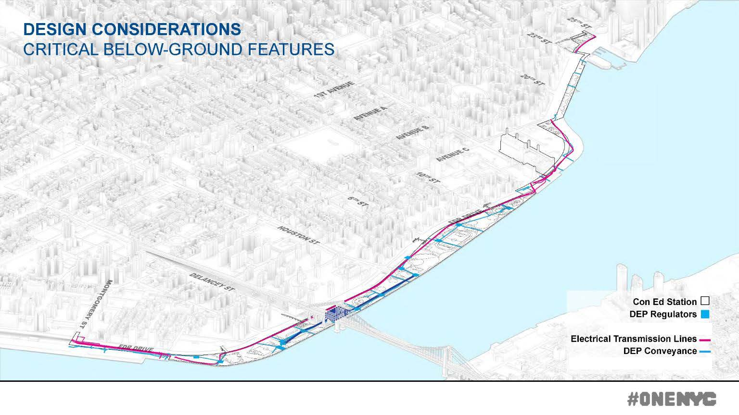

Slide 18
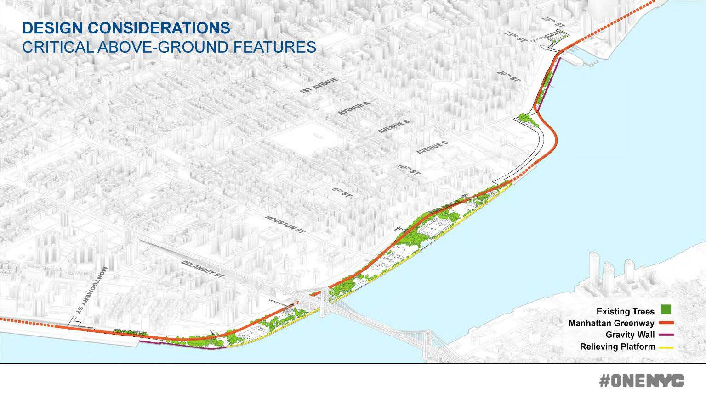

Slide 19
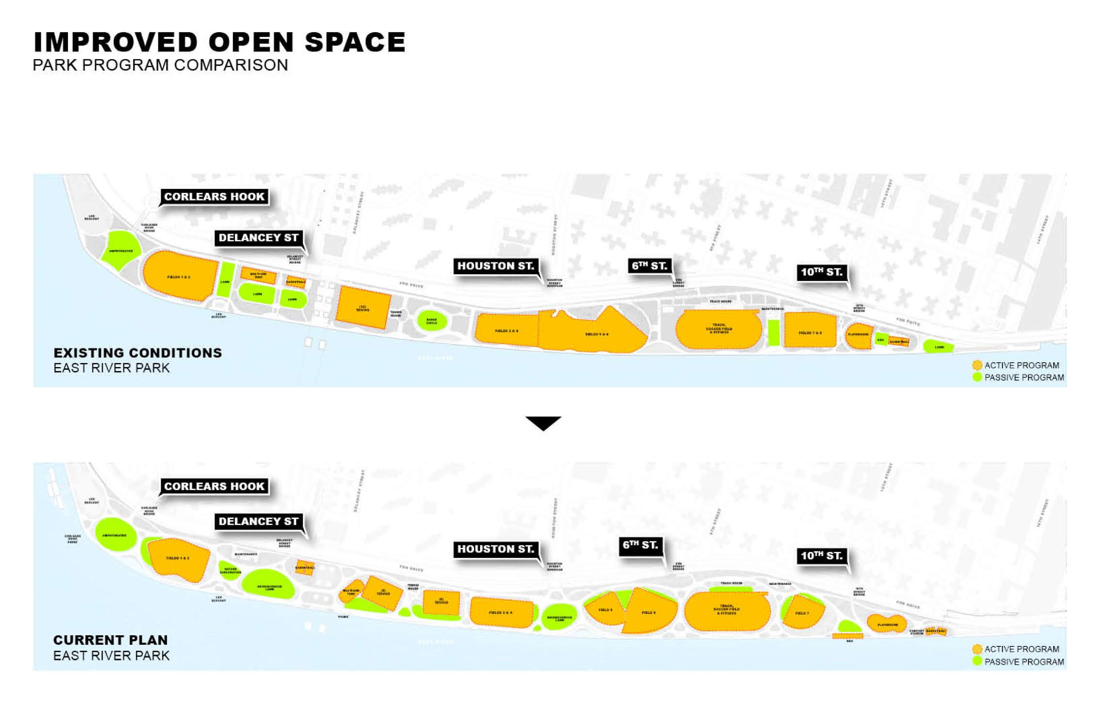

Slide 20
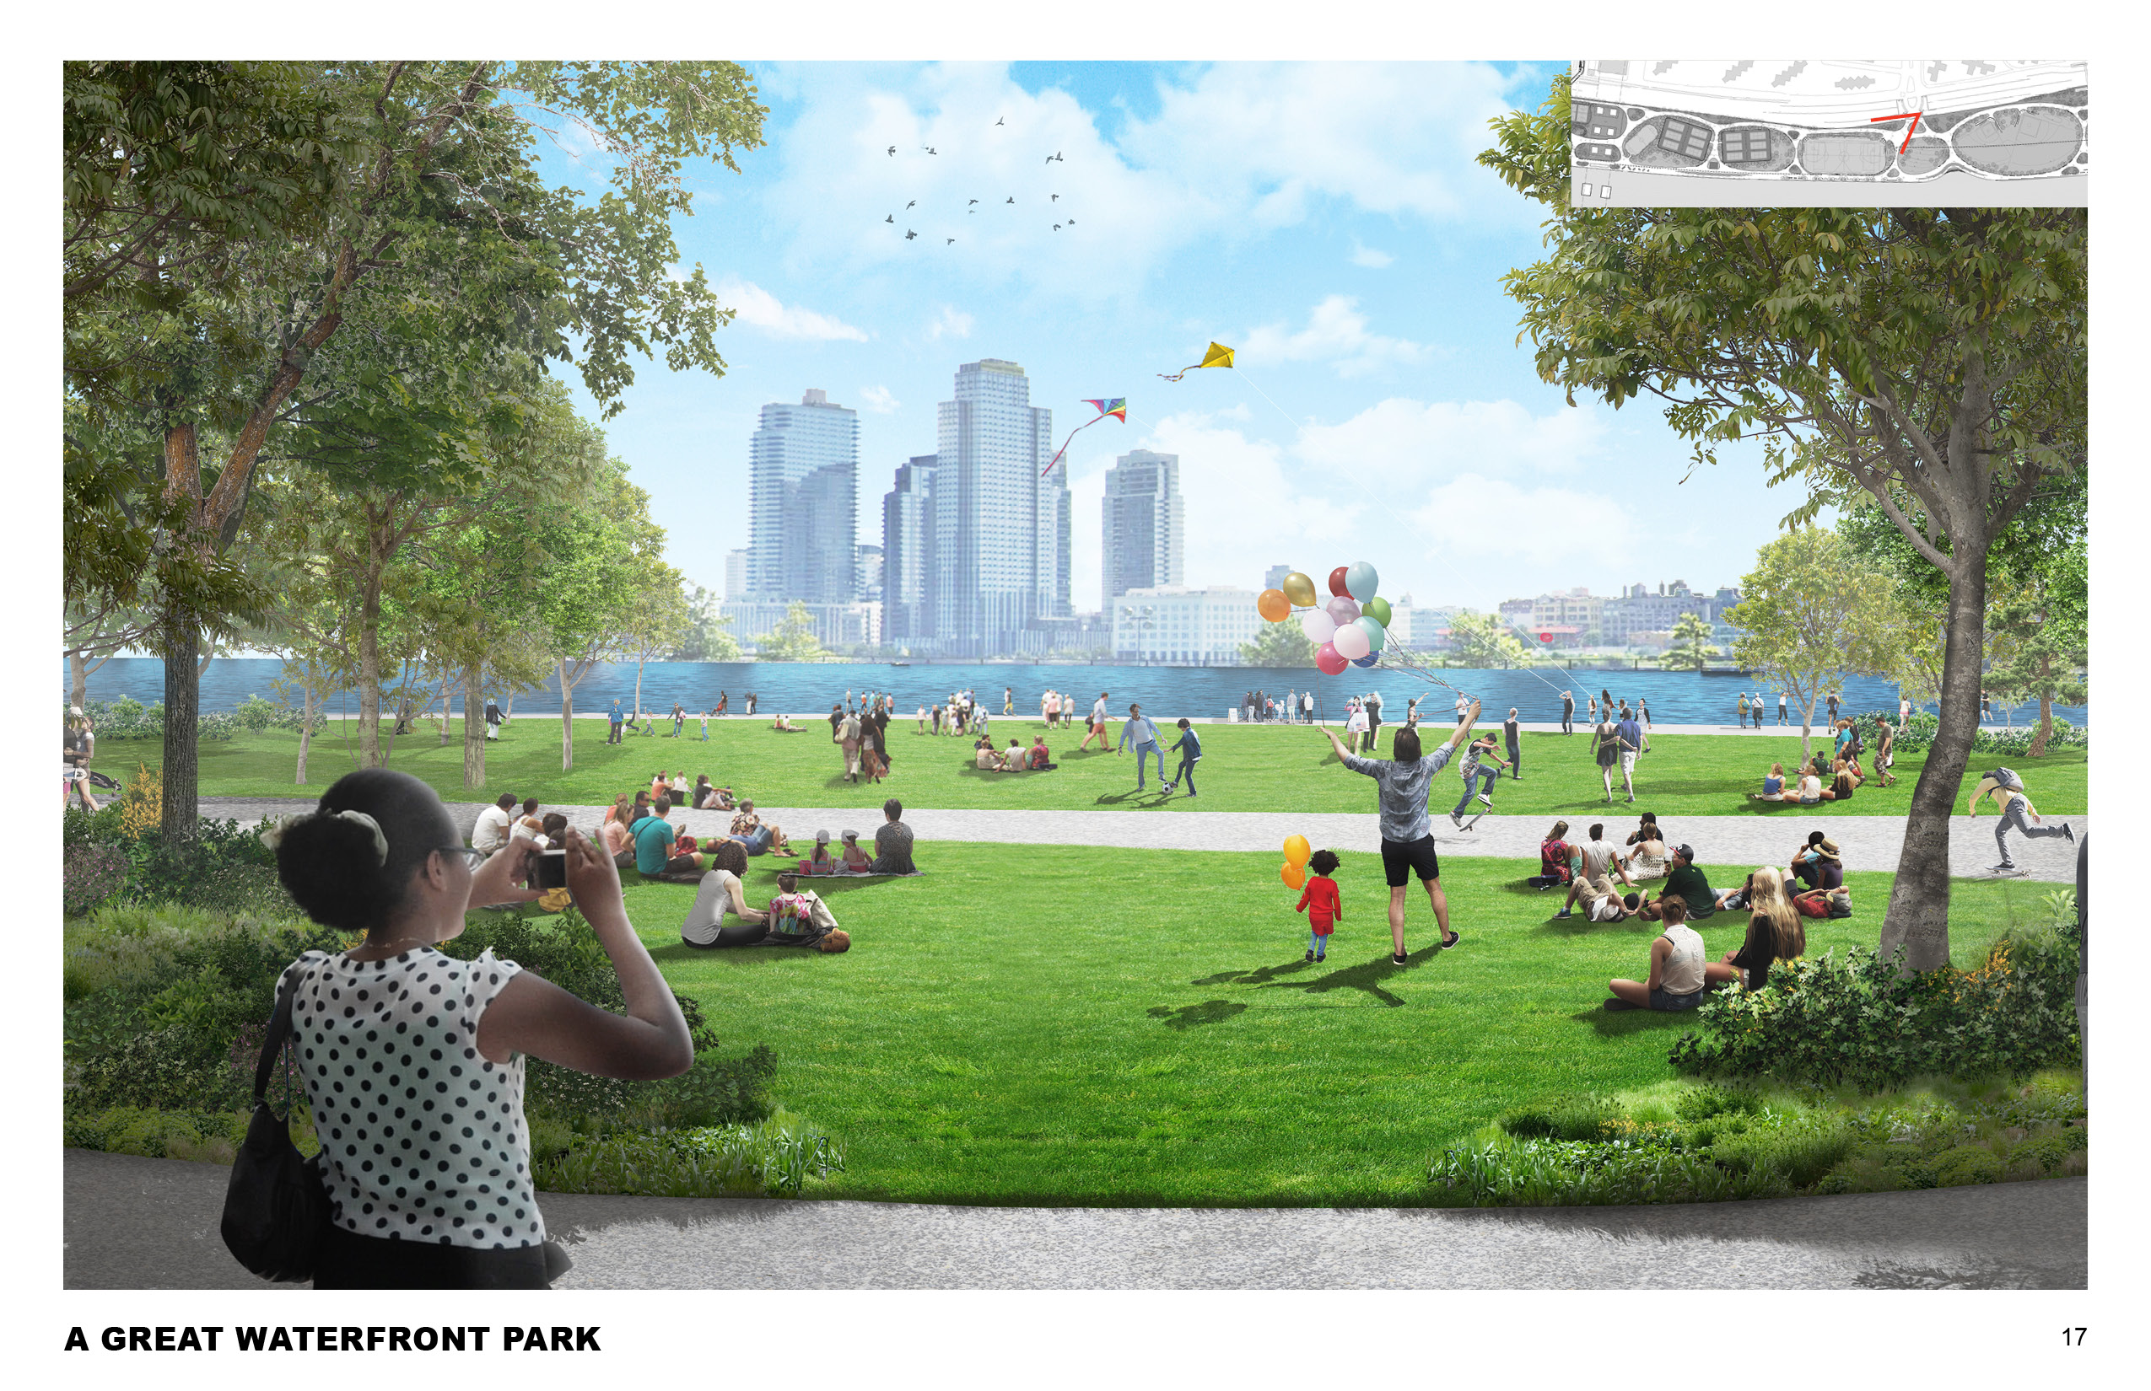

Slide 21
DESIGN WALK THROUGH

Slide 22
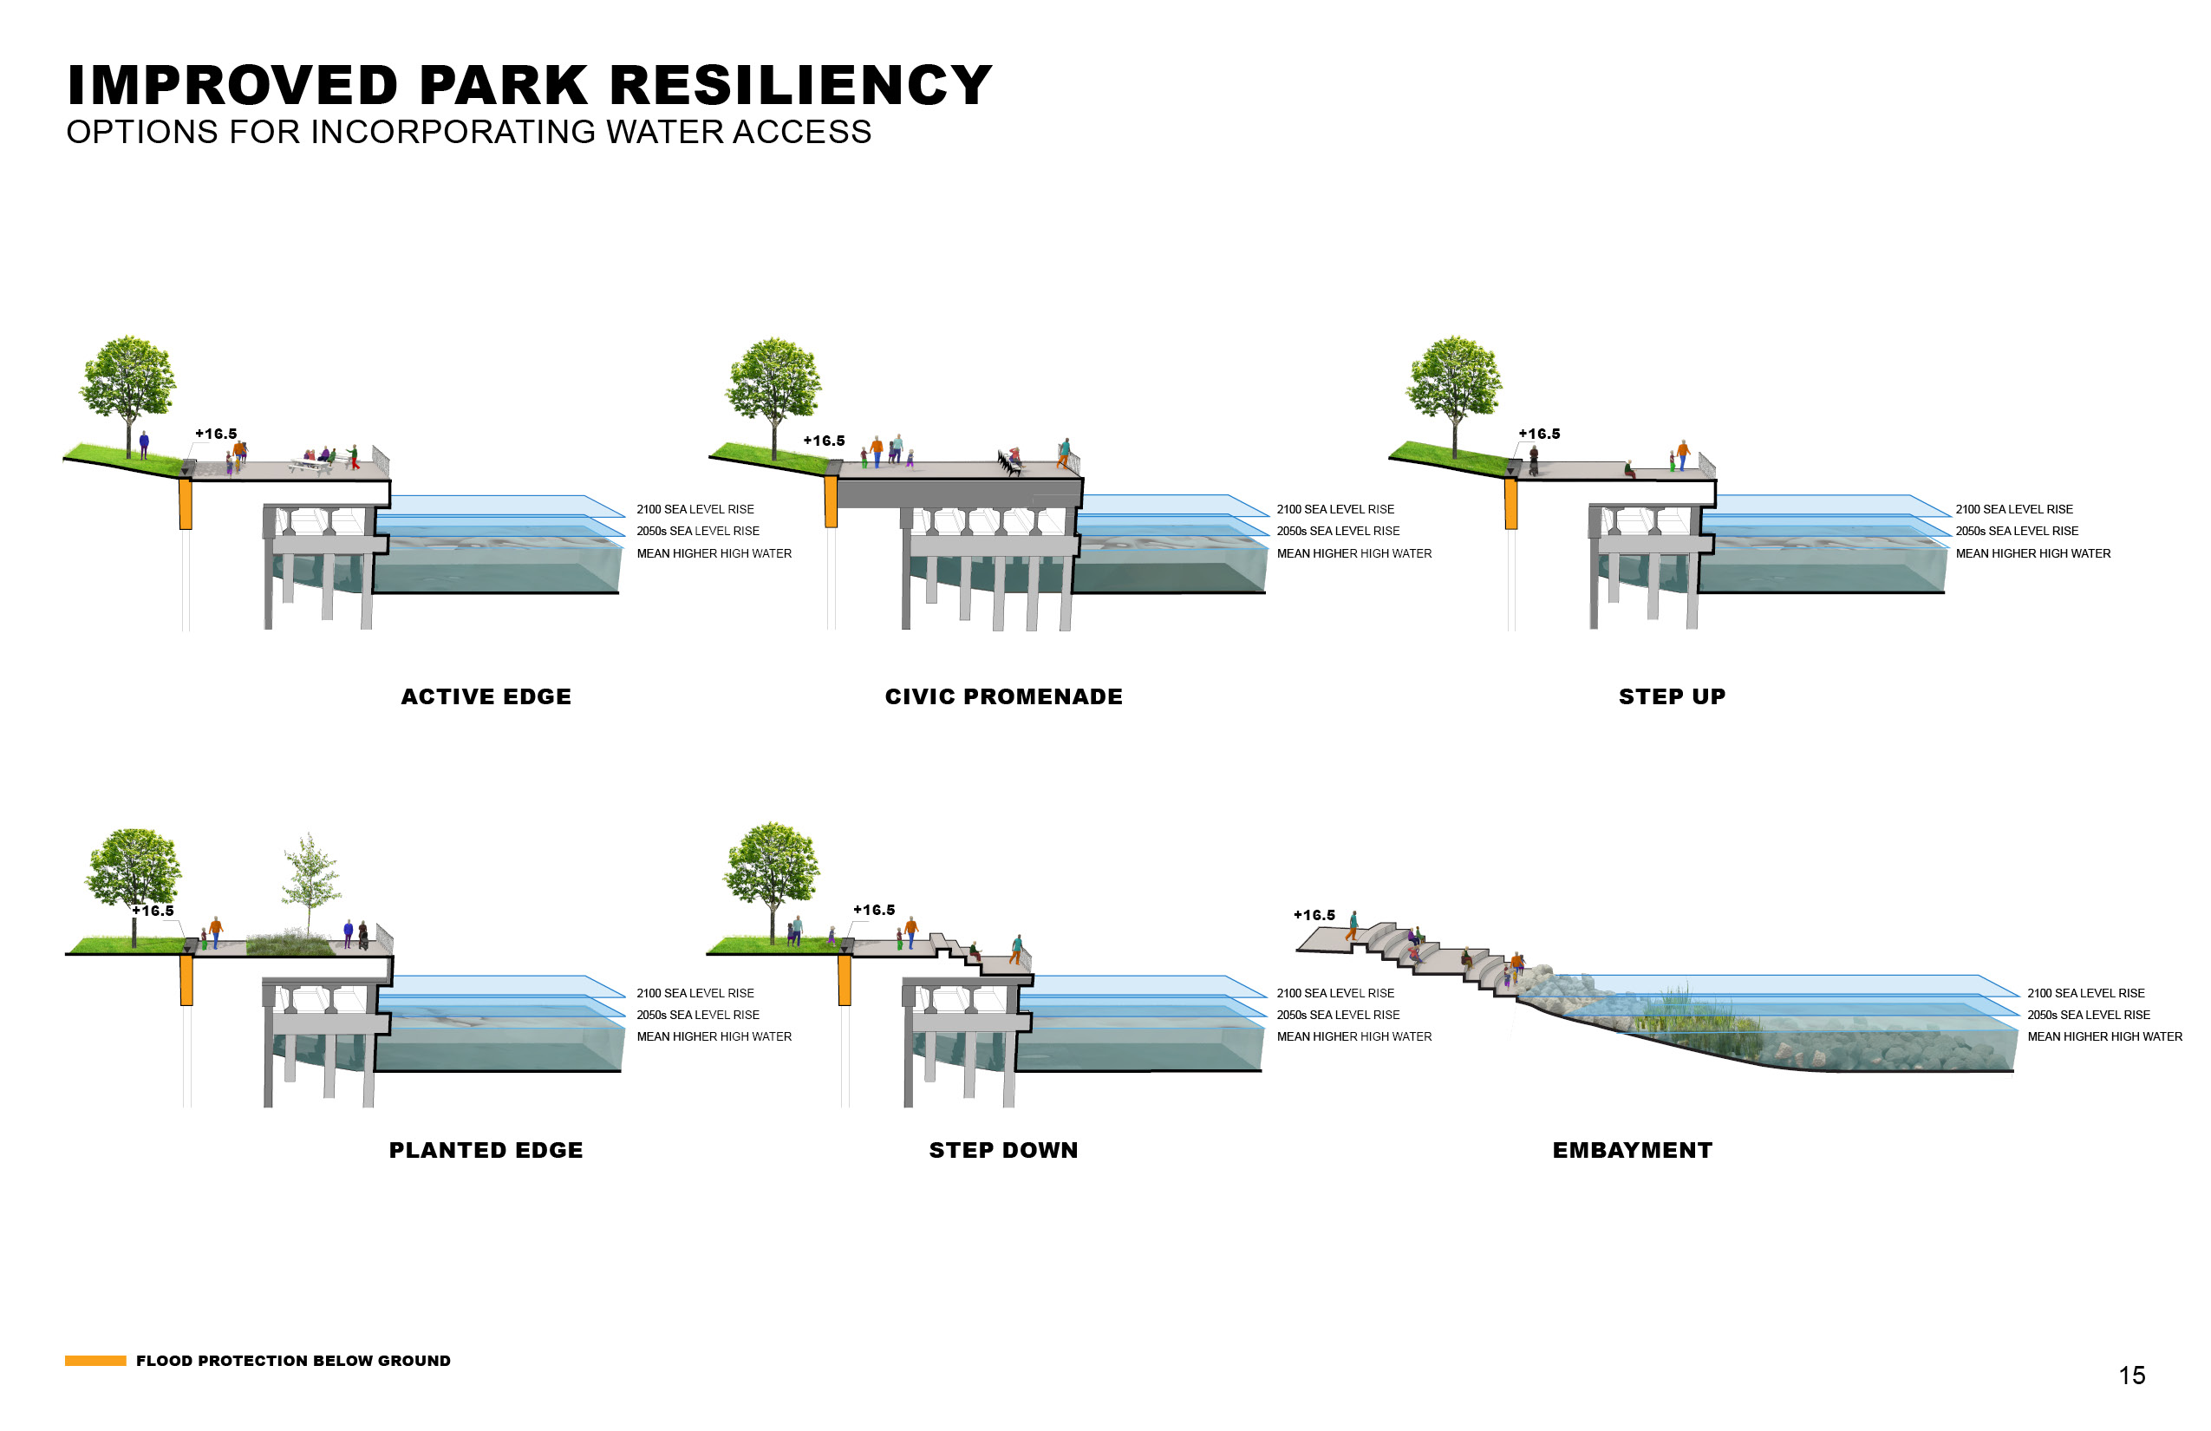

Slide 23
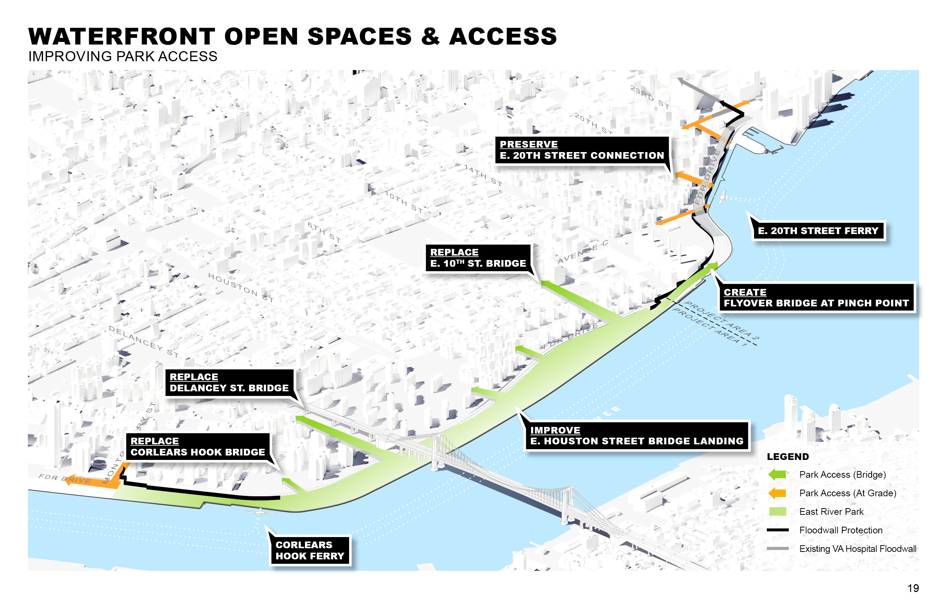

Slide 24
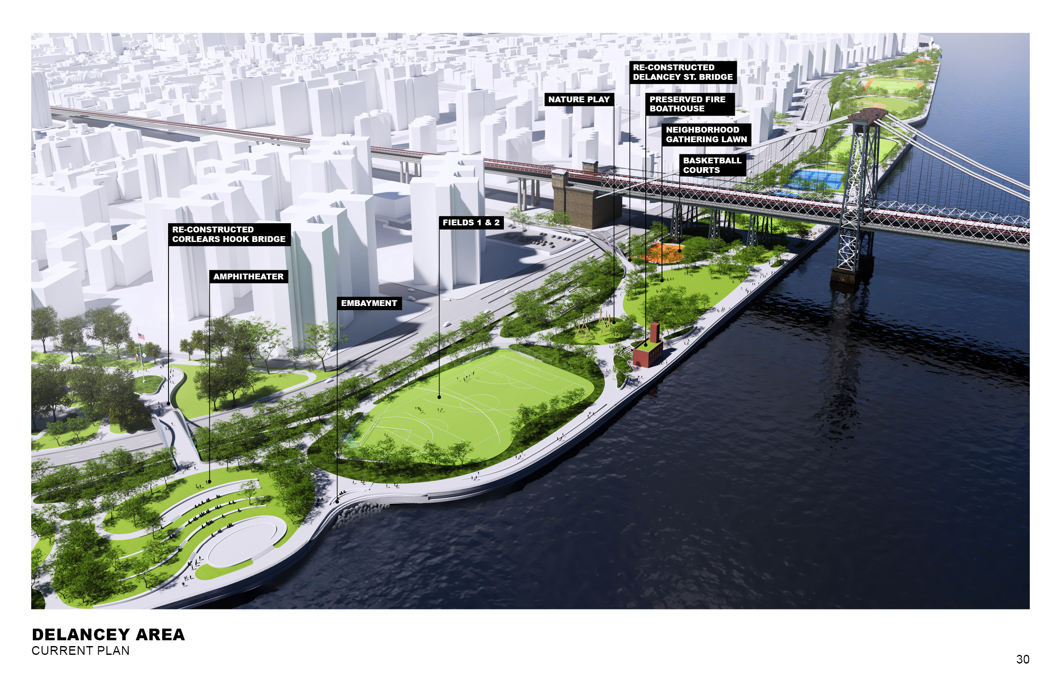

Slide 25
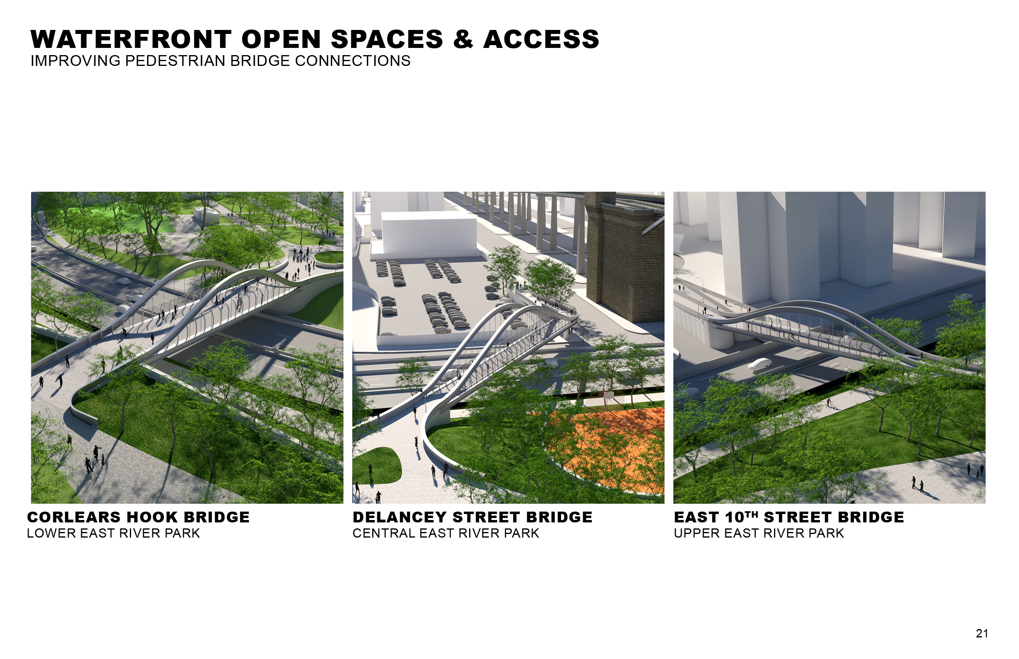

Slide 26
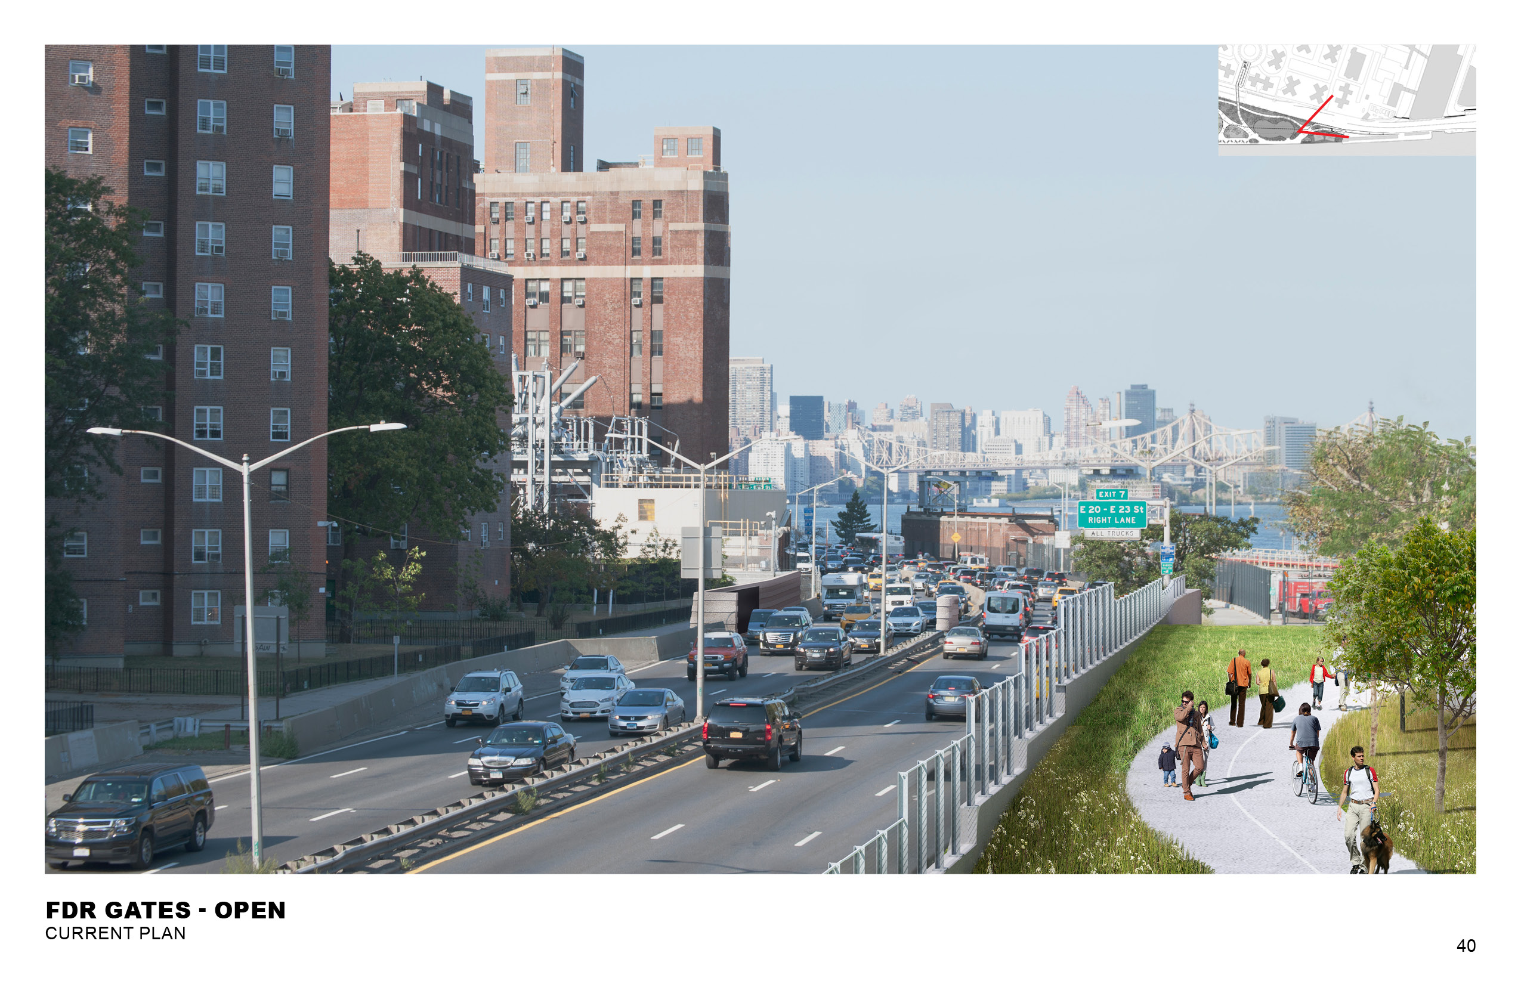

Slide 27
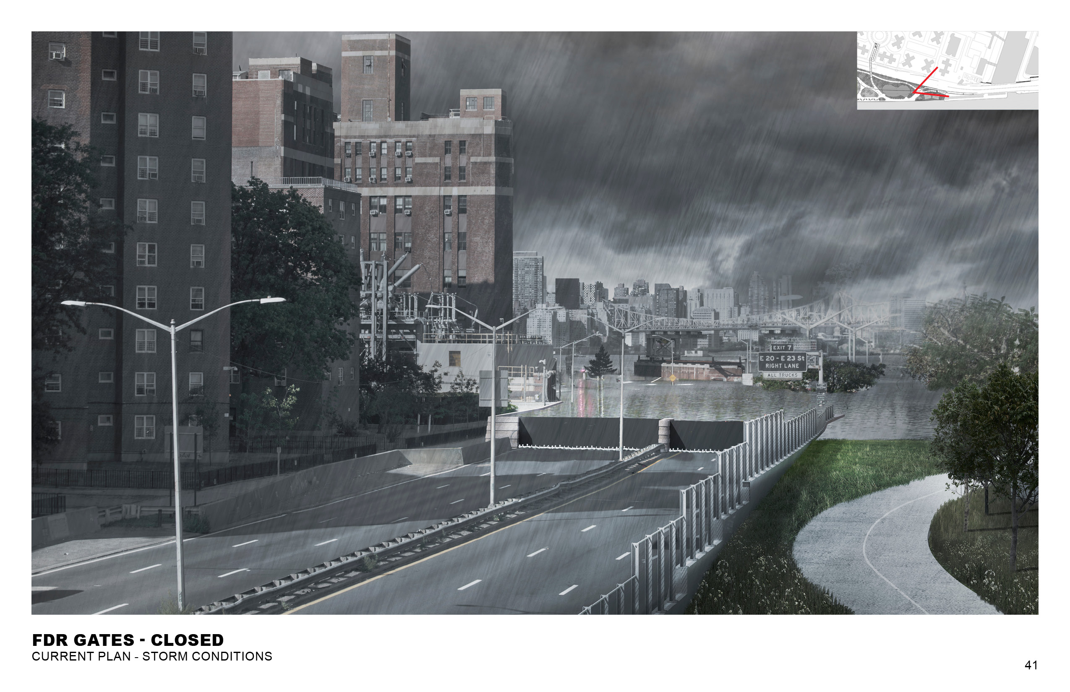

Slide 28

Visit Us!
www.nyc.gov/escr
Twitter: @NYClimate

