Slide 1


Human as a key
Resilience Factor
Sébastien DAZIANO, SUEZ
UNESCO Metropolitan “ECO – RISE” R2020 Colloquium
November 7 & 8, 2019

Slide 2

Human at the core of the trends
Climate emergency
Demographic challenge
Digital revolution
Public expectations

Slide 3



Resilience: an absolute necessity
Change of paradigm
Preserve water resources
Human behaviour

Slide 4

Human at the core of the climate change challenges
  Cause – Vulnerability - Solution
Cause
  Our challenge in term of resilience have human and natural causes
    Human mistakes, malicious acts
    Pressure on the resource
    Natural
Vulnerability / Risks
    Human and financial damages
    Natural ecosystems and environment
    Cybersecurity
Solution
  A holistic approach, at global, national and local scale

Slide 5
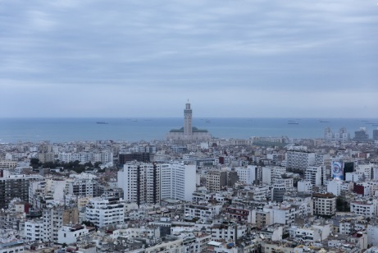
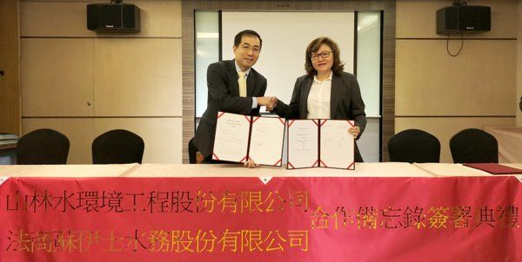
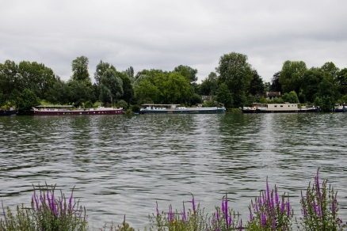
Resilience plans
  Examples
The water quality management plan of LYDEC – Casablanca (Morocco)
    4,4 million inhabitants Great Casablanca
    156 Mm3
    6 500km network, 36 water tanks
Reducing the pressure on the resource for the Forest Water Environmental Engineering Co Ltd (Taiwan)
  Signature of a memorandum of understanding on recycled water
    Increase treatment plants total capacity
    Reduction in energy-related greenhouse gas emissions
Facing extreme events in the Hauts-de-Seine (France)
    1,5 million inhabitants
    625km of network (transportation)
    160 million m3 transported
    1,000 utilities dedicated to flood control

Slide 6

Working in confidence with our stakeholders
  A strong culture of dialogue
The evolution of demographic and environmental factors is changing the background for SUEZ and its customers, whether public authorities or industrial
    Agile and responsive
    An ambitious policy of dialogue for over 10 years in the service of global performance: stakeholders’ expectations through Reputation & Materiality surveys, Alliances
    Public empowerment for resilience – crisis and increasing of capacity building
A recognized performance giving credibility for Suez to support its clients in reaching environmental excellence
    SDG Pioneer: Climate Action through Resource Efficiency in Water and Waste Management
    Verified by the SBT initiative: only Environmental services company worldwide; only French utilities company

Slide 7
Thank you

