Slide 1







Aqua Publica Europea
THE EUROPEAN ASSOCIATION OF PUBLIC WATER OPERATORS
EU Water Safety Plan & Resilience Policy Measures in the EU
ECO-RISE Colloquim, Paris 7/11/19

Slide 2
About Aqua Publica Europea
65
members
Public water operators and their associations
70 MILLION
citizens served every day
8 BILLION
euros of aggregated turnover
APE’s mission
Promoting public water management
Providing a platform for mutual learning

Slide 3
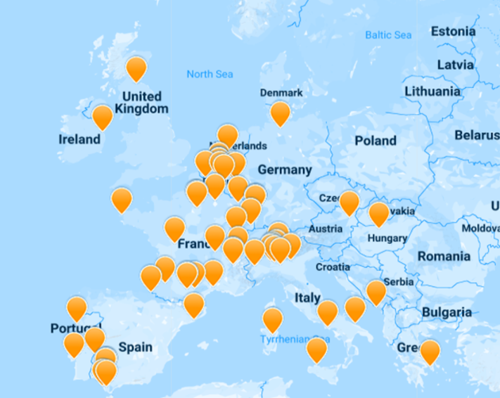
About Aqua Publica Europea
Ten years of collaboration for the general interest
Created ten years ago by the impulsion of Paris, Milan, Brussels and Geneva.
Since then, the association has been growing steadily.
Today: 65 members in 12 countries commit to Aqua Publica’s values

Slide 4



APE contributes to EU and international dialogues
APE is a member of:
European Commission Expert Group on the Implementation of the Drinking Water Directive
European Commission Expert Group on the Implementation of the Urban Waste Water Treatment Directive
Steering Committee of the European Innovation Partnership on Water
Multi-stakeholder Dialogue on Benchmarking Water Quality and Services
Member of the OECD Water Governance Initiative
Member of the OECD Water Financing Initiative
Member of the UN Habitat Global Water Operators Partnership Alliance (GWOPA)

Slide 5
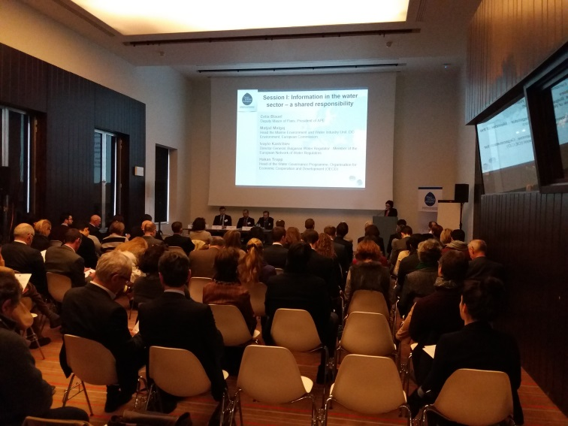

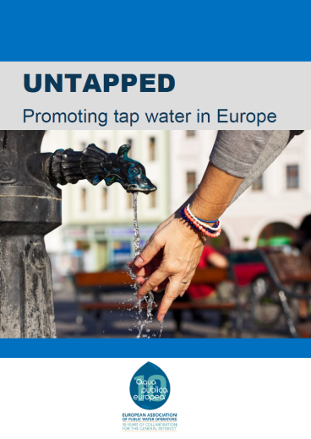
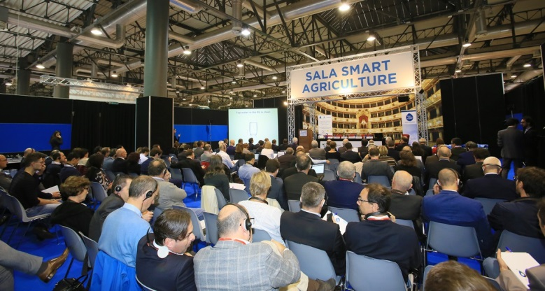
Own Initiatives
​
​
​
Seminar ‘Information and transparency in the Water sector’, Brussels, 2018
Seminar ‘New Drinking Water Directive’, Milan, 2018

Slide 6
The APE Platform
APE provides a dynamic platform for members to exchange best practices, share knowledge and address common management challenges
THEMATIC SESSIONS
Technical meeting open to all members addressing an issue selected by members and featuring presentations by experts from APE members, on projects and best practices
WATER ERASMUS INITIATIVE
Bilateral short-term staff exchange between a ‘visiting operator’ and a ‘hosting operator’ on a specific topic of common interest
WORKING GROUPS
Operators-led working groups addressing general issues
Financing & Tariffs [Aquawal] – Performance – Communication [Aquedotto Pugliese] – Innovation [SMAT + SWDE] – International Cooperation [SIAAP] – Sludge [MM]

Slide 7
Risk management in EU legislation
Floods Directive (2007/60)
→ Obligation of: risk assessment, risk maps, flood management plan
Directive on security of network and information systems (2016/1148)
→ Obligation for “operators of essential services” to take appropriate and proportionate measures to manage risks – part of a national security strategy
[Future] Drinking Water Directive (2019…?)
→ Obligation of risk assessment and risk management for catchment areas, supply system and for the domestic system

Slide 8
Operators working on Water Safety Plans but… 3 sources of uncertainty
Governance (interplay between directives)
→ Overlaps between NIS and new DWD ¤ Entities responsible for risk assessment and management for catchment area and floods
Financing
→ Especially for interventions outside the traditional “perimeter of responsibility” of operators, e.g. floods management and catchment areas…
Methodological and organisational implications of WSP
→ Variance among operators re. : geographic unit to assess and responsibility ¤ kind of human resources needed ¤ frequency of the assessment ¤ methodology for risk assessment ¤ economic implications

Slide 9
Conclusions: key conditions for improving resilience
Coherent legal framework
Effective and conducive governance
Capacity development and training for operators
Multi-sector stakeholder engagement

Slide 10
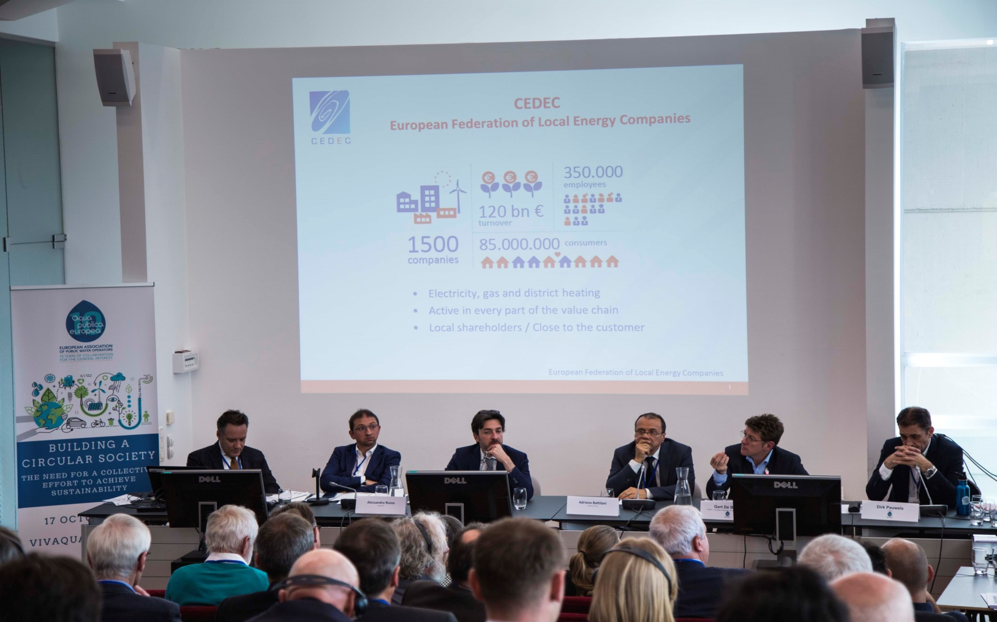
Conclusions
APE Seminar ‘Building a Circular Society’, Brussels, 2019

Slide 11

Further questions?
      Milo Fiasconaro
      Executive Director
      Milo.fiasconaro@aquapublica.eu
      T : + 32 2 518.86.56
      http://www.aquapublica.eu/ @APE_EU

