Slide 1
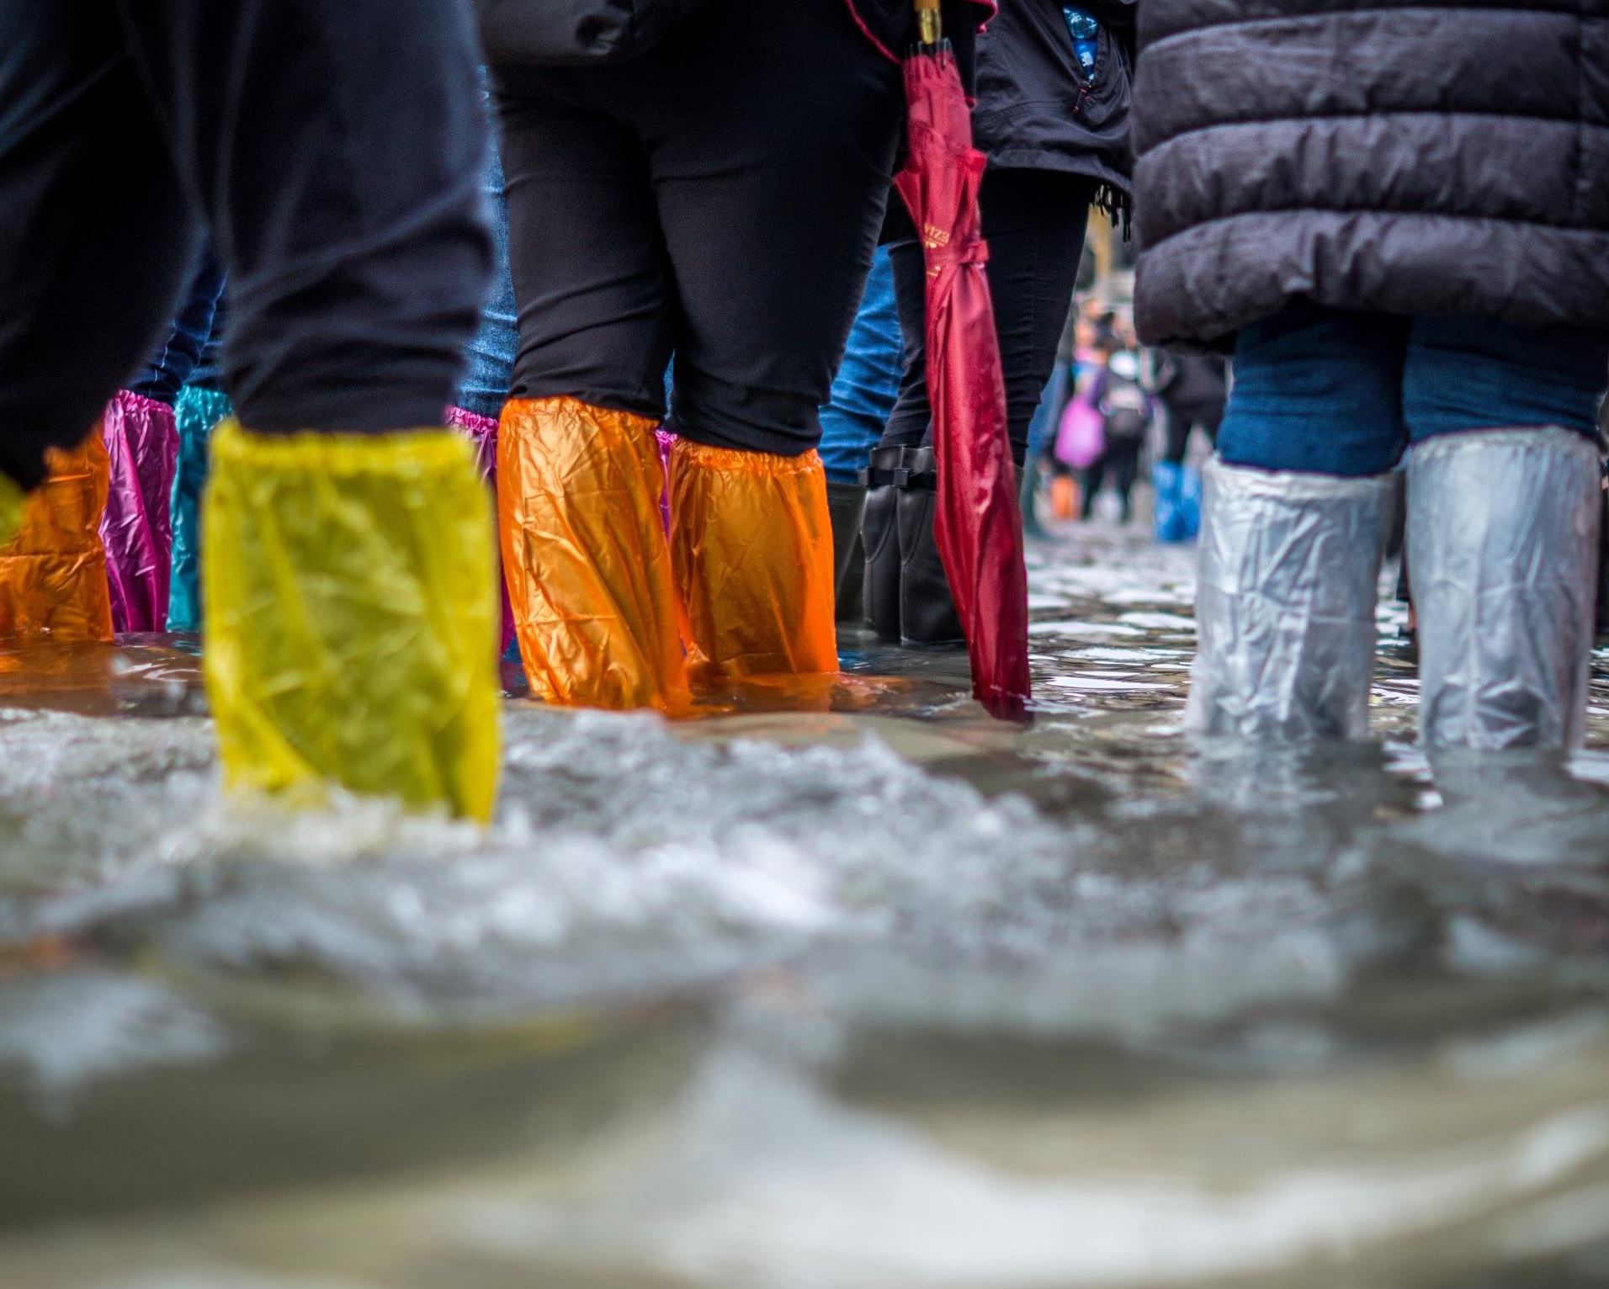
Veolia Eau France
Water Service Resilience Building & Operational Challenges

Slide 2
Flood risks
Increased vulnerability of the resources, in quality and quantity
Aging infrastructures
Water
A major subject of urban resilience

Slide 3
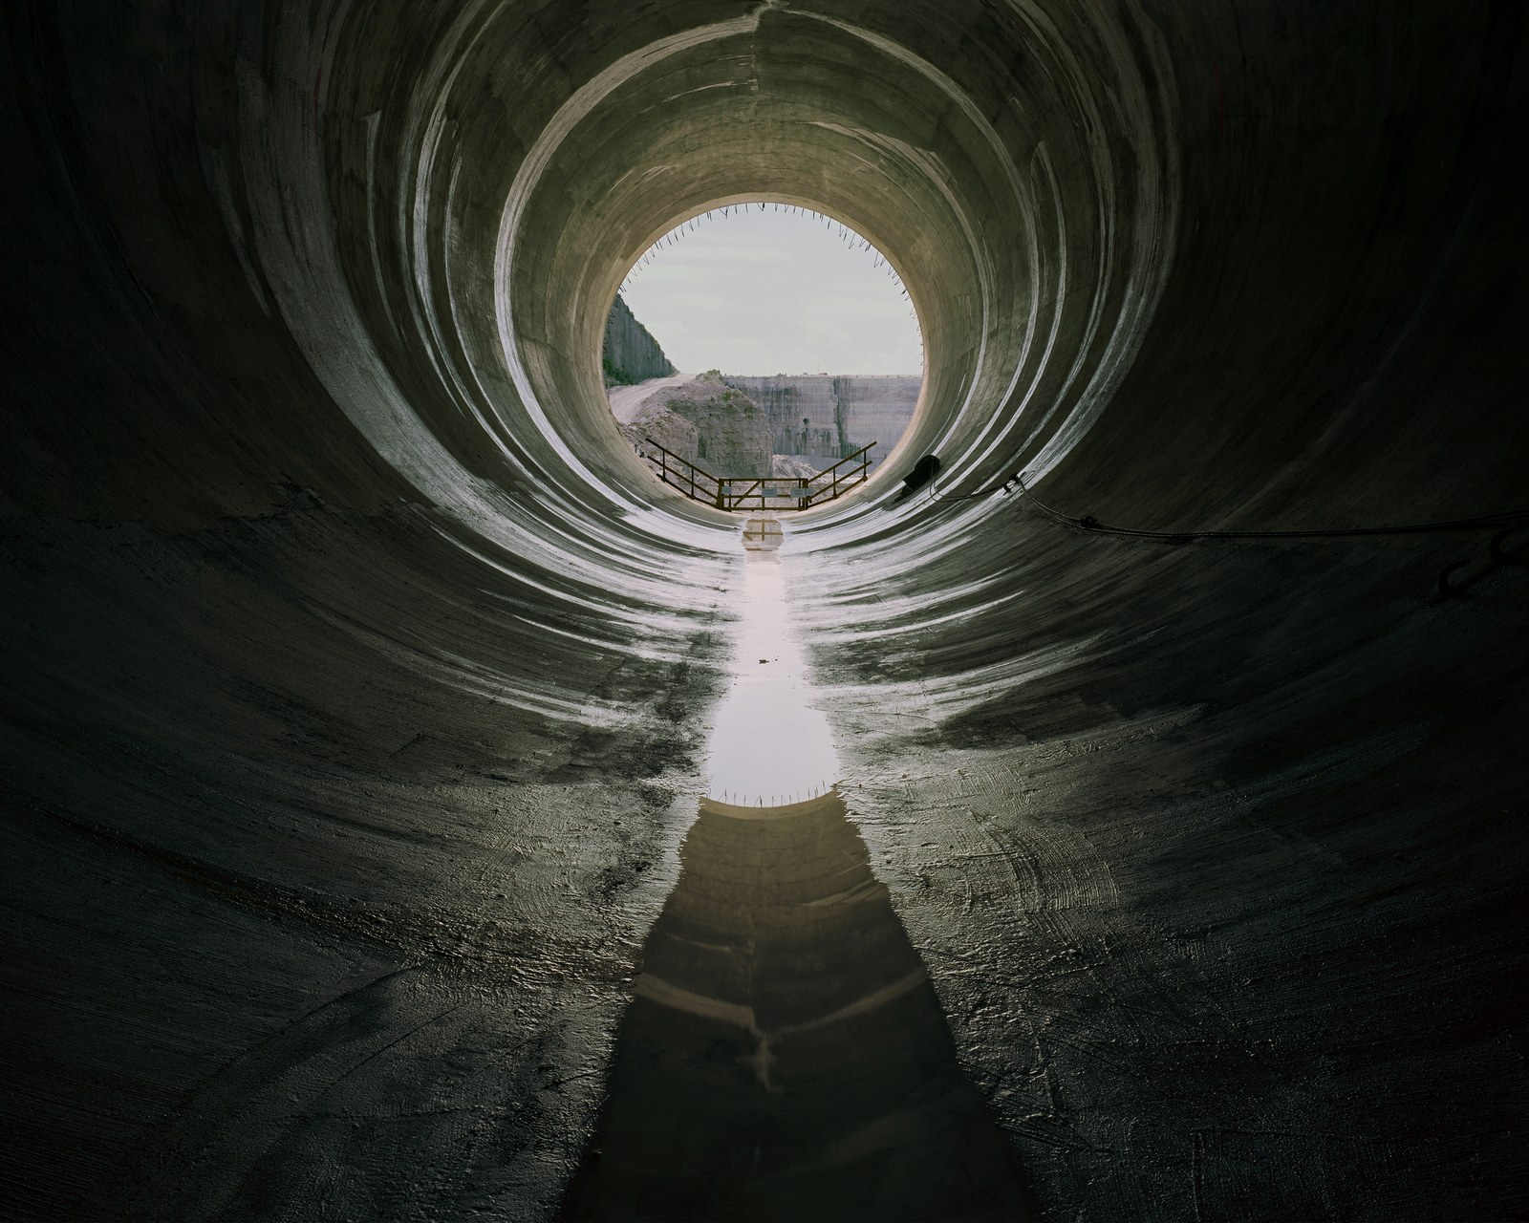
Water : assets of 200 billions €
including aging network = 80% of assets value
and vulnerable resources
Flood protection : assets around 80 billions €
flood dikes
storage basins
rivers developments
Some big assets
In France

Slide 4

Renewal of water pipes over the next 50 years ?
2 billions €/year
= increase the price of tap water by 50% % ?
Building new infrastructures against flood
1.8 billion € in 2018 in France
… and a need for more
Support infrastructures offers
Expensive. Take a long time

Slide 5

Even if sources of investment can be found, it will take time
Context will evolve
  climate change
  sea level rise
  vulnerability of resources
  urban growth
  … and political governance
Support infrastructure offer
A continuous evolution

Slide 6

Fundings for the offer is not enough, work on the demand too
Decrease the needs, the sobriety
Be smarter with what we have
Develop the multiplicity of uses of existing infrastructures
Decrease the impacts, the real ones ….and also the perception of them
Support the security offer
...while working on the demand

Slide 7
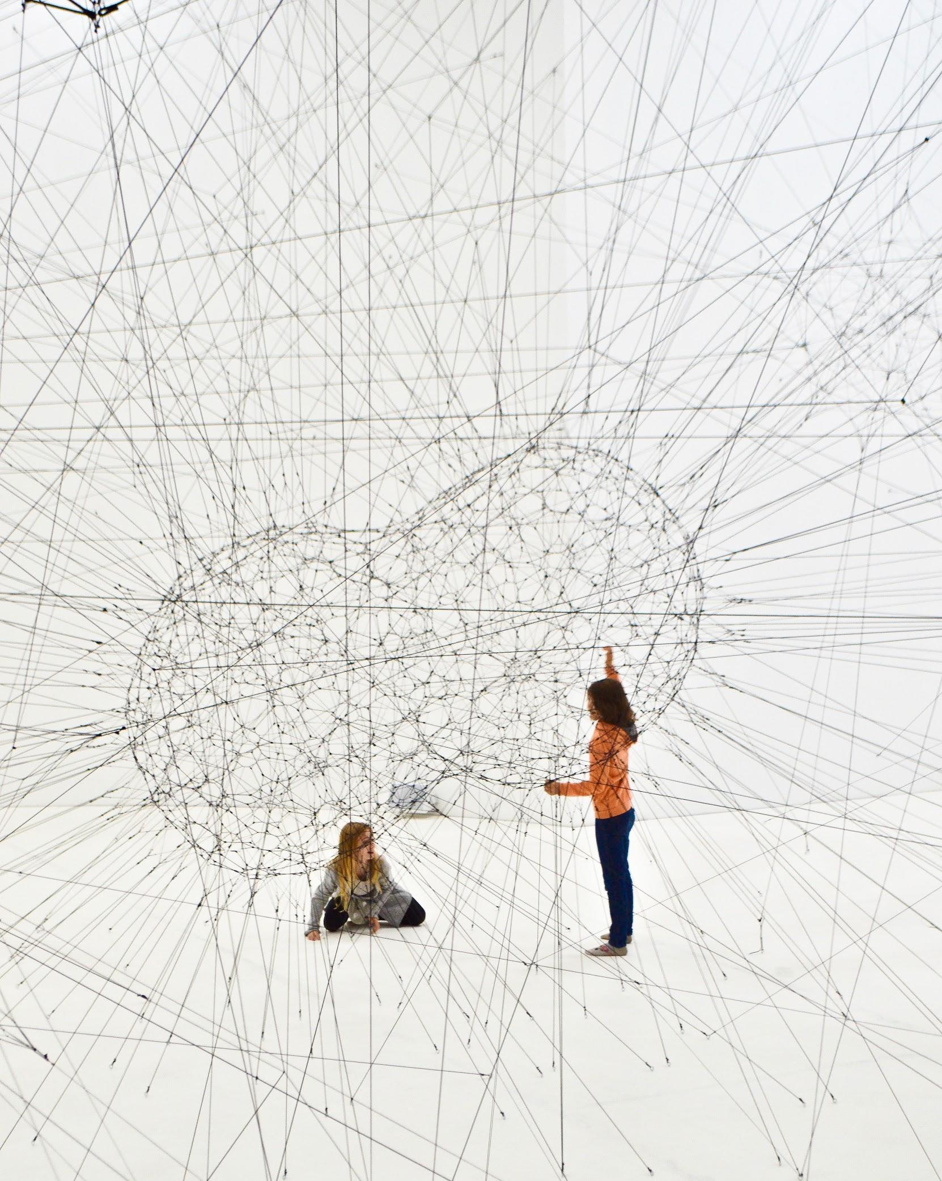
Better maintain what we have : possible in 2 to 3 years
Target the vulnerable facilities and equipments
Set alarm systems on critical points
Maintaining current equipments more efficiently… sometimes destroy it !
Maintaining water networks
Better train all operators
Work on the demand
Better use our infrastructures !

Slide 8
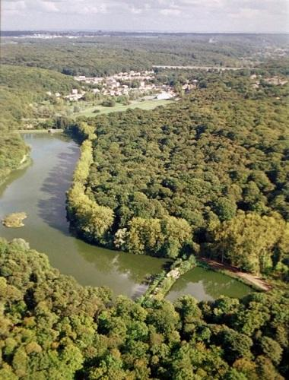

Optimize what we have : 2 to 5 years
Collect data and create model
Simulate
Do more with less
Work on the demand
Better use our infrastructures !
Examples
Whether / flow digital model to regulate water-flow in the Bièvre Valley
H2S treatment in waste water pipes against corrosion

Slide 9
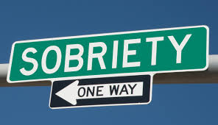
Develop sobriety to lower consumption and protect resources : 3 to 7 years
Smart metering to better target and challenge the consumers
Sobriety as a policy
Factory and water systems yield improvement
Work on the demand
Make it decrease !

Slide 10
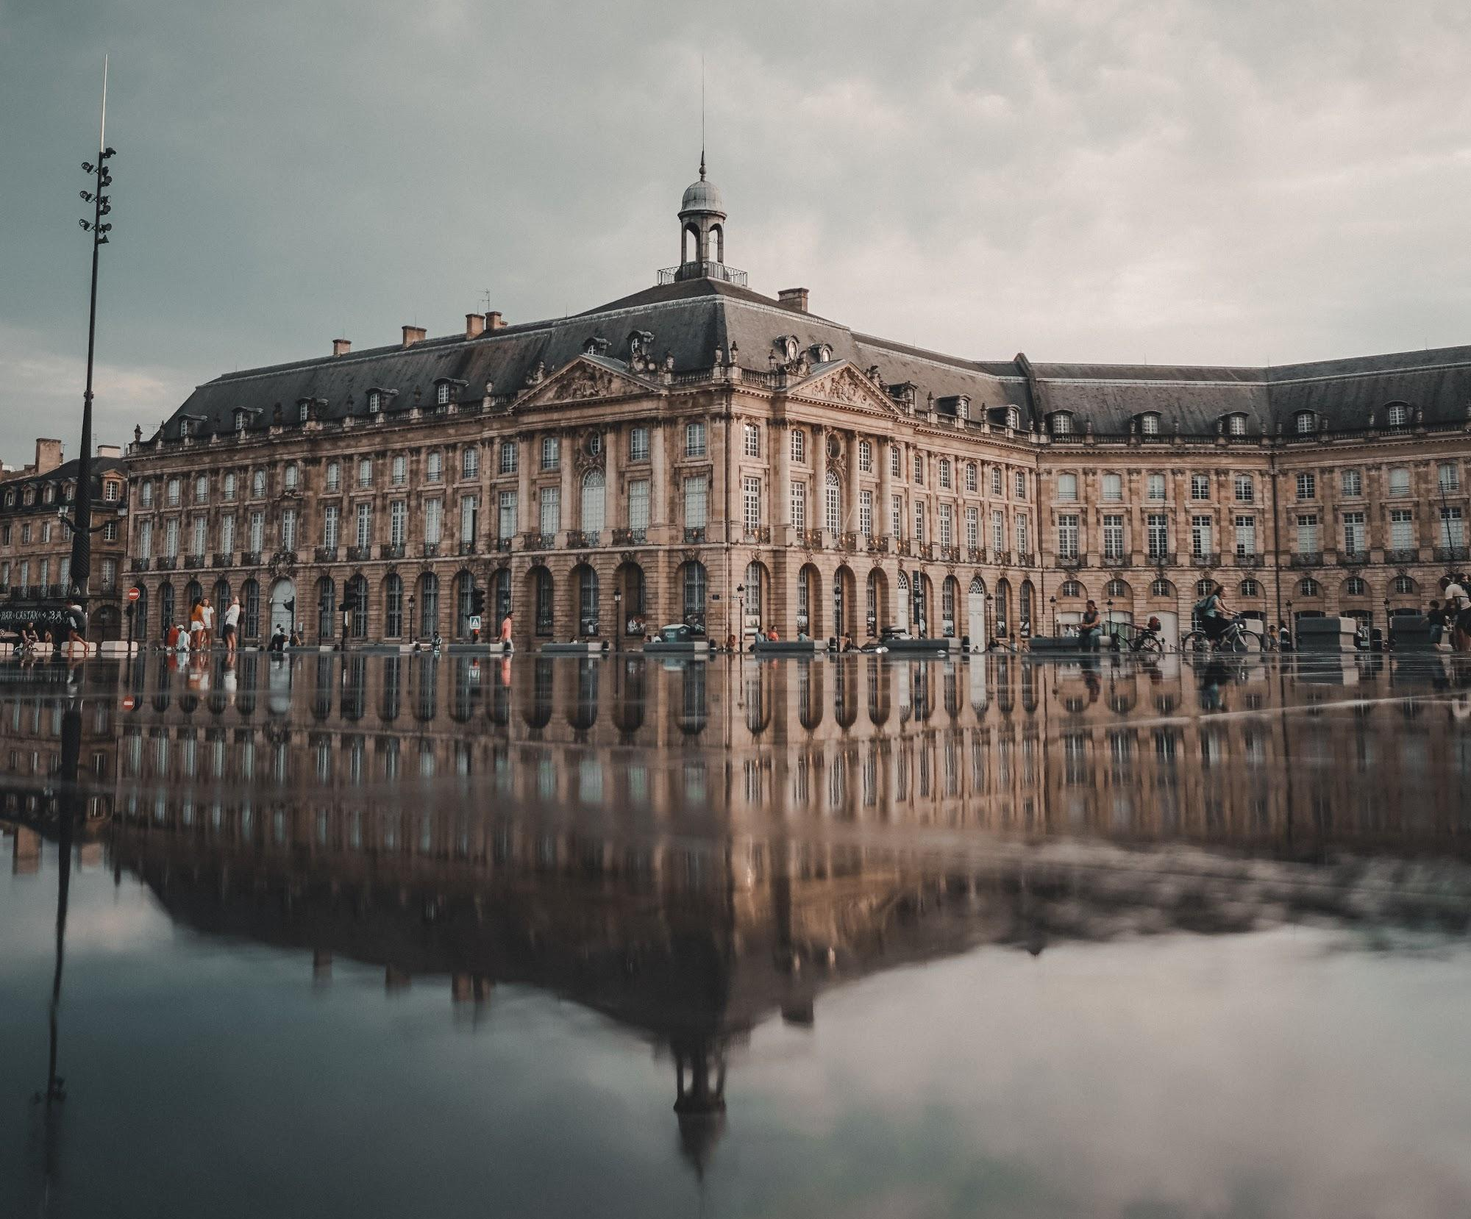
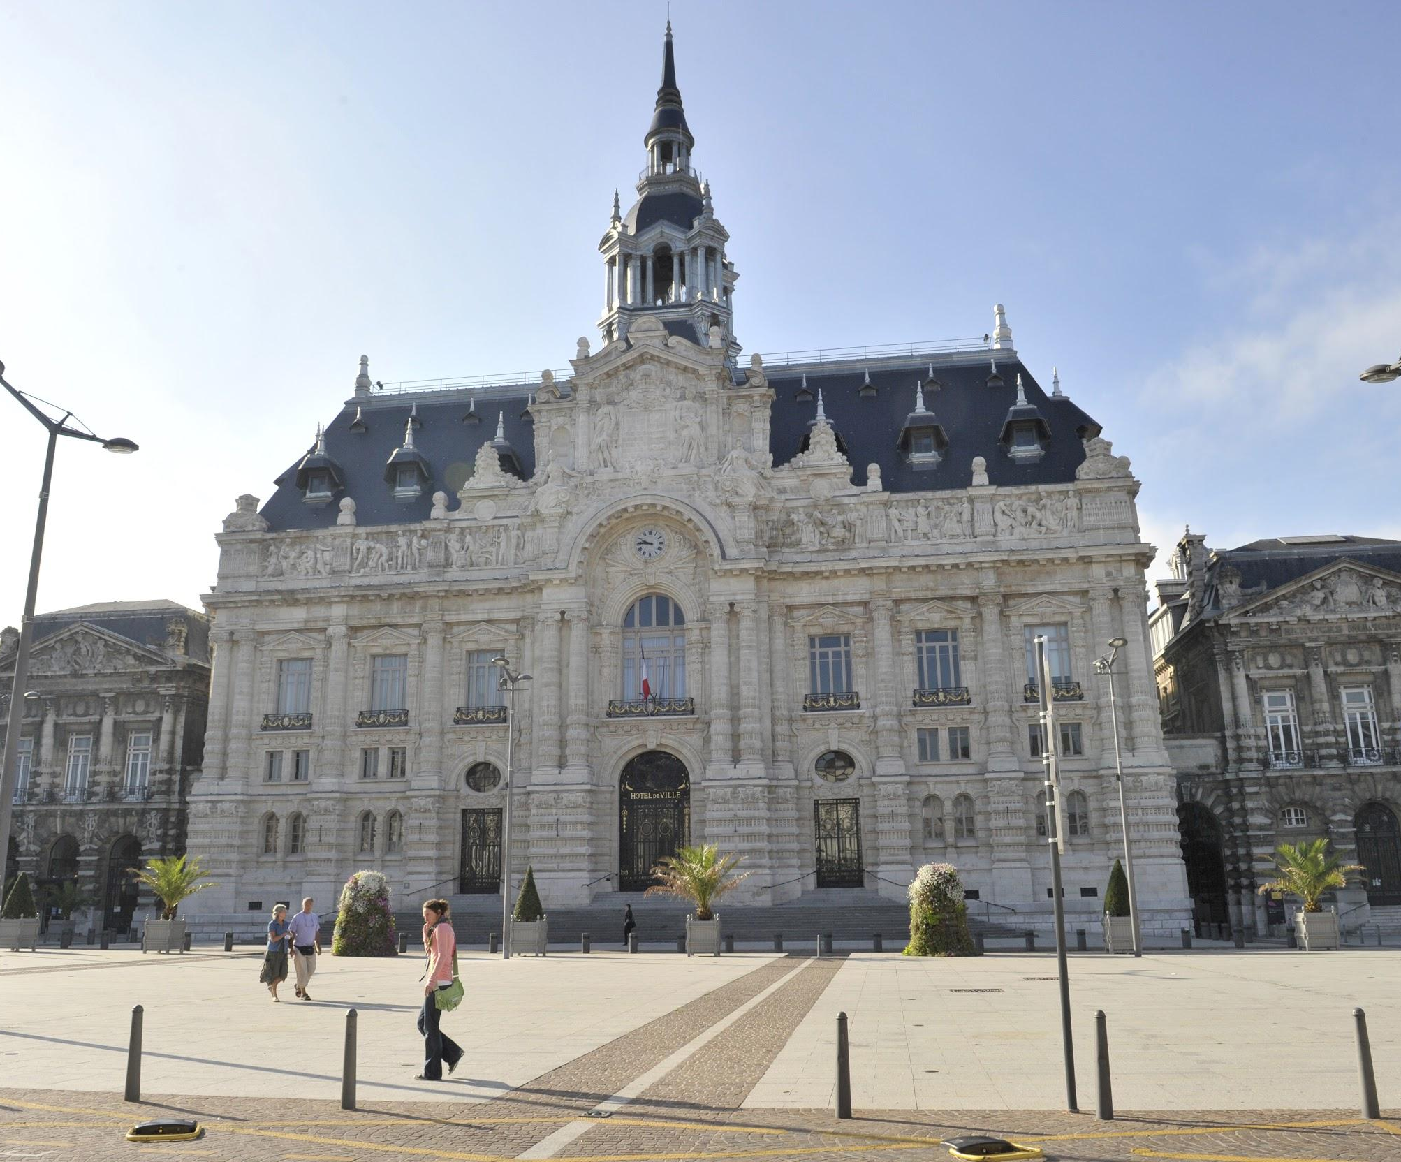
Lower runoff : 5 to 10 years
effluent infiltration device
Set urban planning rules
Work on the demand
Make it decrease !
Examples
Bordeaux mandatory on building permit
Roubaix alternative devices, infiltrating pavements, ...

Slide 11
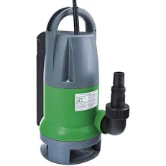
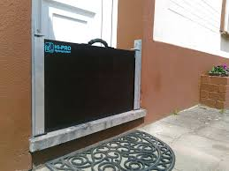
Lower the impacts
Alarm systems for a quicker reactivity
A hit ! : regular crisis training sessions with all the stakeholders
Instead of financing collective infrastructure, help the people and the entreprises to adapt their own infrastructure
Work on the demand
Lower the impacts… or make them acceptable !
Examples
Near Montpellier, 500 diagnostics made on houses and building. => a policy to buy individual underground pumps, cofferdams, ...

Slide 12


Global and Local vision
The EAGLE and the TURTLE
The Eagle :
the Global vision
Short term
Anticipation of events
Shared forces on a large scale
Long term
Points of view at various scales
Anticipation at 10, 20, 50 years
Working on the long term solutions
The Turtle :
the Local vision
Short term
Quick reactions, crisis management
Coaching of the population
Solidarity
Long term
Development of a culture of risk
Better handle chocks
Being able to set the short term actions in a long term strategy

Slide 13
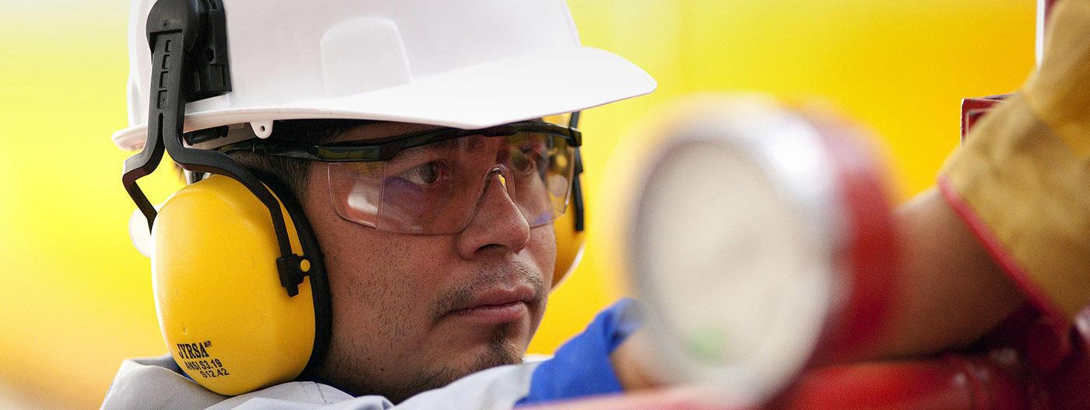

Merci

