Slide 1

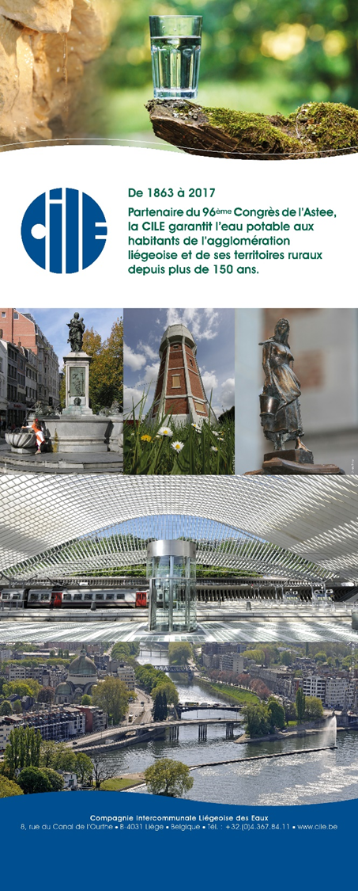
UNESCO Metropolitan “ECO – RISE” R2020 Colloquium
“Eco-development, Climate-impacts & service-Operators’ challenges for Resilient Infrastructure & Sustainable Ecosystems”
Operator’s Communication & Customer Awareness Role in Facing Service Resilience Building & Financing Challenges
Alain Palmans
CEO – Compagnie Intercommunale Liégeoise des Eaux

Slide 2
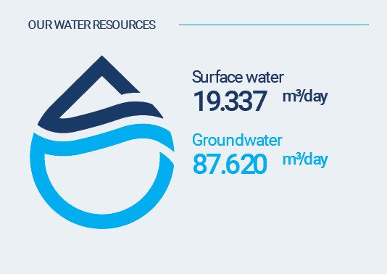
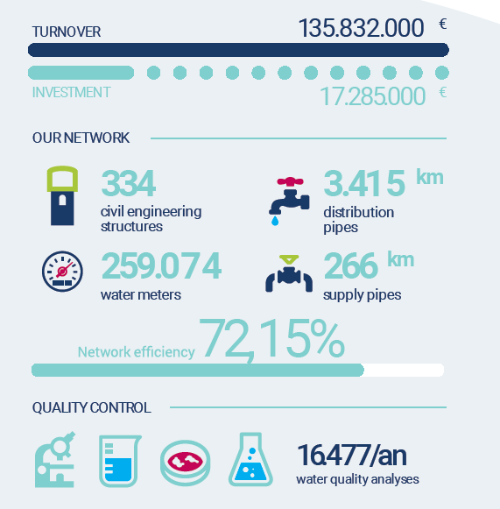
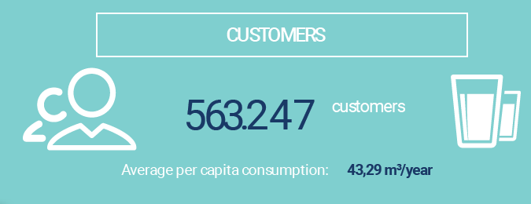
Strengthening the resilience of water services and their financing capacity
CILE in figures (2018)
Total : 39 M m³/Year
Price in m³: 5,51 € ATI
(Unsubsidised real costs for distribution
and sanitation)
Notes:
CILE requires 39 million cubic meters of water to supply the Liège agglomeration with drinking water. 80% comes from groundwater resources, the remainder from reservoirs supplied by a tributary of the Meuse

Slide 3
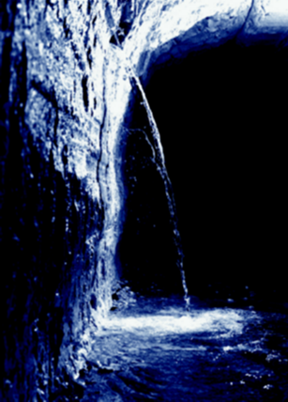
Strengthening the resilience of water services and their financing capacity
History (1): great drought of 1976
During the crisis
Exchange of resources between municipalities
After the crisis
  Merging of the water services of the 24 municipalities(1982)
    Pooling of drinking water resources
  New pumping stations to reinforce gravity intakes (financed by the European Structural Funds)
  Highly increased network meshing
Notes:
In 1976, a severe drought caused difficulties in the supply of drinking water.
During the crisis, the municipalities of Liège helped each other by sharing and exchanging their water resources.
After the crisis, measures were taken concerning both governance (merging the 24 municipalities of the agglomeration and pooling of their water resources) and the development of production capacities (new pumping stations).
These were financed by European Structural Funds.

Slide 4
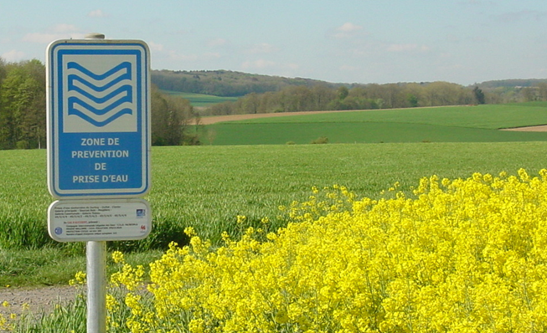
Strengthening the resilience of water services and their financing capacity
History (2)
Until 2014: three interconnected
resources
  Underground galleries in Hesbaye (15 M m³/year)
  Limestone sources of Néblon (10 M m³/year)
  Reservoirs of the Vesdre (7 M m³/year + security)
  Other
After 2014: loan from the EIB (82 M EUR)
  Doubling of supply from the Néblon catchments (about 40 km)
  Fourth resource : Hoyoux limestone sources (contractual reserve of 30.000 m³/d)
Notes:
Until 2014, the Liège region was essentially fed by three major interconnected resources:
The underground galleries of Hesbaye in northern Liège
The limestone sources of the Neblon basin in the South / West
Reservoirs of the Vesdre South / East
The latter is also an important reserve to secure the agglomeration in the event of an incident at one of the other resources.
After 2014, major new investments were made thanks to a mirror loan from the European Investment Bank. They allowed the doubling of the water supply from the catchment of the Neblon and the connection of a fourth resource. an additional contractual security of about 30,000 m³ per day.

Slide 5
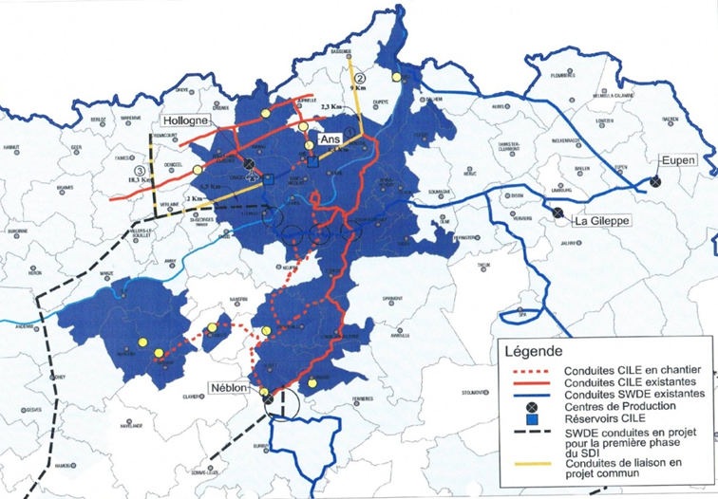
Strengthening the resilience of water services and their financing capacity
Ground Water
Surface Water
Ground Water
Ground Water
Notes:
The drinking water supply in the Liège region is therefore closely based on a networked, solidarity-based distribution model that is highly meshed and centralized around four major regional resources.
The latter are arranged in a star around the agglomeration, offering flexible and efficient security

Slide 6
Strengthening the resilience of water services and their financing capacity
Challenges: Increasing investment requirements
  Mature infrastructures: maintenance, renewal (1% in 2018), modernisation...
  Growing needs and changes in usage
  Rapid technical progress and developments in trades and professions
  Continuously increasing demands (service and quality)
  Anticipation of foreseeable, probable or simply potential consequences of global warming
  Protection/safety of network against acts of malice
  Production master plan in Wallonia: securing and rationalizing by substituting large regional resources for small local catchments (equity financing, regional grants and EIB
Notes:
The viability of this model will depend on increasing needs and the resulting investment requirments in the coming years
As infrastructures mature, they will require, in addition to maintenance, renewal and modernisation of equipment.
Increasing needs and changes in usage.
The need to incorporate rapid technical progress
Developments in trades and professions
Increasing demands, both on the quality of the water and on the services that will be associated with it
Anticipating the consequences of global warming, including vis-à-vis those that are simply probable
The need to protect against the growing risk of malicious acts
Considerable investments are already under way to strengthen the supply of certain areas of Wallonia by replacing large regional resources with small, inefficient local catchments.

Slide 7
Strengthening the resilience of water services and their financing capacity
Threat: reduction in consumption (barely 100l per person per day in Wallonia)
  Rational and economical use of water
  Individualization of society => development of alternative and individual modes of supply
    Rainwater collection (rainwater tanks…)
    Direct access to sources (farmers, businesses and even private persons)
    Private networks (housing developments, apartment complexes…)
      Non-potable water networks => connection to public networks only for drinking water (barely 10-15% of requirements) and for security of supply in case of problems
      Drinking water networks => connection to public networks purely for reasons of supply security.
    In the long term => reuse of «grey water»
Notes:
However, it will be difficult to finance this purely through consumers, other avenues will have to be considered.
In addition, the continuous reduction in consumption (already barely 100 liters per person per day in Wallonia) constitutes a significant threat to the financial resources of the sector. It results from different factors:s :
The rational and economical use of water
The individualisation of society with the development of individual and alternative supply methods including:
Rainwater collection
The use of private networks in real estate projects whether it is non-potable water (connection to the public network is only required for drinking water barely 10-15 % of consumption) a backup supply in case of problems with the private network, or even private drinking water networks.
In the long term, wastewater recovery

Slide 8
Strengthening the resilience of water services and their financing capacity
Consequences: pressures on the viability of the collective and inclusive water access model
  Increased costs per m³ (80 % of the fixed costs)
  Oversizing of networks
    Quality risks
Questions/challenges
  How to safeguard drinking water access everywhere and for everyone?
  How to safeguard the collective, inclusive model?
  Does an alternative model exist?
  How can operators integrate and take control of these paradigm shifts?
  How to convince the authorities of a fair balance of interests while still respecting the common good?
Notes:
The consequences of this development will be hard for the Western collective and inclusive model of water accessibility. With fixed costs at 80%, the charges will be spread over a smaller volume of distributed water, increasing the pressure on the water price to the detriment of populations that will not have access to alternatives, usually the most vulnerable.
The question of safeguarding access to water for everyone everywhere is already being posed.
How can the authorities be sensitized to a fair balance between individual interests and the common good.

Slide 9


Strengthening the resilience of water services and their financing capacity
CONCLUSIONS
The question is barbed because it requires no less than ensuring the resilience of the collective and inclusive water access model while reconciling it with the three contradictory dimensions of sustainable development:
  Investment
  The environment and the rational use of resources
  Social policy in a difficult economic context

