Slide 1
Flood management and governance
Oriana Romano, PhD
Coordinator, OECD Water Governance Programme
Experience Sharing Colloquium of Local Governments, Water and Wastewater Utilities & the Research Community
& November 2019, UNESCO, Paris

Slide 2
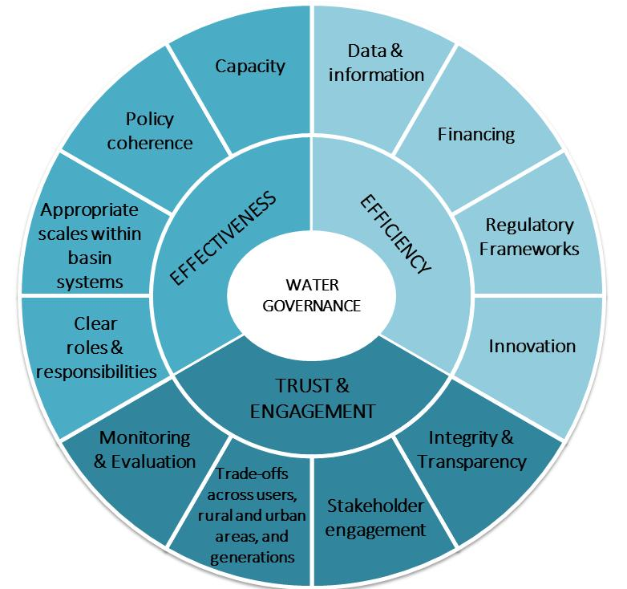


The OECD Principles on Water Governance
www.oecd.org/governance/oecd-principles-on-water-governance.htm
https://www.oecd.org/environment/resources/Council-Recommendation-on-water.pdf

Slide 3

Applying the OECD Principles on Water Governance to Floods
Key challenges for effective, efficient, and inclusive flood governance
Fragmentation of institutions, responsibilities, policies, data
Coordination misalignment between water and land management
Place-based approaches to floods are insufficient
No widespread systemic and comprehensive approach

Slide 4
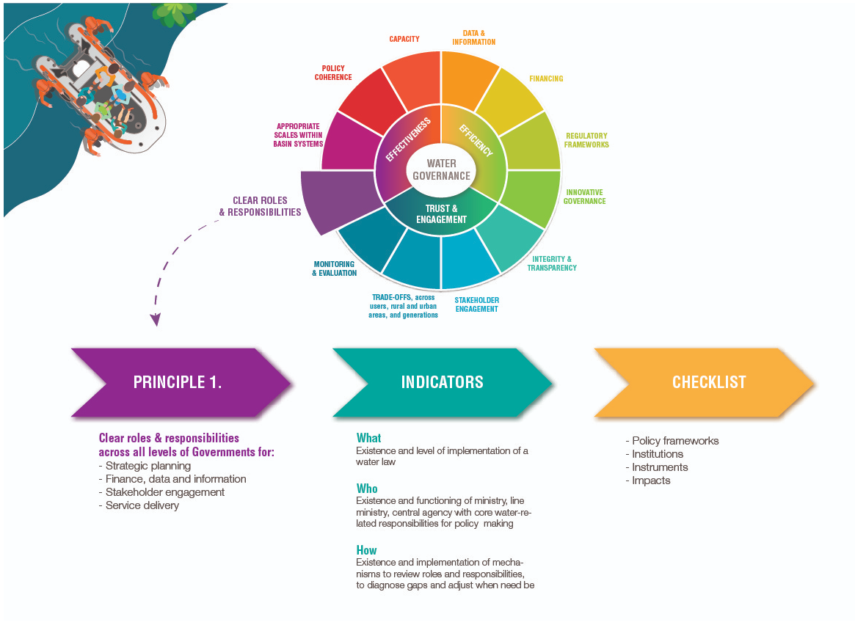

Slide 5
Thank you www.oecd.org/cfe/water oriana.romano@oecd.org

