Slide 1



Ecohydrology Solutions in Urban Setting Ecohydrology Programme of UNESCO
UNESCO “Metropolitan ECO-RISE R2020” Colloqium
7-8 November 2019, UNESCOParis
Giuseppe Arduino
Division of Water Sciences,
UNESCO International Hydrological Programme
Paris, France

Slide 2
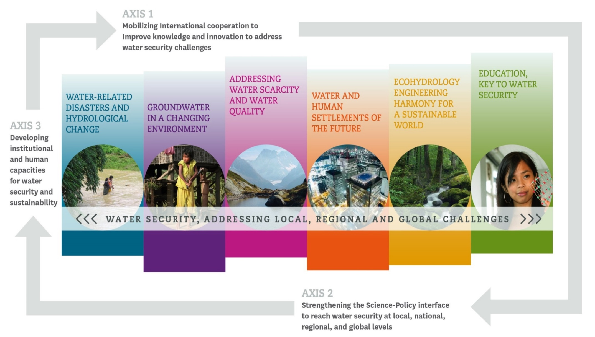
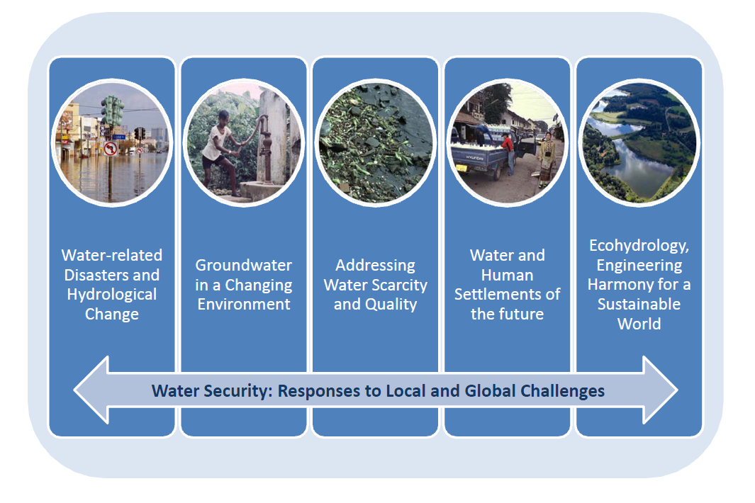
IHP’s Eighth Phase
3 Axes
Axis 3: Enhancing policy advice to reach water security at local, national, regional and global levels.
6 Themes

Slide 3
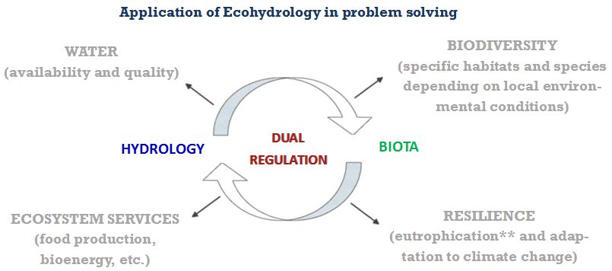
What is Ecohydrology?
Is an integrative science studying the interaction between hydrology and biota and using natural processes as management tools to reinforce ecosystem services on a broad range of landscapes (e.g.: coastal, urban and agricultural areas)
Ecohydrology aims to increase resilience of river basins by managing multi-dimensional parameters which are Water, Biodiversity, Ecosystem Services for society, Resilience to climatic changes and Cultural dimension (WBSRC), all in order to achieve sustainability in both ecosystems and human population
W
B
S
R

Slide 4
Ecohydrology- WHY?
the decline in quality and biodiversity, observed at the global scale in developed and developing countries, has provided
evidence that conventional approaches to water resource management, based on application of engineering techniques, sectoral interventions and the elimination of direct threats such as point source of pollution, are important but not sufficient

Slide 5
Ecohydrology- WHY?
Ecohydrology AIMS to find solutions that, rather than focusing exclusively on technical issues, better respond to sustainable water resource policies and promote social development with stakeholders’ participation at all levels to make integrated water resource management (IWRM) successful.

Slide 6
Ecohydrology- WHY?
Sustainable management of landscapes should be an integral part of the IWRM that must address the big questions of our time - questions about eradicating poverty, enhancing food security, promoting sustainable energy, managing water and environmental resources, controlling disease, mitigating natural and man-induced disasters, and fostering sustainable cities
The development of solutions to these global challenges need to be based on trans-disciplinary approaches recognising cultural and time dependent dimensions of human wellbeing.

Slide 7
Ecohydrology- WHY?
SO THERE IS A NEED FOR AN INTEGRATIVE SCIENCE

Slide 8
I – FIRST PRINCIPLE (Zalewski 2010) Hydrological principle
Quantification of hydrological processes (cycle) as a template for
biogeochemical cycles analysis in a catchment scale, and identification of threats
Precipitation
Evapo-transpiration
Infiltration
Total run off
Retention
Subsurface run off
Surface run off
groundwater flow

Slide 9

II – SECOND PRINCIPLE
Ecological principle
Identification of biological processes and of potential areas for enhancement of ecosystem carrying capacity
RETENTION IN THE CATCHMENT
by enhancement of landscape diversity
TRANSFORMATION
into biomass in land water ecotones
Hot spots
DENITRIFICATION
in anaerobic conditions of wetlands
TRAPPING
in plant biomass (seasonally removed)
storage in the unavailable pool in bottom sediments
SELFPURIFICATION
mineralization of organic matter
reduction of spiraling transport rate
SEDIMENTATION
pondage
at the floodplain
RECIRCULATION
reduction of resuspension
phosphatase – enzymatic release
zooplankton excretion
HYDROLOGICAL CONTROL
hydrological control of biotic feed
back towards water quality
improvement in reservoirs
BIOFILTRATION
- reduction of algae biomass
by biota

Slide 10

III – THIRD PRINCIPLE
Ecological engineering principle
Using biota to control hydrological processes and
vice versa, using hydrology to regulate biota dynamics
H
B
Dual regulation
REGULATION
CONSERVATION
Bioenergy
production
Diffuse pollution buffer stripes (ecotones)
Aquaculture
Reservoir –
Hydrobiomanipulation
Land reclamations
RESTORATION
Water retentivness
ECOLOGICAL ENGINEERING-constructed wetlands, ecotones
River continuum –bypass for fish migration
Sediment release/use system

Slide 11
Ecohydrology Action Areas

Slide 12

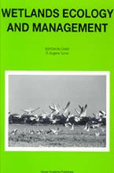
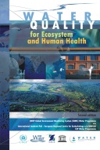



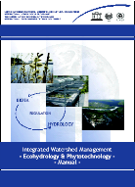
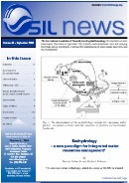

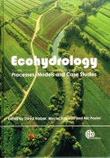
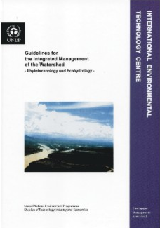
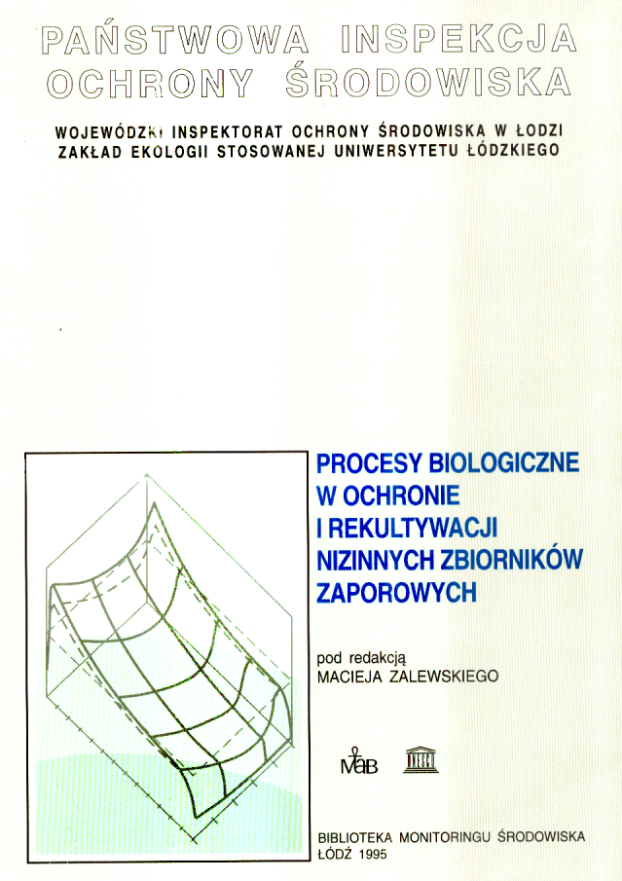
Evolution of Ecohydrology Program
GOAL
Transdisciplinary
Stakeholder
needs
Advanced science
Reversing river basin and coastal zones degradation
EH
Ecol
Hydr
Econ
Eng
Interdisciplinary
Ecol
Hydr
Multidisciplinary
Fundamental science
Ecol
Hydr
Dual regulation
Ecol
Geo
Econ
Years; Events
1990
1995
2000
2005
2010
Notes:
Twenty years ago Ecohydrology was introduced as a new paradigm (ZalewskiZalewski et al., 1997), which could help solve the main problem of loss of ecological quality of water, at the basin scale. For the first 5-7 years the paradigm was refined and seen to take its place as a sub-discipline of Hydrology (Kundzewicz, 2002). Its role was succinctly expressed by Bonnell (2002) as “providing a means of integrating landscape hydrology with freshwater biology, and this is the important paradigm shift”. It was quickly realised that the paradigm development was supported by three academic disciplines: – hydrology; ecology and social social science, which integrated three critical issues – water, nature and people. This approach meet the need for a better integration of the efforts of the scientists representing the three disciplines, increasing the chances for a better addressing the rising global challenges, and elaborate innovative solutions.

Slide 13

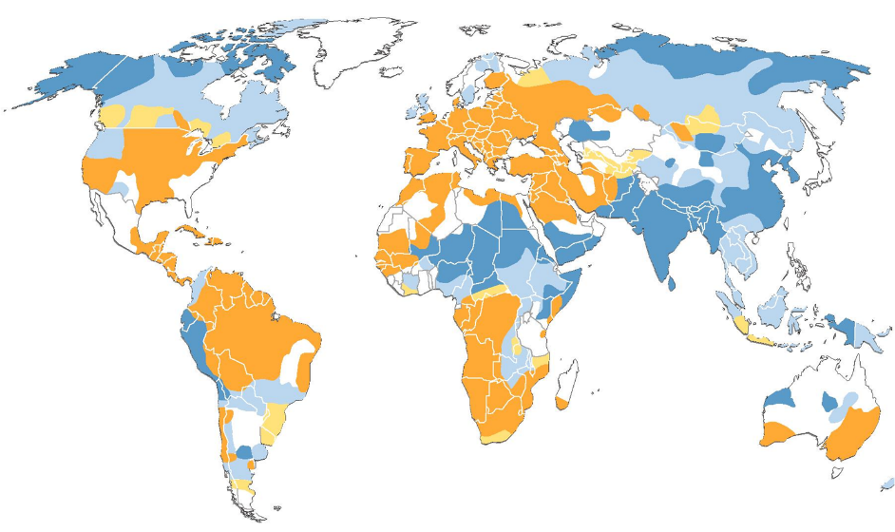
Unesco’s Ecohydrology “family”
SCIENTIFIC ADVISORY COMMITTEE
MEMBERS - IHP COORDINATION
2
IHE
ERCE
1 – RESEARCH
2 – EDUCATION, CAPACITY BUILDING
3 – OUTREACH AND DISSEMINATION
2
ICCE
1,2,3
ASPAC
2
2
1,2,3
CENTRES:
ICCE - International Centre For Coastal Ecohydrology, Portugal
ERCE - European Regional Centre For Ecohydrology, Poland
ARCE – African Regional Centre For Ecohydrology, Ethiopia
APCE – Asia-pacific Centre For Ecohydrology, Indonesia
CIH – International Centre On Hydroinformatics, Brazil
CHAIRS:
Ecohydrology And Hydroinformatics – Capital Normal Univ. Beijing
Ecohydrology – Ihe, Delft
Ecohydrology: Water For Ecosystems And Societies, Univ Algarve,
Faro, Portugal
FOCAL POINTS FOR ECOHYDROLOGY
LAC – Latin America And Caribbean
ARCE
LAC
APCE
L. Chicharo, 2016
G. Arduino, 2018

Slide 14

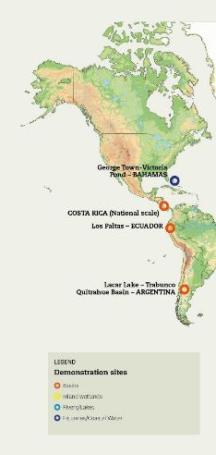
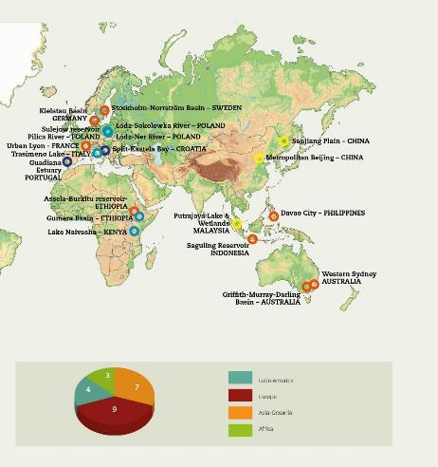
Theme 5: Ecohydrology
8 out of the 24 Sites are established and currently operated by 4 Water Centres & 2 Water Chairs
They integrate the concept of “enhanced ecosystem potential” with EH strategies closely related with water to improve IWRM on specific areas.
UNESCO IHP Ecohydrology operates through 24 demonstration sites in 18 Countries

Slide 15

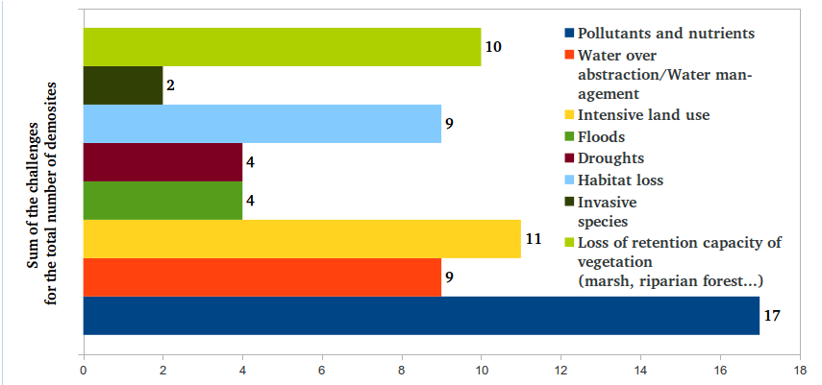
Major issues addressed by the demonstration sites
The three main threats are the excessive presence of pollutants and nutrients, intensive land use and loss of retention capacity of vegetation.
Notes:
Ordre ascendant/descendant + logos

Slide 16


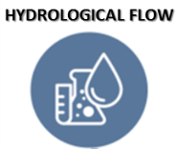

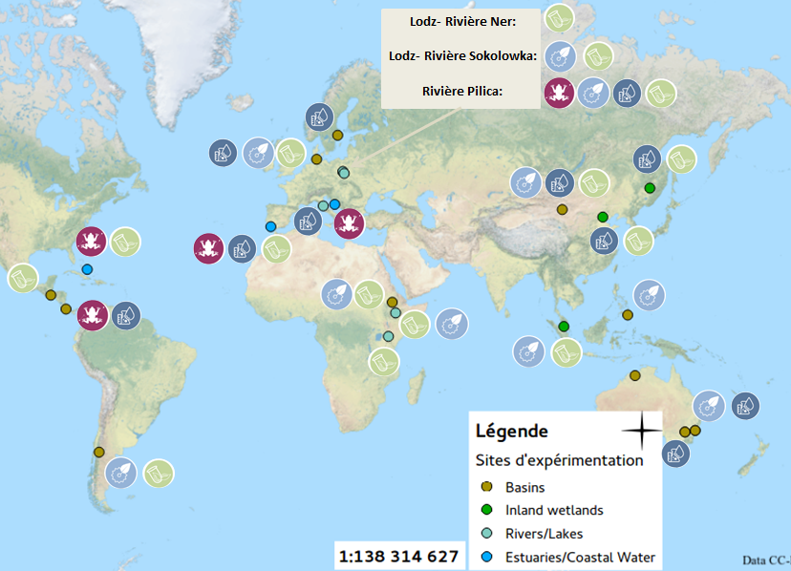
Application of ecohydrology
Four ecohydrology engineering solutions:
Lodz-Ner River:
Lodz-Sokolowka River:
Pilica River:
65% of the demosites are using the phytotechnologies as EH solution.
48% -> hydrological flow
43% -> ecohydrological infrastructure
22% -> faunatechnology
Legend
DEMOSITES

Slide 17
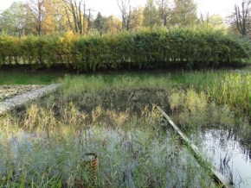

Ejemplos de demosites
Demosite Lodz – Sokolowka River
(Poland)
ECOHYDROLOGY BASED URBAN WATER MANAGEMENT AND CITY PLANNING FOR HUMAN HEALTH AND SUSTAINABLE DEVELOPMENT (LODZ, SOKOLOWKA RIVER)
Łódź is the 2nd city in Poland with 768.755 habitantes. There are 18 small water streams crossing Łódź. Sokolowka River flows flows through the north part of Łódź and it is supplied by 50 outlets of rain water.
Objectives:
Rehabilitation of the Sokolowka River and its valley.
Elaboration and and legalization of the Blue-Green Network Concept
Implementation of best management practices by developers in storm water management
Formulation of strategic documents
Ecohydrology engineering solutions applied:
Construction of reservoirs to mitigate the extreme storm water flow
Storm water purification in sedimentary-biofiltration system
Phytotechnology in reservoirs for the development of blue-green network in urban areas health and quality of life
Humedales construidos
LATEST RESULTS
The sequential storm water purification system reduced N and P concentrations of 60% , and the technology was transferred to other river systems in Lódz

Slide 18
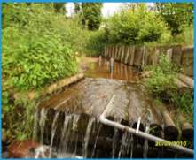
Constructed Porous Riffle in the Urban Periphery of Lyon (France)
SINCE 2008 A PILOT SITE USING ECOHYDROLOGICAL PRINCIPLES IN THE URBAN PERIPHERY OF LYON, FRANCE.
Objectives:
To implement a solution based on natural processes to filter and store the pollution emitted by a combined sewer overflow outlet, to subsequently bio-transform or digest this pollution by mechanisms based on natural processes, with the aims to improving the self-purification capacity of these seasonal river overflows, including sewers.
Ecohydrology engineering solutions applied:
Through previous scientific publications and fieldwork, scientists found that porous sediment in a river can be a powerful bioreactor and, based on this, the development of a system called "permeable landfill" was elaborated, allowing sediment accumulation and increasing the transfer of water within it; thus, an artificial ripple was built in the river.
LATEST RESULTS
It was confirmed that artificial porous riffles can help to filter and process organic pollution emitted by a combined sewer overflow system.

Slide 19



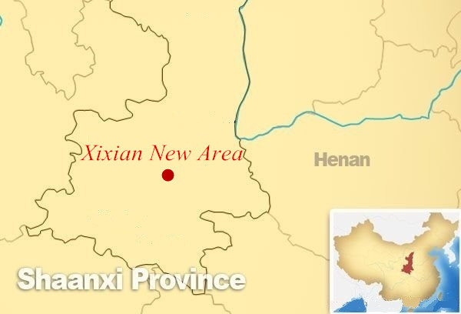
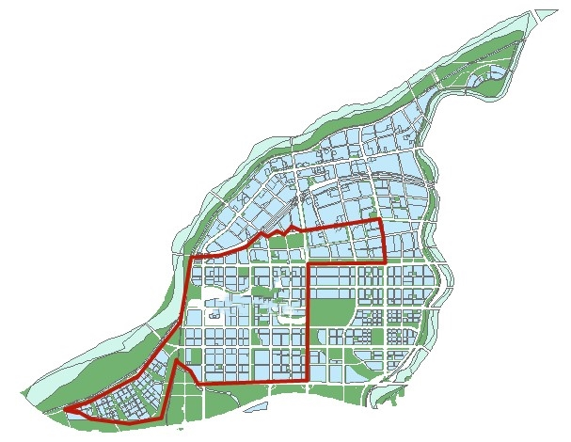
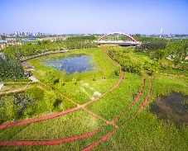




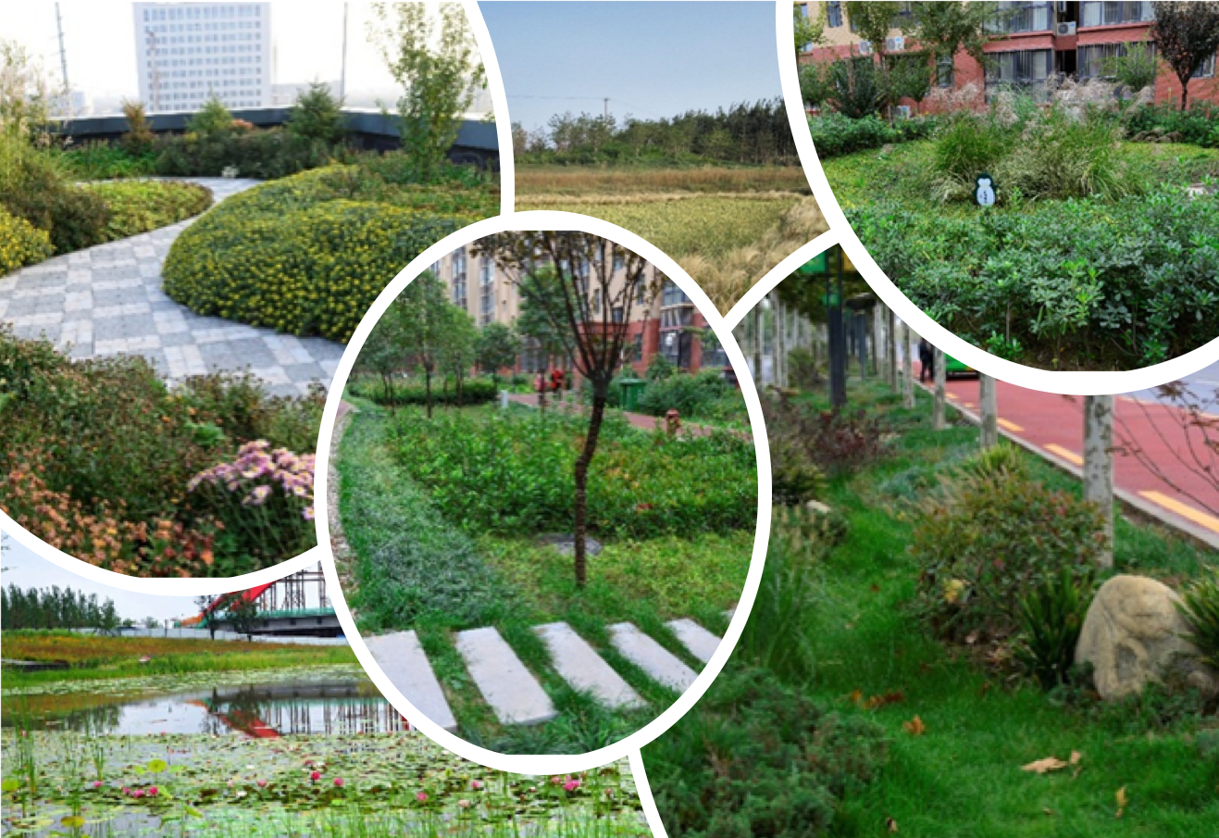





Fengxi Sponge City Demonstration Site
SITIO DEMOSTRATIVO
Demonstration site description
Major issues
F
Floods
P
Pollutants and Nutrients
D
Droughts
Up-dated in March 2018
Lithology/geochemistry
Malodorous black river ; Urban waterlogging; Water resources shortage; Habitat Loss; Loss of Retention capacity of vegetation; Water ecological fragility
H
Habitat Loss
L
Loss of retention capacity of vegetation
The quaternary loose deposits are all within 300 meters underground, and the aquifer is made of sand, gravel pebbles and part of loess.
Main Description
N34°16′36.39″ E108°41′58.43″
Fengxi Sponge city((i.e. Fengxi New City)
Fengxi Sponge City is located in the Fenghe catchment, Shaanxi, northwestern arid area of China, with a total area of 143.17 km² and a population of 169,308.The central 22.5 km² is the sponge pilot area (identified with red outlines).
Social-ecohydrological system
Catchment Ecohydrological sub-system
Catchment sociological sub-system
Flood, Fresh water, local climate and air quality regulation, moderation of extreme events, waste -water treatment, erosion and non-point source prevention, recreation and mental and physical health, habitats for species
EH Objectives
EH Methdology
Objectives
Stakeholders
Water
Investigation and observation; Positioning monitoring; Data collection and processing; Mathematical modeling
and analysis.
Improve the living environment; Enjoy the body and mind; Construct a healthy and harmonious social-ecohydrological system.
Government; Residents; Companies; Xi’an University of Technology, Chang’an University, Northwest A&F University, Xi’an University of Architecture and Technology; Xianyang Meteorology; Xi‘an Highway Institute.
Biodiversity
One of the first national demonstration sites for Sponge City Construction in China
Ecosystem Services
Conserve Ecohydrological processes in Natural ecosystems
Enhance Ecohydrological processes in novel ecosystems
Apply complementary Ecohydrological processes in highly impacted systems
Resilience
P
Yes
P
Yes
P
Yes
Cultural or
social dimension
Are inputs to:
Set conditions for:
Set conditions for:
Participate in:
Ecohydrology Principles and solutions
Life zones
Activities
* Quantification of the hydrological processes at catchment scale and mapping the impacts
* Identification of potential areas for enhancement of ecosystem sustainability potential (carrying capacity).
* Managing biota to control hydrological processes and vice versa (ecological engineering)
Warm temperate dry forest
Social investigation , opinion poll ,observation and monitoring , rainwater harvesting, Information sharing, sponge concept promotion in campuses
EH IMPLEMENTATION PRINCIPLES
Precipitation (mm/yr)
T (°C)
520
13.6
EH SOLUTIONS
PET Ratio: 1.541
Elevation: 380~470
Humidity: subhumid
Results
Low elevation greenbelt , rain garden, vegetation ditch, rainwater wetland, rainwater purification corridor, embankment and vegetation buffer zone, green roof, regulation pond, etc.
Main Expected Result
Pollutants and floods control, rainwater utilization, ecosystem restoration, landscape, public space for residents
Ecohydrological infrastructure
Hydrological flow
LATEST RESULTS
More than 60% annual SS load in the sponge pilot area (22.5km²) is left on the land.
More than 70% annual rainfall runoff is harvested or infiltrated in the soil, and waterlogging rarely occurs in the sponge pilot area (22.5km²).
The water quality of fenghe river and weihe river crossing the pilot area respectively reaches class Ⅲ and Ⅳ(GB3838-2002,China) on the whole.
Phytotechnology
Contact: Prof. Dr. Jun XIA
Contact: Prof. Dr. Jiake LI
Developed by:
An initiative of:
E-mail: xiajun666@whu.edu.cn
Chinese Academy of Sciences ,Beijing, China
E-mail: xaut_ljk@163.com
Xi’an University of Technology, Xi’an , China

Slide 20
Dissemination strategy of the ecohydrology concept
Reflect on the way to harmonise the scientific data produced/acquired in the different ecohydrology demosites in order to
facilitate the dissemination of the Ecohydrology concept to scientists, Member States and the general public.
2015-2016
New design of the EH demonstration sites
network within IHP-VIII
Design of “demonstration site Cards”
Collect scientific information and elaborate them in a standardized/harmonised synthetic card
for each demonstration site

Slide 21

Web platform: an interactive network
(collaboration with CIH, Itaipu’)
The web-platform is the interactive environment that will enhance the dissemination of the ecohydrological concept within different targets, from scientists to general public and to Member States
ecohydrology-ihp.org

Slide 22
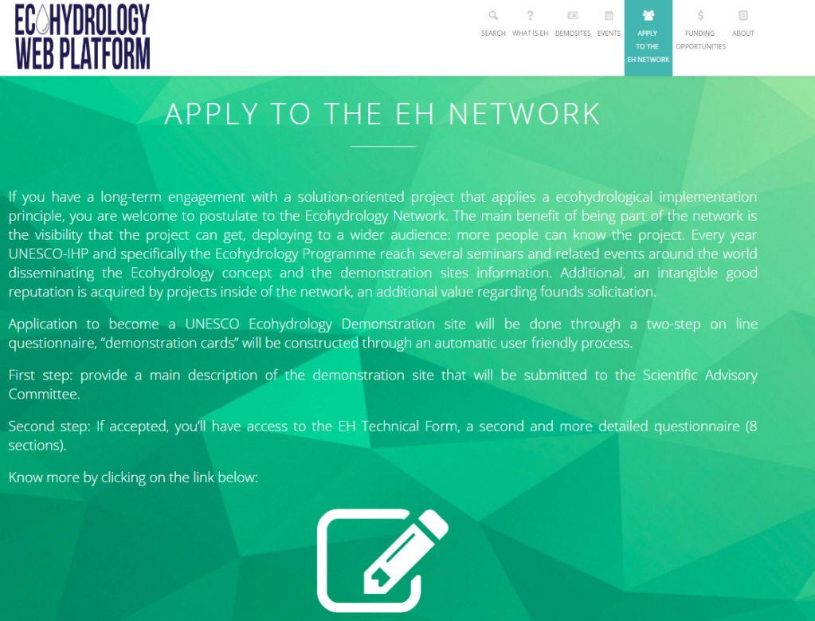
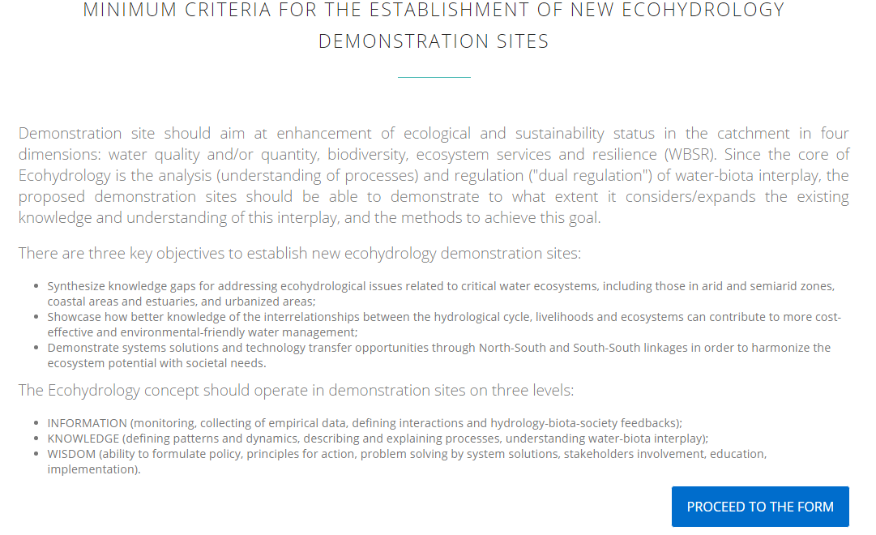
Apply to the EH network
Application to become a UNESCO EH Demonstration site will be done through the web platform and “demo cards” will be constructed through an automatic user friendly process.
Notes:
A METTRE A JOUR SI ON A LA VERSION FINALE

Slide 23
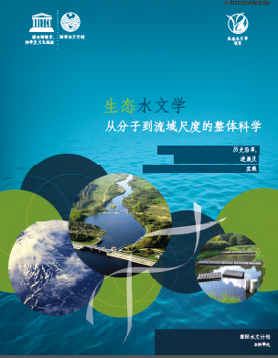
Dissemination Material
Ecohydrology as an integrative science from molecular to basin scale (2016).
Historical Evolution, advancements and implementation activities
Now available in English, Spanish and Chinese
Notes:
A METTRE A JOUR SI ON A LA VERSION FINALE

Slide 24
Thank you for your attention
ecohydrology-ihp.org
g.arduino@unesco.org

