Slide 1
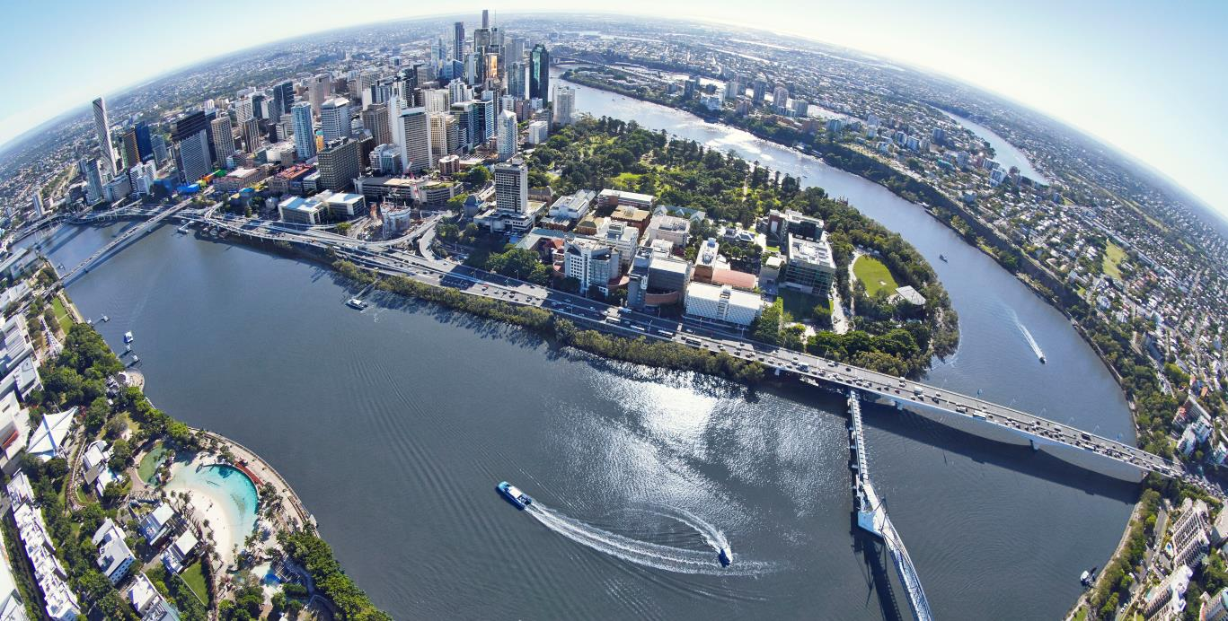
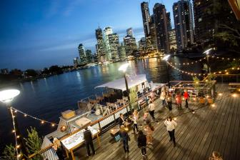
Water Industry Perspectives and Adaptation Challenges to climate Change Impacts
DIANE D’arras IWA president

Slide 2
international Water Association
A charity (non-profit organization) with members in more than 130 countries,
A unique, global knowledge hub for water professionals
connecting scientists to practitioners and communities so that pioneering research delivers sustainable solutions
fostering technological innovation and drives best practice through international frameworks and the specialists groups

Slide 3
International & environmental context/challenges have changed strongly since 4/5 years

Slide 4

Blue infra has now its own place!

Slide 5
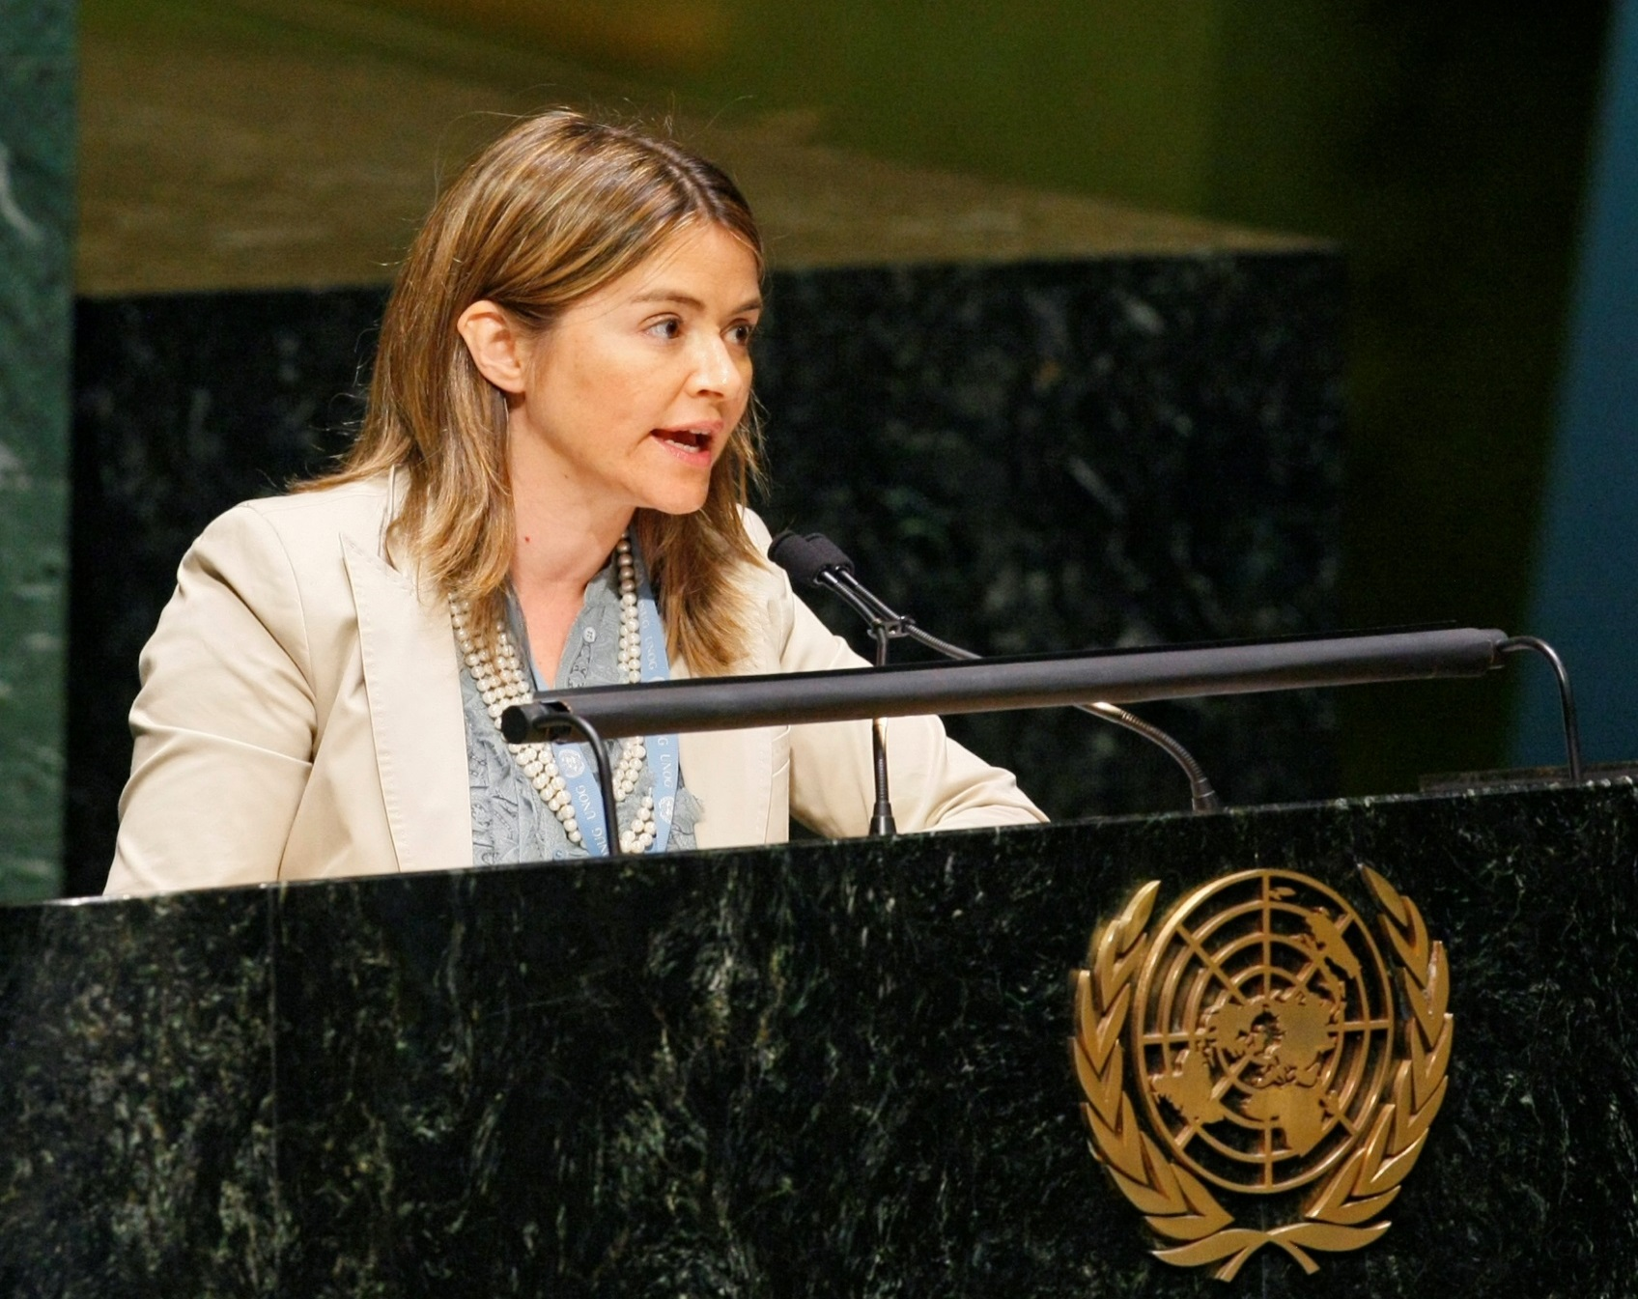
THE Right to water

Slide 6

challenge 1: LEAVING NO ONE BEHIND
Notes:
Right to water is still a challenge in its application and not only in developping countries

Slide 7
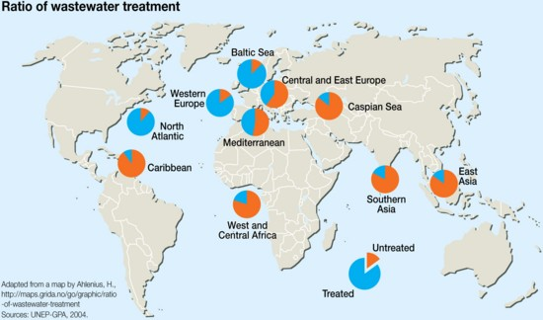
Challenge 2:
80% of wastewater is untreated

Slide 8

COP 21 : a great political momentum

Slide 9
Water Industry Perspectives and Adaptation Challenges to climate Change Impacts
DIANE D’arras IWA president

Slide 10
Climate mitigation : challenges
France/Germany 7500 Kwh/p/y
Water production: 30 Kwh/p/y for 70 m3/y (if no desal)
Water distribution: 35 Kwh/p/y for 70 m3/y
W. Water treatment: 70/150 Kwh/p/y for 70 m3/y
70m3/y is 170l/d TOTAL: 200 Kwh/p/y

Slide 11
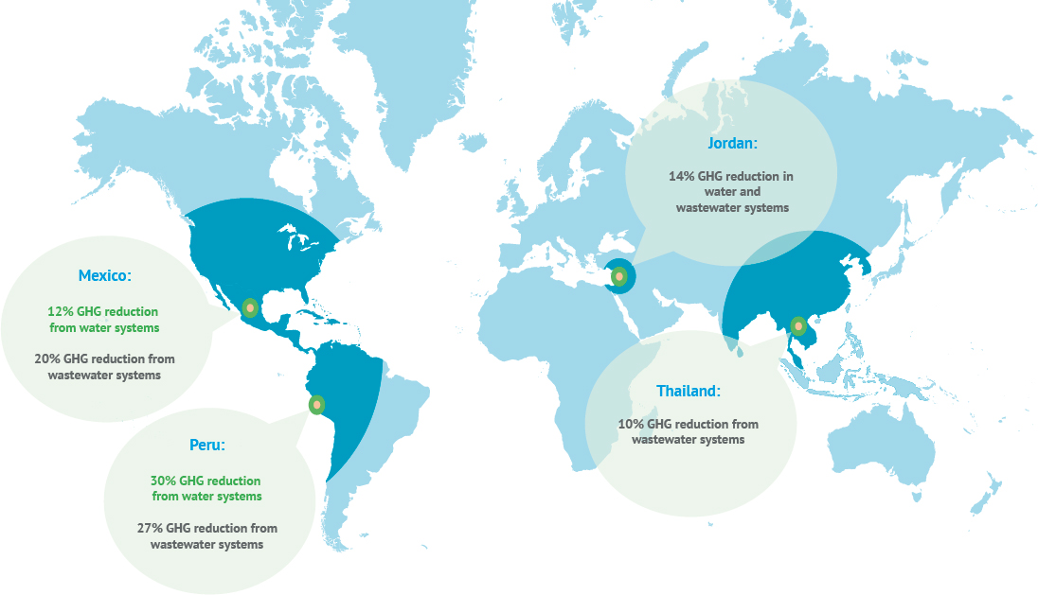
Climate mitigation: wacclim project

Slide 12
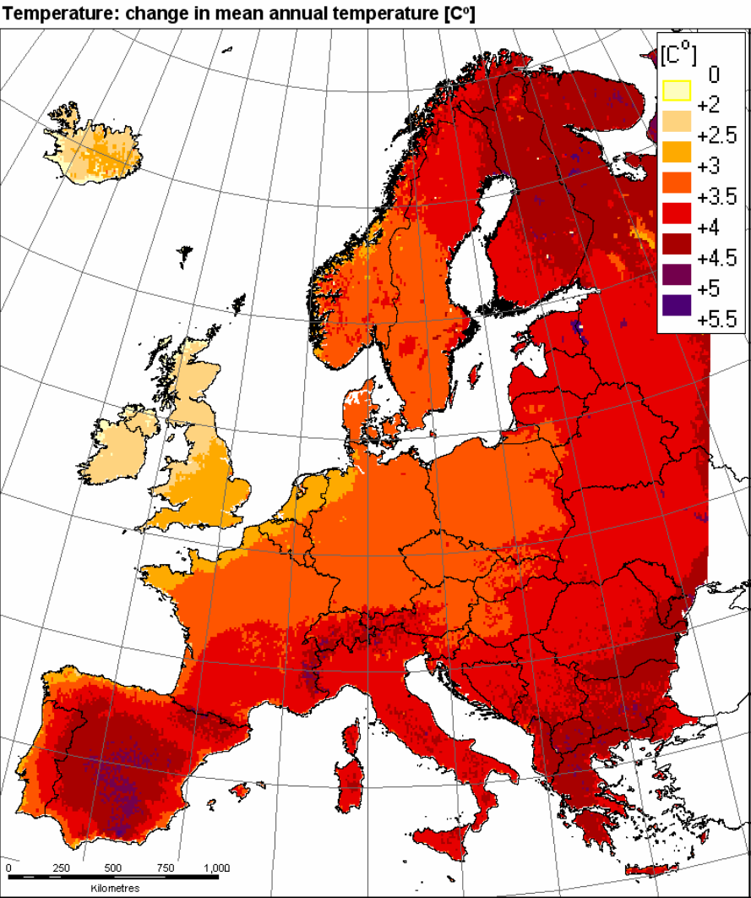
Adaptation and resilience: challenge
Climate change: what we fear !

Slide 13
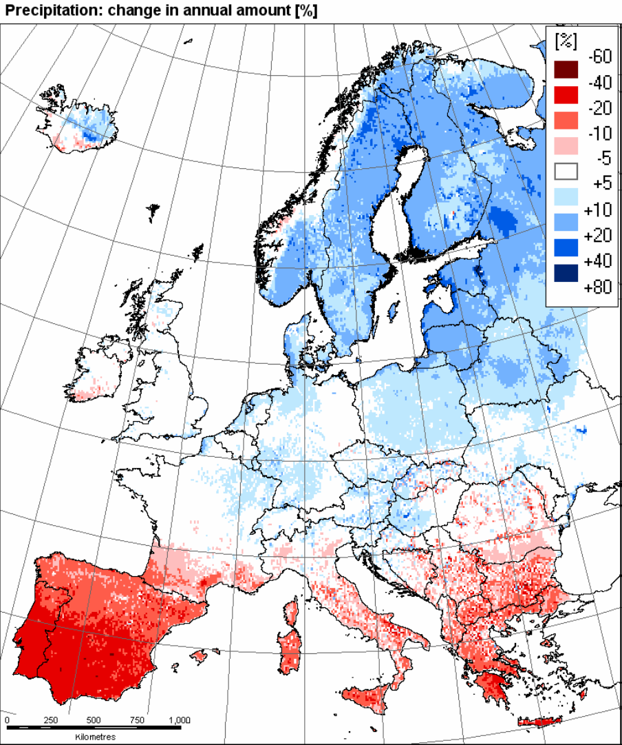
what we do not know so well
Precipitation change in annual amount %

Slide 14
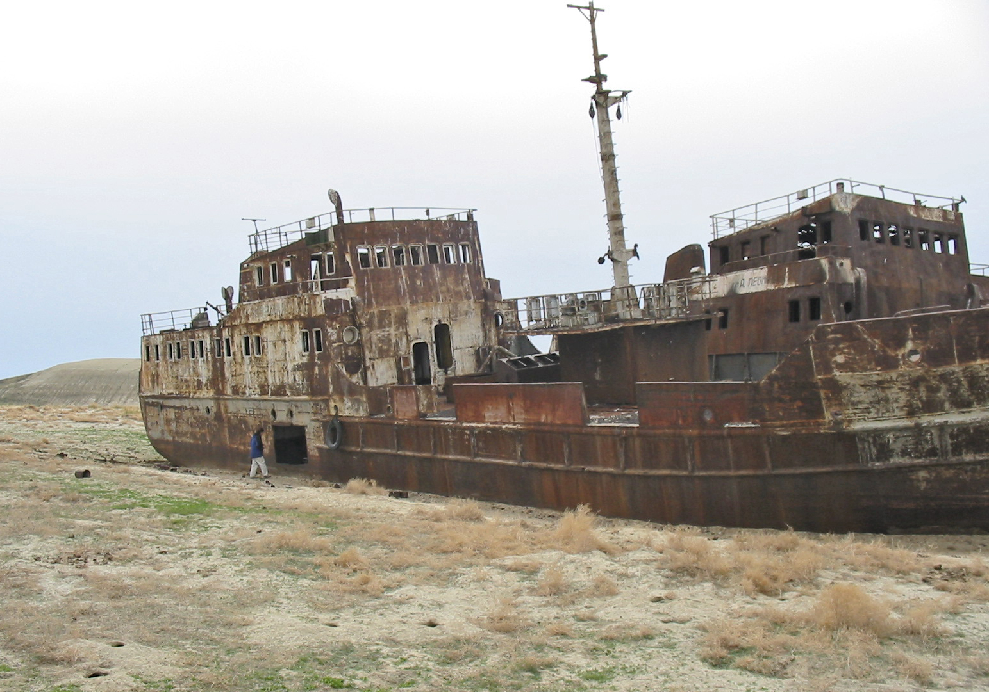
WHAT WE see
An abandoned ship in the former Aral Sea, near Aral, Kazakhstan.

Slide 15
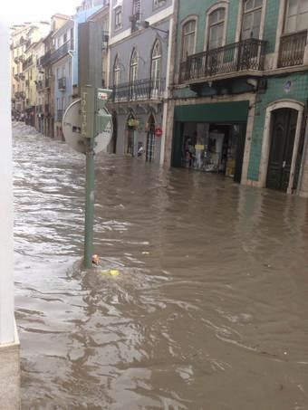
WHAT WE see

Slide 16
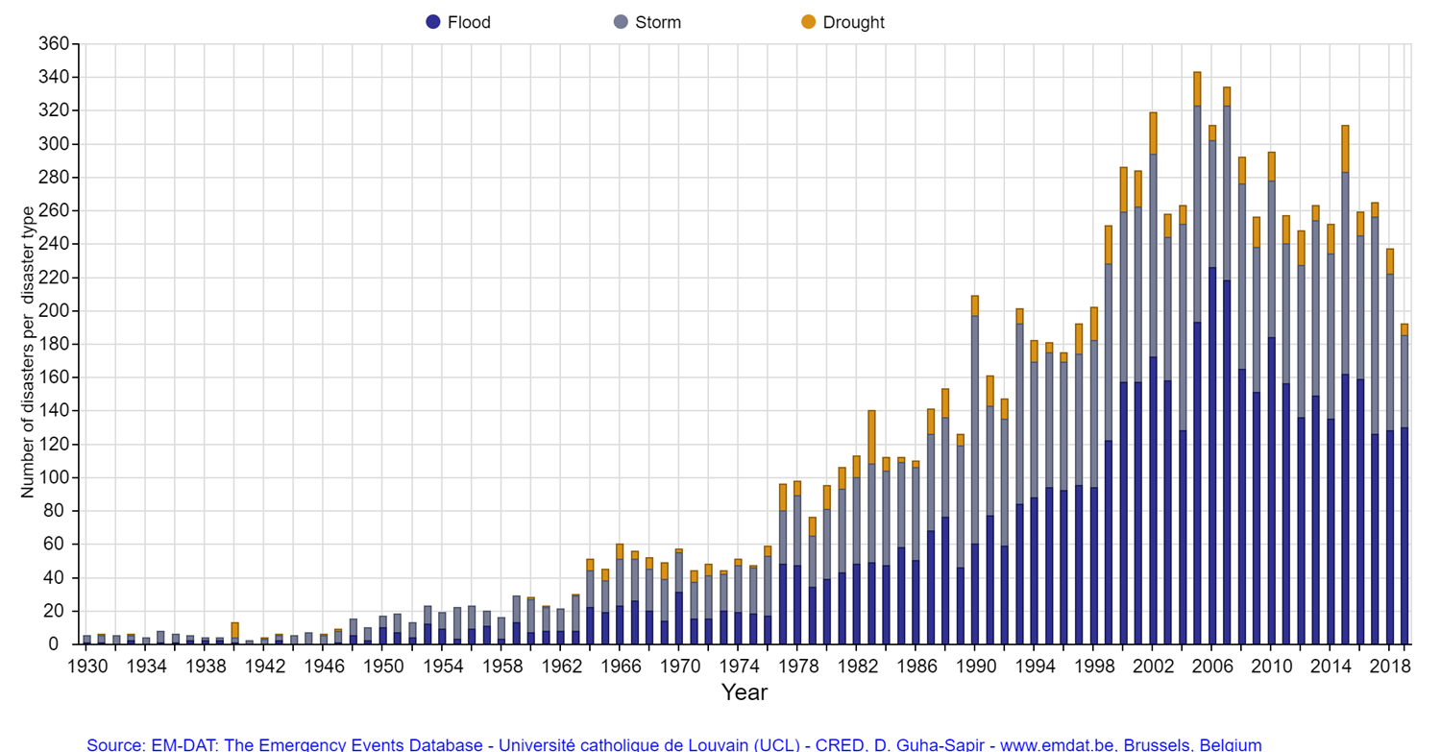
WHAT WE mesure: Number of disasters per continent !

Slide 17
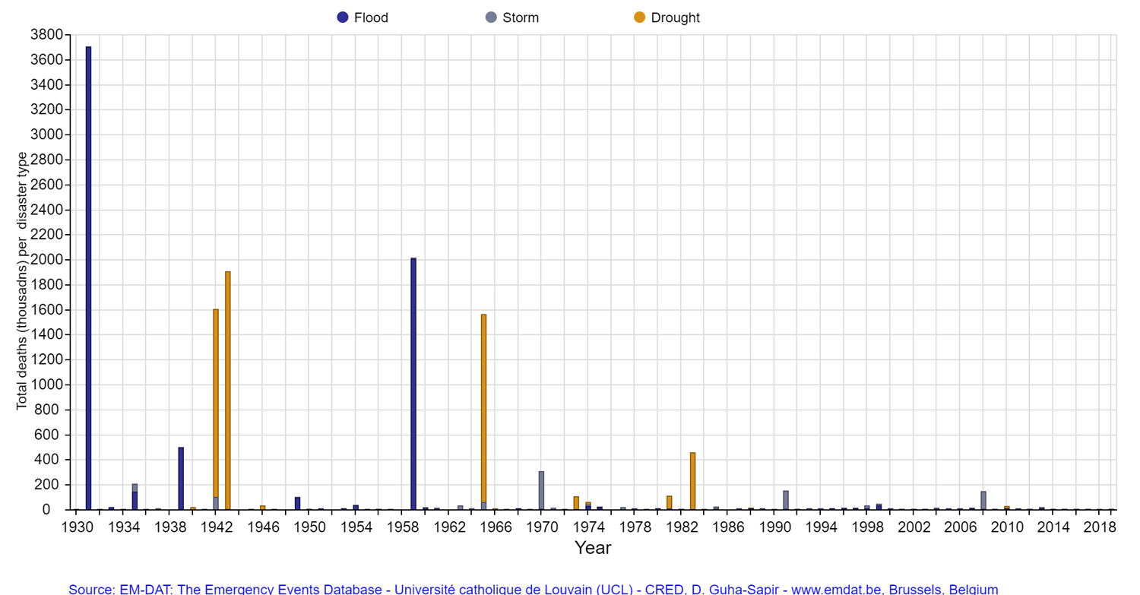
Impact of disasters
death (1000) per type
… anticipation and resilience are key

Slide 18
Anticipation and Resilience are key
Assessment of the situation
Predictive tools & alert systems
Optimization of existing facilities
UNDERSTAND
the local context & the working of your wastewater system
IMPROVE the efficiency of your current infrastructures
ANTICIPATE, MEASURE, ALERT
Planning
New installations
DEFINE
together an action plan meeting your objectives
DESIGN, BUILD, OPERATE
new suitable stormwater infratstructures

Slide 19
ICT part of the solution

Slide 20
Reengineering in general
Reduce the amounts of water and energy used
Reuse and use diverse sources of water with treatment that matches the use—“fit for purpose” water quality
Recover energy from water whether it is heat, organic energy or hydraulic energy
Recycle or “upcycle” materials such as nutrients or organic matter
Replenish waterbodies and their ecosystems by taking from or discharging to them only what can be given or eliminated by the natural environment

Slide 21
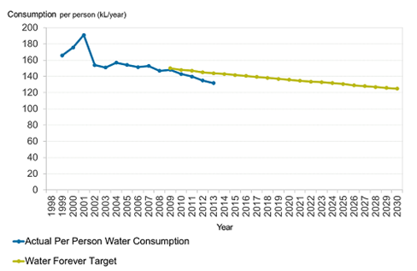
Perth water corporation MTP

Slide 22

Opportunity: regulators
IWA mobilization for better regulation/regulators

Slide 23
Water consumption reduction most efficient for mitigation
France/Germany 7500 Kwh/p/y
Water production: 30 Kwh/p/y for 70 m3/y (if no desal)
Water distribution: 35 Kwh/p/y for 70 m3/y
W. Water treatment: 70/150 Kwh/p/y for 70 m3/y
70m3/y is 170l/d TOTAL: 200 Kwh/p/y
Energy home hot waters : 400/600 Kwh/p/y 12 to 18 m3/y

Slide 24
Reengineering in general
Reduce the amounts of water and energy used
Reuse and use diverse sources of water with treatment that matches the use—“fit for purpose” water quality
Recover energy from water whether it is heat, organic energy or hydraulic energy
Recycle or “upcycle” materials such as nutrients or organic matter
Replenish waterbodies and their ecosystems by taking from or discharging to them only what can be given or eliminated by the natural environment

Slide 25
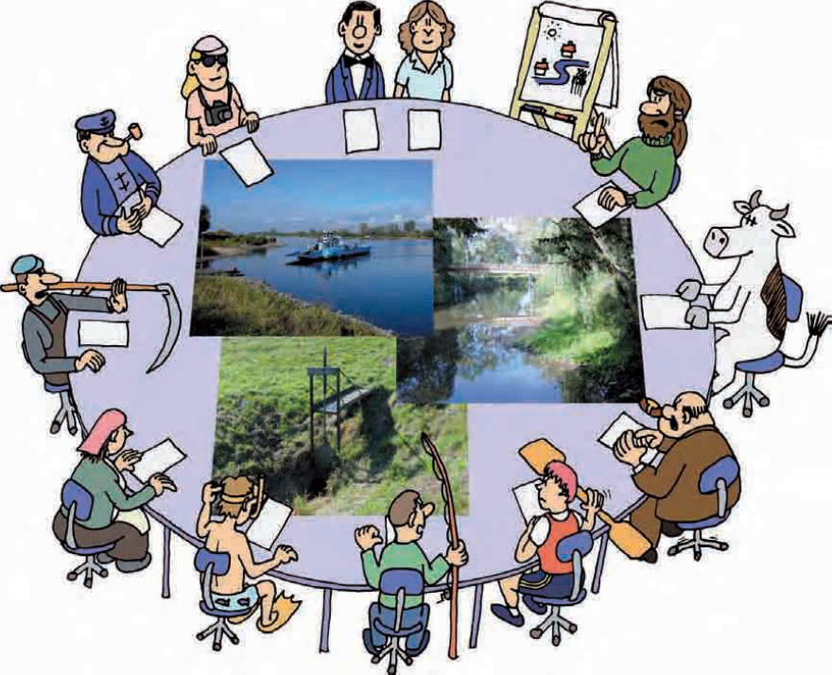
necessity: Participative process:

Slide 26
Challenge 4: accelerating the innovation process

Slide 27
Many reasons for a slow process
The risk adverse of public tenders
The cycle of the investment (15 to 50 years)
The cost/ benefit advantage of the innovation not always visible for everybody
The business models
Many players (engineering companies, IFI’s, …)
The health or administrative organizations (precautionary, legal, …)

Slide 28
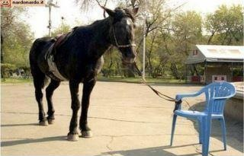
Sometimes the chains that prevent us from changing
are more mental than real

Slide 29
Thank you!
IWA Cities of the Future Programme
Follow @IWAHQ on Twitter and share your urban water vision using #WaterWiseCities
IWA-Connect Group: Cities of the Future

