Slide 1

Planning for Change
Laurna Kaatz, Climate Program Director, Denver Water
UNESCO
November 7, 2019

Slide 2
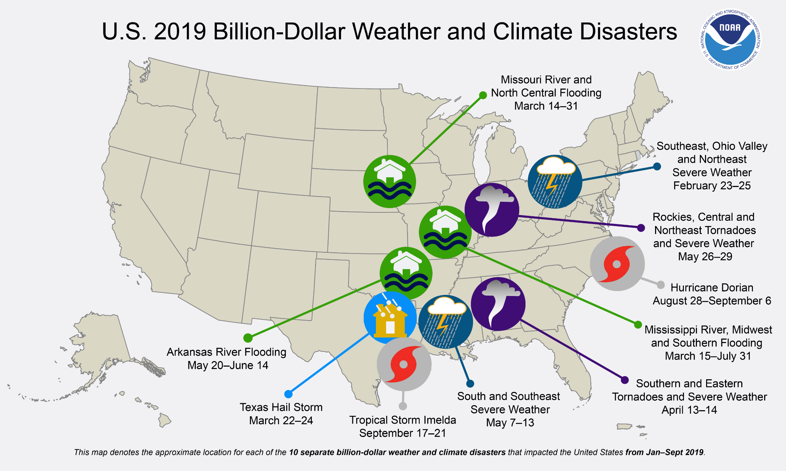

Slide 3
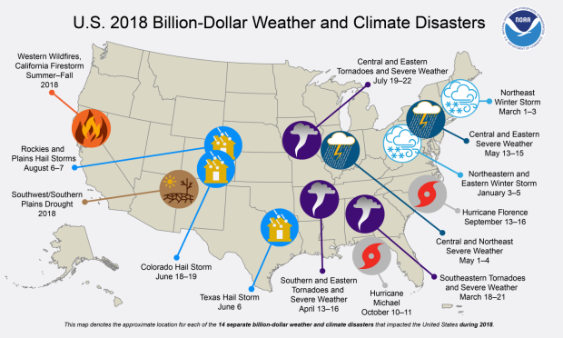
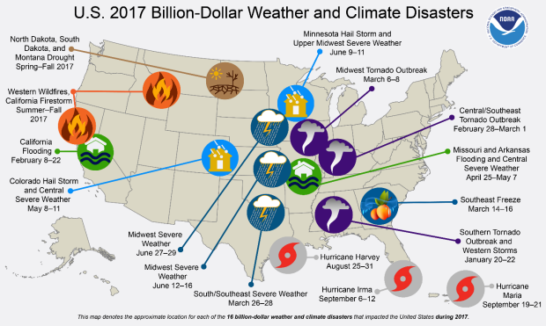
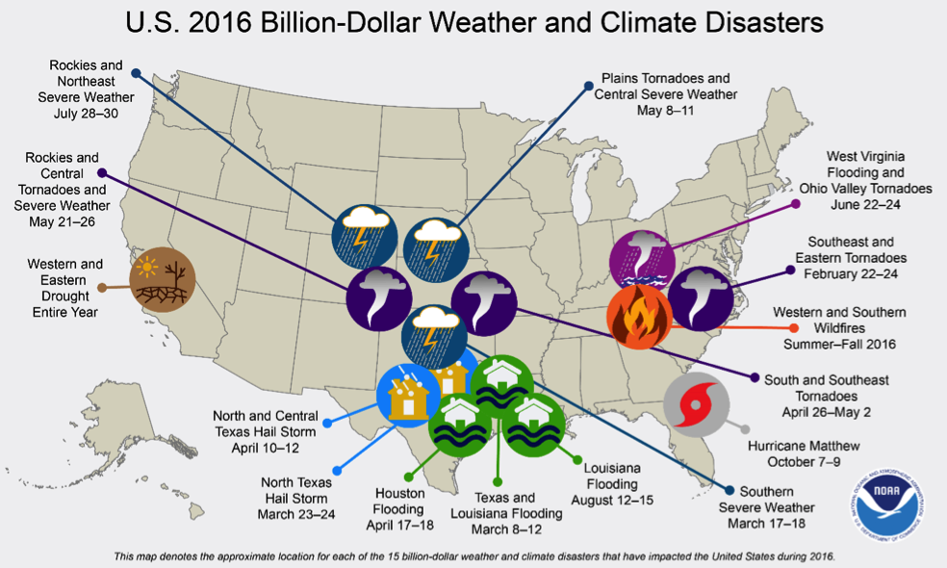

Slide 4
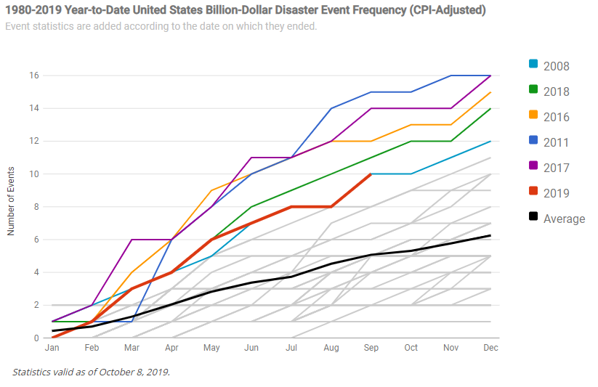
Note: each line is a year from 1980-2019.

Slide 5

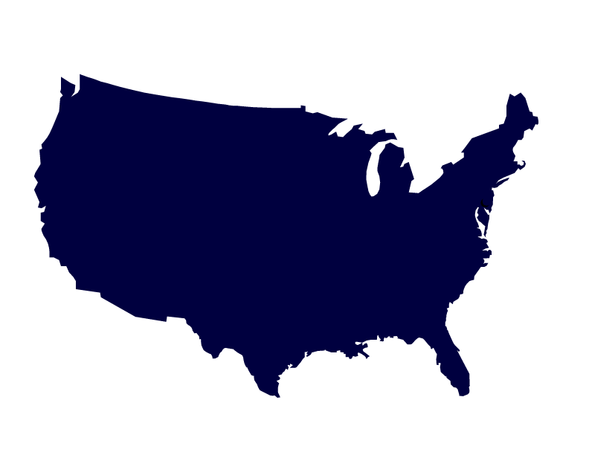
Water Utility Climate Alliance
Seattle
Public Utilities
Portland
Water Bureau
San Francisco
Public Utilities
Commission
Southern Nevada
Water Authority
New York City
Department of Environmental Protection
Denver
Water (chair)
Philadelphia
Water Department
Metropolitan
Water District
of So. California
Central Arizona
Project
San Diego
County Water Authority
Austin
Water
Tampa Bay
Water
Vision: Climate-resilient water utilities, thriving communities
Mission: Collaboratively advance water utility climate change adaptation
http://www.wucaonline.org/

Slide 6
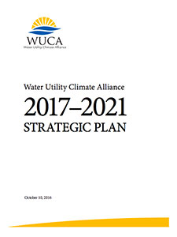
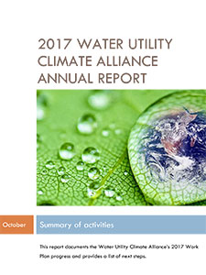
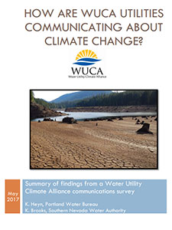
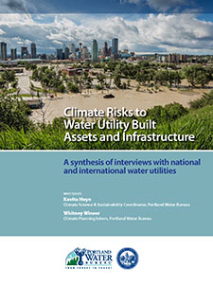


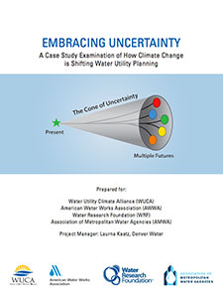
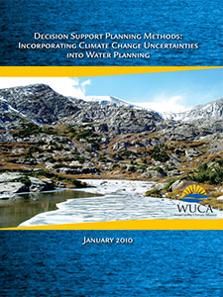
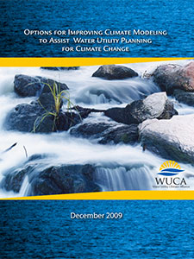
Available at: WUCAonline.org

Slide 7

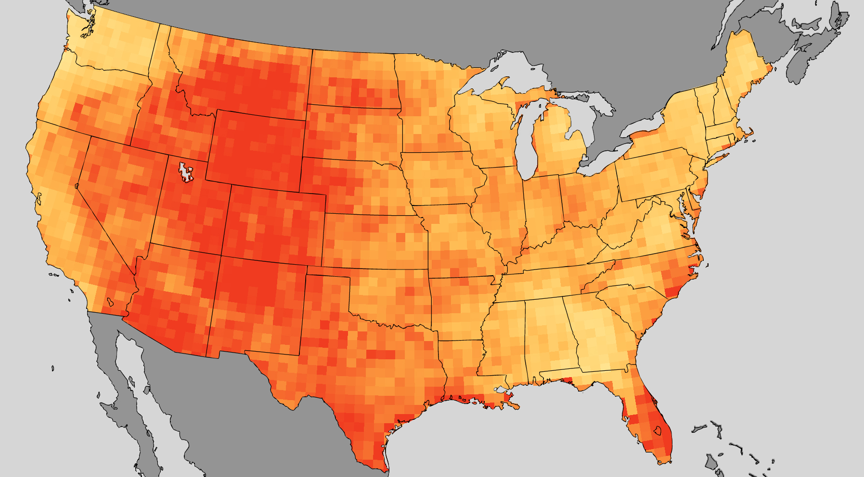

Heat Impacts to Staff and Infrastructure
Portland
Water Bureau
Denver
Water
Southern Nevada
Water Authority
Oklahoma City
Utilities
Miami Dade Water and Sewer
Increase in total heatwave days per year
Map showing ratio of total heatwave days per year for mid-century compared to the 1970-2000 baseline.
Source: NOAA Climate.gov map by Dan Pisut and Richard Rivera, based on data provided by Mary Jo Nath and Gabriel Lau.

Slide 8
Study Scope: Infrastructure Summary

Slide 9
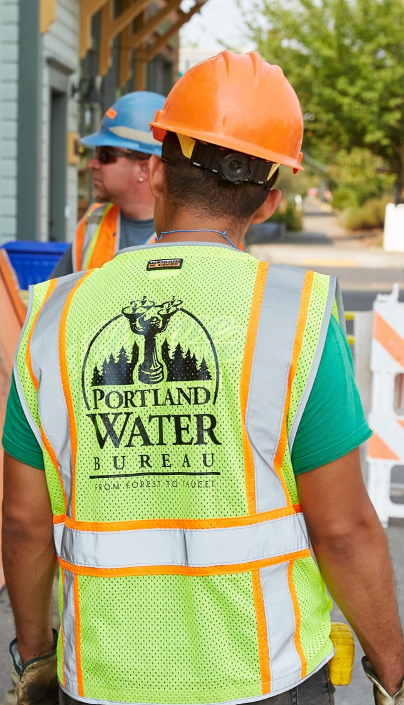
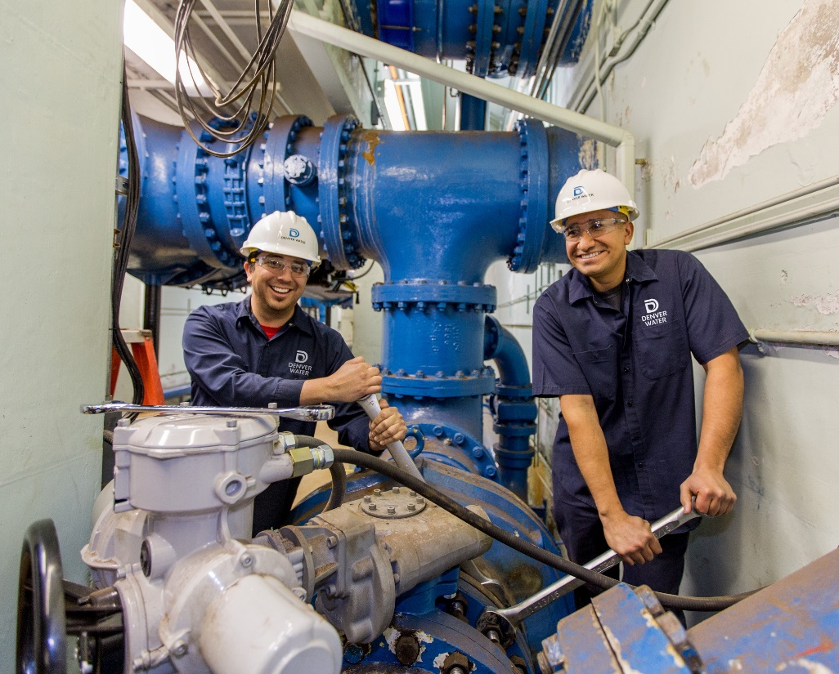
Study Scope: Personnel
  Twofold analysis focused on
    Health
    Productivity

Slide 10
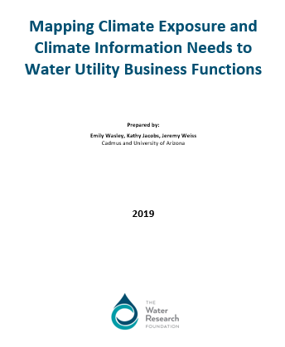
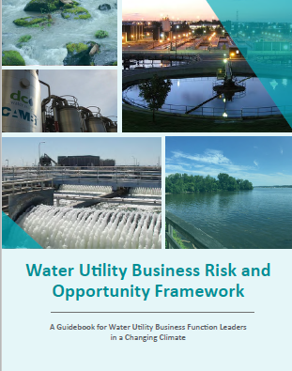
Mapping Climate Exposure and Climate Information Needs to Water Utility Business Functions
  Emily Wasley, CADMUS
  Publication by December 2019
  Will be available to the public on both the WRF and WUCA websites

Slide 11
Heat Map
Southern Nevada
Water Authority

Slide 12
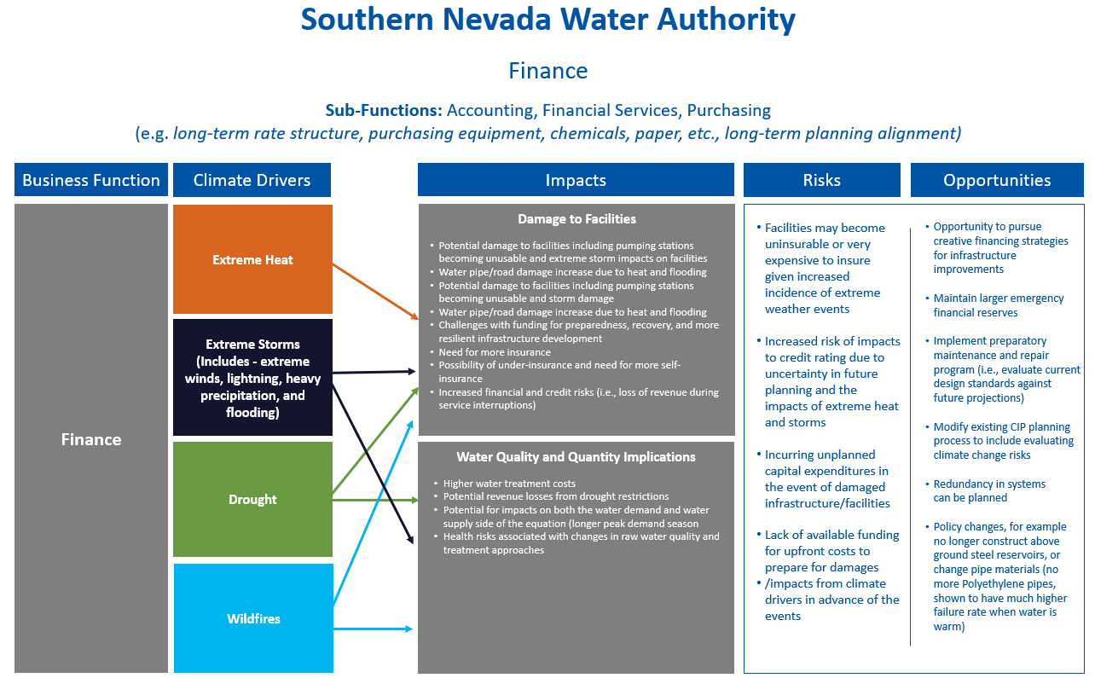

Slide 13
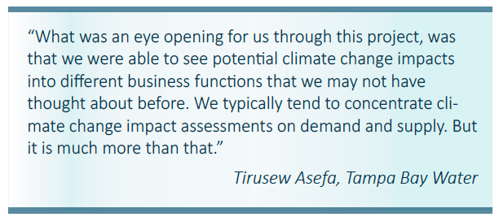
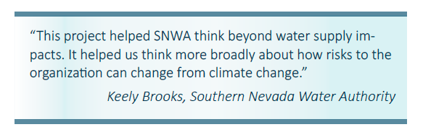
Research and Framework Benefits
The Framework can strengthen your utility management and provide multiple benefits.

Slide 14
Vision:
- Foster smart user and consumers of climate information
- Encourage action on adaptation planning given deep uncertainty
- Effectively communicate and build a community
Focus:
- State of the science: climate, applied, decision, communication
- Practical
- Adaptation and resilience

Slide 15
Key Lessons
Some climate change signals are more certain than others
Embrace uncertainty: natural variability, future emissions, response of the physical environment, modeling, translation
Projections versus predictions
Caution: do not mistake precision for accuracy
Adopt DMDU planning principles:
  Seek robust plans that perform well over many futures, not optimal plans designed for a single, best-estimate future
  Make your plans flexible and adaptive
Use evidence-based strategies and solutions
Practice, repetition, time, and missteps
are keys to success

Slide 16
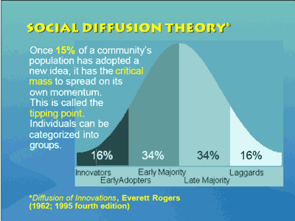
Are we making a difference?
Training Stats
  Hosts: Colorado, California,
  Oregon, Florida
  >200 participants
  >40 drinking water utilities,
  serving nearly 50 million people
  or ~14% of U.S. population
  Upcoming Austin, TX – Dec 2019
Excellent reviews, refining as we go
“This was the best workshop that I have ever been to. Jovial people with lots of enthusiasm, dispensing lots of worthwhile information….” A project manager with a South Florida Utility
“This was great and informative. This was very time-consuming but the time flew by quickly b/c it was engaging and very interesting.” A drinking water utility participant

Slide 17
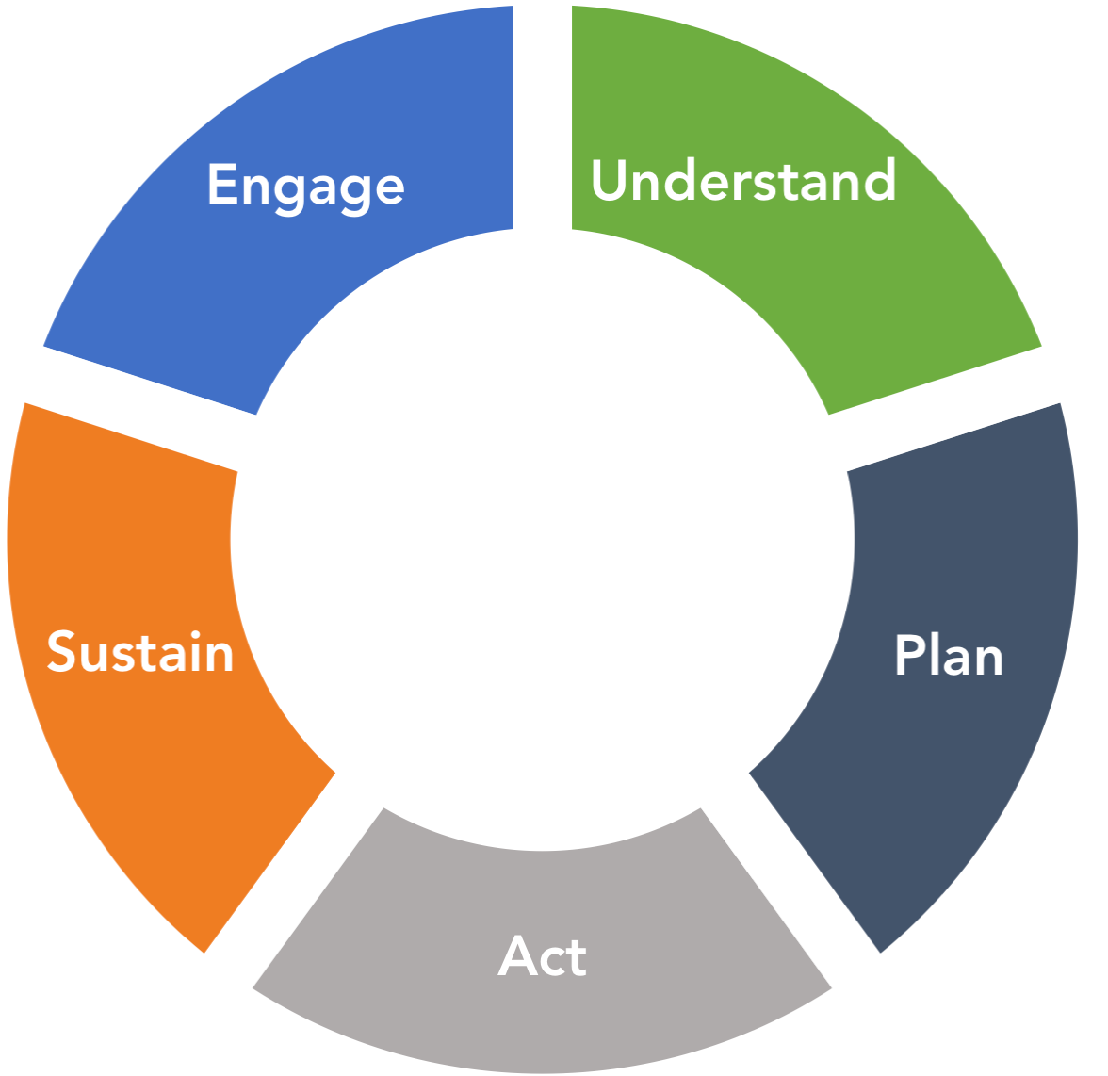

Spectrum of Climate Adaptation
Motivate action
Engage and support others
Develop climate messages
Understand climate science
Understand your system
Assess risks
Monitor conditions
Develop funding
Build capacity
Manage expectations
Add to planning frameworks
Plan for multiple futures
Act with purpose
Implement changes in assets, operations, practices
Notes:
These actions are comprised on 15 adaptation themes which can give you a better sense of what the actions include and which what comprise our (current) 46 leading practice examples

Slide 18

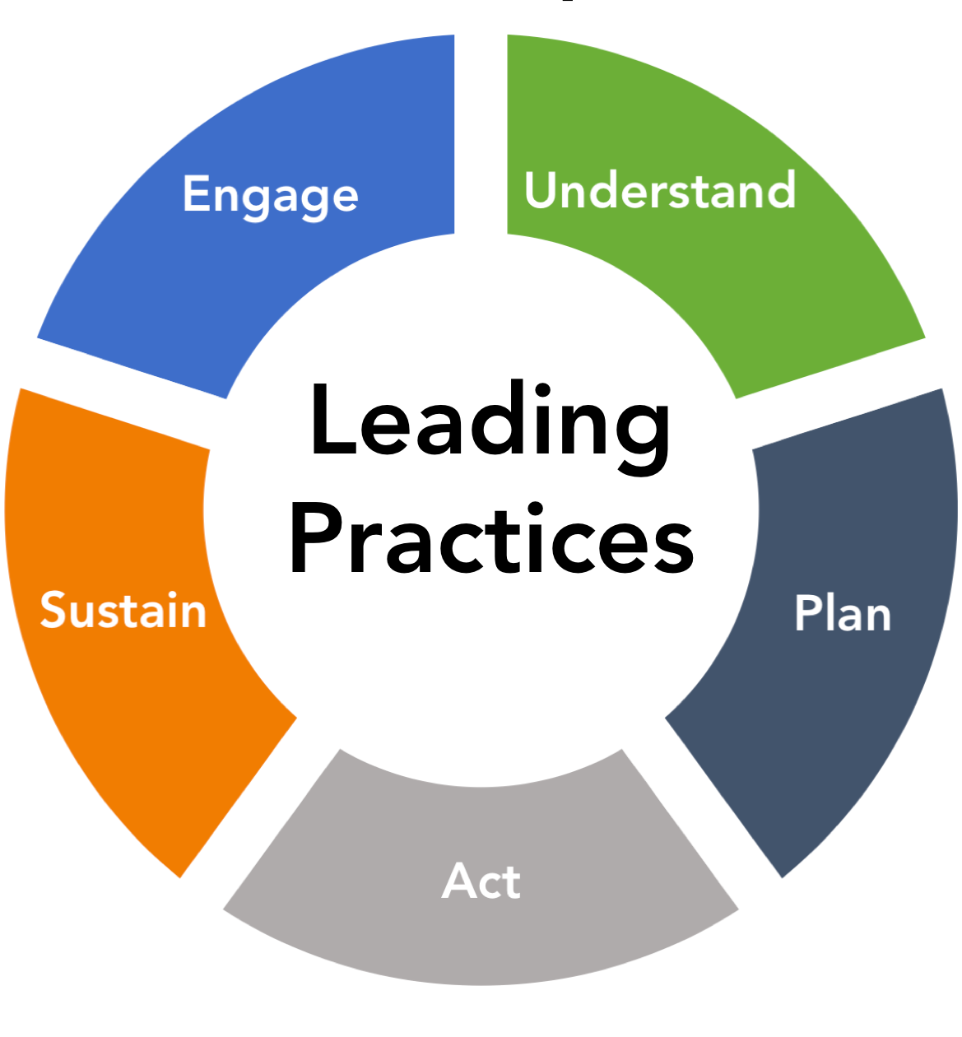
Spectrum of Climate Adaptation
Leading Practice: Recognize the power of well-placed climate change screening questions
Climate adaptation happens when there is increased awareness that future conditions will be different. While it is not clear how big changes will be, a lot can be accomplished just by asking managers to evaluate new vulnerabilities to understand the implications of an uncertain future.
Notes:
Transition to David
1. State the practice (read what it is and where it fits in the wheel)
David: “I will present an example in the Plan category with the leading practices principle Recognize the power of well-placed climate change screening questions”
<or something similar. Point here: be sure to say with the best practices principle is and in what climate adaptation category it is under. Remember in the next slides to relate how this practice has enhanced planning at your utility.

Slide 19
Heat Map
San Francisco Public Utilities Commission

Slide 20

Recognize the power of well-placed climate change screening questions
Plan
Notes:
2. Describe the example strategy (short overview, NOT the details)
3. Share why it matters (how it helps to Engage, Understand, Plan, Act, Sustain)
--- FROM TEXT ---
Recognize the power of well-place check boxes
Leading practice principle: Climate adaptation happens when there is increased awareness that future conditions (e.g., weather, sea levels) will be different. While there is often not a clear answer to how big changes will be, a lot can be done by just getting those making decisions to pause and consider how they might adjust - this could be adding ”considered climate change” to planning checklists.
Example strategy: SNWA incorporated a screening tool for proposed infrastructure/capital projects to ensure engineers are “considering climate change” in projects that may be climate sensitive, and have a life expectancy beyond 20 years. The screening tool helps the project initiator determine if the project is at risk to future climate conditions and determine what level of risk assessment would be needed to determine if an alternative design for the project is warranted. The screening tool, which is a decision tree, is a first step in educating staff in climate-resilient infrastructure. A future climate summary sheet for the service area is also provided to help project initiators adjust their assumptions about future climate conditions. These steps have not required extensive analysis or required a climate change expert be involved. However, the work has made staff aware that long-lived infrastructure may experience climate different from today, and discuss what should be done differently, if anything.
Example strategy: <forthcoming from San Francisco, David>
Pointers to additional resources: Climate Resiliency Design Guidelines v. 3.0, 2019, NYC Mayor’s Office of Recovery and Resiliency. https://www1.nyc.gov/assets/orr/pdf/NYC_Climate_Resiliency_Design_Guidelines_v3-0.pdf

Slide 21
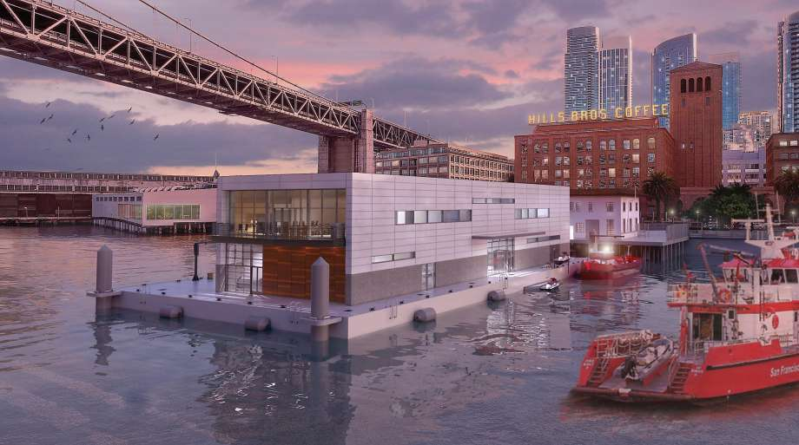
Recognize the power of well-placed climate change screening questions
Plan
Fireboat Pier Design:
Rising with Rising Seas

Slide 22
Examples
Seek out climate champions throughout your utility (Arizona)
Tailor the climate adaptation message for the intended audience (Philadelphia, PA)
Know your water system (Denver, CO)
Foster sustained relationships with the climate science community (Tampa, FL)
Recognize the value and limits of climate science in planning (Los Angeles, CA)
Build in-house capacity (Portland, OR)
Recognize the power of well-placed climate change screening questions (SFPUC)
Be prepared to act when opportunities arise (San Diego, CA)
Take on climate change as another component of risk management (Nevada)
Leverage existing funding mechanisms (Austin, TX)
Establish a community of practice to integrate climate utility-wide (Seattle, WA)

