Slide 1
IHP Flood and Drought Monitoring : Providing Data and Services to Member States
UNESCO Metropolitan “ECO – RISE” R2020 Colloquium
Experience Sharing Colloquium of Local Governments, Water and Wastewater Utilities & the Research Community
Dr. Abou AMANI, Executive Officer
UNESCO
November 7 - 8, 2019

Slide 2
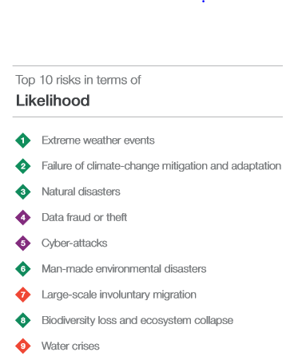
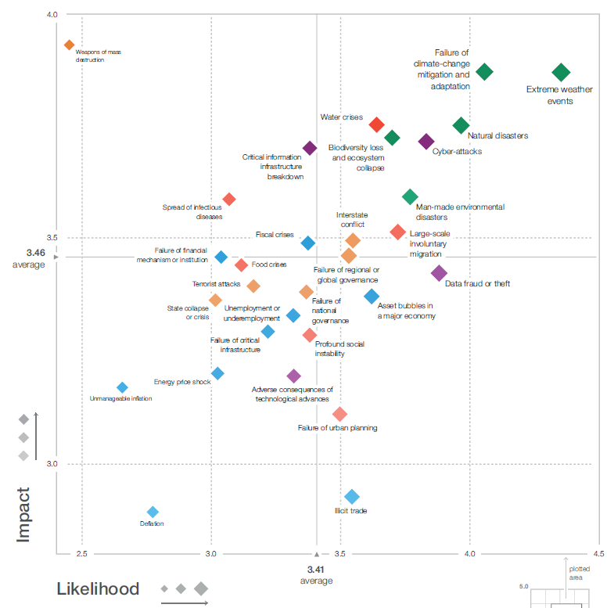
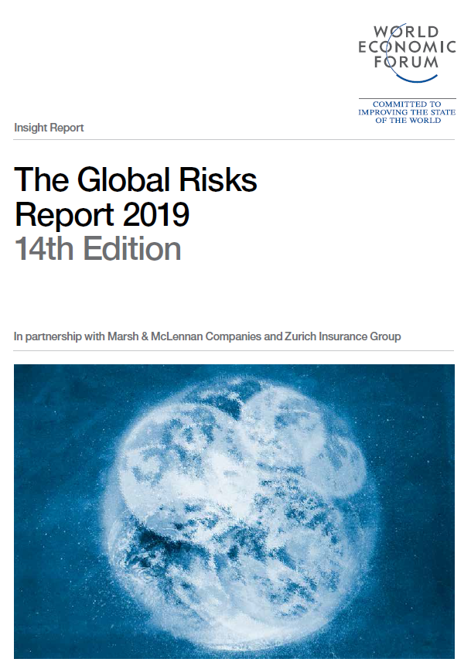

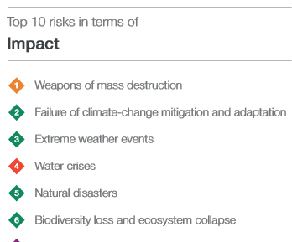
Global Risks Landscape 2019: Risk and uncertainty
Notes:
Global risks are intensifying but the collective will to tackle them appears to be lacking- Global Risk Report of the World Economic Forum 2019.
Environmental risks continue to dominate among the top identified risk included in the annual Global Risks Report 2019, launched during World Economic Forum in Davos early this year. Extreme weather (flood and drought) was the risk of greatest concern, but the report shows increasingly worried about environmental policy failure: having fallen in the rankings after Paris, “failure of climate-change mitigation and adaptation”. The results of climate inaction are becoming increasingly clear.

Slide 3
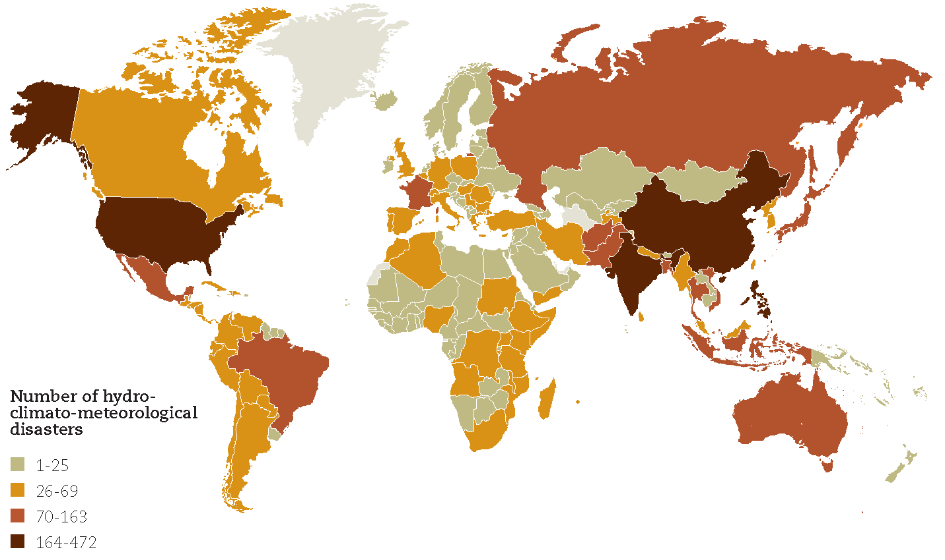
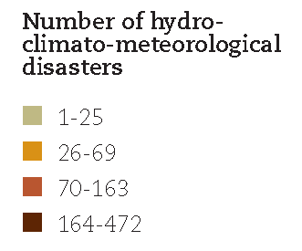
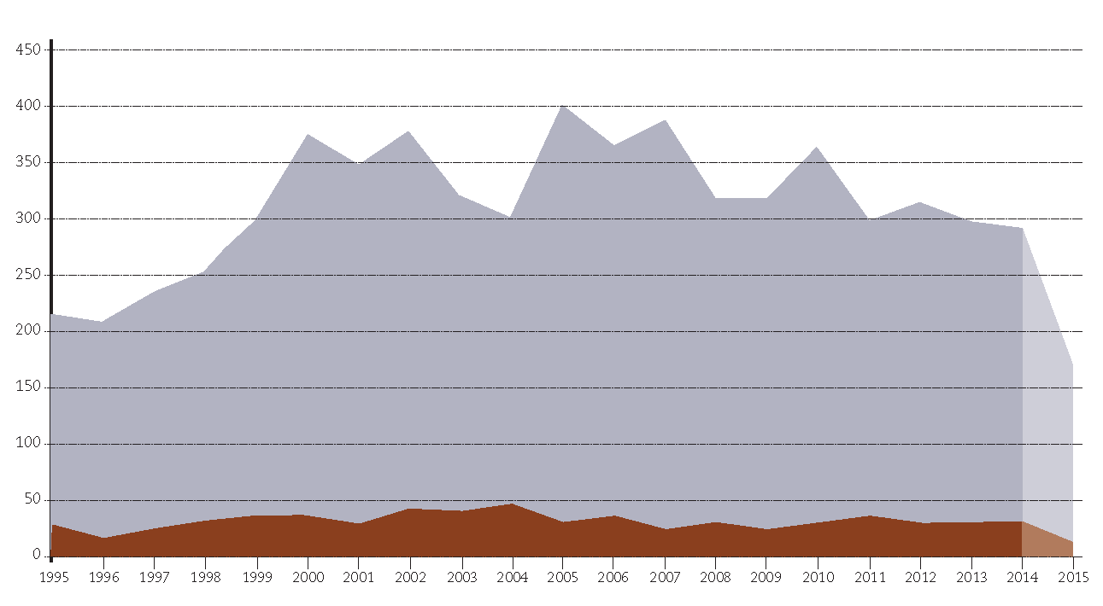


Number of weather-related disasters reported per country (1995-2015)
Trends in the number of disasters by major category
(weather-related & geophysical 1995-2015)
From CRED & WMO 2015

Slide 4
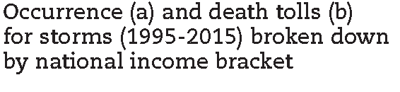
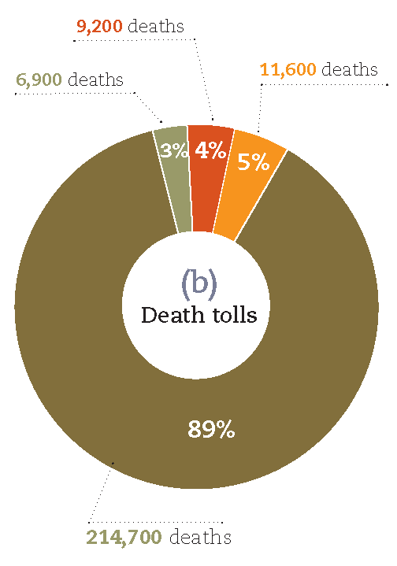
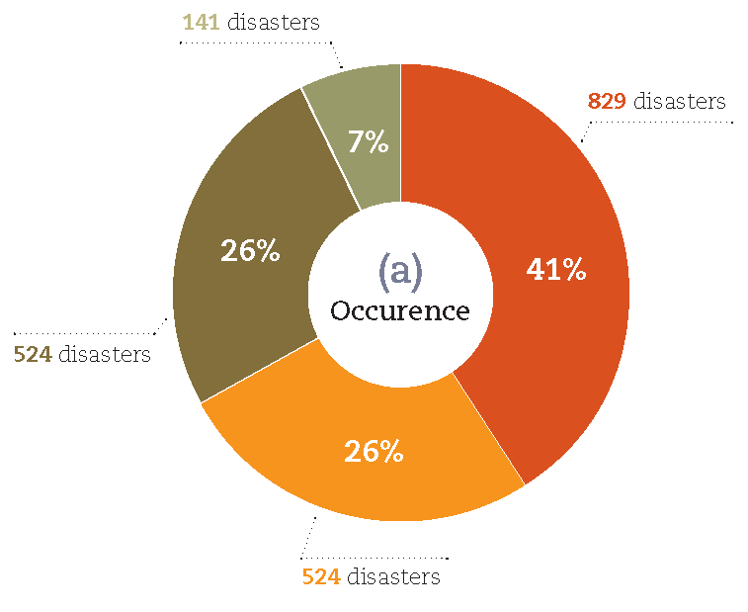
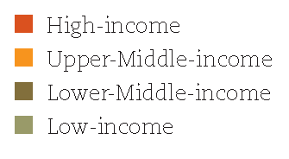
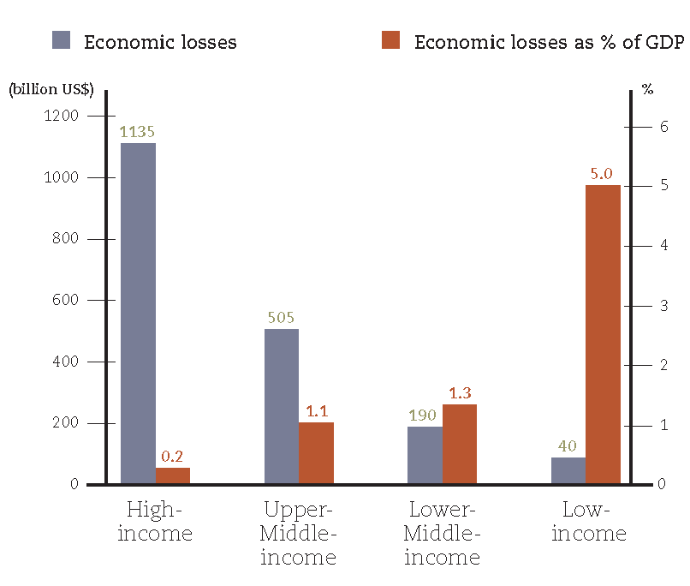
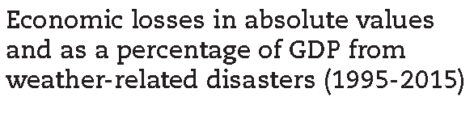
Disasters affect us differently

Slide 5

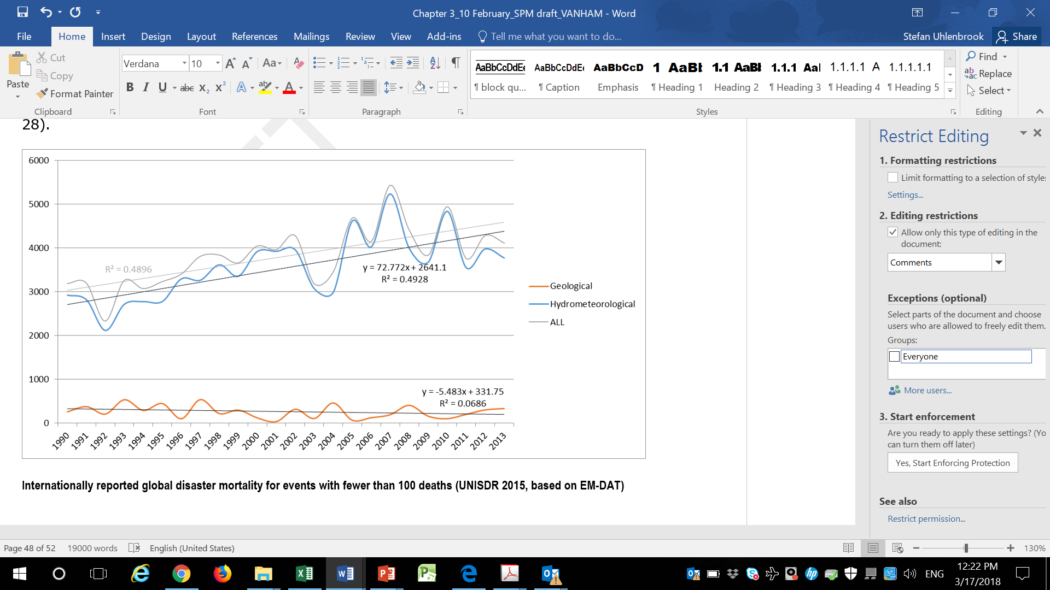
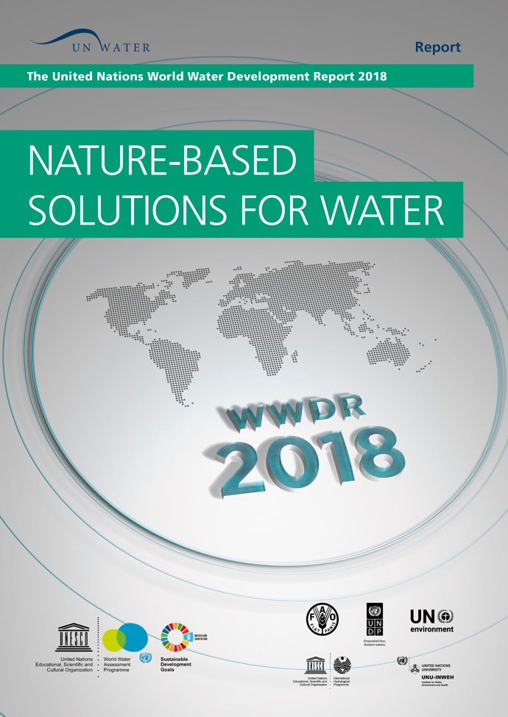
Water-related risks
Floods have accounted for 47% of all weather-related disasters since 1995, affecting a total of 2.3 billion people.
WWDR, 2018
Notes:
Water resources variability has a significant impact on development.
Around 30% of the global population is estimated to reside in areas and regions routinely impacted by either flood or drought events – the major water-related disasters through which water variability manifests itself.

Slide 6
Water-related risks
Average global economic loss from floods and droughts
is over US$40 billion per year across all economic sectors.
WWDR, 2018
Notes:
Water resources variability has a significant impact on development.
Around 30% of the global population is estimated to reside in areas and regions routinely impacted by either flood or drought events – the major water-related disasters through which water variability manifests itself.

Slide 7

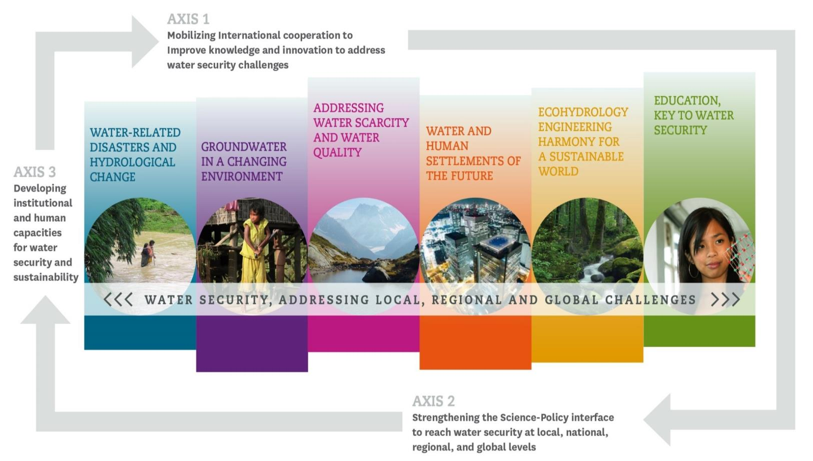
International Hydrolgical Programme (IHP, VIII 2014-2021)

Slide 8

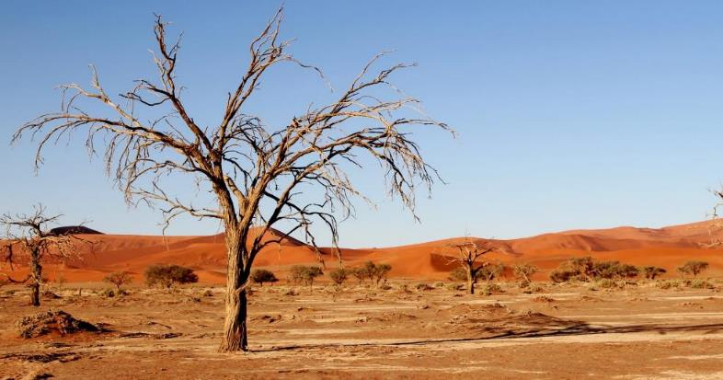
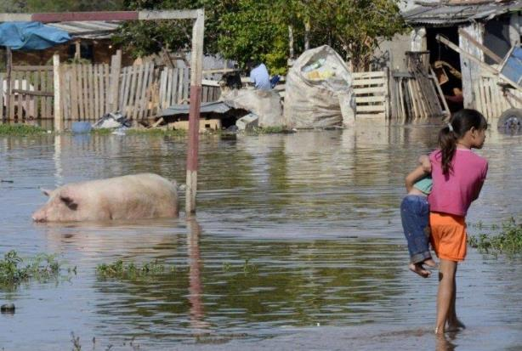
Theme 1: Water-related Disasters and Hydrological Change
  1.1 Risk management as adaptation to global changes
  1.2 Understanding coupled human and natural processes
  1.3 Benefiting from remote sensing data and ground truth
  1.4 Addressing uncertainty and improving its communication
  1.5 Improve scientific basis for hydrology and water sciences for preparation and response to extreme hydrological events
Flood Paraguay, March 2016
Notes:
Increasing water scarcity - 2

Slide 9
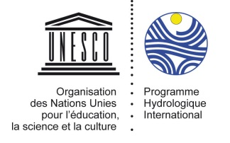
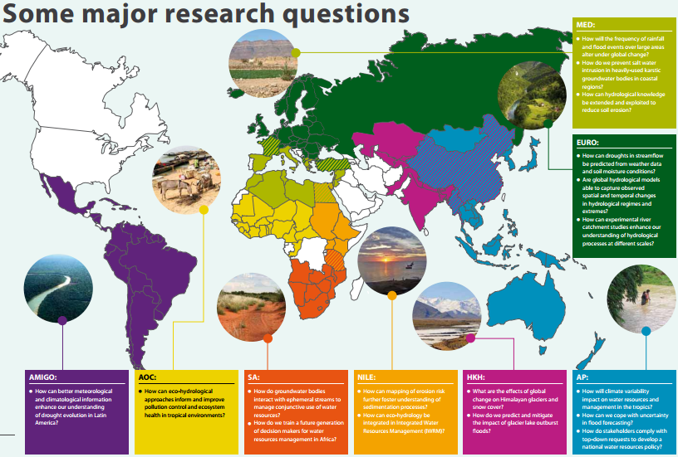
FRIEND - Water

Slide 10
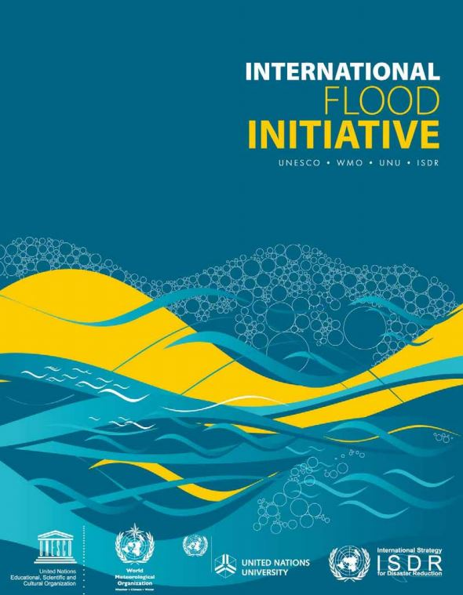

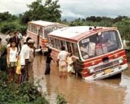
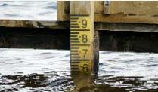
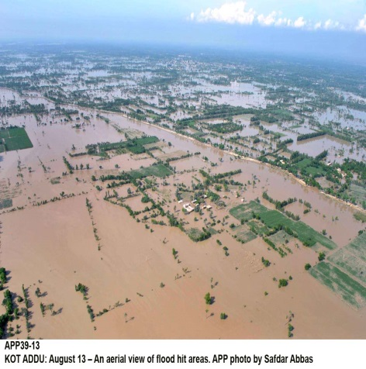
IFI
Develops capacity building to better understand and respond to floods hazards while taking advantage of their benefits
Focus on research, information networking, education and training to empower communities

Slide 11
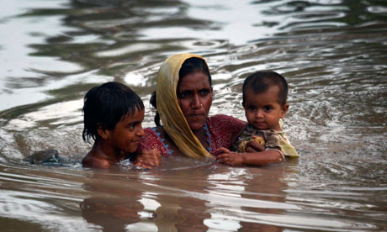
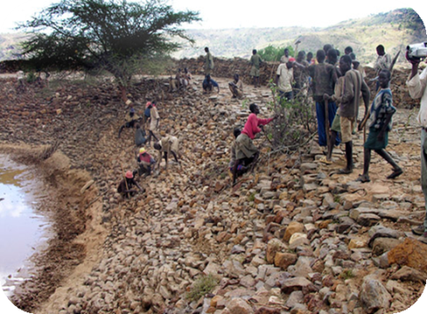

HOW TO DECREASE DISASTER RISK?
Natural hazards can’t be stopped but we can decrease our vulnerability and increase our capacity to cope
  Prevention/Preparedness
  Prediction
  Protection
$$Risk= \frac{Hazard × Vulnerability}{Capacity to cope}$$
Notes:
Risk= The likelihood that humans will be seriously affected by a hazard
Vulnerability= How susceptible a population is to the damage caused by a hazard

Slide 12

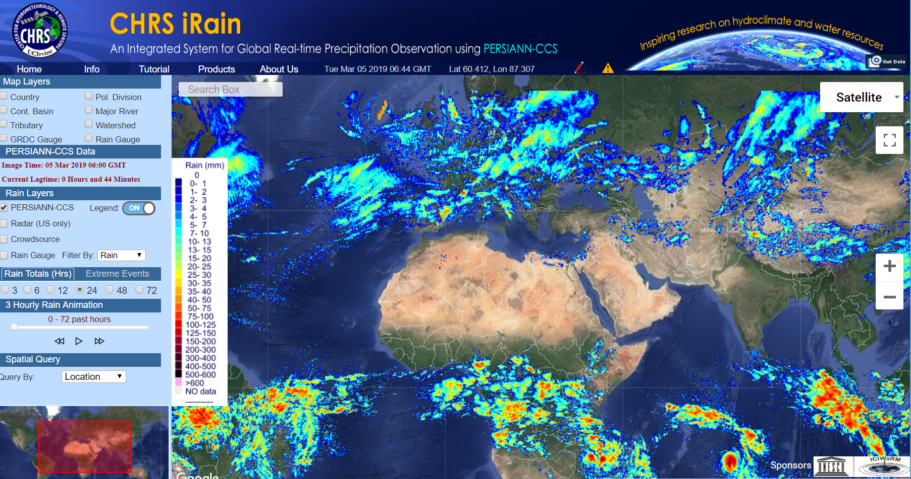
G-WADI Geoserver iRain: the Real-time version of the PERSIANN Family of Products
iRain.eng.uci.edu

Slide 13
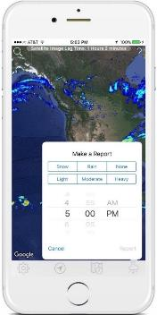
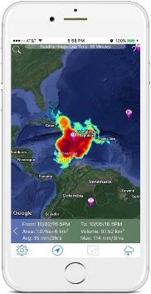

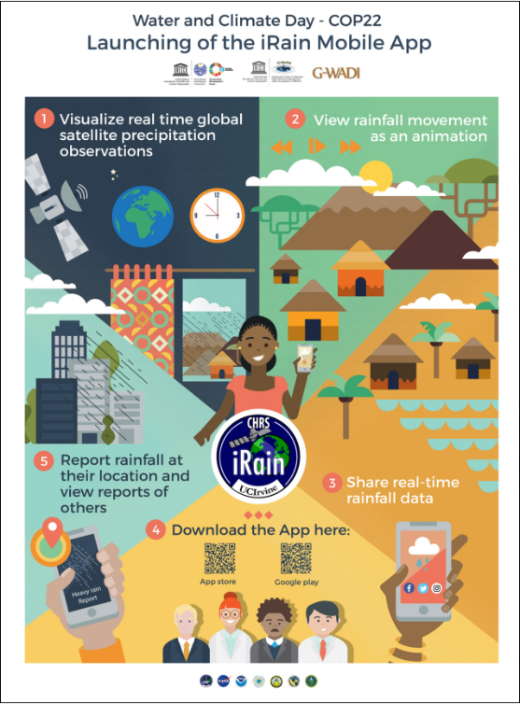
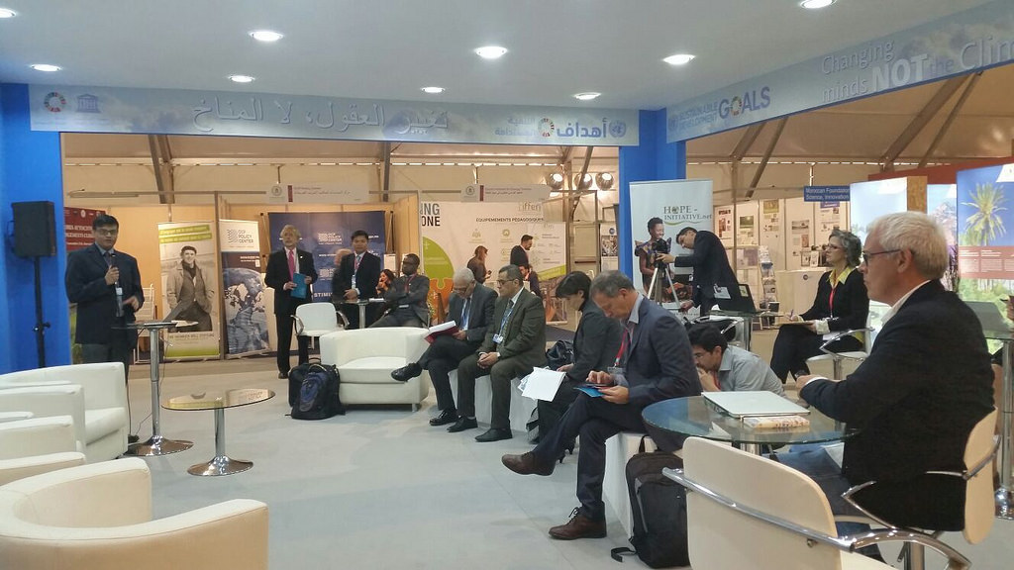
Engagement with local communities through participatory approach and citizen-science
iRain launched at UNFCCC COP22

Slide 14
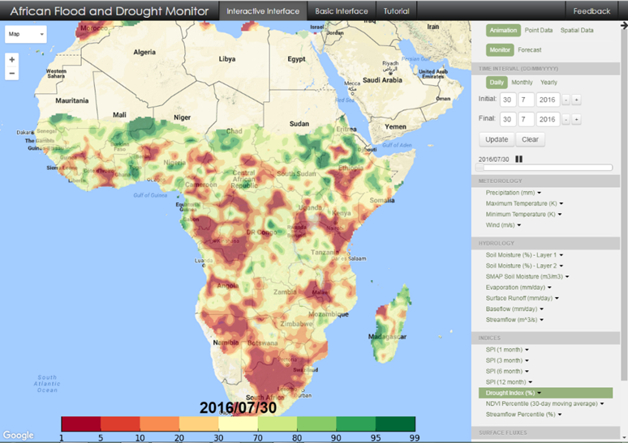
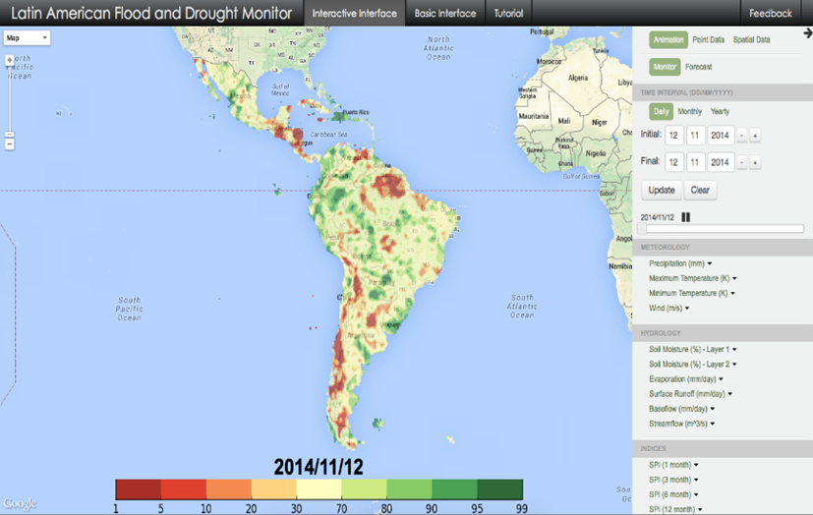
Improved climate services for risk management : African and LAC flood and drought Monitors
Designed to strengthen the capacity of African and LAC countries for near real-time monitoring and seasonal forecasting to raise awareness of the impact of floods and droughts on vulnerable and disadvantaged groups.
System was deployed in
LAC
West Africa
East Africa
Southern Africa
Currently been adapted for Lake Chad Basin with higher spatial resolution
User Interface: http://stream.princeton.edu

Slide 15
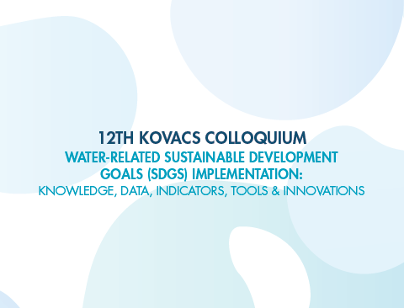
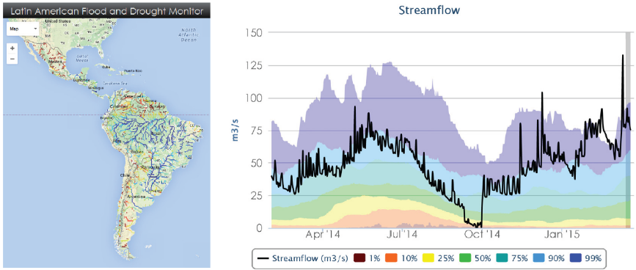
Data Tools & methodologies
Latin American Flood and Drought Monitor
  Regional Monitoring and Early Warning of Floods and Droughts
    Monitoring of Precipitation, Streamflow and Vegetation
    Short term forecasting and early warning (7 days)
    Longer term seasonal forecasts (3-6 months)

Slide 16

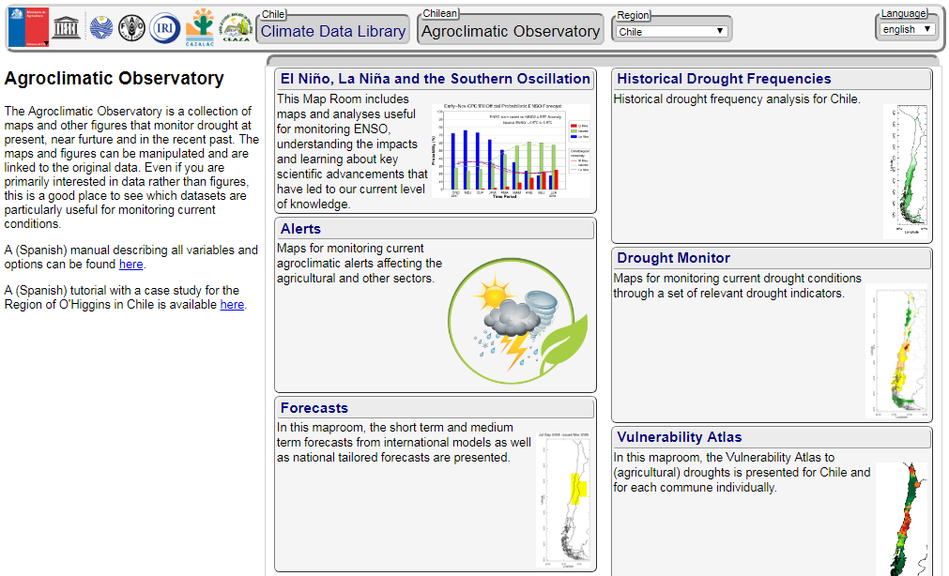
National drought monitoring and flood and drought early warning strengthened
Development of relevant, timely and actionable information
High resolution local versions in pilot countries
Support governments in LAC and Africa to integrate information in decision-making
Publication of guidelines
Drought Vulnerability Atlas
It is these antecedents that have led to the need to generate a special UNESCO publication to address the issue of drought in this region of America. This is: The Drought Atlas of Latin America and the Caribbean
Chilean Agroclimatic Observatory

Slide 17
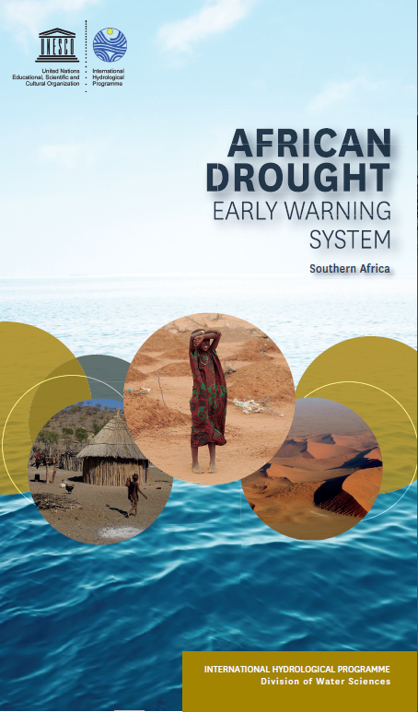

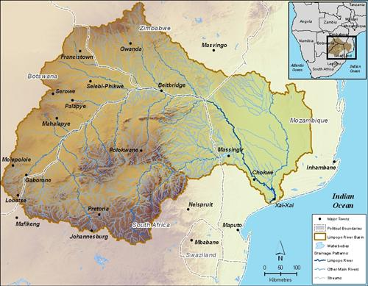
African Drought Early Warning System Expansion
to Southern Africa – Review of SADC drought mitigation plans
Training on the African Early Warning System
November 2016,
Harare, Zimbabwe
35 participants
(23% women)
12 countries (Angola, Botswana, Democratic Republic of Congo, Lesotho, Malawi, Mauritius, Namibia, South Africa, Swaziland, United Republic of Tanzania, Zambia, Zimbabwe)

Slide 18
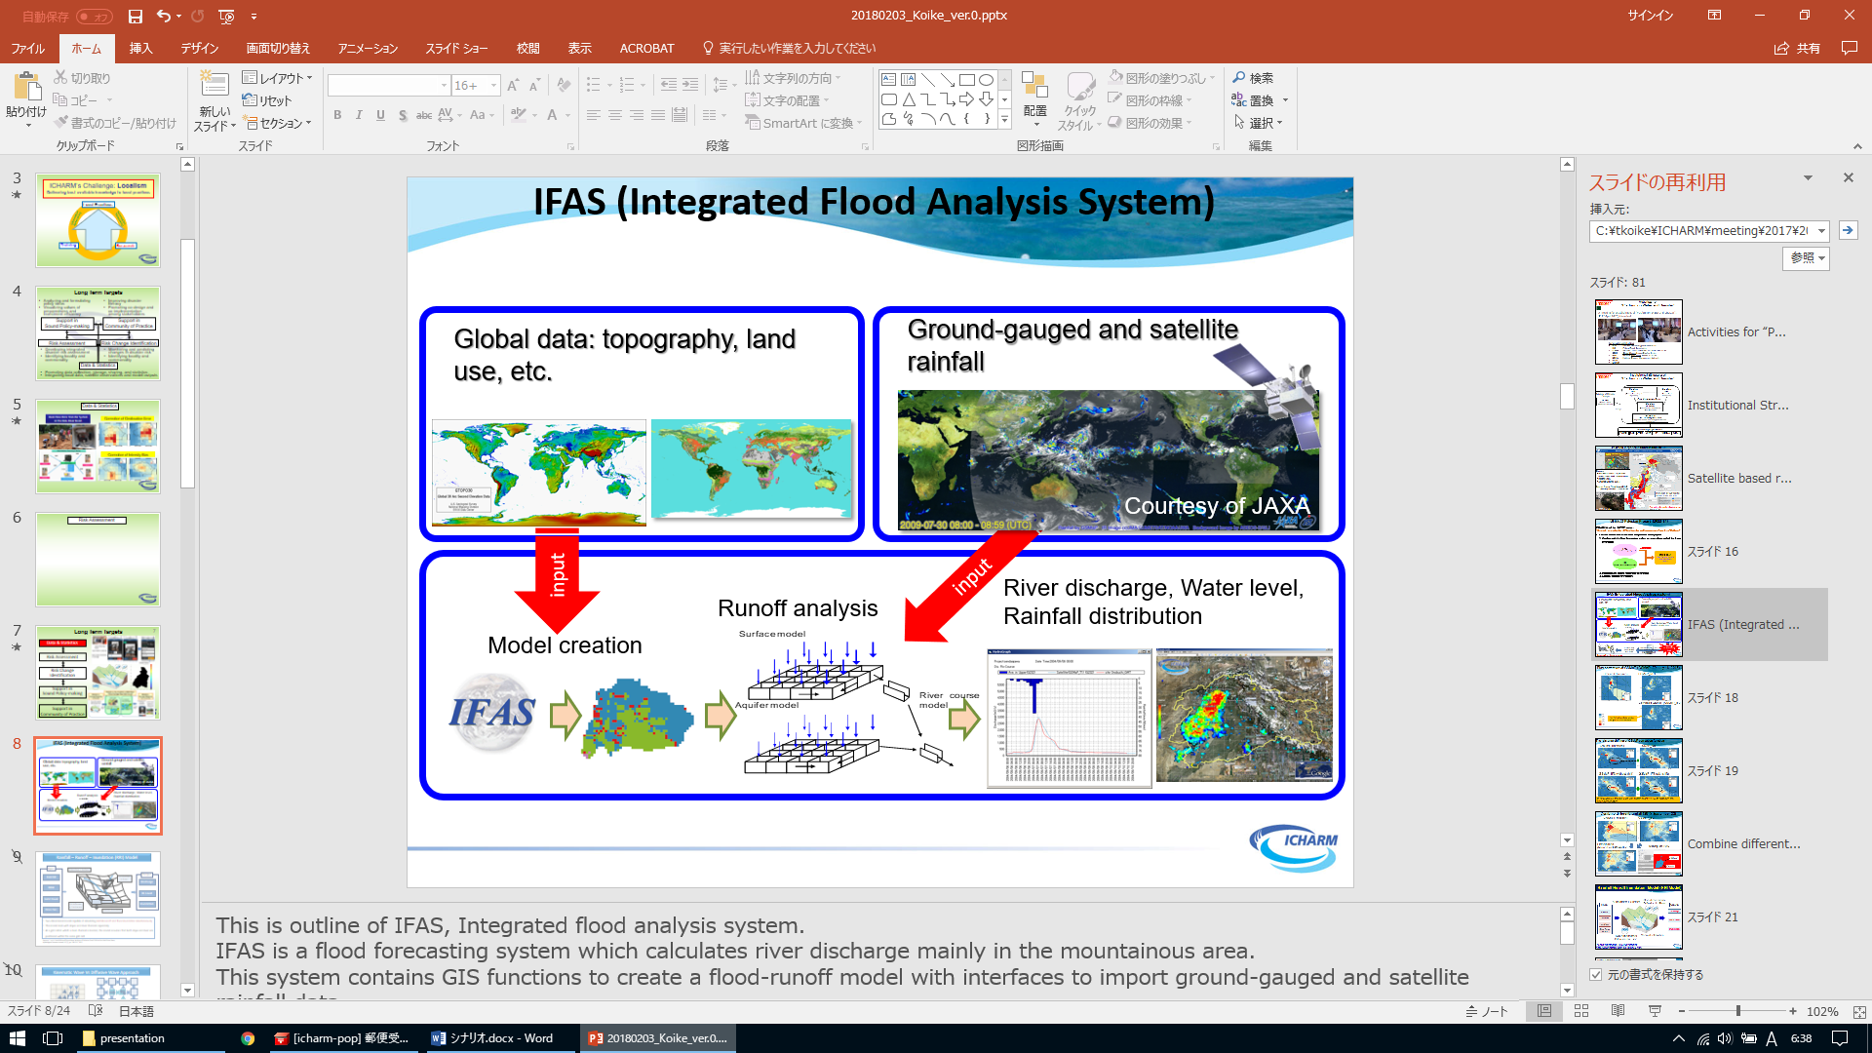
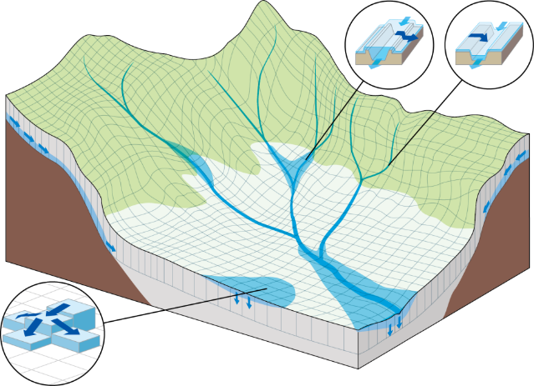
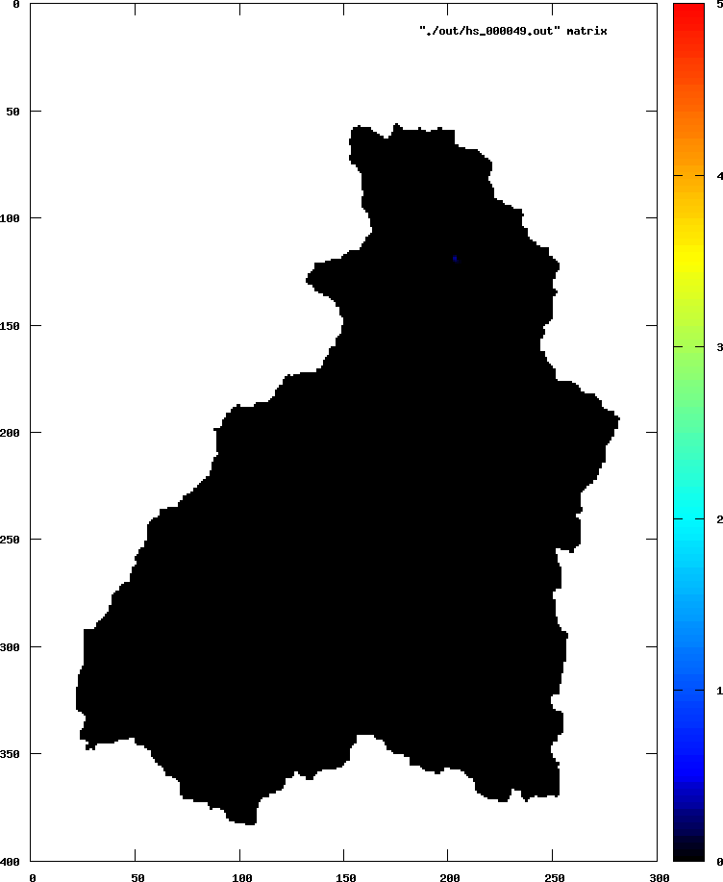
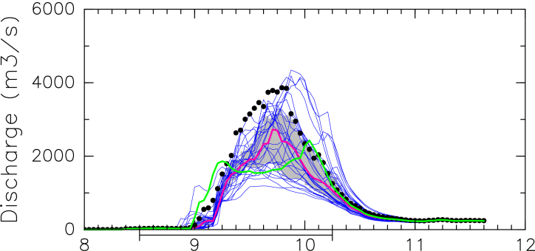
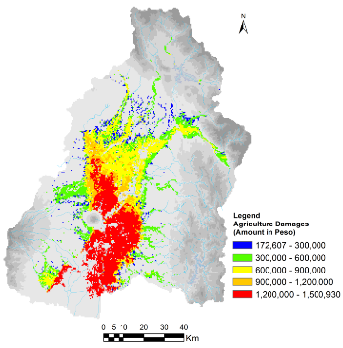
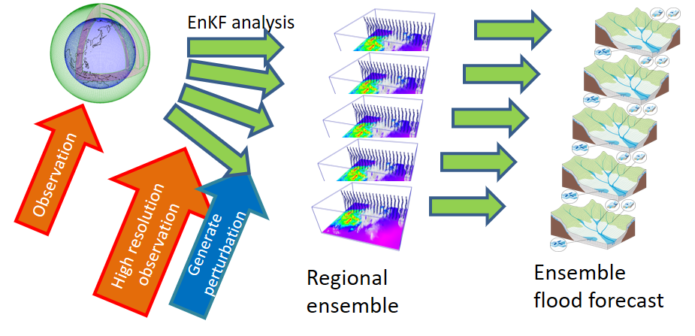
Flood Risk Assessment
Integrated Flood Analysis System(IFAS)
Rainfall-Runoff-Inundation (RRI) Model
Flood Impact on Rice Production
Ensemble
Flood Prediction
Rice Production
Fragility Curve
18

Slide 19
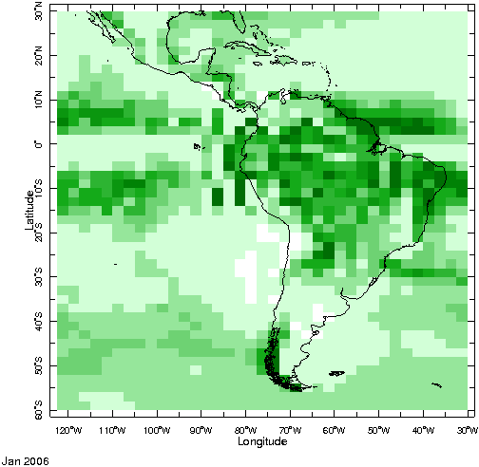
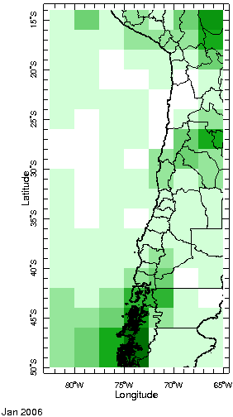
How to utilize the information in the coarse Global Circulation Models
to take long-term decisions at the local level?
1 pixel for the whole region

Slide 20
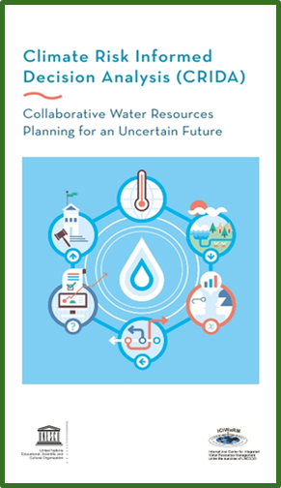
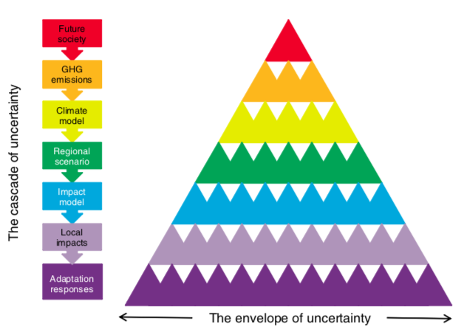
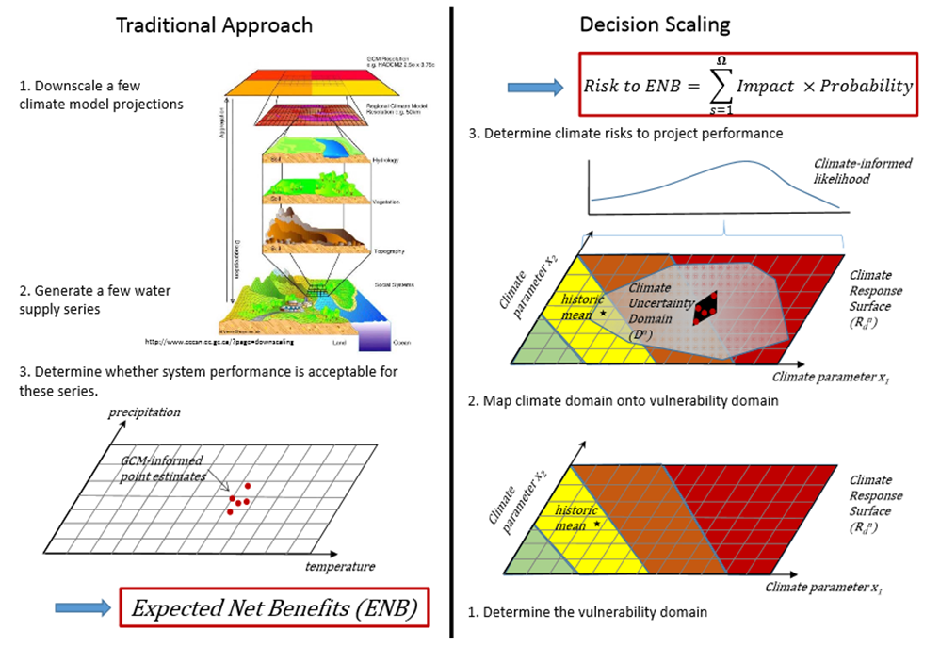
How to deal with the large uncertainty in the different model projections?
The Cascade of Uncertainty in Climate Change Projections
CRIDA helps the water resources planner to navigate through an uncertain world toward imperfect but robust and socially acceptable solutions in line with local needs
Wilby and Dessai, 2010
Notes:
A cascade of uncertainty proceeds from different socio-economic and demographic pathways, their translation into concentrations of atmospheric greenhouse gas (GHG) concentrations, expressed climate outcomes in global and regional models, translation into local impacts on human and natural systems, and implied adaptation responses.
Hydrological Programme (IHP) within the framework of Climate Risk Informed Decision Analysis (CRIDA) has engaged with various stakeholders in different regions to design a robust Climate Stress Test using bottom up approach to identify uncertainty of climate projection for water resources management in cooperation and collaborations with category II centres and centre of excellences. The IHP undertaken case study based on CRIDA and other citizen sciences approaches advocates to move away from the ‘one size fits all’ approach, and to pursue locally embedded solutions to the specific threats to water insecurity due to climate and other global changes. CRIDA is a stepwise guide to assess the climate risk level for all water-intensive investments and to gauge the level of effort necessary to reduce risks. It has now been applied to local-scale facilities such as water utilities as well as basin-scale planning processes.

