Slide 1
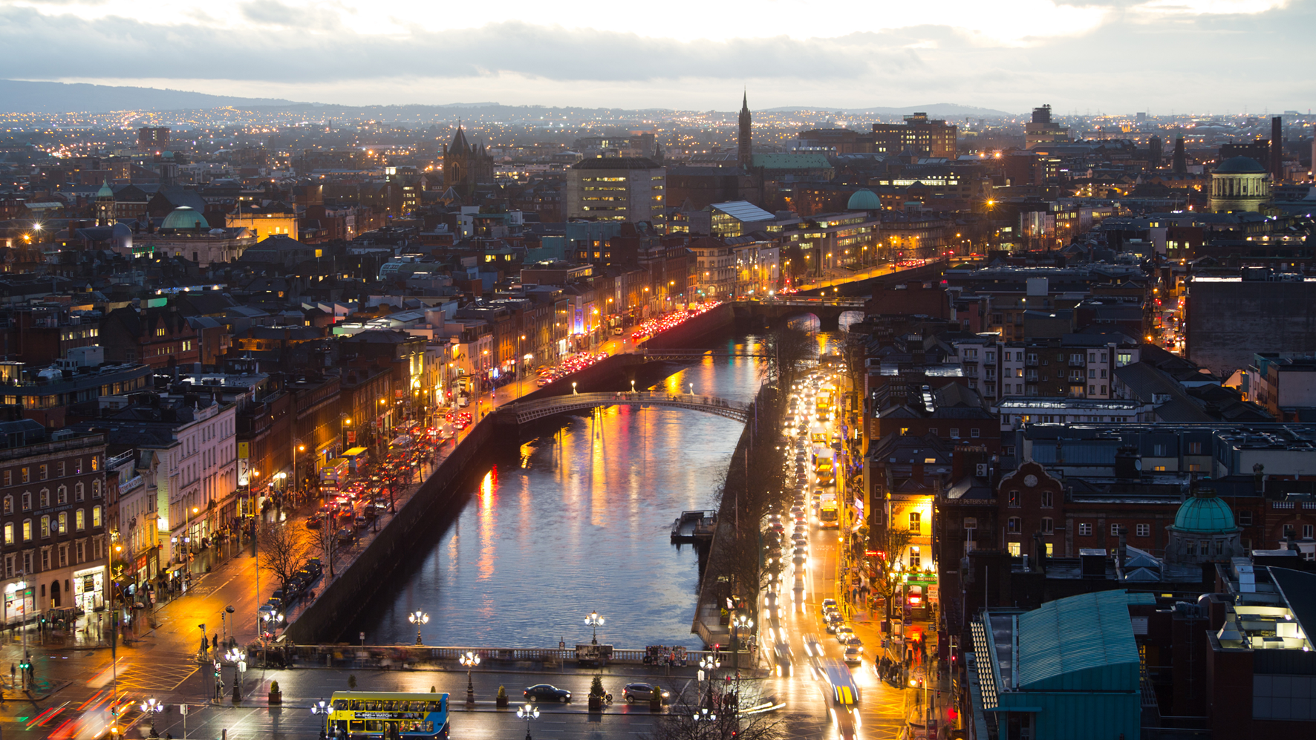

Water Utility Commitment for Resilient Cities
Maximilien PELLEGRINI, SUEZ
UNESCO Metropolitan “ECO – RISE” R2020 Colloquium
November 7 & 8, 2019

Slide 2
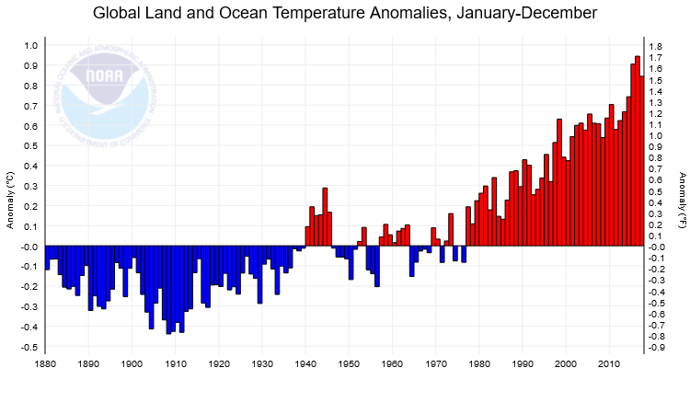
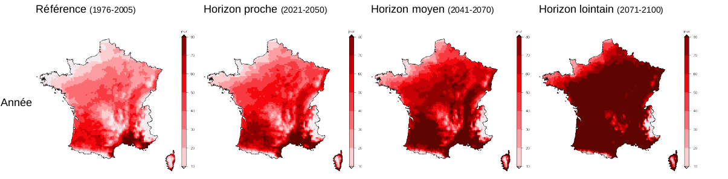
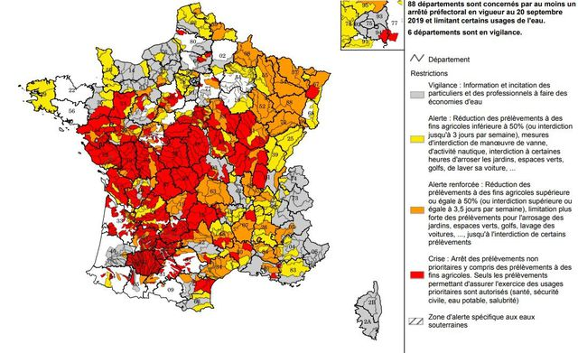
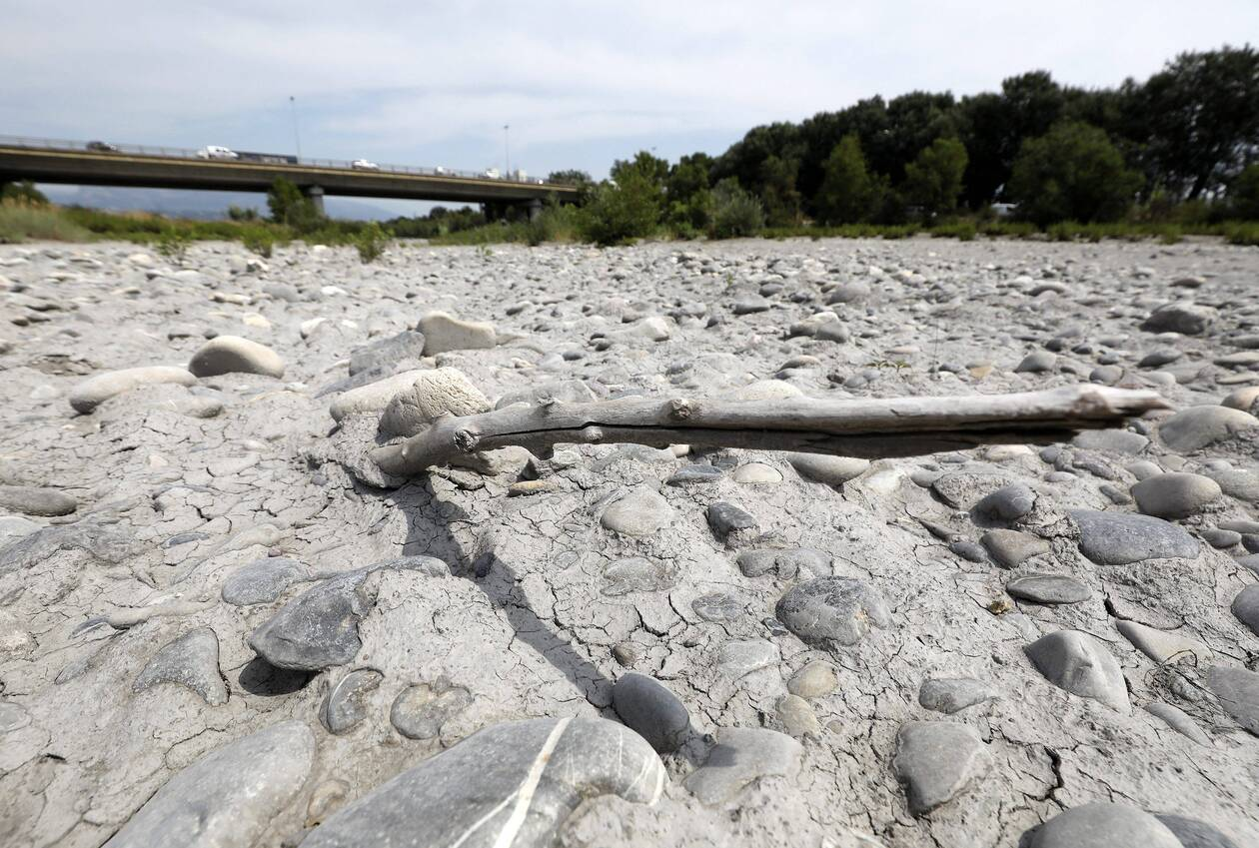
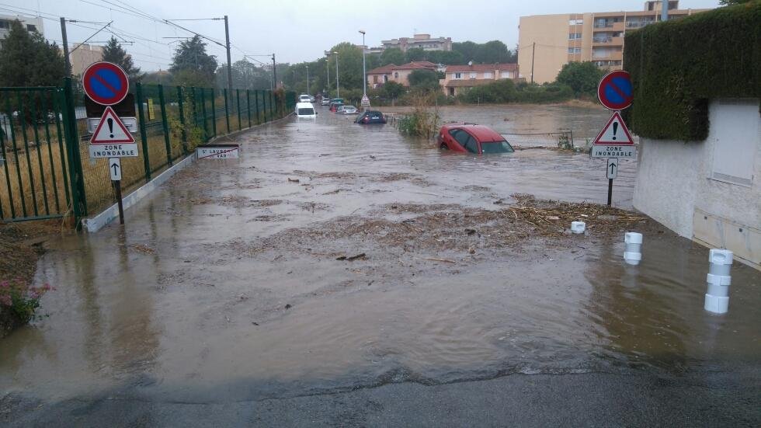
Global warming effects on water: resource availability, infrastructures resilience issues
Example of a climate projection. Number of days over 25°C/year at different times to come. Météo-France / CNRM2014: Aladin model from Météo-France. RCP 8.5. Drias-climat.fr.
Summer flows
-30 to 60%
Var river, in Saint-Laurent-du-Var, July 2019
20 Sept. 2019: Record with 88 French dpt under water restriction. 213 regulations.
Floods in Cagnes-sur-Mer and Saint Laurent du Var, Sept. 2017

Slide 3



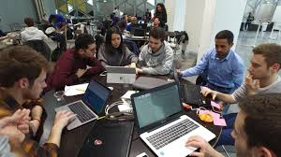
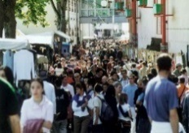
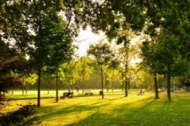




New challenges for cities
GOVERNANCE
QUALITY OF LIFE
ENVIRONMENT
    Centralised vs decentralised governance
    Stakeholders involvement
    Innovative structures to manage projects to transform local policy
    53% of the world's population lives in cities/ 66% by 2050
    A pronounced desire to improve their quality of life
    Toward “City-as-a-Service”, chrono-urbanism and “high societal quality”?
    By 2030, the total surface area of urban areas X 3
    80% is the increase in energy consumption by 2050
    55 % is the increase in water needs
ECONOMY
CITIZEN PARTICIPATION
    Budget constraints and transparency
    Attractivity for tourism, citizens, business, investors
    Participation
    Inclusion
Water Utility Management at the core of these challenges

Slide 4
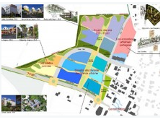
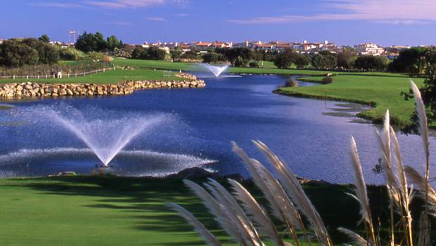
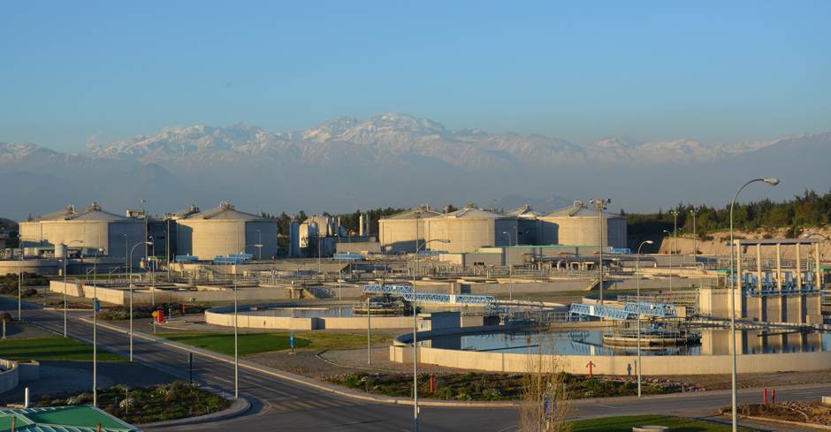
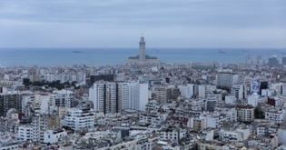
Our vision of the sustainable & resilient city
Many solutions, but we have to speed up…
Anticipate
  And model the city for planning its evolution
    Global Master Planning
    Climate Change and Resilience Plan
    Dedicated environmental assessment tools
Adapt
  To the growing demand on water and to the challenges of Climate Change
    Aquadvanced solutions
    Reuse
    Artificial aquifer recharge
    Desalination
Be circular
  To limit the use of scarce resources through circular economy
    Material recovery
    Energy recovery
Include
  To basic services provided to all inhabitants
    Water social tariff schemes
    Dedicated solutions for non consolidated urban zones (Casablanca, Mumbai…)

Slide 5



Fostering collaborative actions
  to scale-up the implementation of climate-responsible solutions
Business Alliance for Water and Climate – UN Global Compact
    Since 2015, SUEZ as co-funder
    51 signatories to raising awareness of the business sector on water, catalyzing collaboration, and scaling critical lessons on water sustainability around the world
    OECD Water Governance Initiative
    International multi-stakeholder network of members from the public, private and non-for-profit sector
    Sharing good practices in support of better governance in water sector
    A strong partnership with UNESCO to fight against oceans pollution
    Innovation and research with academics around specific topics such as oceans acidification and deoxygenation
    To contribute to innovations and solutions, national and local politics, education and raising awareness among citizens.

Slide 6
Thank you

