Slide 1
UNESCO’s Contribution to Disaster Risk Reduction
Smart Resilient Territory
Notes:
Page1
Ladies and Gentlemen,
It gives me great pleasure to have an opportunity to welcome you to the 10th conference of the international society for integrated disaster risk management, IDRiM 2019 in Nice, France.
As one of the supporting organizations of this event, I would like to thank the French Ministry for the Ecological and Inclusive Transition and the City of Nice for their support of this conference.
I would also like to thank Mr. Roland Nussbaum, Secretary-General of the Association Francaise pour la Prevention des Catastrophes Naturelles (French platform for disaster risk reduction), who has organized this conference with its partners and invited UNESCO for the opening of this long-lasting international conference.
IDRiM has chosen topics relevant to the global discussion on disaster risk reduction (DRR) such as DRR for sustainable growth, resilient community, STI for DRR. Topic this year seems rather new, “ Smart Territory”. We have seen a lot of discussion and research on Smart City but the notion of Smart Territory looks rather new. I assume that IDRiM picked up this topic for the forward-looking for innovative solutions for DRR. We look forward to having a fruitful discussion for the coming 3 days.
I will try my best to set the scene in my presentation for the Smart Territory and DRR together with UNESCO’s activities on DRR.
I will start by introducing UNESCO DRR activities, then I will set up the scenes for smart territory.

Slide 2
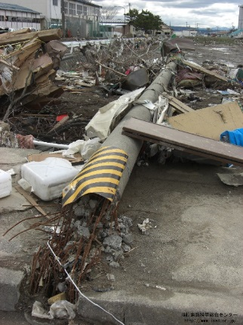
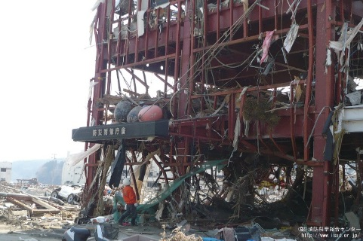
Smart Resilient City
Smart City
smart cities are those cities with “smart (intelligent) physical, social, institutional and economic infrastructure while ensuring centrality of citizens in a sustainable environment"
UNHABITAT III
Smart City has strategic use of
- New technology and innovative approaches
- Central and institutional approach.
Disaster Risk Reduction (DRR) is crucial part of Smart City. The advanced technology depends on critical infrastructure such as electricity, fiber cables, computers and government.
The ruined Minamisanriku Town Hall (Great Japan east earthquake, 2011)
2
Notes:
Page 8
Smart city and DRR
As we have seen many discussions, definitions, and practices on Smart City, I would like to start from the Smart City.
One definition, this one is from UNHABITAT III conference, says that smart cities are those with “smart (intelligent) physical, social, institutional and economic infrastructure while ensuring centrality of citizens in a sustainable environment;” often referring to specific activities in cities such as smart economy, smart mobility, smart people, smart environment, smart living, smart governance etc.
Smart City often links to the strategic use of 1) new technology and innovative approaches to enhance the efficiencies and competitiveness of cities. Also often link to 2) the usage of the central and institutional approach.
City in relation to DRR, we can define characteristics of the risks of the city as 1) concentration of critical infrastructure and functions such as economy, politics, and finance and 2) social and economic diversity of stakeholders. The concentration of critical functions in the city makes it difficult to make a priority and to take necessary measures for resilience. If critical facilities and functions are damaged or disrupted, it may occur cascading damage and effects in the various field due to its interconnectivity of the different functions. This may cause a delay in recovery and reconstruction activities.

Slide 3
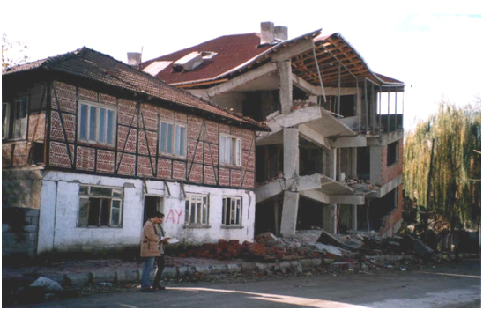
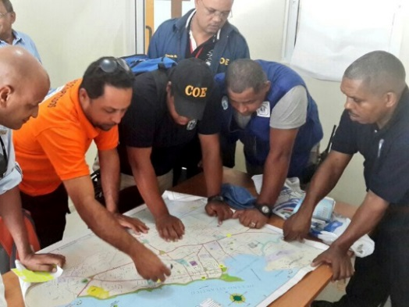
Smart Resilient Territory
Territory includes wider
- geographical coverage: Urban + Rural
- social/economical coverage: modern + Traditional
In addition to the approaches used in Smart City, Smart Resilient Territory would use
- New technology + Traditional and simple technique
- Institutional + local/individual approach.
Himis construction didn’t collapse after earthquake in 1999, modern structure collapsed. © Randolph Langenbach
Community member discuss the tsunami evacuaction route in 2014. © Bernardo Aliaga
Notes:
P 9
On the contrary to Smart City, Smart Territory includes wider coverage. Smart Territory has wider geographical coverage, both urban and rural areas, and wider social/economical context both modern and traditional. Therefore, it may require different and additional approaches in order to achieve the resilient “Smart Territory”.
For the Smart Territory, 1) local knowledge and simple technology can support the resiliency in addition to the high technology. Also, 2) individual and community approach can be an important element in addition to the institutional and central system for the smartness.
As you see in the picture, in the case of the earthquake in Turkey, traditional construction withstood the earthquake in Turkey after the earthquake and the modern reinforced concrete building collapsed just next to the traditional building. Traditional or simple technology can be utilized for the resilience of the Smart Territory.
On the right is the community meeting to discuss the evacuation route from the Tsunami. Sensitizing individuals and communities to evacuate when they receive the alert is as important to invest in high technology tsunami detection and alerting system. individual or community behavior is the key in addition to the institutional settings.

Slide 4
Smart Resilient Territory
- DRR is one of theme in Smart Territory and one of the important element to ensure its continuity.
- For DRR in Smart Territory, the Smart Territory need to implement not only advanced technology but also local human activities such as community, knowledge, experience.
Map for Smart Resilient Territory
Institutional
Central
UNESCO DRR Activities
IPRED
VISUS
PRERADE
Local knowledge
Simple tech
OPERANDUM
Early Warning System
High
technology
U-INSPIRE
INDRA
IREACT
Individual
Community
Notes:
Page10
In "Smart Territory" as well as "Smart City", DRR has a crucial role to ensure the safety of human lives and properties as well as the continuity of the activities of the territories.
Following the points at the previous slide, I elaborated a little bit to help us understand the overview of the DRR in Smart Territory.
Below is a provisional framework to describe the DRR solutions for Smart Territory. The frame is divided into 4 areas by the axis. One axis is about technology between high-tech and traditional techniques. The other axis is about implementation between institutional and individual.
Please Click. Additional information (UNESCO DRR activities) appears.
These are the UNESCO DRR activities concerning Smart Territory DRR corresponding to this framework. I would like to explain the framework using some of our activities.
As can be seen from this mapping, UNESCO's DRR initiatives are widely followed from the latest technology to local knowledge, from the community to the institutional level.
I will introduce several UNESCO DRR activities included in this mapping from the next slide. I will pick up 4-5 projects.
I wish this framework could help the discussions at this conference for the next 3days.

