Slide 1
Data Science & Smart Sensing developments for safe & sustainable drinking water distribution

Slide 2
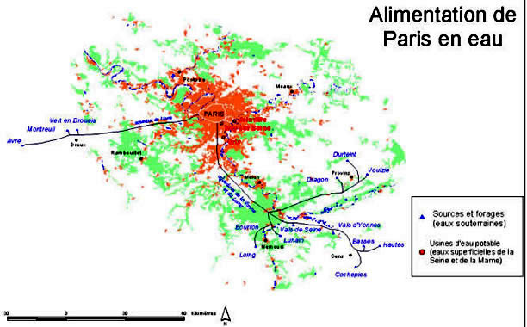
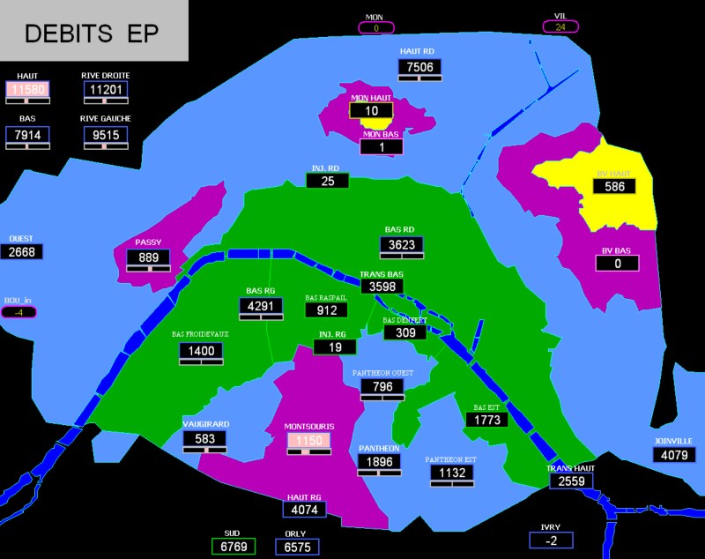
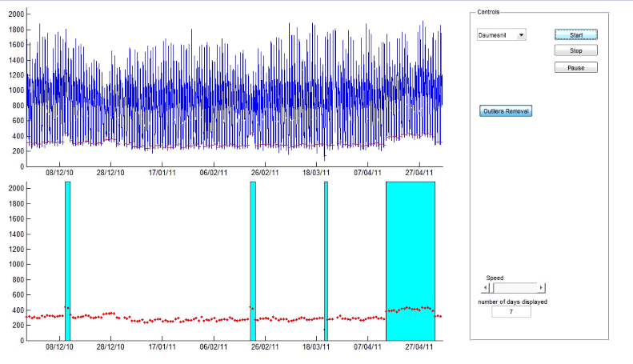
Water Quality Monitoring for « commercial » operations
-
Data science development

Slide 3




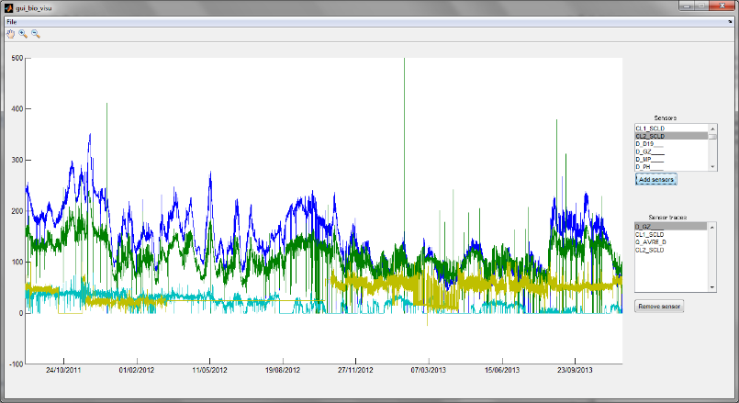


Water Quality Monitoring
Goal: Early contamination detection
Constraints: Using non-specific WQ sensors → [Chl]
Case study: analysing EDP & Univ. Lille ChlorScans data
  Inflow network Panthéon
  Chlorscan 1 reservoir
  Chlorscan 2 reservoir
  Total chlorine Saint-Cloud factory

Slide 4

Solution Concept
Data Acquisition
Data
Pre-processing
Data
Analysis
Decision making

Slide 5
Solution Concept
Data Acquisition
Data
Pre-processing
Data
Analysis
Decision making

Slide 6
Step 1 → Data Pre-Processing
Data Acquisition
Data
Pre-processing
Data
Analysis
Decision making

Slide 7
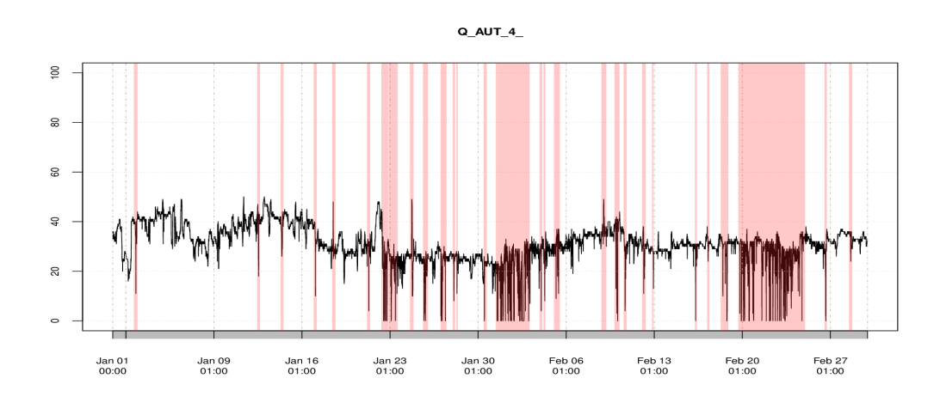
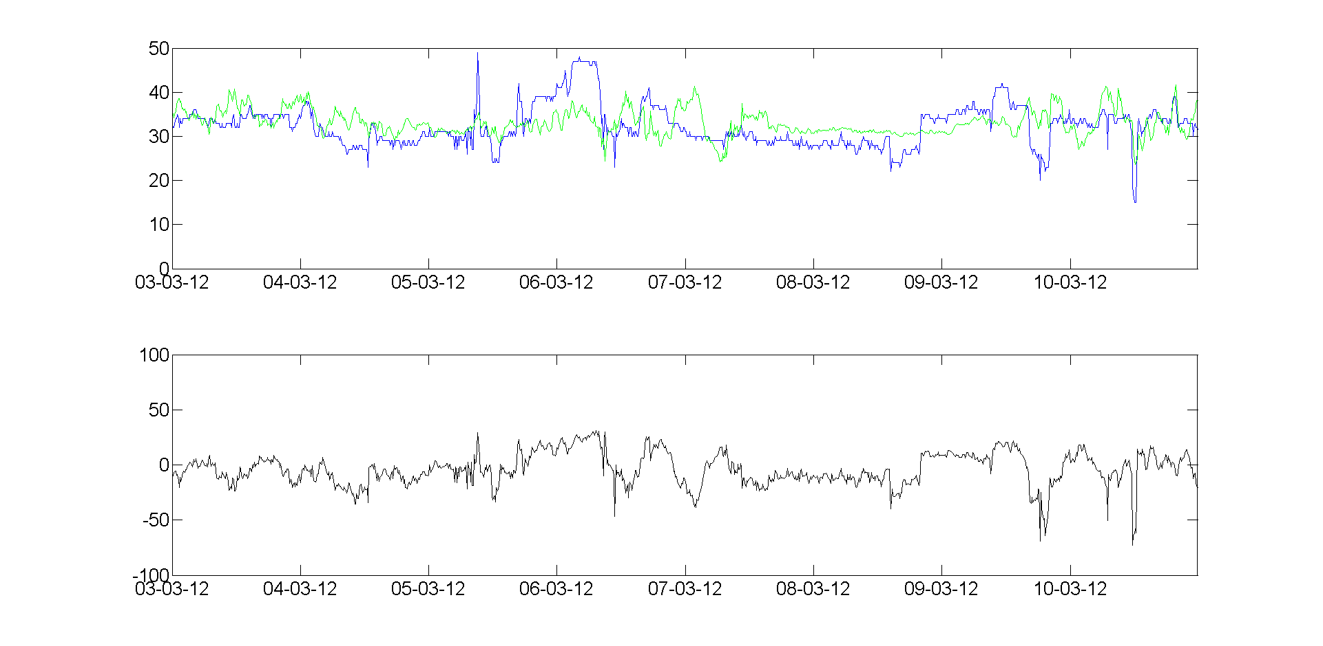
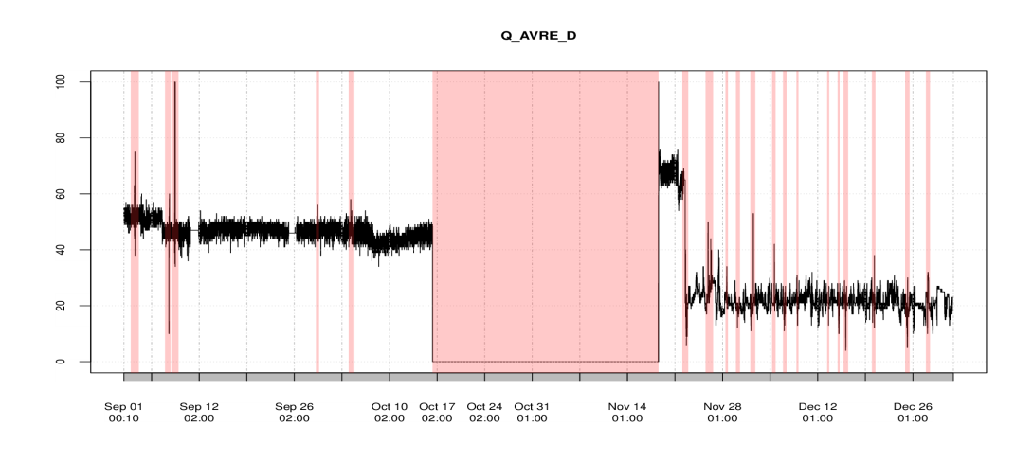
Step 1 → Data Pre-Processing
Detect & remove “absurd” data points
Replace missing and removed data points if possible

Slide 8
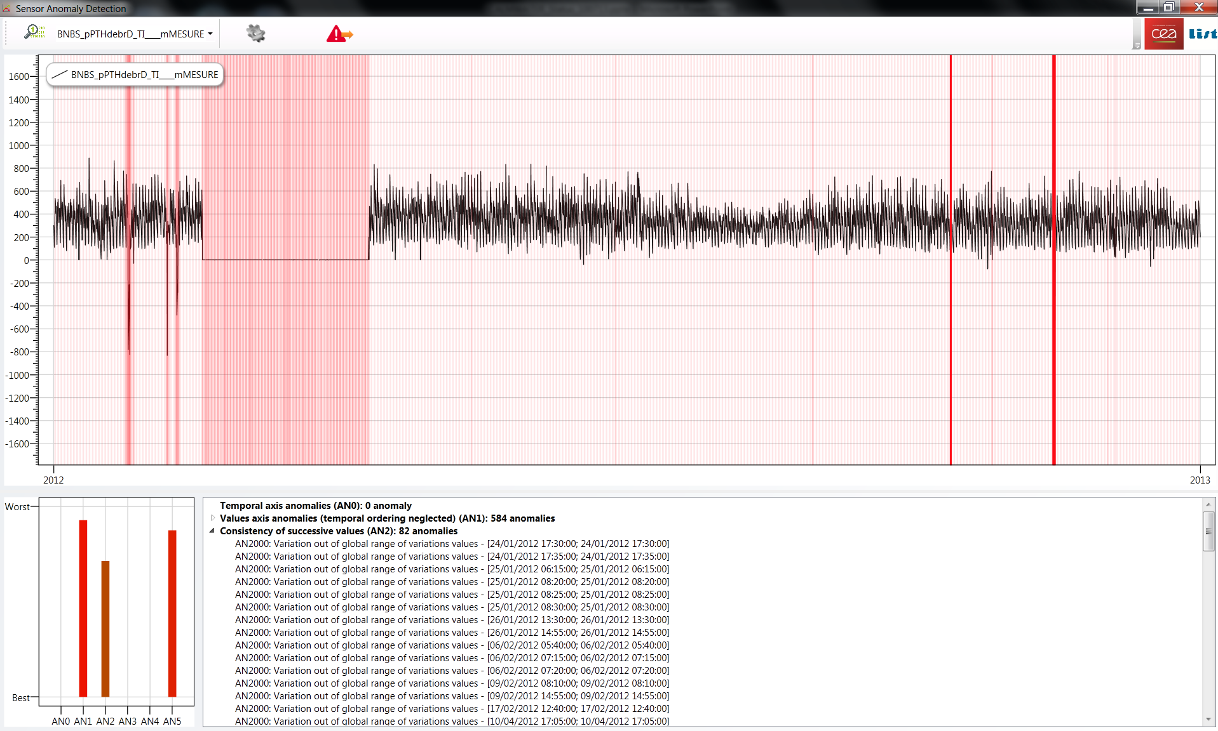
Step 1 → Data Pre-Processing
According to the number & types of measurement anomalies:
sensor reliability can be assessed
further decisions can be discussed

Slide 9
Step 2 → Water Quality Anomaly Detection
Data Acquisition
Data
Pre-processing
Data
Analysis
Decision making

Slide 10
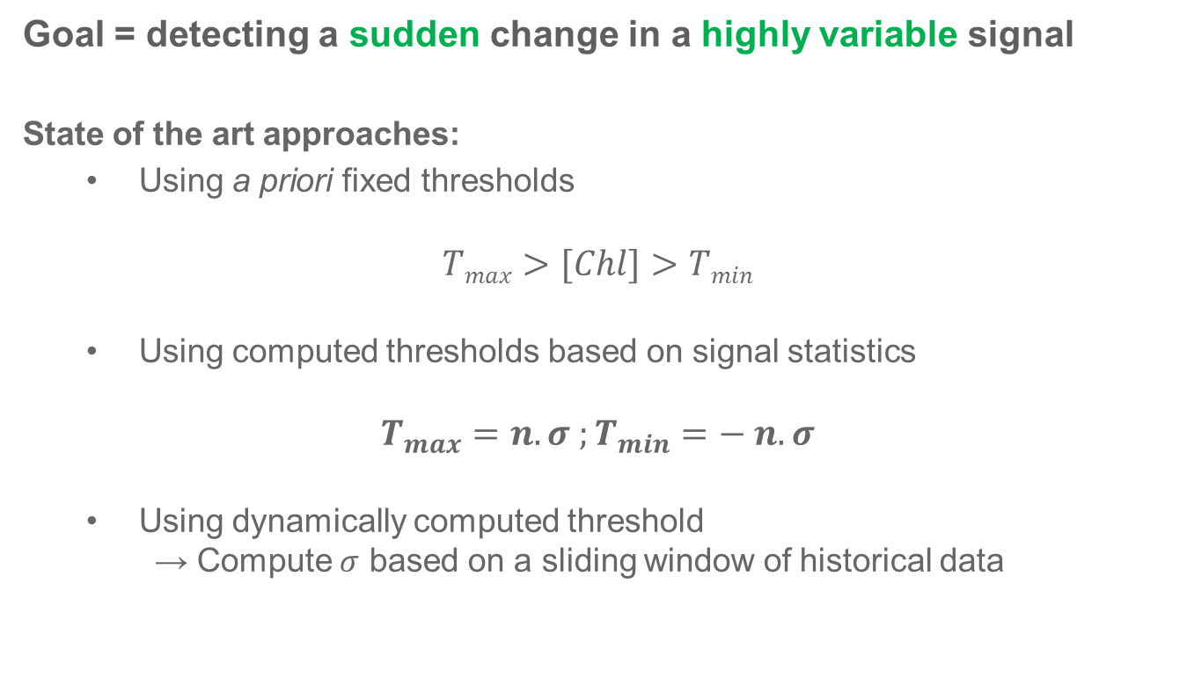
Step 2 → Water Quality Anomaly Detection
One class classifier = Normal behaviour of the signal Vs Anomaly

Slide 11
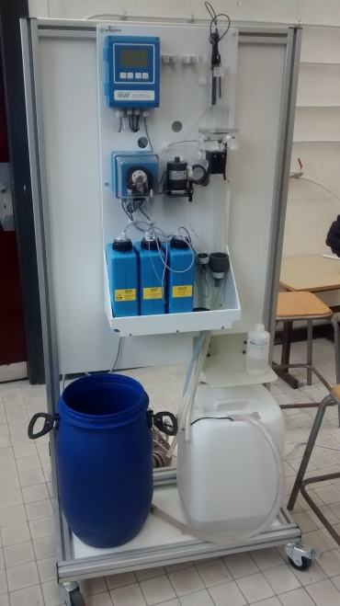
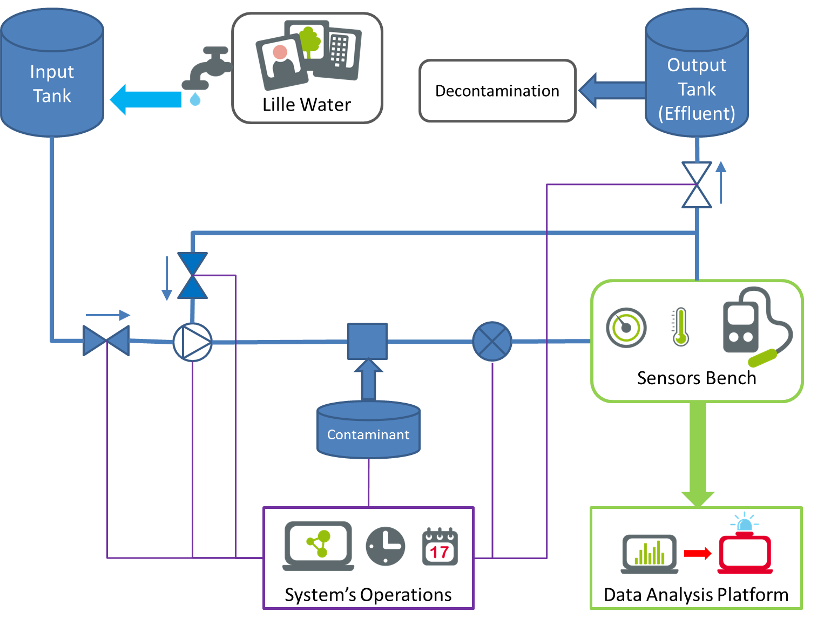
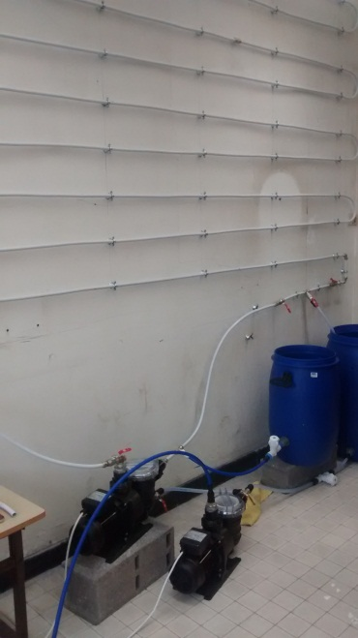
Validation : In Lab. Demonstration
Setting-up live experiments at Lille University for benchmarking

Slide 12
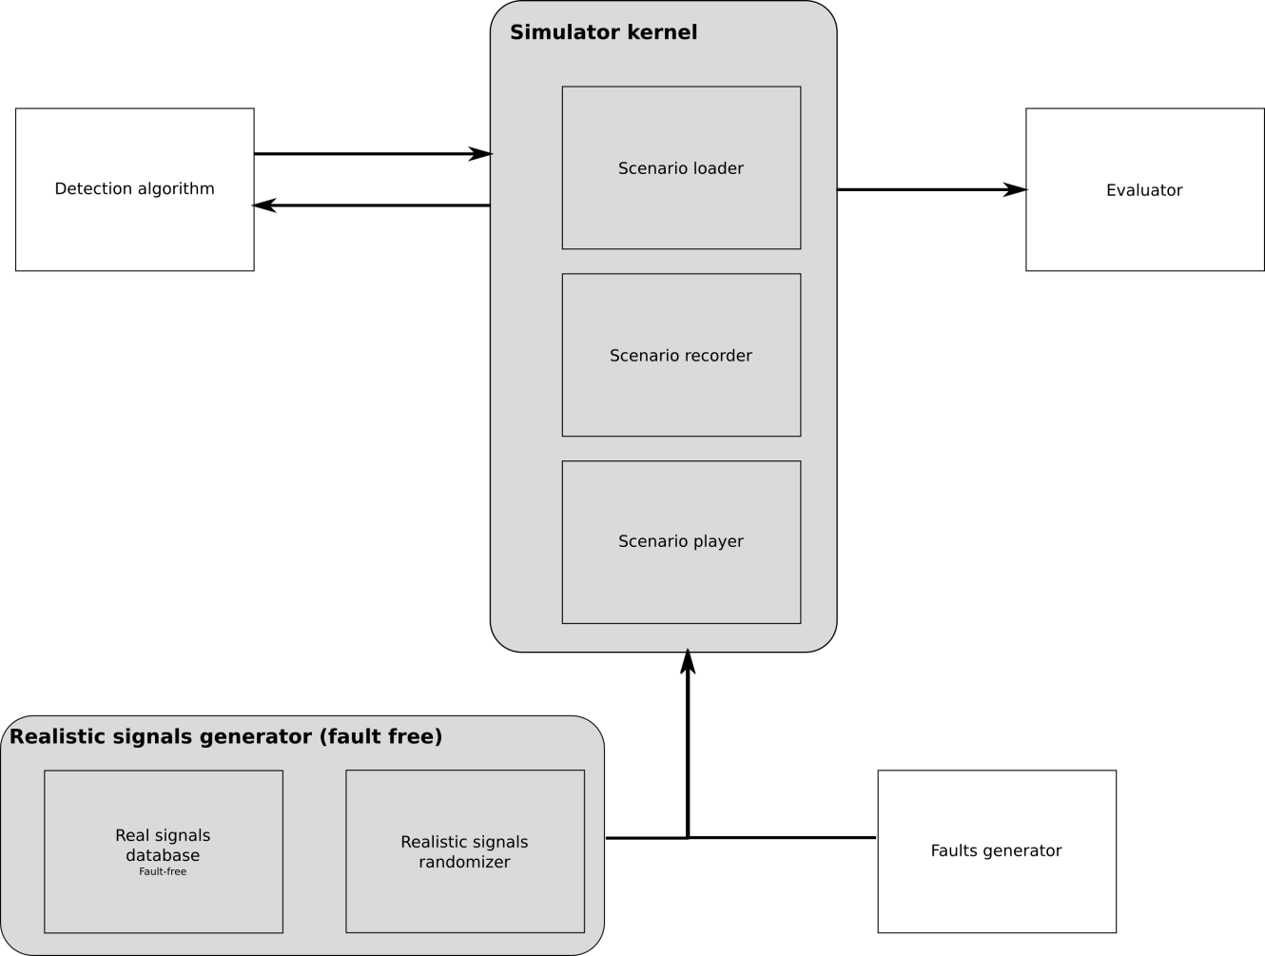
Validation : In Silico Demonstration
Exploiting existing EDP data with simulated anomalies

Slide 13
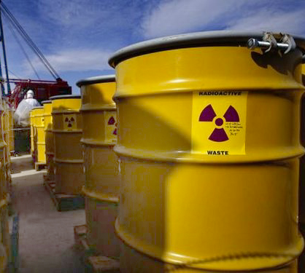
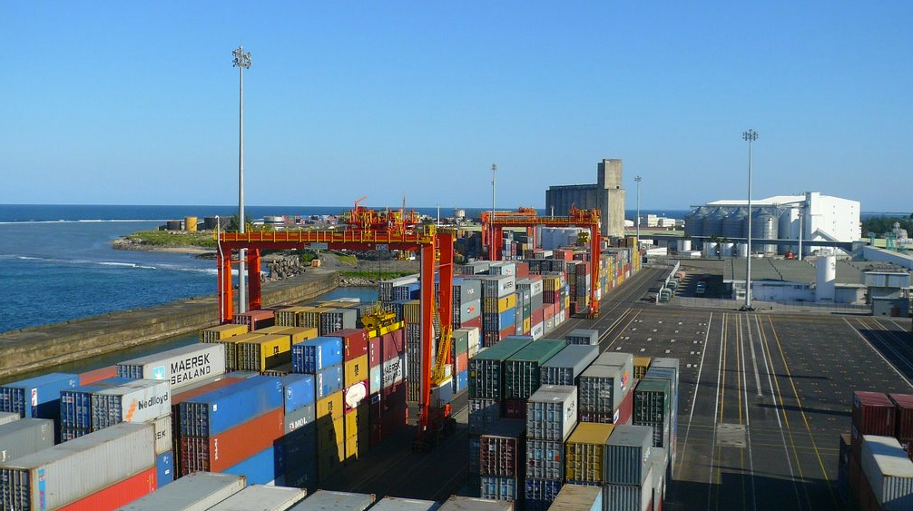
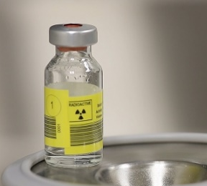
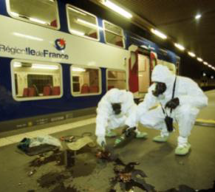
Radiological Monitoring for Homeland Security Applications
-
SMART SENSors development

Slide 14
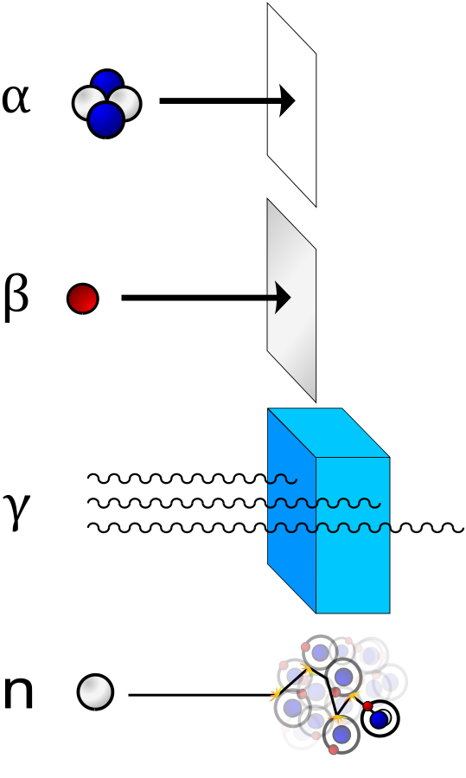
Water Monitoring
Goal: Detect Alpha & Beta contamination in drinking water
Operational requirements:
Online measurement (max 10 mn)
No influence:
  Temperature
  Turbidity
  Organic materials
  High concentration of chlorine

Slide 15

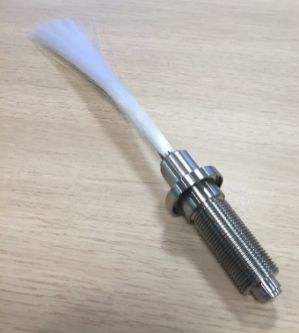
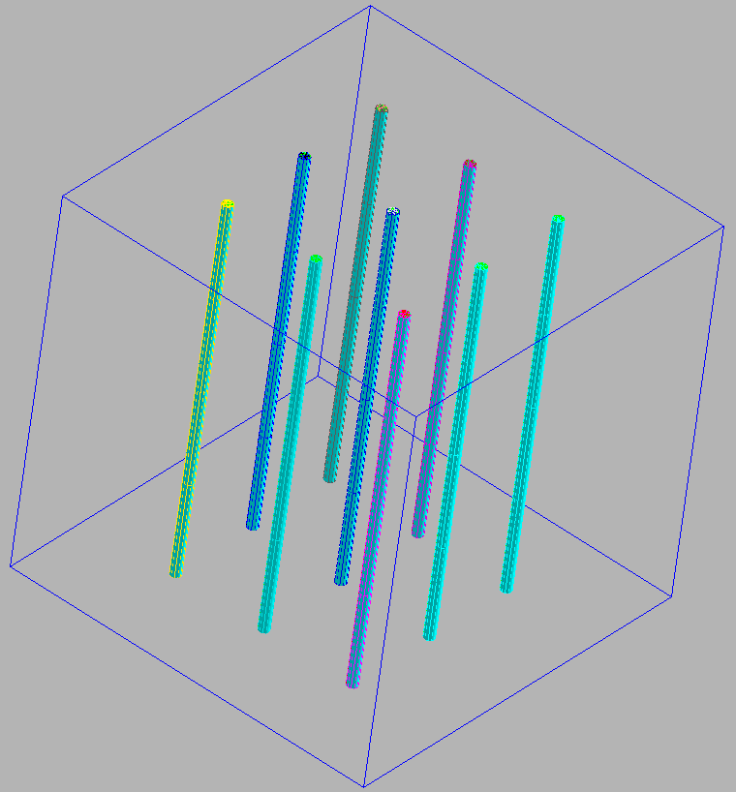
The SAFEWATER Concept
Water out
beta or alpha
Water in
Scintillating optical fibers bundle
Photomultiplier
Signal Processer
Counting and smoothing module
Notes:
MCNP is a general-purpose Monte Carlo N-Particle code that can be used for neutron, photon, electron, or coupled neutron/photon/electron transport.
Los Alamos National Laboratory

Slide 16
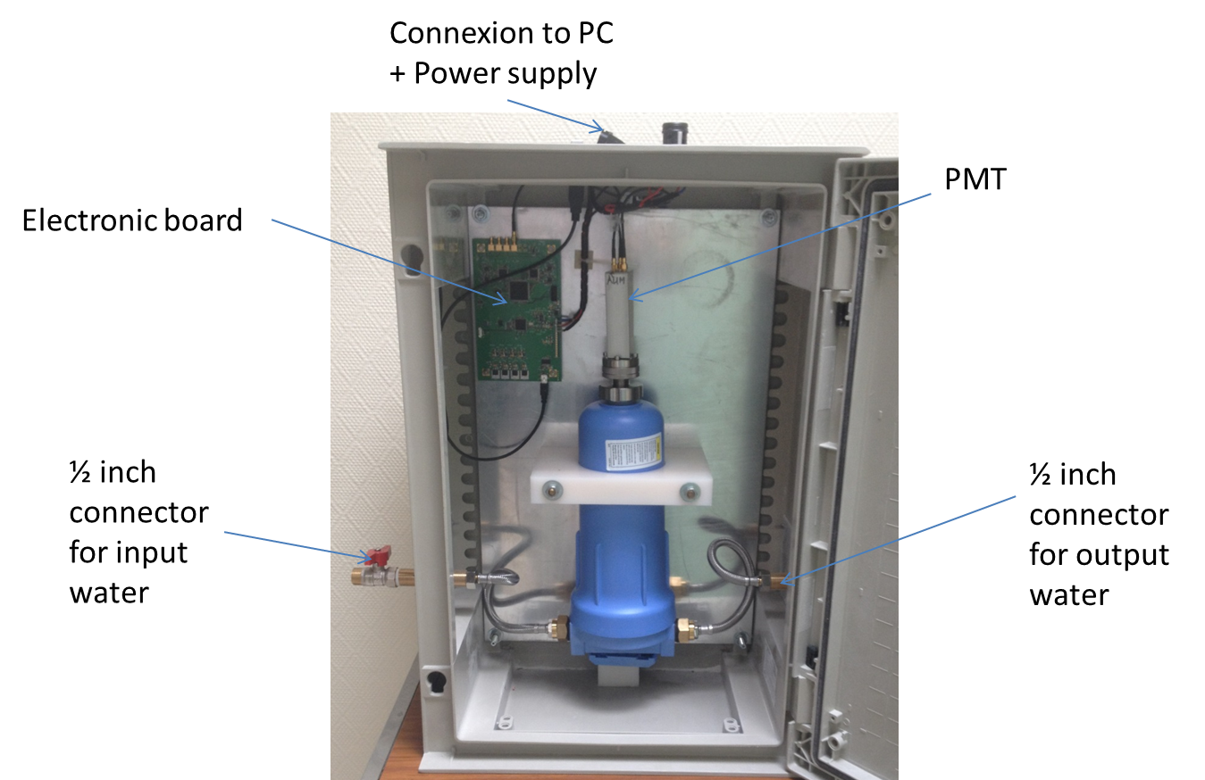
Safewater Solution : Hardware release 1

Slide 17
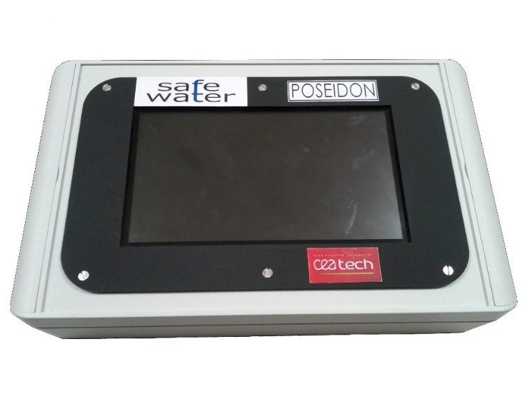
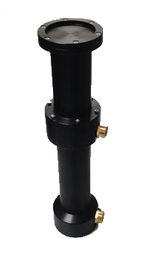
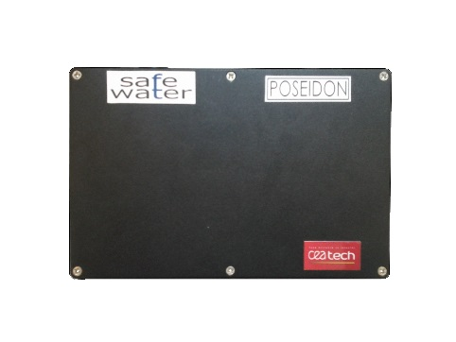
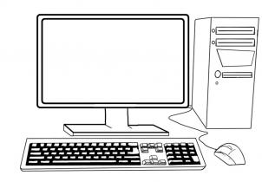
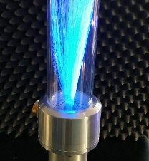
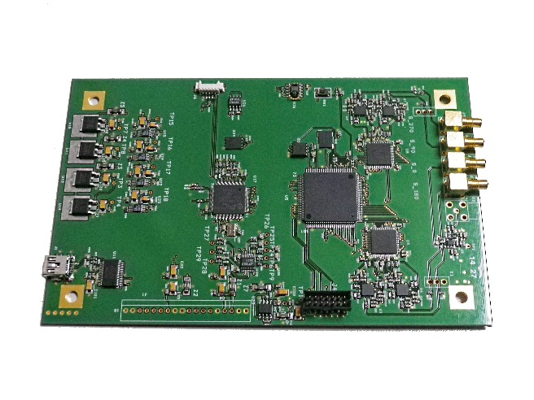
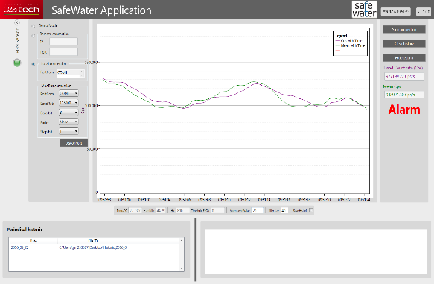

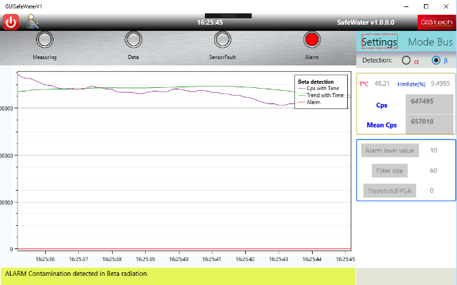
Safewater Solution : Hardware release 2
Sensor
Acquisition/processing
Display
Alarm Threshold

Slide 18
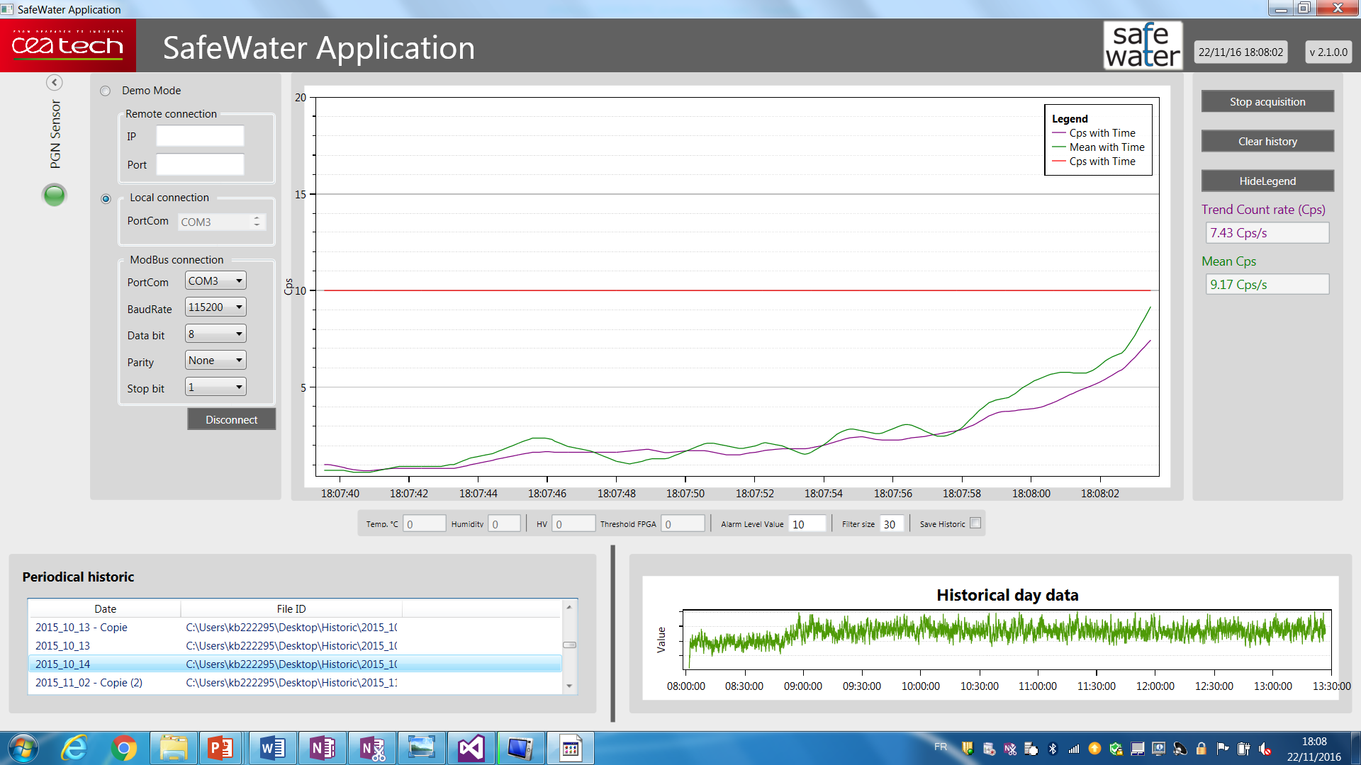
Safewater Solution : Software release 1
Alarm Threshold
Connexion
Current value
Daily Data Files
Measurments of the day
Notes:
Variable conditions with different water sources and contaminants other than radioactive materials have been evaluated, in order to determine the level of the background noise and its influence on the sensor.
During in-situ measurements in HAGIHON (Israel), variable conditions with different water sources and contaminants (other than radioactive materials) have been evaluated:
- Temperature
- Turbidity
- Organic materials
- High concentration of chlorine
->The sensor was not influenced by changes in water

Slide 19
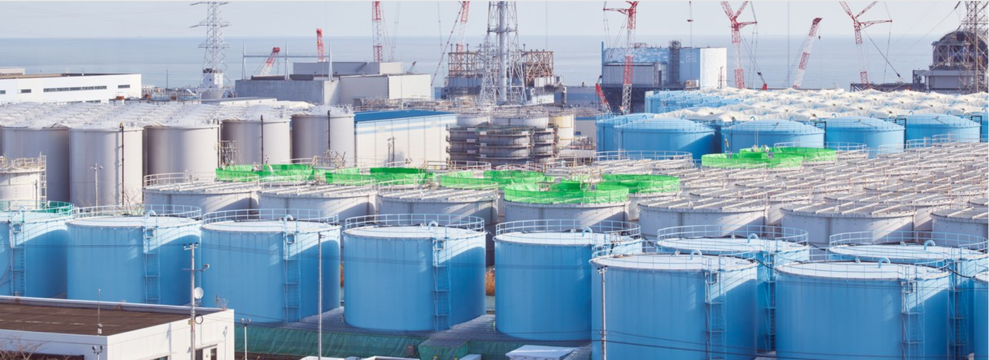
A new challenge : Tritium Detection for D&D applications
Main requirements (as defined by TEPCO)
Average tritium concentration to be detected:~1500 Bq.L⁻¹
Real time measurement
Manage the impact of salinity (~20000 ppm)

Slide 20
Direction : CEA TECH
Department : DCSI
Laboratory : LADIS
THANK YOU
Commissariat à l’énergie atomique et aux énergies alternatives
Institut Carnot CEA LIST
CEA Saclay – DIGITEO LABS | 91191 Gif-sur-Yvette Cedex
Phone. +33 (0)1 69 08 88 55 | Fax. +33 (0)1 69 08 89 65
  Etablissement public à caractère industriel et commercial | RCS Paris B 775 685 019

