Slide 1









MOCOPEE
Research program
Main results
SIAAP coordinators
V. Rocher and S. Azimi
S. Guérin-Rechdaoui¹, R. Mailler¹, J. Bernier¹, Y. Fayolle², S. Laruelle³, C. Causserand⁴, M. Spérandio⁵, A. Pauss⁶
1
6
2
3
5
4

Slide 2
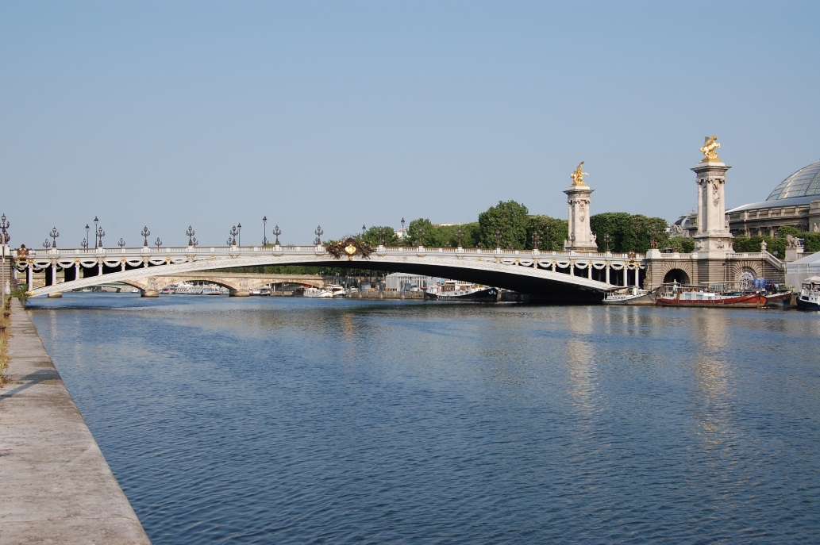
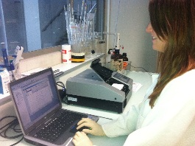
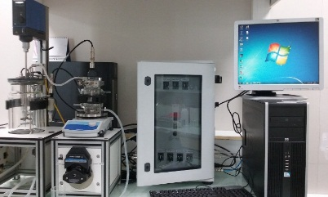
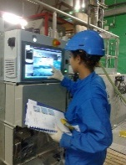
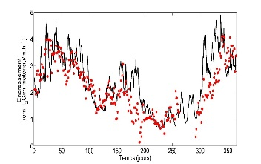
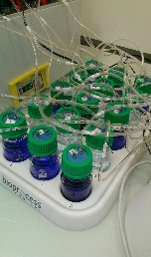
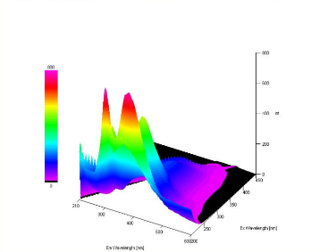

Contents
The SIAAP in the Paris area context
The Mocopée research programme as a tool box
Operational applications of the results of Mocopée

Slide 3
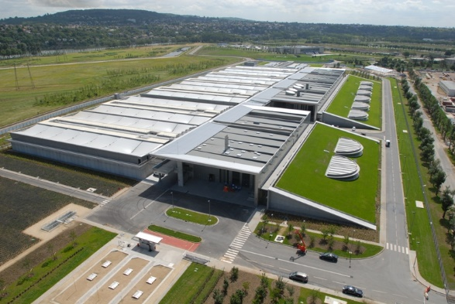
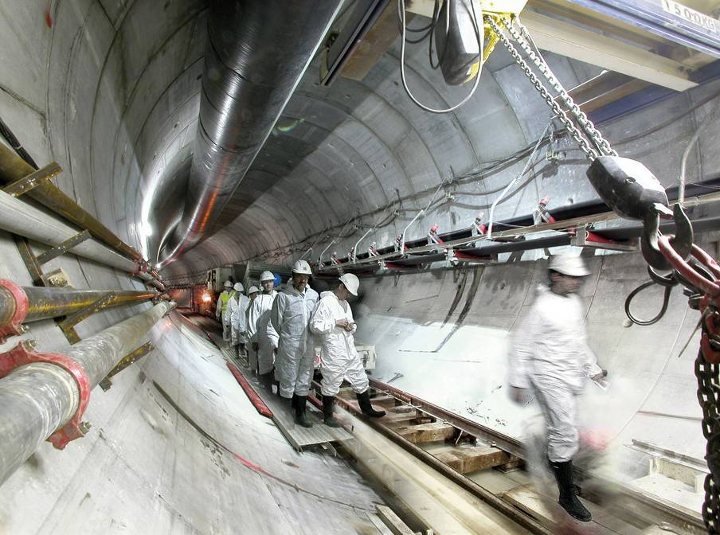
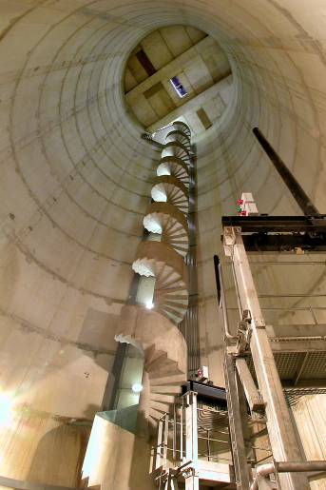
SIAAP presentation
An outstanding industrial tool in
an urbanized area
SAV
1 700 000 m³.d⁻¹
SEC
240 000 m³.d⁻¹
SEM
50 000 m³.d⁻¹
SEG
300 000 m³.d⁻¹
Paris
Marne
MAV
75 000 m³.d⁻¹
SAM
600 000 m³.d⁻¹
Seine
N
10 km
SIAAP area
2 000 km² / 9 millions inhabitants
2,5 millions d³ / j (dry weather)
440 km of pipes
6 WWTP
≈ 30 m³/s discharged in the
Seine River

Slide 4
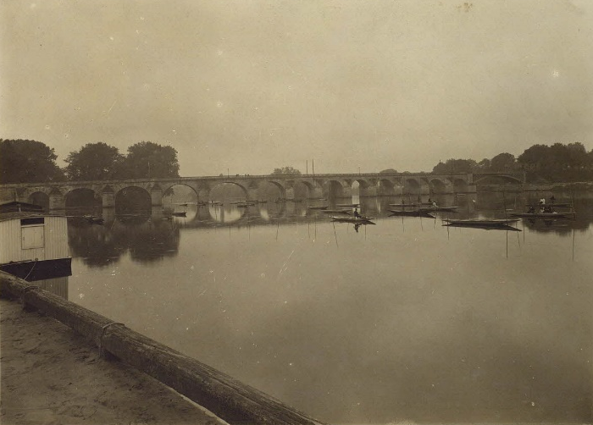
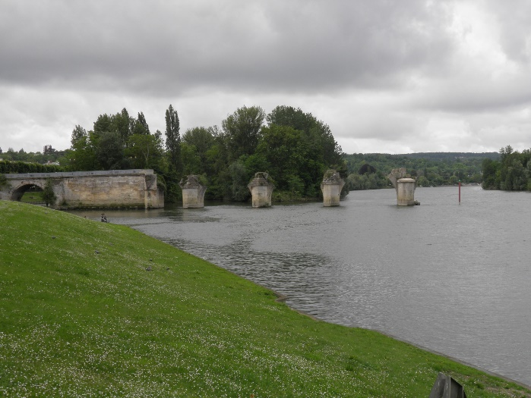
SIAAP presentation
An outstanding industrial tool in
an urbanized area
Seine River
(mean flow 300 m³/s - summer flow 100 m³/s )
Fleuve
Q low flow
Mun.
Pop.
Impact
m³/s
M inhab.
Inhab./ m³.s
Heavy anthropogenic pressure
Rhin
1 500
Strasbourg
0,7
470
Rhône
1 000
Lyon
1,8
1 800
Seine
100
Paris
12
120 000

Slide 5

Background
Major changes for the environmental protection
  A European regulation to reach good quality in surface water
  The need for high performance technologies
  Energy and chemical costs containment

Slide 6
Background
Major changes for the environmental protection
  A European regulation to reach good quality in surface water
  The need for high performance technologies
  Energy and chemical costs containment
Water Framework Directive
Restoring the good ecological
and chemical state
Rivers, water bodies, transitional waters,
coastal waters, heavily modified water bodies
WFD thresholds
Good state
Total phosphorus(mg P / L)
0,2
3
-
3
PO
(mg PO
-
0,5
4
4
/ L)
NH
+
(mg NH
+
/ L)
0,5
4
4
NO
-
-
0,3
Good Status target
90th percentile
2
(mg NO
/ L)
2
2027
NO
-
-
50
3
(mg NO
/ L)
3

Slide 7
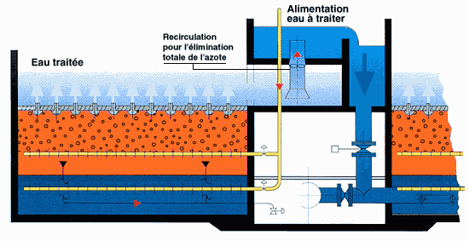
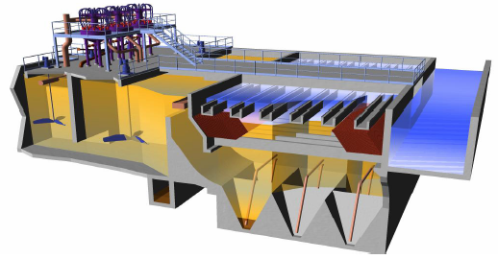
Background
Major changes for the environmental protection
  A European regulation to reach good quality in surface water
  The need for high performance technologies
  Energy and chemical costs containment
Biofiltre (Biostyr®)
Lamella physico-chemical settler tank (Actiflo®)

Slide 8

Background
Major changes for the environmental protection
  A European regulation to reach good quality in surface water
  The need for high performance technologies
  Energy and chemical costs containment
Chemicals (2017)
27 912 264 €
Energy (2017)
80
600
514 351 MWh
- €
7.364.437 €
487 311 MWh
51.219 t
4.030.164 €
4.371.851 €
22.624 t
X 1.000 Tonnes
X 1.000 MWh
40
960.608 €
13.235 t
300
7.742 t
1.009.236 €
871 784 €
1 466 733 €
2.317.609 €
9.2029 t
60 984 MWh
1.112 t
16 747 MWh
-
Caustic Soda
Methanol
0
Coagulant
Ferrous chloride
Calcium nitrate
Electricity
Biogaz
Fuel
Natural gaz
Polymers
Consomption (MWh)
Costs (€)

Slide 9
The Mocopee programme
A program with 4 areas
  Innovative methods for characterizing and monitoring processes with respect to current industrial practices
  Modelling of the operation of the sewer-plant-river systems and developing control strategies
  Understanding and quantifying the processes involved in the ageing of facilities
  Make it possible to recover resources contained in WW and exploring innovative processes

Slide 10




































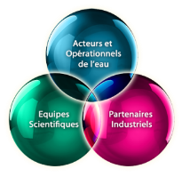
The Mocopee programme
Scientific partners
Manufacturing companies
Associations
Built as a gateway
  The Mocopée research program is a workshop between research community and staff on the ground

Slide 11



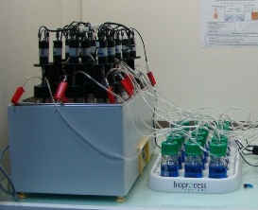
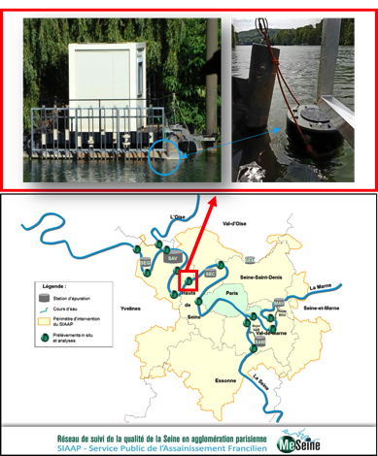
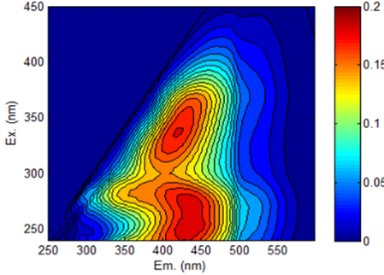
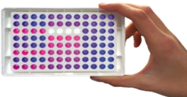
Operational applications
Design and development of new methods
  Assessment of Biomethane potential (BMP) in 48 h instead of 20 days
  Bacteria determination in 10 h instead of 48 h
Innovative approach
  Fluorescence 3D to assess the biodegradable fraction of OM
Mathematical modelling as decision making tools
BMP in less than 96 h
Microbiologial assesment
Organic matter analyse
BMP in 48h
BMP in 96h
In situ E.Coli mesurent
BOD5 in 48h.
Analyse MO via Fluo3D

Slide 12

Operational applications
Sewer network
WWTP
River
Process 1
Process 2

Slide 13

Operational applications
Sewer network
WWTP
River
Sensor
monitoring
Process 1
River model
Process 2
Output
Set-point
Downstream
Prediction (6h)

Slide 14
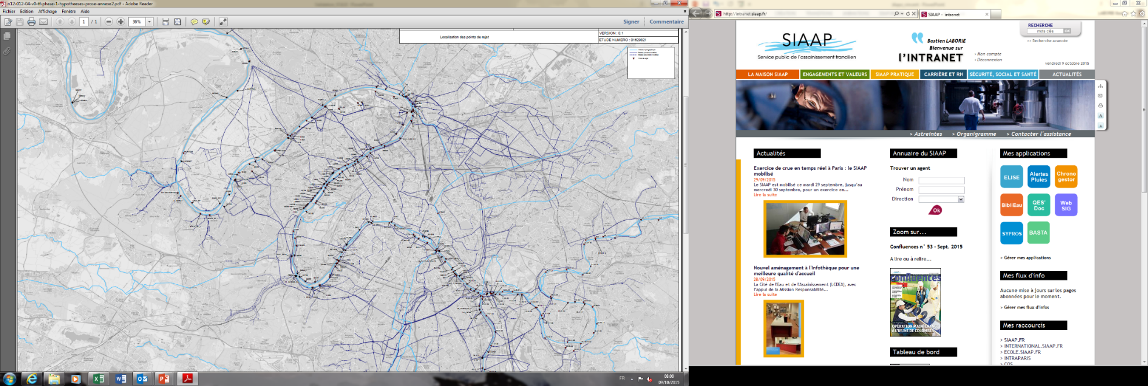
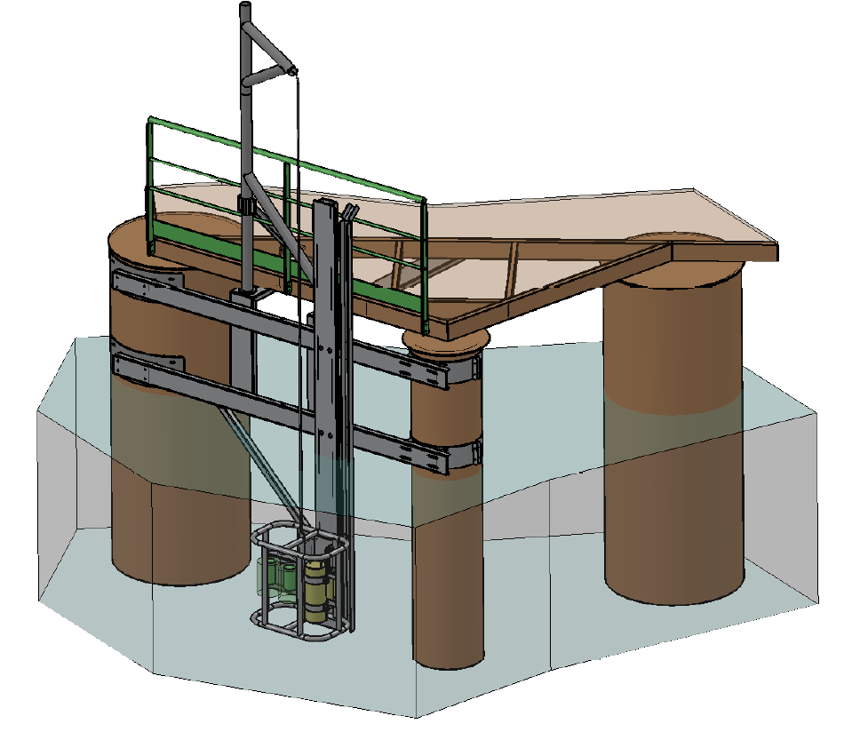
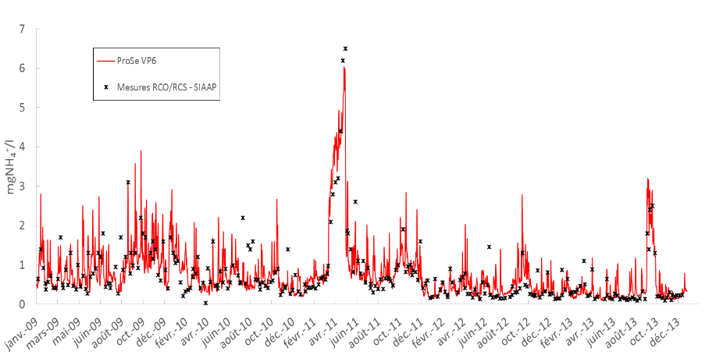

Operational applications
Sewer network
WWTP
River
Sensor
monitoring
Process 1
River model
Process 2
Output
Set-point
Downstream
Prediction (6h)
Design, development and construction of metrological and mathematical tools for the « River »
Downstream
Simulation NH₄⁺ – Andrésy
Andrésy
Bougival
Paris
Suresnes
Oxygen / pH / Conductivity / T°C
TOC / DOC / NTU / NH₄⁺ / PO₄³⁻ / Chloro a

Slide 15

Operational applications
Sewer network
WWTP
River
Sensor
monitoring
Sensor
monitoring
Network model
Quality
Prediction (6h)
Process 1
River model
Process 2
Input
constrains
Output
Set-point
Downstream
Prediction (6h)
Andrésy
Bougival
Suresnes

Slide 16
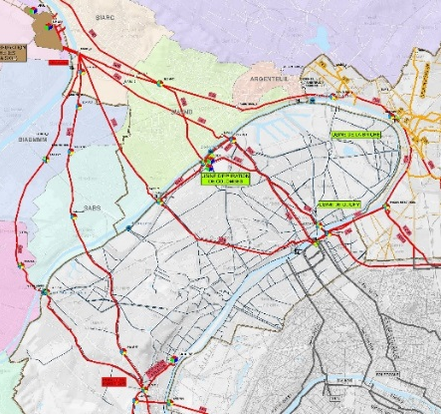
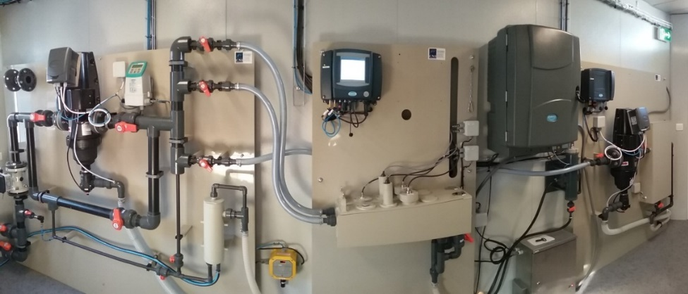
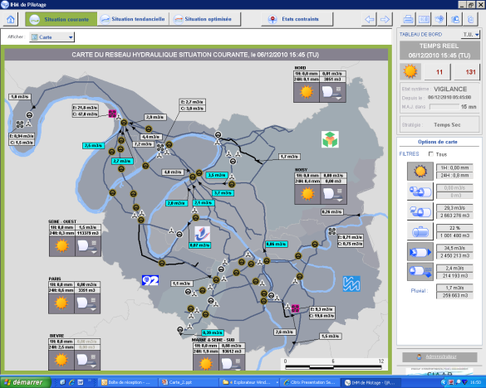
Operational applications
Sewer network
WWTP
River
Sensor
monitoring
Sensor
monitoring
Network model
Quality
Prediction (6h)
Process 1
River model
Process 2
Input
constrains
Output
Set-point
Downstream
Prediction (6h)
Design, development and construction of metrological and mathematical tools for « sewer system »
Downstream
Sewer monitoring sites
Site of Clichy – Hauts de Seine
Support model to manage water flows
La Frette
Andrésy
La Briche
Bougival
Clichy
Suresnes
St Cloud
Paris
Conductivity / NTU / DOC / NH₄⁺

Slide 17

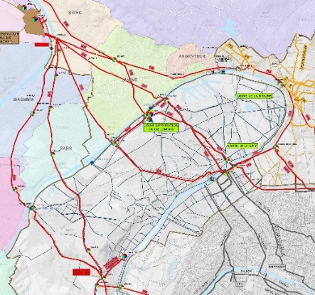
Operational applications
Sewer network
WWTP
River
Sensor
monitoring
Sensor
monitoring
Network model
Quality
Prediction (6h)
Process 1
River model
Process 2
Input
constrains
Output
Set-point
Downstream
Prediction (6h)
WWTP model
Andrésy
La Frette
La Briche
Bougival
Clichy
St Cloud
Suresnes
Paris

Slide 18
Operational applications
Sewer network
WWTP
River
Sensor
monitoring
Sensor
monitoring
Network model
Quality
Prediction (6h)
Process 1
River model
Process 2
Input
constrains
Output
Set-point
Downstream
Prediction (6h)
Design, development and construction of metrological and mathematical tools for « WWTP »
Input constrains
WWTP model
Output set-point
Andrésy
NH₄⁺
35,8
mg N/L
NH₄⁺
2,3
mg N/L
NO₂⁻
0,1
mg N/L
Bougival
NO₂⁻
1,8
mg N/L
PO₄³⁻
PO₄³⁻
3,1
mg P/L
Suresnes
0,9
mg P/L
Environnemental and economical impacts
Lamella settler tank
MBR
Biofiltration
WWTP
€ / kg CO₂
€ / kg CO₂
€ / kg CO₂
€ / kg CO₂

Slide 19


Operational applications
Sewer network
WWTP
River
Sensor
monitoring
Sensor
monitoring
Network model
Quality
Prediction (6h)
Process 1
River model
Process 2
Input
constrains
Output
Set-point
Downstream
Prediction (6h)
WWTP model
Andrésy
La Frette
La Briche
Unitary process models
Bougival
Clichy
St Cloud
Suresnes
Paris

Slide 20
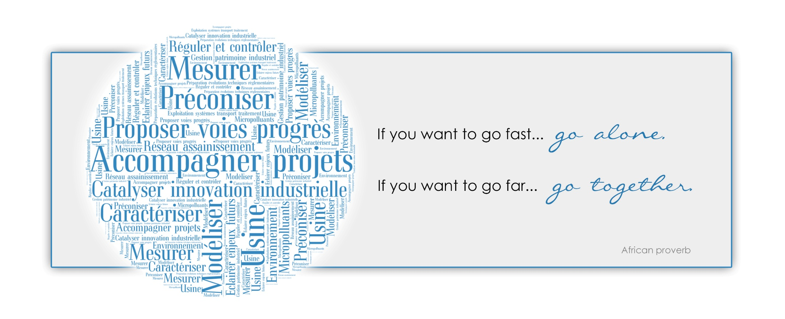
thank you for your attention

Slide 21
Mocopee’s structure
A program with 4 areas
Scientific objectives
Operational application
To promote innovative metrological methods or characterization tools
To solve operational problems and to optimize process efficiency with a full scale implementation
Notes:
Scientific objective
Promote innovative metrological methods or characterization tools
And promote evolution of operation practices

Slide 22
Mocopee’s structure
A program with 4 areas
Scientific objectives
Operational application
To improve existing mathematical models and control loops
To help operators as decision making support
Notes:
Scientific objective

Slide 23
Mocopee’s structure
A program with 4 areas
Scientific objectives
Operational application
To improve knowledge on processes involved in concrete and metallic structure degradations
To design innovative tools for diagnose and anticipation of degradations
Notes:
Scientific objective
Slide + Understanding links between the degradation and operational conditions
Operational application
Slide + It aims also to improve operational practices for rehabilitation and construction and define operational conditions

Slide 24
Mocopee’s structure
A program with 4 areas
Scientific objectives
Operational application
To improve knowledge on upcoming innovative processes
To provide guidance for the evolution of our industrial tool
(from WWTP to WWRRP)
Notes:
Recovery and recycling of nutrients
Evaluate innovative processes for pollutant and nutrients recovery and recycling.
Scientific objective
Operational application
Bring scientific considerations to provide guidance for evolution of industrial tool toward material processing

