Slide 1





UNESCO Metropolitan “ECO – RISE” R2020 Colloquium
“Eco-development, Climate-impacts & service-Operators’ challenges for Resilient Infrastructure & Sustainable Ecosystems”
Professor Isam Shahrour, Professor Ilan Juran & Dr. Silvia Tinelli
November 7 & 8, 2019, Conference Room IV, UNESCO H.Q., Place de Fontenoy, Paris

Slide 2
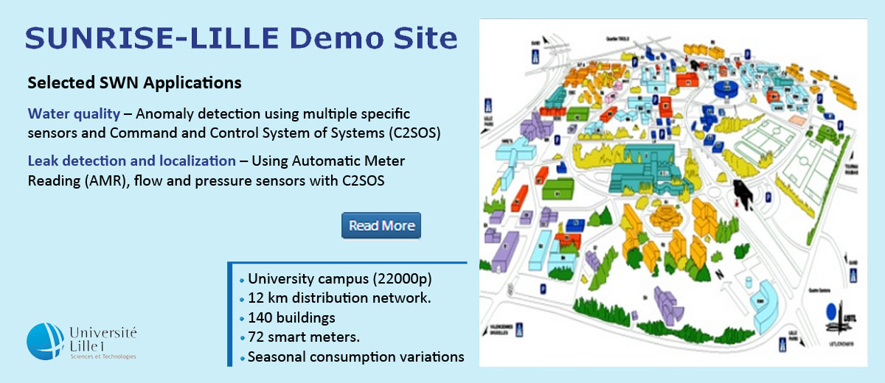
European Smart Water project
SmartWater4Europe

Slide 3
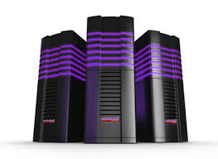


Smart Water System Architecture
Asset Digital model
Data transmission
Data Storage
Analysis
Users

Slide 4
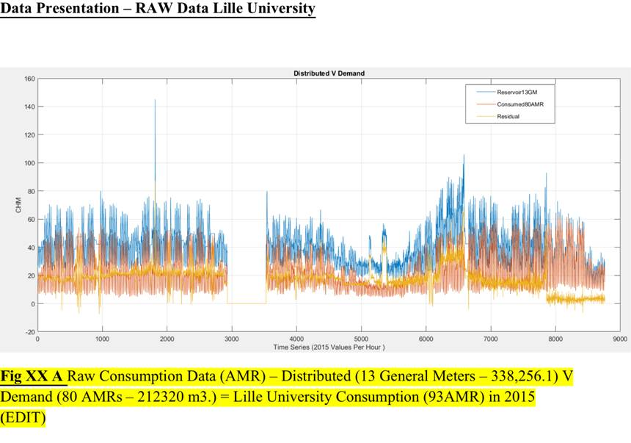
Flow Data Presentation – Raw Data Lille University
[Farah, E. (2016)]
Distributed (Reservoir 13 GM)
Consumed
Residual
Raw Consumption Data (AMR) – Distributed (13 General Meters – 338,256.1) V Demand (80 AMRs – 212320 m3.) =
Lille University Consumption (93AMR) in 2015 (EDIT)

Slide 5
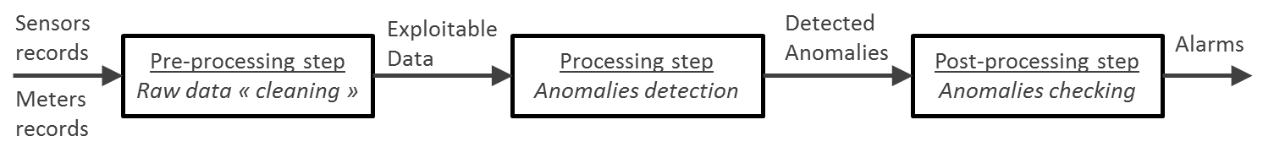
Methodology
Water Monitoring & Data Processing system
Functional Architecture
Confidence level of anomaly likelihood (after data normalization)
Severity of the anomaly
Risk of the anomaly
Sensor Deficiency
Statistical Analysis
Leak Detection Prototype System

Slide 6
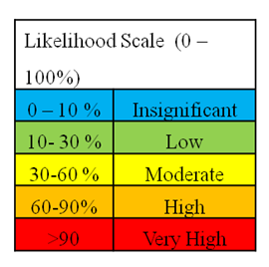
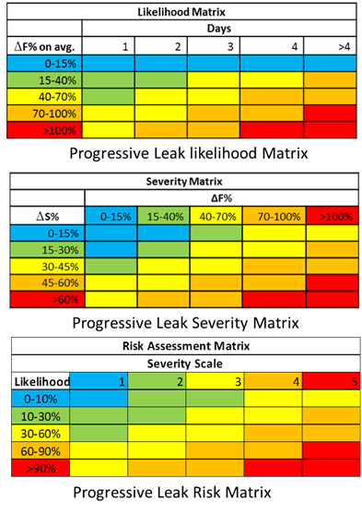
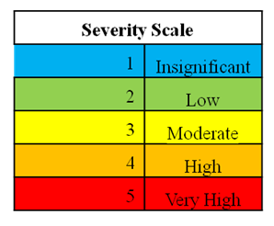
Risk Assessment Analysis
Likelihood matrix: function of amplitude (ΔF) and elapsed time period (ΔT) of the detected anomaly
Risk severity matrix: function of amplitude increase rate (ΔS) and ΔF
- Risk matrix: combination of the likelihood scale and the severity scale

Slide 7
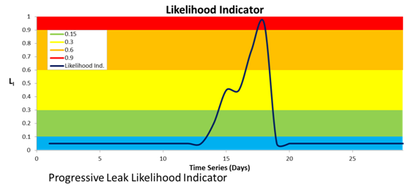
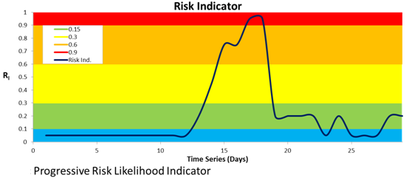
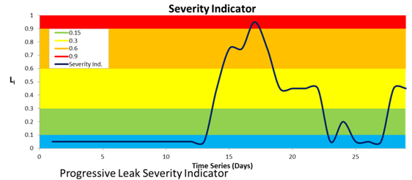
Likelihood, Severity and Risk indicators
Progressive leak

Slide 8
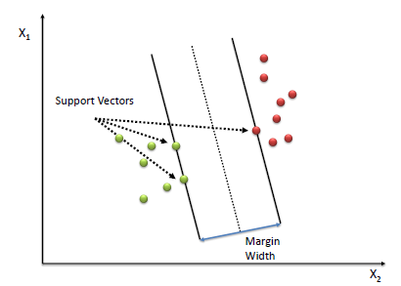
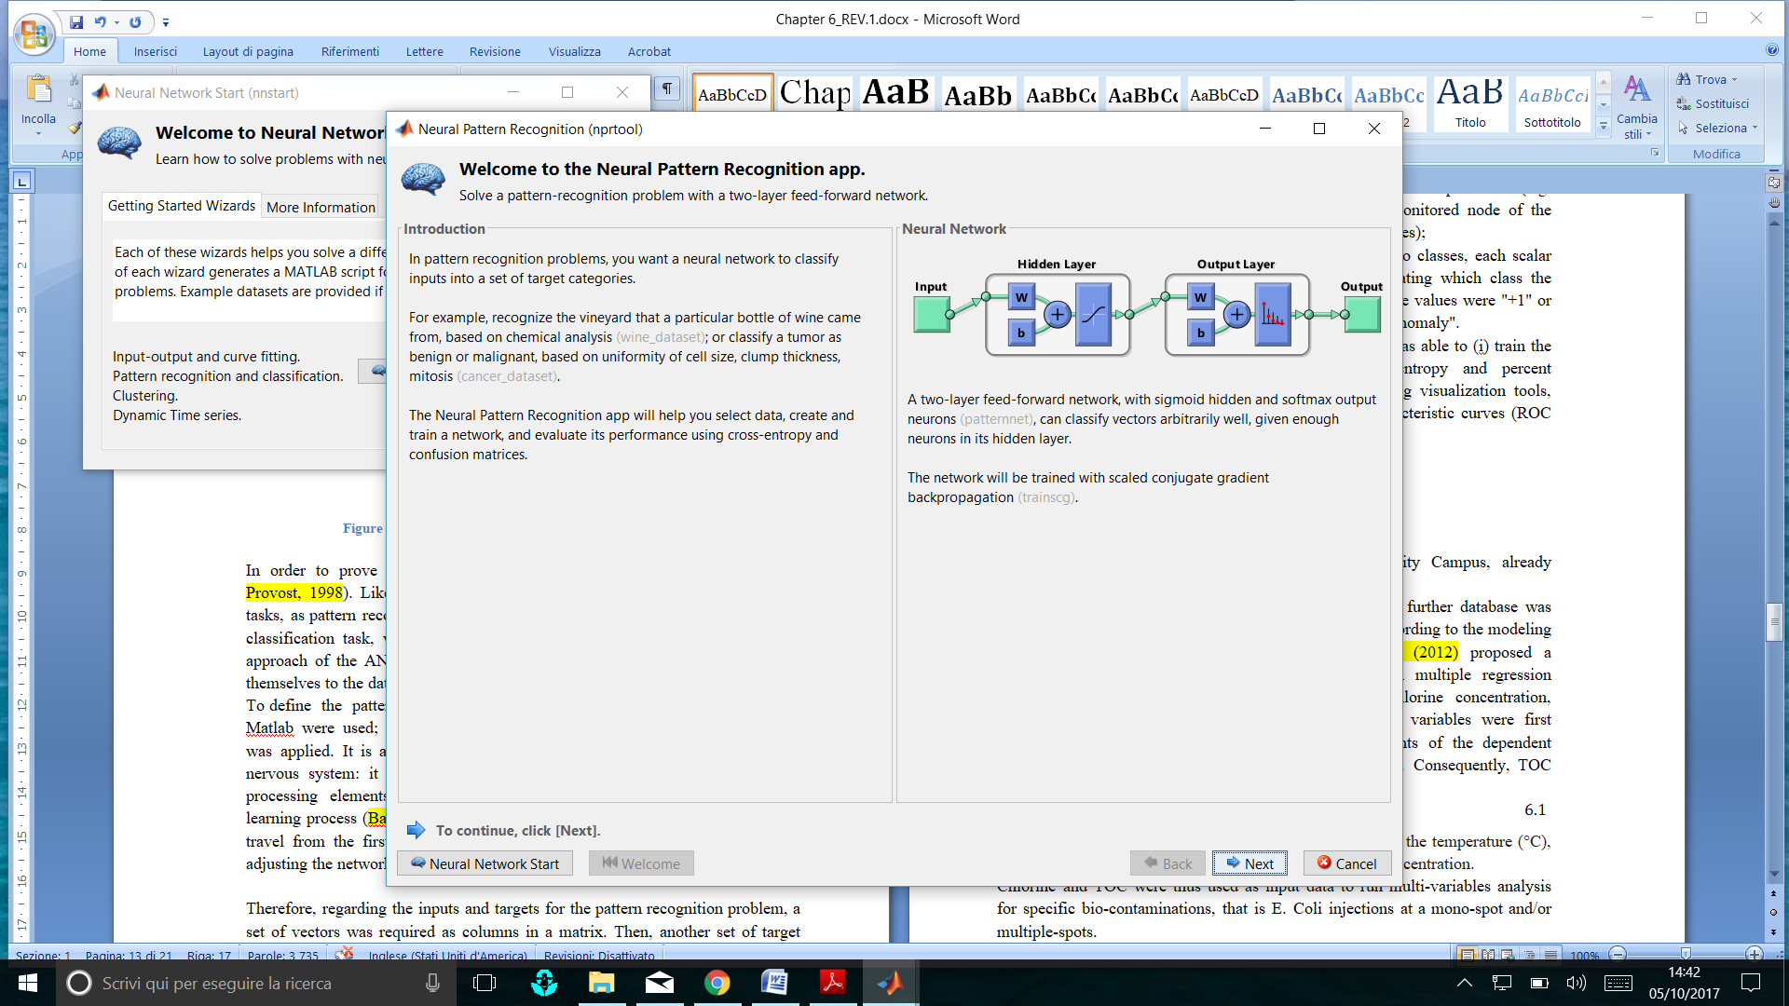
SW4EU AI-based Algorithm for Leak Geo-Localization
Tested Pattern recognizers: Supported Vector Machines (SVMs) and Artificial Neural Network (ANN)
SVMs
SVM ALGORITHMs
The Optimal hyperplane is used for the classification of upcoming data, after being trained from two data categories
Classification:
(ΔF-ΔS-ΔT)
Likelihood
Severity
Risk
ANN
The Artificial Neural can classify vectors arbitrarily in n- dimensional space, given enough neurons in its structure
ANN

Slide 9
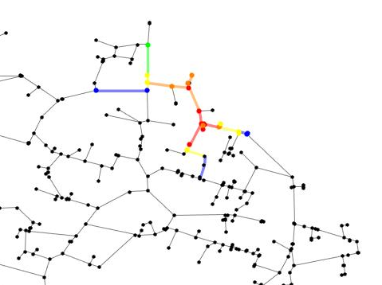
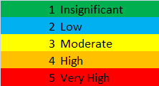
Multi-parameters Analysis
Multi-parameter Input:
Node: Demand - Pressure
Pipe: Flow - Velocity - Head Loss
Leaks Detection
SVM – Classification Loss ≈ 0%
ANN – Classification Error = 5.26*10⁻⁷
Output

Slide 10
Water quality - Lille Lab. Demo Site
S::can-spectro::lyser,
(Chlorine, Conductivity, Turbidity, pH, UV- Absorption, TOC)
EventLab-Optiqua
(Refractive Index - RI)
Intellitect-Intellisonde
(Conductivity, pH, Chlorine, Turbidity)
[Amani Abdallah, PhD Thesis, 2015]

Slide 11
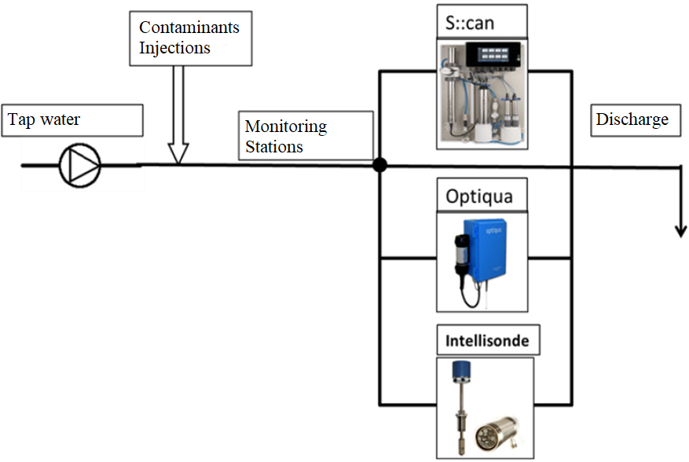
Monitoring Stations
[Lille Demo-Site]
S::can-spectro::lyser: Chlorine, Conductivity, Turbidity, pH, UV- Absorption, TOC
EventLab-Optiqua: Refractive Index – RI
Intellisonde: Conductivity, pH, Chlorine, Turbidity

Slide 12
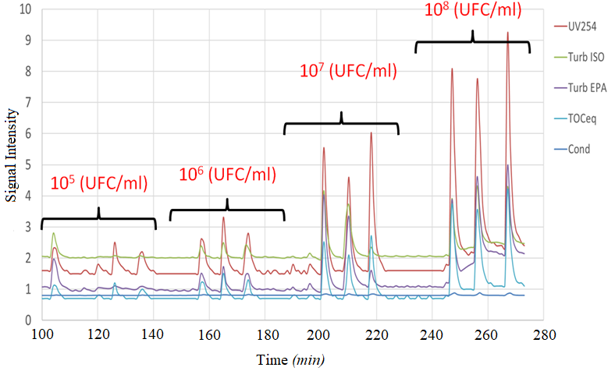
S::can SENSITIVITY with different E. coli injections
[Amani Abdallah, PhD Thesis, 2015]

Slide 13
AI-based Algorithm
Tested Pattern recognizers: Supported Vector Machines (SVMs) and Artificial Neural Network (ANN)
SVMs
SVM ALGORITHMs
The Optimal hyperplane is used for the classification of upcoming data, after being trained from two data categories
Classification:
(ΔF-ΔT)
Likelihood
Severity
Risk
ANN
ANN
The Artificial Neural can classify vectors arbitrarily in n- dimensional space, given enough neurons in its structure

Slide 14
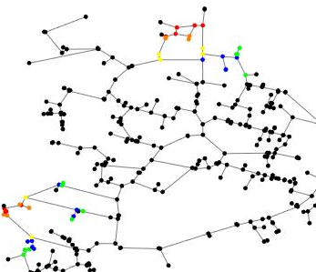
Multi-parameters/Multi-injections Analysis
[SW4EU Research report 2017]
SVM – Classification Loss ≈ 0%
ANN – Classification Error = 5.26*10⁻⁷
Anomalies

Slide 15
Conclusions
DMA Monitoring for Risk Assessment of Network Leakage with statistical data analysis yielding Likelihood, Severity, Risk indicators
Results demo-illustrate the feasibility of a LEAK Prototype System for simulating operator experience of leak detection
Feasibility & demo-illustration of AI-based models with pattern recognition features for reliable leak detection and geo-localization filtering false alarms
Demo-illustration of the Prototype Systems for early warning systems with likelihood & risk indicators
Feasibility & demo-illustration of AI-based models with mono/multi-parameters pattern recognition features for reliable bio-contamination detection
Multi-parameters analysis improves anomaly detection & geo-localization reliability

Slide 16
Thank you!
Professor Isam Shahrour, Professor Ilan Juran & Dr. Silvia Tinelli
November 7 & 8, 2019, Conference Room IV, UNESCO H.Q., Place de Fontenoy, Paris

