Slide 1


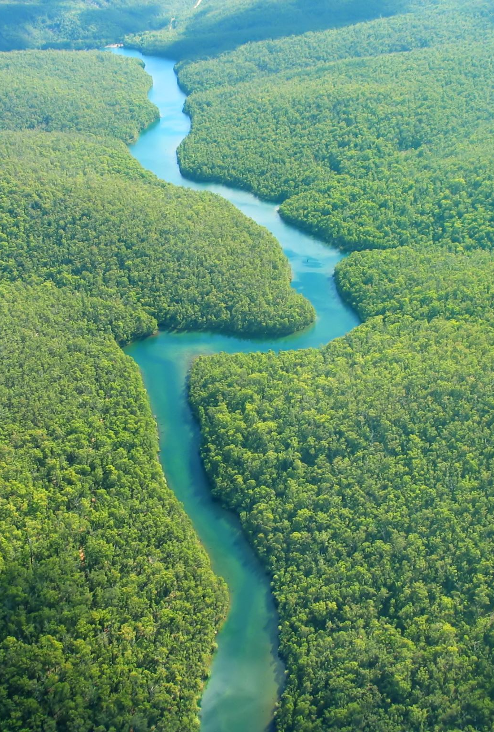
* UNIVERSITY PARIS NANterre * UNESCO CHAIR « Water, territories in transitions »
David BLANCHON
Marie-Anne GERMAINe
Département de Géographie-Aménagement, UFR SSA
Equipe MosAïques, UMR CNRS LAVUE 7218

Slide 2
UNESCO CHAIR « water, territories in TRANSITIONs »
The chair was created according to UNESCO's objectives, particularly Priority 5 of the Intergovernmental Hydrological Programme-IX : SCIENCE-BASED WATER GOVERNANCE FOR MITIGATION, ADAPTATION, AND RESILIENCE
We want to defend an idea: Water governance must be adaptation-oriented, context-driven, and locally determined to take into account historical and territorial specificities and challenges (§205 IHP)
consolidate research and teaching activities.
Strengthen and build international partnerships.

Slide 3
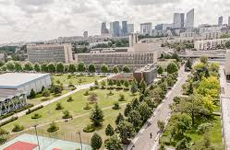
UNIVERSITY OF PARIS NANTERRE Department of GEOGRAPHY and Planning
35000 students
Campus 15 mn from Paris
Departement of Geography and Planning : 500 students, 2 masters programs, including one on Water management.

Slide 4
PROPOSAL FOR ECOMED
Mapping tools for forecasting, reacting and improving resilience of territories facing extreme events (floods and droughts).

Slide 5
Our proposal seeks to address local Disaster Risk Managemeng territorial implementation challenges focusing on academic/policy, partnerships, procedures, information, tools and community engagement. It is based on the scanning of DRM knowledge base, geographical analysis and the use of participatory mapping tools to encourage stakeholder engagement during three major phases of extreme event management: before, during, and after a disaster.

Slide 6
4 STAGES OF CAPACITY BUILDING
Step 1 diagnosis/benchmarking: gathering the DRM policy documents, plans, procedures data and tools in use. Gathering/listing relevant DRM resources, data sources and available tools and systems.
Step 2: participatory policy and mapping workshop: usage of QGIS and Umap paired with other data and technical solutions identified in step 1); gathering of other relevant data (GIS, socio-cultural, local knowledge
Step 3: on situation training with other stakeholders (inhabitants, NGOs…) = improving plans and tools (if software development is needed) and the ability to use them.
Step 4: diffusion and sharing with other groups.

Slide 7
Tools will be Free and Open Source Software for GIS (FOSS4G) and any technical solution compliant with the Open Geo Consortium (GOS)’ standards.
The approach will be low tech, free/low cost and maintenance.
The approach will be Open Data; compatibility with the OdbL licence of the OpenStreetMap project (and the French Open Data policy) will be favored

Slide 8
Finally, with the other partners of ECOMED consortium, we also want to create a conceptual framework for achieving climate change adaptation and mitigation and provide the ECO-MED and PHI a global forum for international expertise, and establish stakeholders’ Mediterranean dialog and mutual understanding.

Slide 9
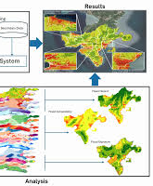
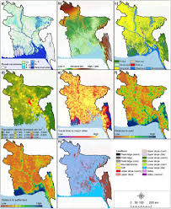
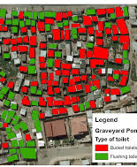
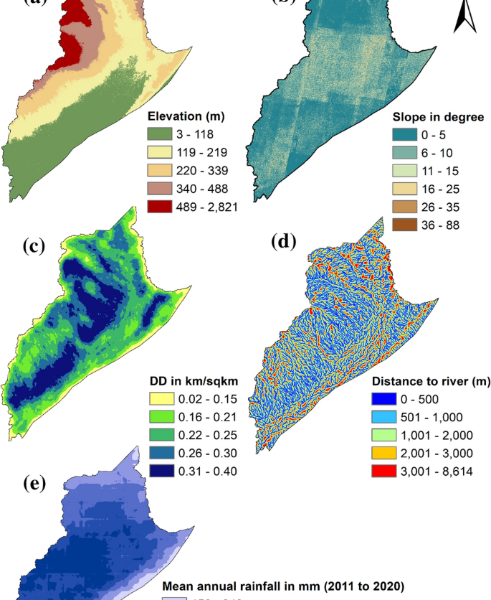
Thank you for your attention

