Slide 1




Strategic Partner
Co-founding NY City Agency
Co-founding University
W-SMART works for Sustainable Water Security
International Association for Water Security Management Assessment, Research & Technology
Strengthening Resilience and Crisis Management Capacity
Gerard Luyet, President
Former Director of
Geneva Water
Prof. Ilan Juran, CEO
Former NYU Dean,
CUE Faculty
Notes:
The aims of W-SMART are to strengthen resilience and crisis management capacity
NYU : New York University
CUE : Civil and Urban Engineering

Slide 2


The W-SMART Association was created at the aftermath of 9/11, 2001
The 4 main objectives of the program include:
Experience sharing workshops;
Corporate crisis management training;
Research, development and field demonstrations;
Global solidarity initiatives.
Recognized by UNESCO in 2021, W-SMART has become an Official UNESCO Partner NGO.
Notes:
The W-SMART Association was created at the aftermath of 9/11 under the leadership of the Commissioner of New York City Department of Environmental Protection. It involves private and public metropolitan water and wastewater utilities.
Its goal is to create an international experience sharing forum and promote collaboration among the member-utilities for upgrading their capabilities to ensure sustainable water safety and security with regard to terrorism, industrial and natural disasters.
The 4 main objectives of the current program include:
Experience sharing workshops of members and strategic partners on emerging utilities’ challenges, including lessons learned for capacity building strategies facing climate impacts;
Corporate crisis management training including experience sharing and expert support for improving corporate’s guidelines as well as planning, execution, communication, and debriefing of corporate exercises for promoting a crisis management culture;
Research, development and field demonstrations in utilities’ sites in collaboration with universities and research institutions for operator’s assessment of innovative solutions and smart monitoring systems, including participation in EU sponsored projects conducted with the leadership of the members and strategic partners;
Global solidarity initiatives with the leadership of the members to provide assistance to a third party facing an extreme event and/or crisis management challenges.
Recognized by UNESCO, in 2021 W-SMART has become an Official UNESCO Partner NGO.

Slide 3

SCOPE 1 : Crisis Management Training
Crisis Management Exercises.
- Pipe burst;
- Water contamination - Cryptosporidium;
- Bomb threats;
- Failure in the automatic operating system of the water
treatment plant;
- Water contamination – Legionella.
Capacity Building
- Experience sharing workshops.
- Training corporate core group of trainers.
- Review and upgrading of corporate crisis management
guidelines and capabilities.
- Training for planning, execution, and debriefing of
corporate-wide crisis management exercises with lesson learning.
Notes:
Crisis Management Exercises with W-SMART members as observers for exercises conducted by their Peers.
DEVELOPED EXERCISES
o Pipe burst;
o Water contamination - Cryptosporidium;
o Bomb threats;
o Failure in the automatic operating system of the water treatment plant;
o Water contamination – Legionella.
Capacity Building
Experience sharing workshops.
Training corporate core group of trainers (media training for optimal crisis communications).
Review and upgrading of corporate crisis management guidelines and capabilities.
Training for planning, execution, and debriefing of corporate-wide crisis management exercises with lesson learning.

Slide 4

Cybersecurity
Price of June, 2025

Slide 5
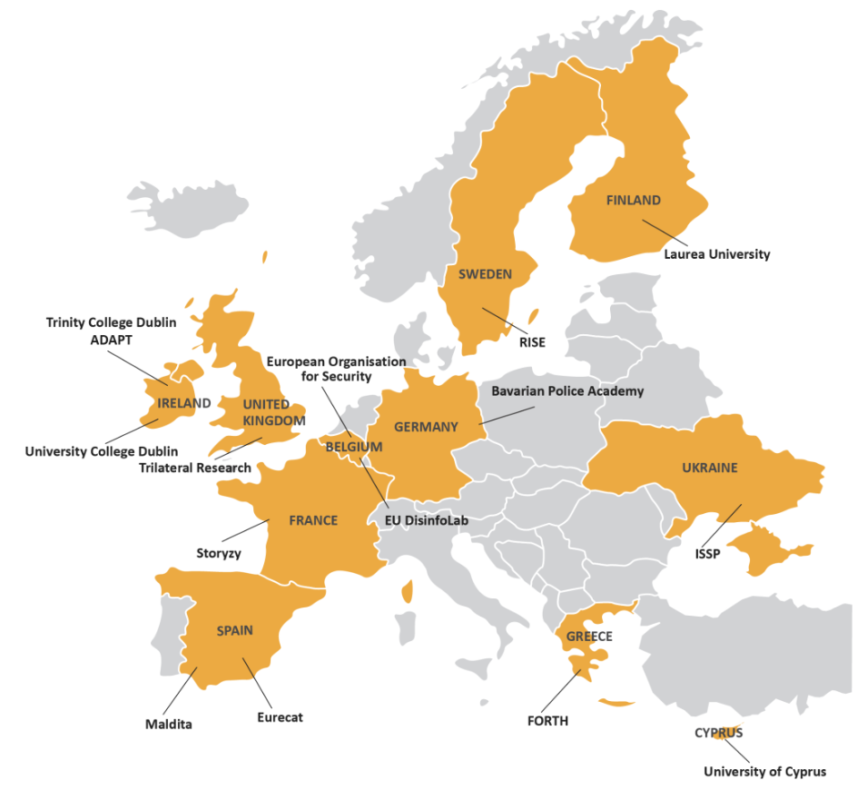
ATHENA Project
The ATHENA consortium consists of 14 partners and 1 associated partner including universities, civil society organisations, research institutions, a law enforcement academy and an industry organisation from 11 countries: ​
Notes:
Cyber attacks are part of the threats that, among many others industries, water utilities must be prepared for.
The ATHENA consortium consists of 14 partners and 1 associated partner including universities, civil society organisations, research institutions, a law enforcement academy and an industry organisation from 11 countries: ​
Out of the classical precautions associated with cyber-resilience, some main takeaways that are addressed within the ATHENA project, which is a European founded project, are the following:
- How could the operators of water infrastructures/services enhance their capacity to detect early/low warnings of cyber-attacks?
- What are the key parameters that need be checked to establish the level of severity of a cyber-attack?
- What are the most vulnerable situations that the water operators may face under a cyber-attack?
- What would be the operational conservative measures that a water utility should take when a cyber-attack is detected?
- Who should lead and manage the response to a cyber-attack (advantages and disadvantages for each case)?
- How to develop strong and efficient relationships between IT and OT worlds?
- Lessons learned from real or imagined cases of cyber-attacks at water utilities.
- Approach to crisis management at water utilities.

Slide 6
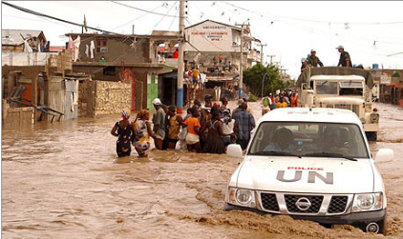
SCOPE 2 : Global Solidarity Initiatives
Strategic partnerships with international aid organizations in vulnerable regions facing climate challenges:
Maputo : Sustainable sanitation initiative in partnership with IWA.
Civil Society Initiative : Cooperation between Palestinian and Israeli Mayors.
UNESCO-IHP “ECOMED” ACADEMY : Network of climate response capacity building center of coastal metropolises.
Notes:
Global Solidarity Initiatives
Strategic Partnerships with International Aid Organizations, UNESCO-IHP, Operators, Metropolitan Governments & Stakeholders in Vulnerable Regions facing Climate Challenges:
Maputo (Mozambique) : Sustainable and resilient sanitation service chains in Maputo province, Mozambique, in partnership with IWA, for the benefit of the urban poor
Civil Society Initiative : Cooperation between Palestinian and Israeli Mayors. Heads of Israeli and Palestinian cities cooperate on waste water.
And of course,
UNESCO-IHP “ECOMED” ACADEMY : Network of Climate Response Capacity Building Center of Coastal Metropolises.

Slide 7
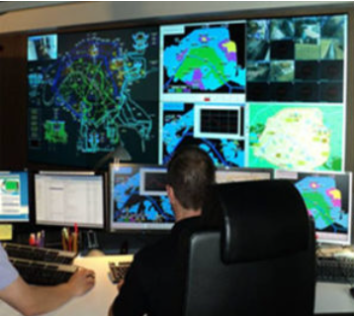
SCOPE 3 : Research & Innovation Center
Collaborative research with member utilities, strategic partners, and research institutions
Demonstrations in utility sites of innovative solutions :
INCOM : Intelligent network control and operating system for anomaly, diagnostics and leak detection.
Bio-SMART : Bio-safety monitoring & active risk control for early detection of bio-contamination.
EU-PRIMA : Improving water storage, distribution and management solutions across the Mediterranean.
Notes:
Collaborative Research with Member Utilities, Strategic Partners, and Research Institutions Including EU Sponsored Projects
and Demonstrations in Utility Sites of Innovative Solutions to Emerging Utilities Challenges:
INCOM : Intelligent Network Control and Operating System for Anomaly. Diagnostics and Leak Detection.
Bio-SMART : Bio-Safety Monitoring & Active Risk Control for early detection of bio-contamination.
The sponsors of these two projects were : VITENS, Suez, and Eau de Paris.
EU-PRIMA : Improving water storage, distribution and management solutions through cooperation and demonstration across the Mediterranean.
PRIMA = The Partnership for Research and Innovation in the Mediterranean Area.
The Lead Institution was The Cyprus Institute.

Slide 8


